Slide 1
Guide: Ms. Hetal Shrimali
C. K. Pithawalla College of Commerce-
Management Computer Application
Project Title :Online Shop
Submitted By: Dhumal Mohit

Slide 2
CONTENTS
Introduction
Project Profile
Project Introduction
Environmental Description
Hardware & Software Requirements
Tools & Technology
Proposed System
Scope

Slide 3
Uml Diagrams
Use Case Diagram
Activity Diagram
System Diagrams
Table Structure

Slide 4
Project Profile
Introduction
Project Introduction

Slide 5
Project Profile
Project Title : Online Shop
Project Type : E-Commerce Website
Project Objective : To Provide A Platform For Online Shopping
Project Guide : Ms. Hetal Shrimali
Team Member : 3
Front-End : Html, CSS, JavaScript, Bootstrap
Back-End : PHP
Submitted By : Dhumal Mohit

Slide 6
Project Introduction
What is This Platform?:
A Platform To Feature All Types Of Products To Make A Worthy Purchase For Themselves
Why It Matters:
- Unavailability of Useful Products On Different Platform to Provide Them All Of Those At Same
Place

Slide 7
Environmental Description
Hardware & Software Requirement
Tools & Technology

Slide 8
HARDWARE & SOFTWARE REQUIREMENTS
Client Side :
- Internet enabled devices with Web Browser
Server Side :
- Xampp Server
- Disk Space (1 GB)
Development Side :
- Processor (AMD Ryzen 7 5800X 8-Core Processor)
- O.S (Windows 11)
- Memory (48 GB)
- Hard Disk (500 GB)
- Web Browser : Developed in Google Chrome

Slide 9
TOOLS
Documentation Tool
Development Tool
MS word
MS power point
Visual Studio
Code

Slide 10
TECHNOLOGIES
Front End
Back End
HTML
CSS
JavaScript
Bootstrap
Scripting Language
MySQL
JavaScript
Database

Slide 11
PROPOSED SYSTEM
Aim & objectives
Scope

Slide 12
AIM & OBJECTIVES
Upcoming Features:
user can upload their projects ,
project category like premium ,
projects
free projects ,
add payment gateway.

Slide 13
Scope
Scope
Admin
User

Slide 14
Admin
Admin do all the task dose. As well as they have a permission
(Insert , Update , Delete).
Admin can manage its own profile.
Admin can register.
The main admin handles the authentication process and the database.
The main admin manages Project details of different .
Admin manages the contact us and Logout given by the users .
Admin also manages the Projects.

Slide 15
User
Users can register, login and manage their profile through website.
User can see Project provided by the website .
User can use all Website features after Registration.
User also sends the request for the registration to the admin.

Slide 16
Uml Diagrams

Slide 17
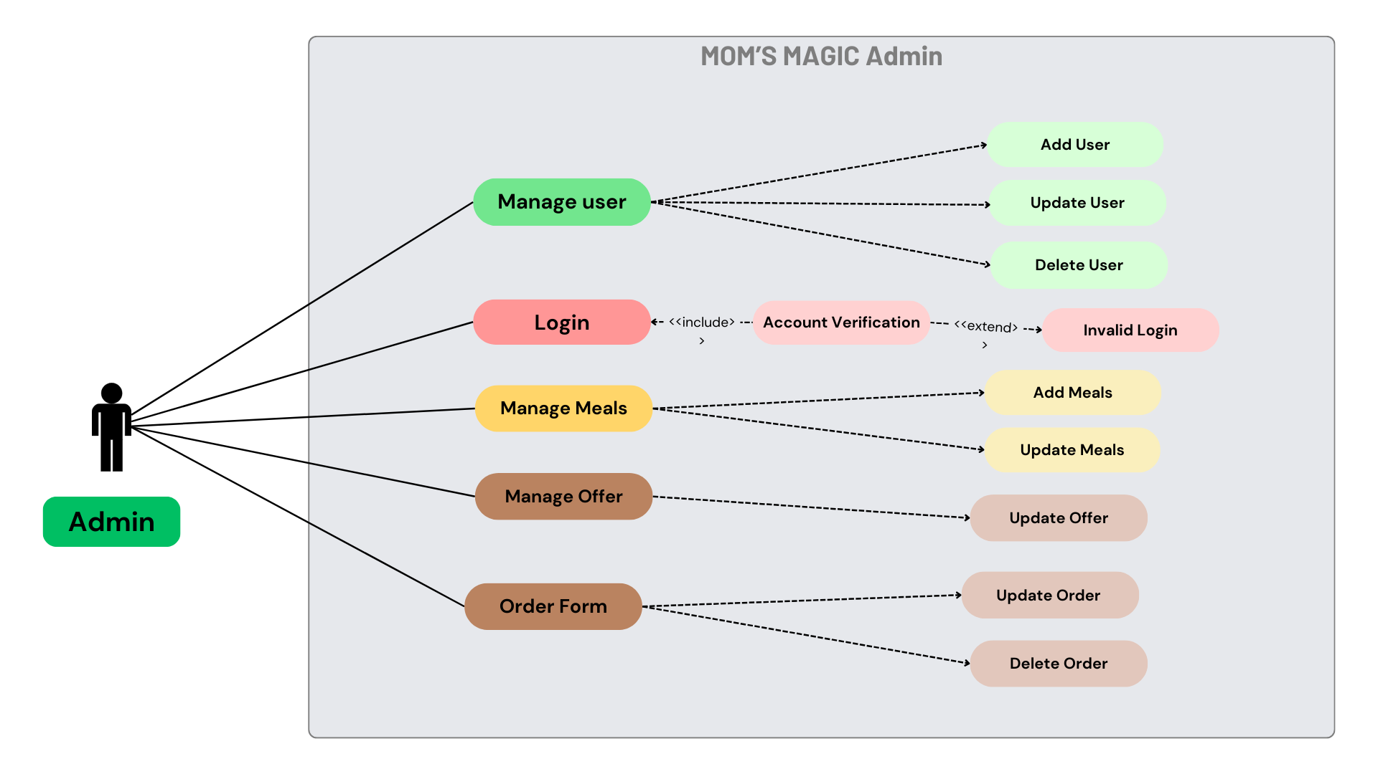
Admin Use Case Diagram
Manage Order
Update Order
Delete Order

Slide 18
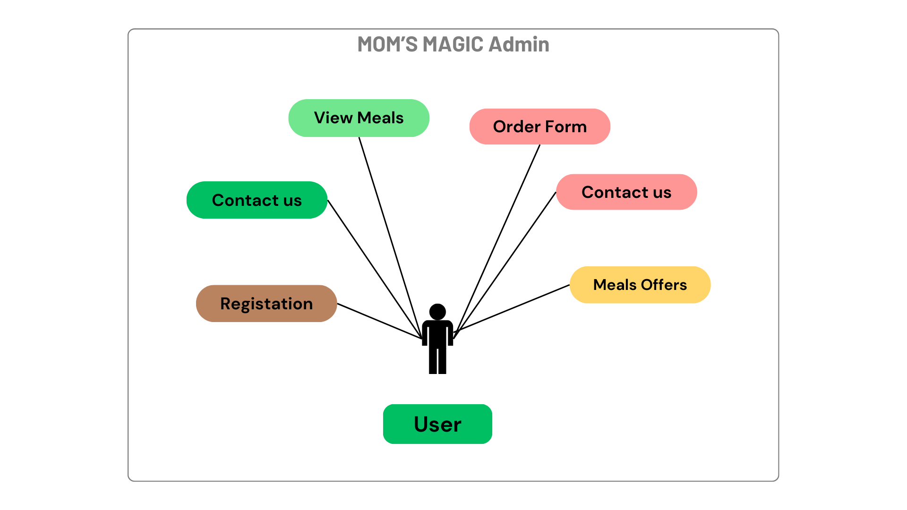
User Use Case Diagram
View Products
Product Offer

Slide 19
Activity Diagram

Slide 20
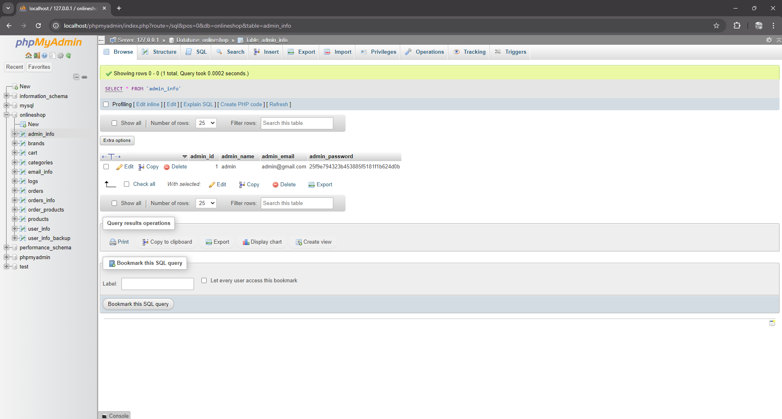
Table Name : tblAdmin Use : It is used to store the information of Admin and Sub Admin

Slide 21
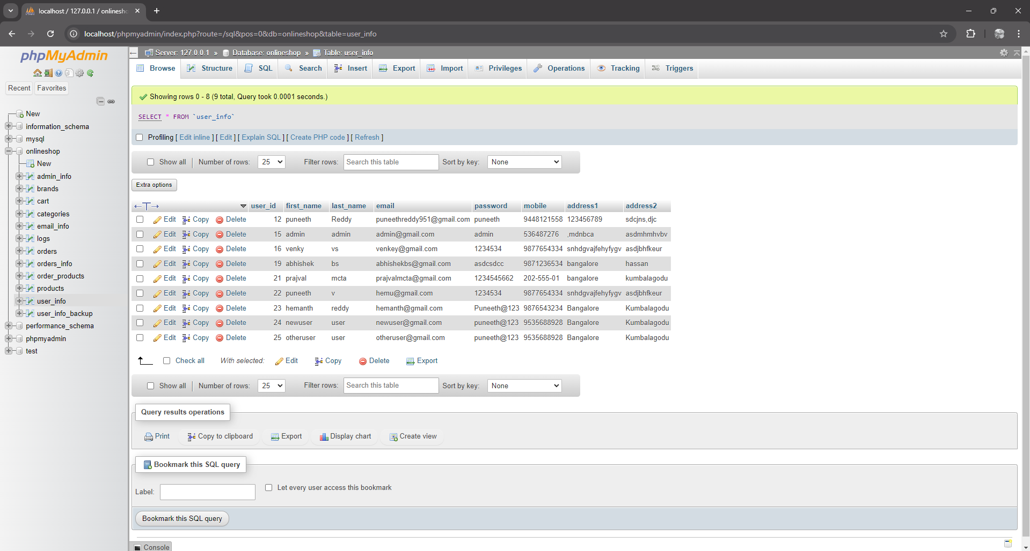
Table Name : user Use : It is used to store the information of User.

Slide 22
Table Name : order Use : It is used to show all orders made by users.

Slide 23
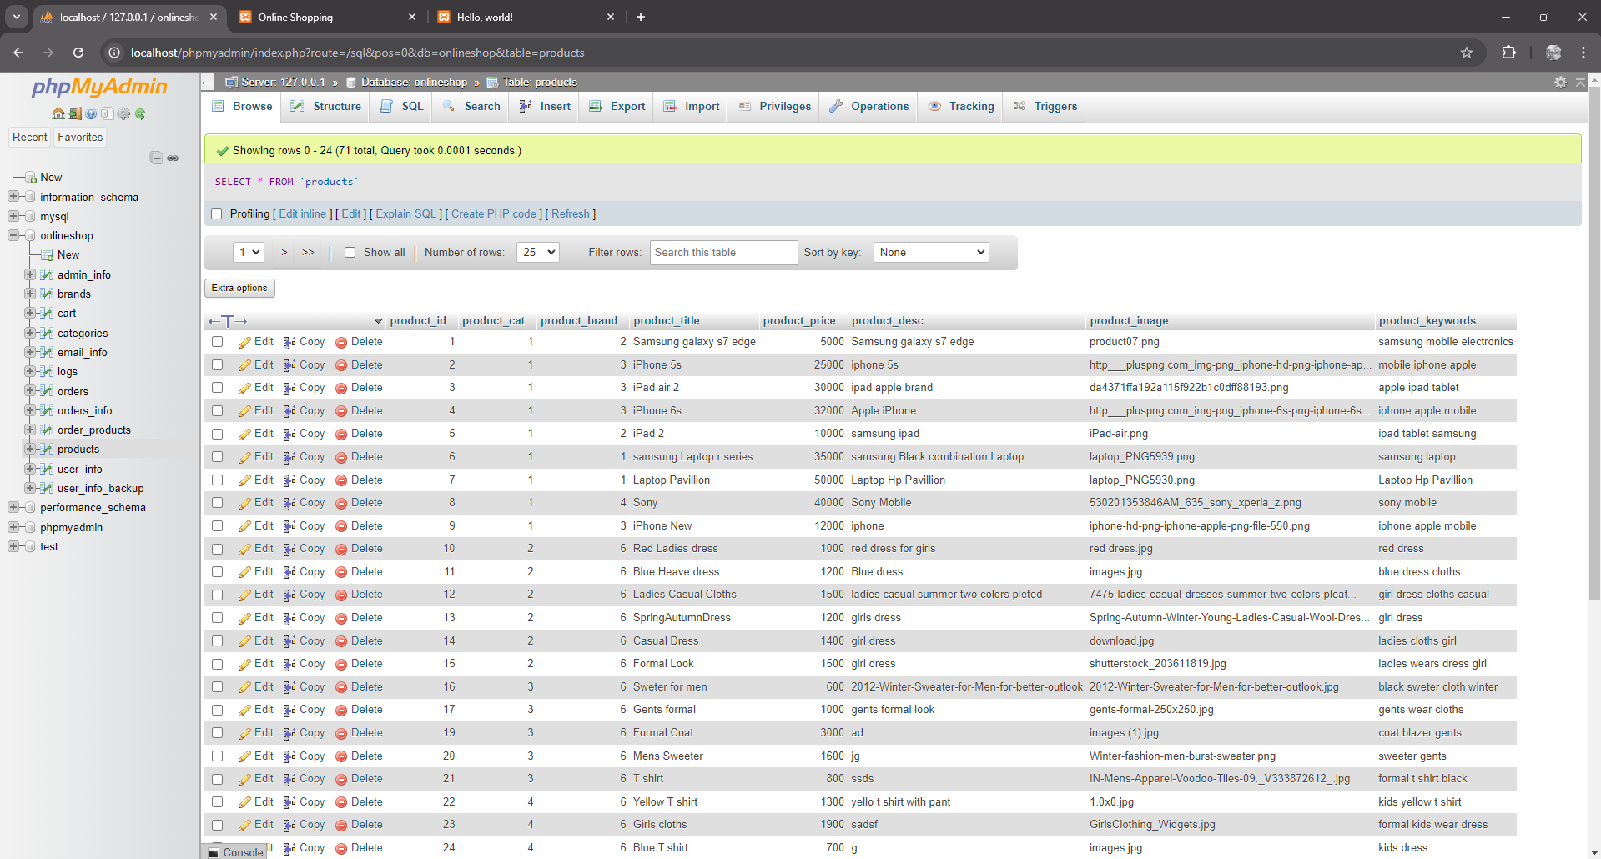
Table Name : products Use : It is used to show all type of Products on Website..

Slide 24
Thank You

