Slide 1
LIFESUM ANALYTICS TEST
Delivered at 23/03/18 to Lars Yencken (lars@lifesum.com)

Slide 2
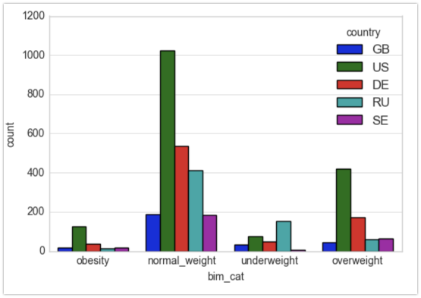
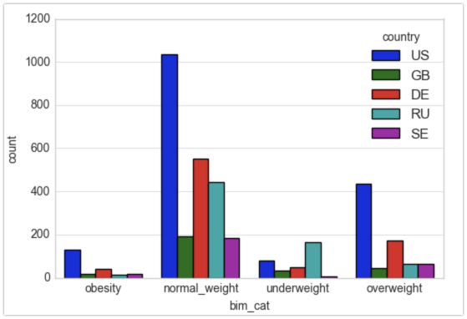
Demographics
Typical Lifesum user: the most important par of users are female, with a global mean age about 28 years old and with the BIM indicator category « normal weight ».
To make an overview of their goals and needs, we focus the analysis on the fifth most representative countries.
User’s BIM category at registration
User’s goal BIM category

Slide 3
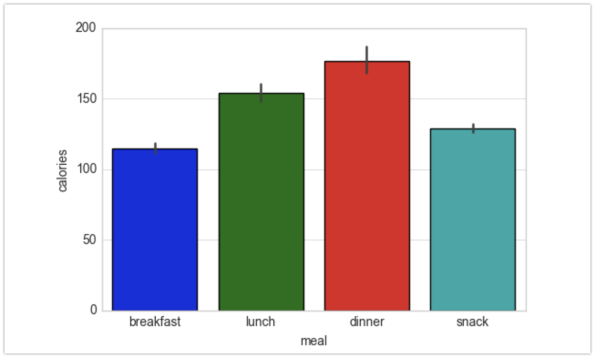
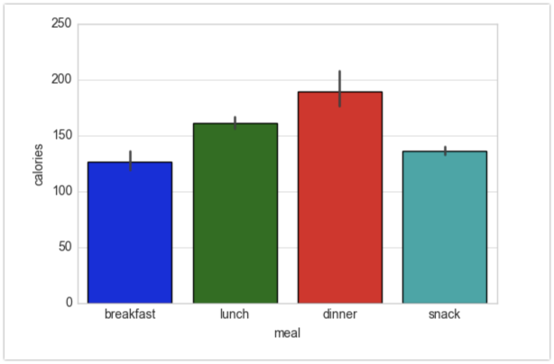
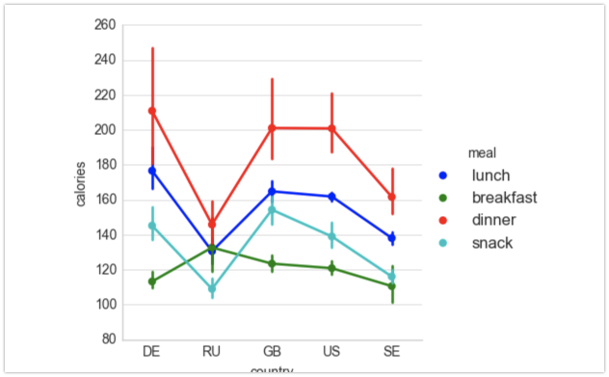
Nutrition
Please find below the calories balance per meal depending on gender and countries
Mean calories balance per meal (gender=female
Mean calories balance per meal (gender=female
Mean calories balance per meal for main countries

Slide 4
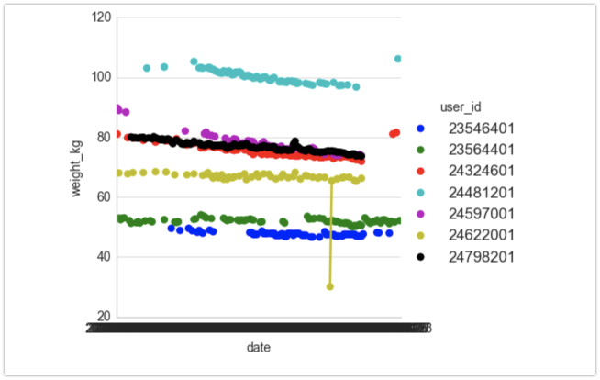
Success
As we can see below, there is a relation between the frequency of meal tracking and the evolution of weight (in kg)
However, we cannot conclue anything about users who don’t track their meal
User’s weight (kg) evolution for top 7 seven meal trackers

