Slide 1
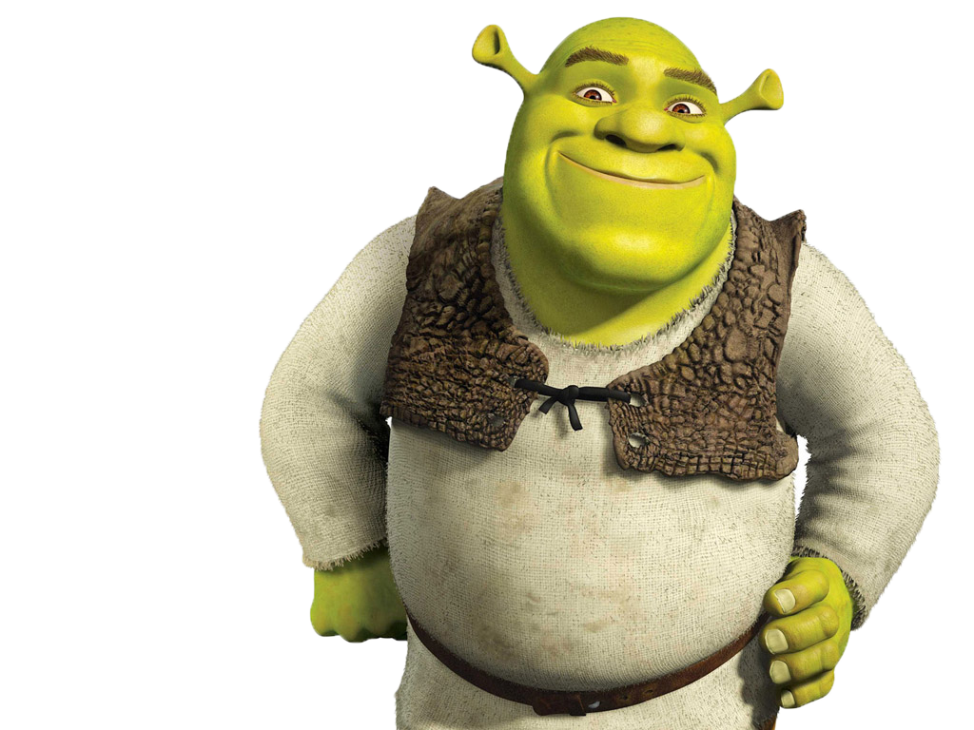
TEAM SHREK
COMP 472

Slide 2
Our Heuristic Function - Explained
Wanted to prioritize tokens and their positions
Developed through some trial and error
Computes board ‘snapshots’ based on token positioning at certain depths
Quick to compute and evaluate
Can be improved by taking move consideration (more playtesting), or…
...an idea we had: create a database (file) that has the absolute best possible moves compiled after computing at depth 30, for example, and build a graph/structure to get the moves back given a board state
Heuristic retrospect: content! But room to improve

Slide 3
Our Heuristic Function - Pseudocode
Black Cells = 2x // Diagonal moves - count twice in importance
White Cells = 1x // No diagonal moves - count once in importance
For each cell, check if it has adjacent cells of the same color.
If R has R beside it, +2 for each
If G has G beside it, -2 for each
IF it's a winning board, and winning for Green, result is 999999
IF it's a winning board, and winning for Red, result is -999999

Slide 4
Our Search Function - Explained
Standard alpha-beta pruning
Initially was minimax algorithm implementation
Alpha-beta truly helps getting faster results, allowing for more complex heuristics
Depth of ‘n’, for the tournament we set it to depth 4
Originally wanted to go to depth of 5, but search time averaged around 2.7s, sometimes slightly over 3s
Search retrospect: content!

Slide 5
Tournament Results
3 wins, 1 loss, 4 ties
Overall 5 points result
3 wins - enemy AI taking over 3s
1 loss - error in our code to evaluate winning conditions
4 ties - equally matched AI heuristic and search capability

Slide 6
Finally...
Pros:
Tournament result was good
Tournament flowed nicely
Heuristic & search were good
Team workflow was good
C++ definitely a positive
Cons:
Error in code - costed us wins
Lack of time to improve AI & heuristic (database idea)
Poorly structured code (all in one file)

