Slide 1

#XamExpertDay

Slide 2




UI Testing with Xamarin.Forms
Codrina Merigo
_Codrina_
Notes:
Good afternoon everyone!

Slide 3

Notes:
First of all I want to thank our sponsors and the organizers who picked up my session.
Now please raise your hand if you are a developer…Ok, this session is also for testers, don’t worry! This is the last session of the day and it feels almost like an usual day at work. Imagine you had an one-day task – something simple, like creating a login page. So, you started in the morning, created your beautiful page, linked all the actions and services, you fine tuned the UI in order to meet all the pixel perfect stuff requested by the designer, you wrote the Unit Test and some manual tests have been performed and all went smoothly. Then, at the end of the day, you check your quality requirements or your Definition of Done check list, you read: “UI Tests to be written ” and you ask WHY?

Slide 4
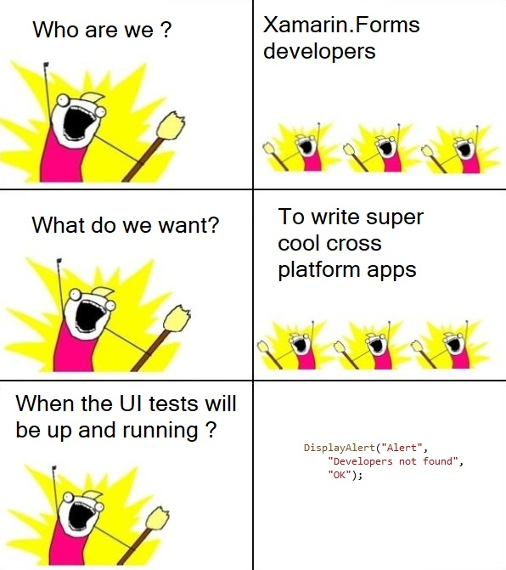
WHY
Notes:
But WHO better than you to write them? The designer has created everything, but of course he doesn’t know how xaml works, what’s behind the screen really…
The Product Owner know the business requirements and testers have been tapping all over you screen and everything worked OK.
So, either you are the dev of the view, or you know how XAML works, The “AutomationId” will became your Best Friend!

Slide 5

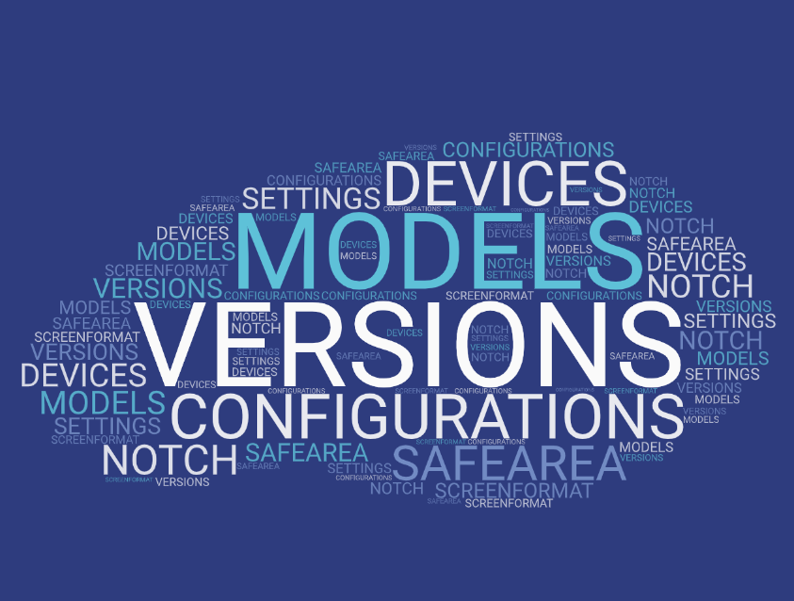

Notes:
Mobile apps are not like web browsers – depends on various variable, os versions, configurations, customizations
So, either you are the dev of the view, or you know how XAML works, The “AutomationId” will became your Best Friend!
But, first of all, let’s see some basic concepts and we will be back on the “AutomationID” – doesn’t it seems very powerful ? Automation – and all goeees wowwww

Slide 6
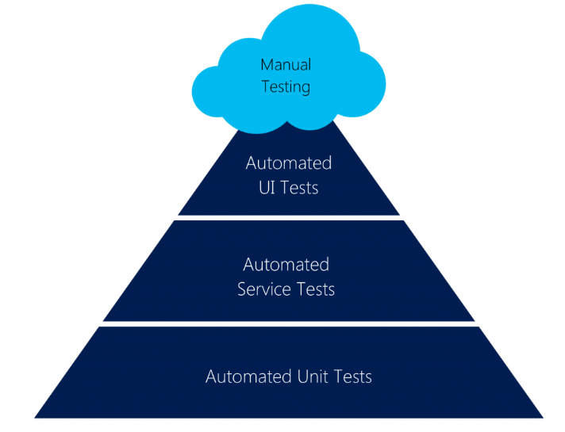
App Testing
UI Tests This is the layer where you would be testing
the product more from an end-user’s perspective.
Your top priority would be to ensure that ‘UI Design Flow’
is in-line with the design requirements.
Service Tests helps you ensure that the services
are working properly and give you the right data.
Unit Tests are normally written by the developers who write test code to verify the functionalities that were developed by them.
Since the testing at UI level is so brittle, it is recommended to focus on these
tests to only verify ‘UI flow & interactions’ without looking into the system functionality.
Picture credits : https://mobilefirstcloudfirst.net/wp-content/uploads/2017/01/Test-Pyramid-1024x806.png
Notes:
Automated UI Tests are between Unit /service tests and manual testing. From this lay4er you will completely impersonate the end-user with every action he can take and ensure that everything is displayed as it was designed. Also, UI Tests are fragile, is recommended while writing this tests to focus only on the ‘UI Flow and interactions’ and not on the functionalities – let’s leave that for the unit test.
*Talking about app testing, manual tests are or should be always performed, but in the last years, an tests pyramid with focus only on the automated tests have appeared
*The base base-layer of the pyramid
*This test is done to make sure that interaction through the
UI widgets delivers the right output on the screen

Slide 7
F.I.R.S.T. Principles
Fast (ui tests are slow but dev must try not to write them even slower)
Independent(not use other tests)
Repeatable (not use constants like access tokens)
Self-validating(by using asserts)
Timely ( try not to be very complicated, maybe an action can be split in multiple tests).
Notes:
UI Test as every automated test can use the FIRST Approach – each test has to be :

Slide 8
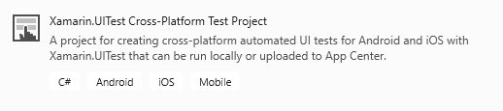
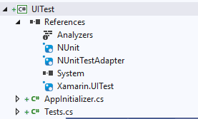
UI Test Project
if (platform == Platform.Android)
{
return ConfigureApp.Android
.EnableLocalScreenshots()
.DeviceSerial(DroidDeviceID)
.Debug()
.ApkFile(ApkPath)
.StartApp();
}
else
return ConfigureApp.iOS
.EnableLocalScreenshots()
.Debug()
.DeviceIdentifier(IOSDeviceID)
.AppBundle(AppPath)
.StartApp();
To find the ios device id run instruments -s devices on your mac,
for android launch adb devices from command line
ApkPath is something like "C:\Users\Projects\MyApp\MyApp.Android\bin\Debug\myApp.apk"
AppAPath for the ipa is something like ="../../../MyApp/MyApp.iOS/bin/iPhoneSimulator/Debug/MyApp.iOS.app"
Notes:
As seen for the example, our application is identified by the keyword app and, if needed, the application is able to take screenshots,
that will be stored inside the bin folder of the UITest project.

Slide 9
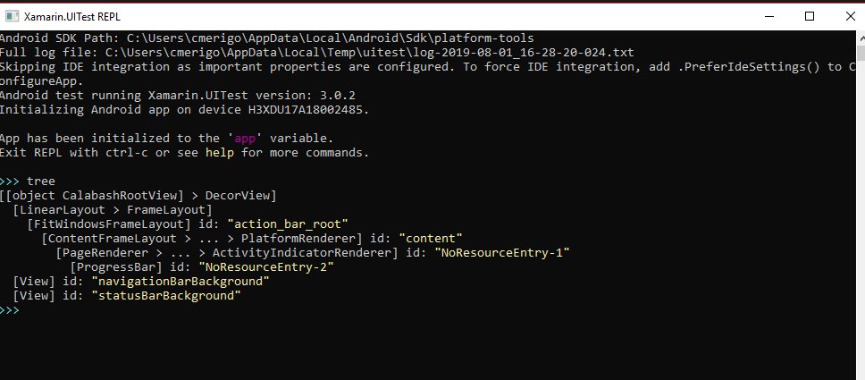
Repl() - read-eval-print-loop
The REPL is a console-like environment in which the developer enters expressions or commands.
It will then evaluate those expressions and display the results to the user.
tree
app.Query(e => e.All())
The REPL is helpful when creating UITests as it allows us to explore the user interface
and create the queries and statements so that the test may interact with the application.
Notes:
One of the important tools in creating UITests is the the REPL (read-eval-print-loop).

Slide 10

DEMO
Notes:
See the solution and invoce the Repl() console and test basic query on the login screen (tree and query all)
Show test results pad

Slide 11
AAA Pattern
Arrange, Act, Assert
Sample
[Test]
public void TestMySum()
{
// Arrange
int a = 5;
int b = 7;
// Act
int result = MySum(a, b);
// Assert
Assert.AreEqual(12, result);
}
public int MySum(int a, int b)
{
return a + b;
}
Notes:
Here we have an example of a function, that given two integers, a and b, I returns ‘a+b’ . So a simple way of using the pattern might be :
Another way of writing the ui tests is using the so called feature files that are written in some cases of ‘ behavior driven development or BDD.

Slide 12
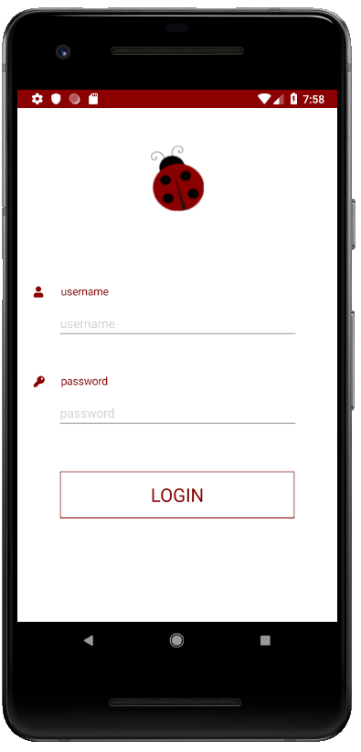

BDD Approach
Behavior Driven Development
Given
When
Then
This process allows you to write tests a non-technical language that everyone can understand (e.g. a domain-specific language like Gherkin).
BDD forms an approach for building a shared understanding on what kind of software to build by discussing examples.
Sample
As a registered user,
I want to be able to login,
so that I can see the Application.
Scenario 1: User is able to log in.
Given that I am a registered user,
when I enter the username ‘Codrina’
and password ‘ladybug’,
then I should see
the first screen of the app.
As a [role]
I want [feature]
So that [benefit]

Slide 13
AutomationId – your new best friend
In order to identify a control on the screen, each control needs an unique identifier called AutomationId set to the visual element, for example:
<Label x:Name="label1" AutomationId="MyLabel" Text="Hello, Xamarin.Forms!" />
Or
var label1 = new Label {
Text = "Hello, Xamarin.Forms!",
AutomationId = "MyLabel"
};
It’s important also to write every single action and
not take anything for granted
UI Automation is supposed to run slow in order to emulate an actual user interaction - keep that in mind that sometimes we may wait for an element to pop on the screen before we verify if it is actually on the screen.
Notes:
(for example: the keyboard pops on the screen, an input text is always empty,
the keyboard disappears or hides a part of the screen which contains the ‘Login’ button,
the popup is shown and is completely loaded)

Slide 14
DEMO
Notes:
Write simple test for the login feature and play it

Slide 15
Queries inside and outside Repl()
Samples
//label
bool myLabel = app.Query(e => e.Marked(“MyLabel")).Any();
app.Tap(“MyLabel");
//syncfusion element
switches = app.Query(e => e.Marked("SfSwitch Control. State changed"));
x = (float)switches[c].Rect.CenterX;
y = (float)switches[c].Rect.CenterY;
app.TapCoordinates(x, y);
//swipe gestures
app.SwipeLeftToRight();
//entry
app.Tap(“MyEntry");
app.EnterText(Constants.Value);
app.DismissKeyboard();
//inside webview
/*through Safari for iOS
and through Chrome for Android
use the browser developer tools
to visually identify
the elements inside the DOM.*/
app.Tap(c => c.WebView().Css("#element"));

Slide 16
DEMO
Notes:
Write test to show more features

Slide 17
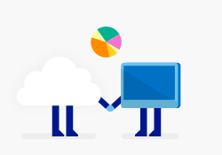

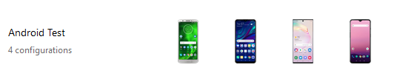


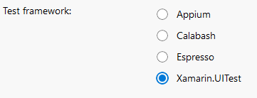




Run your tests on App Center Test Cloud
Run on first device when ready
Configure your run by selecting
Upload package and UI Test
using nodeJs and following
app center instruction
appCenter
Validation
Wait for
devices
Run on second device when ready
Generate report for results
Run on third device when ready
Run on nth device when ready
Notes:
Wide and deep testing on real devices with real expectations- same model but different ios versions

Slide 18
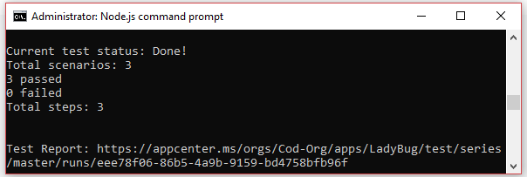
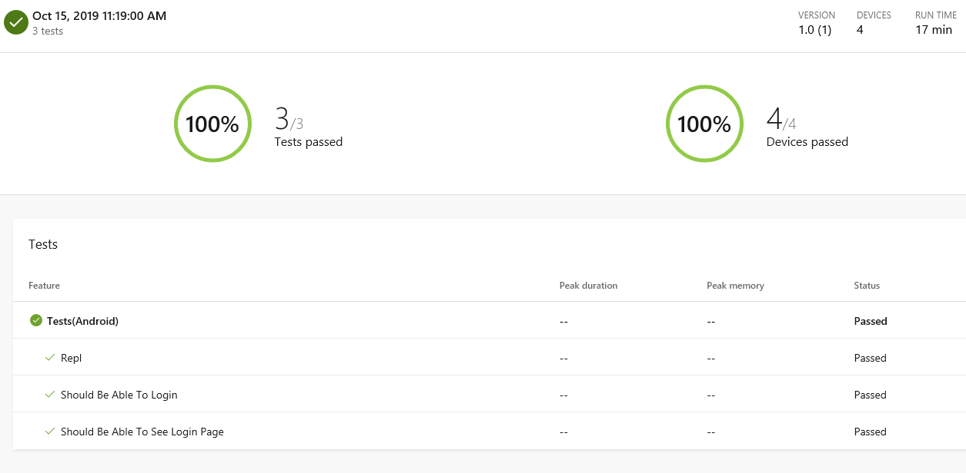
App Center Test Cloud Reports

Slide 19

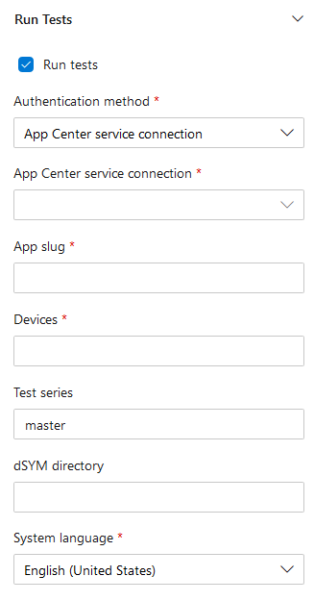

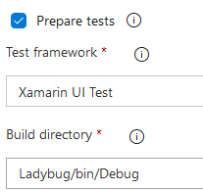
Add Ui Tests to DevOps using AppCenter
Enable task
From app center you get:
appcenter test run uitest
--app "codrinamerigo/LadyBug"
--devices "codrinamerigo/android-test"
--app-path pathToFile.apk
--test-series "master"
--locale "en_US"
--build-dir pathToUITestBuildDir

Slide 20
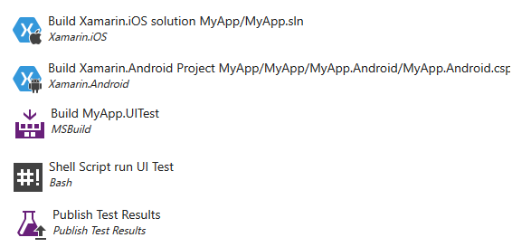
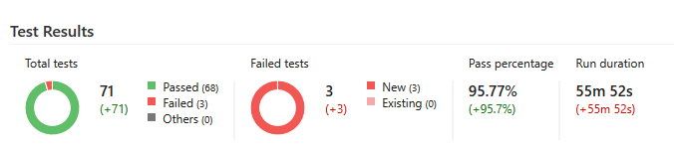
Add Ui Tests to your TFS
TFS
mono ../../../NUnit.Runners.2.6.3/tools/nunit-console.exe
myApp/MyApp.UITest/bin/Debug/
myApp.UITest.dll
-xml=UITestResult.xml
NUNIT

Slide 21
From my experience . . .
UI Tests aren't compatible with the Shared Mono Runtime, so remember to disable it for Android!
For debug purpose, right-click on the iOS Project > Options > Compiler and add the string ENABLE_TEST_CLOUD
If sometimes, the iOS simulator doesn’t pop on the screen,
might be useful to delete the xdb folder inside TMPDIR (on the Mac machine) and retry.
Try to write no more that 20 ui tests per project to run them locally…
Open the Android simulator on your Mac before running the tests
Don’t forget about your UI Test – try to keep them live

Slide 22
Q & A

Slide 23
Thank You!
_Codrina_

