Slide 1
Product Needfinding
Kevin Yuan and Moe Ko

Slide 2
Domain Finding

Slide 3
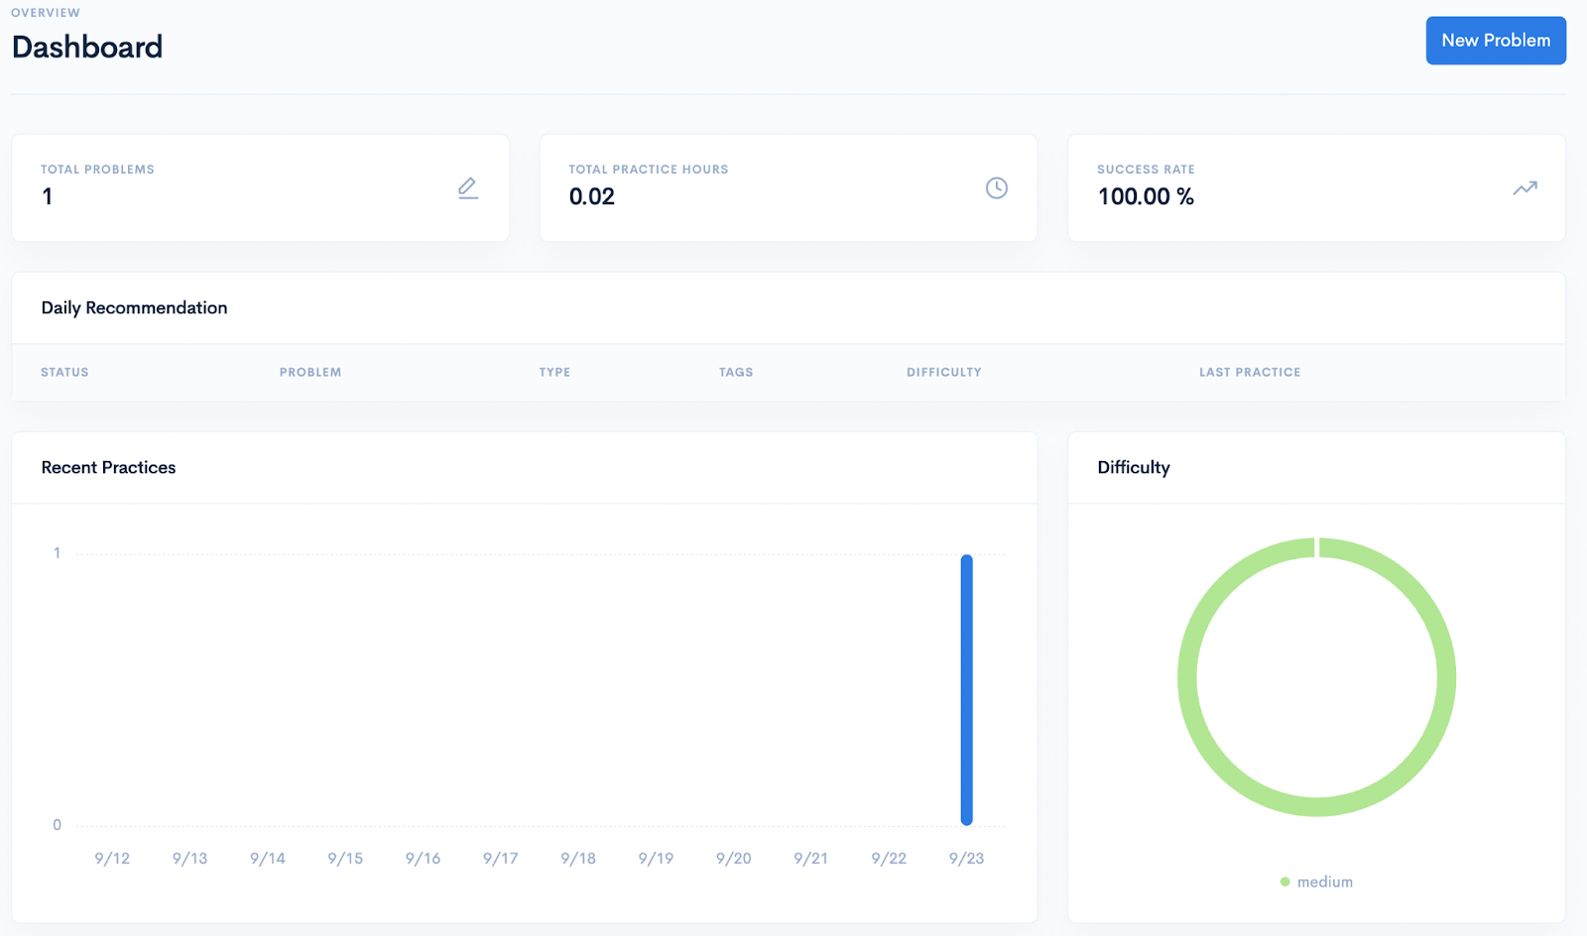
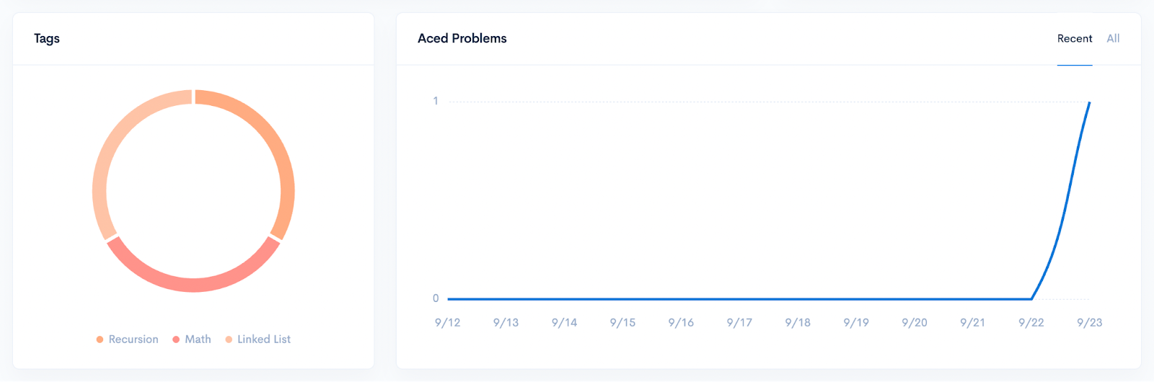
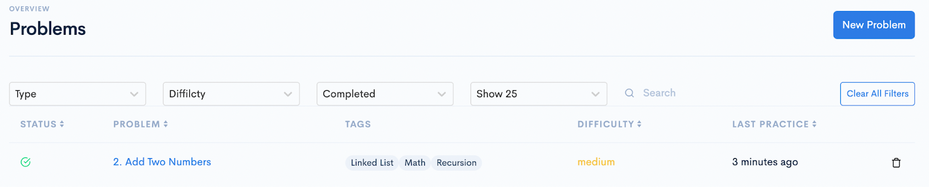
Dittocode.io
Pros
Can visually see LeetCode progress with pie charts, both difficulty and topics
Improvements
Users should be able to find useful question collections like Blind75 and NeetCode150.

Slide 4
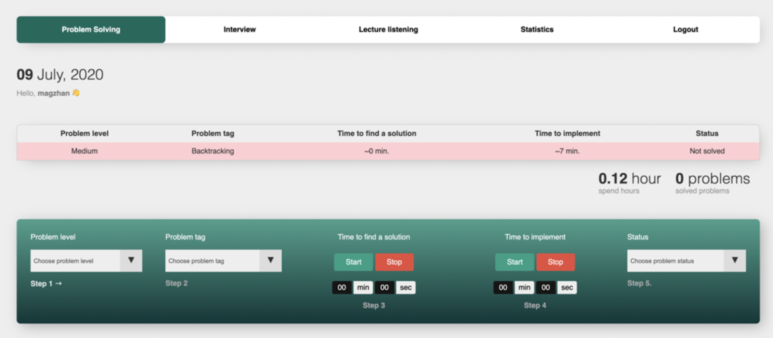
PrepLogger.com
Pros
Users can easily filer questions based on problem difficulty and tags.
Users have stopwatches for time to implement
Improvements
Could include hyperlinks that take users directly to the question on Leetcode

Slide 5
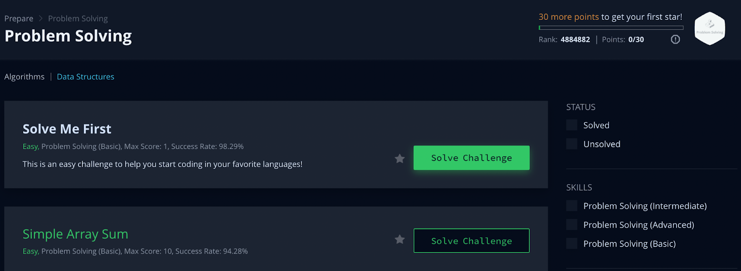
HackerRank.com
Pros
Users can easily filter solved and unsolved problems using the checkboxes
Improvements
Points progress bar is ambiguous, and problems do not have tags (to identify the topics)

Slide 6
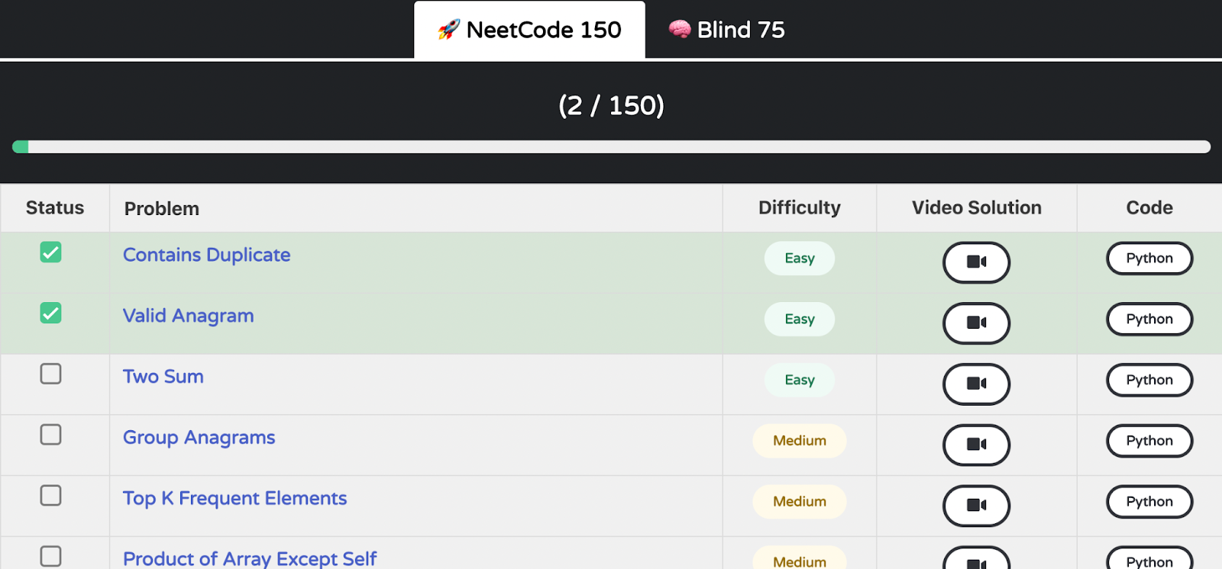
Neetcode.io
Pros
Users can easily navigate between the two popular question collections.
Users can see their progress with an interactive progress bar.
Improvements
Does not show progress based on difficulty, only total question completed.

Slide 7
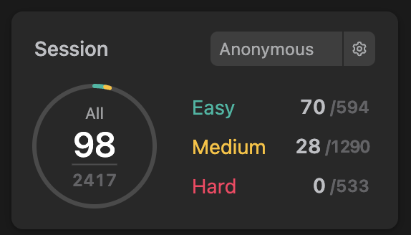
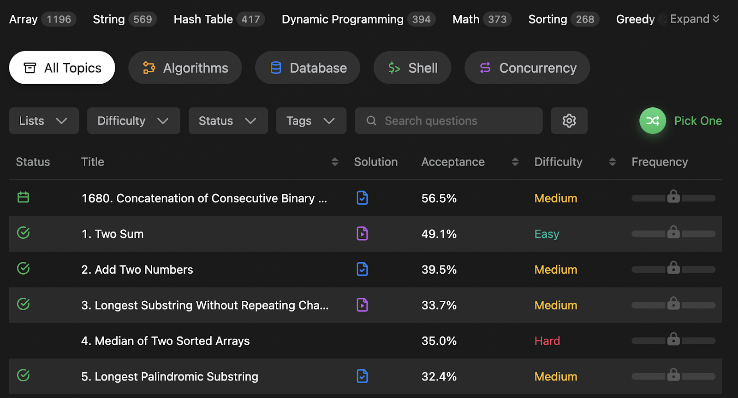
Leetcode.com
Pros
Users can access company-specific questions
Useful question collections
Improvements
Lacks any job preparation information.
No organizational tool for the job application process

Slide 8
Empathy Mapping

Slide 9
Interview Questions: Summarized
1. How do you keep track of your Leetcode progress?
2. Do you think it is useful to keep track of your Leetcode progress?
3. How do you pick your next Leetcode questions to attempt?

Slide 10
Participant 1
SAY Did not even think about tracking Have extensive question filtering | THINKS Why would people track their progress? Isn’t it easy to track progress?
DOES Goes to HackerRank.com Checks off completed questions | FEELS Confused Uncertain

Slide 11
Need
A way to easily distinguish completed problems from uncompleted problems

Slide 12
Participant 2
SAY Prefer seeing topics proficiency Collections aren’t effective, can daunt new people | THINKS Thinks other people also want to track their progress Thinks that it is most useful to choose questions based on difficulty and company problem sets.
DOES Keeps a target of how many Leetcode questions to complete a week Uses Leetcode built-in tracker and subtopic tracker | FEELS Feels overwhelmed by question collections Confident in organizing

Slide 13
Need
A way to easily track mastery of topics

Slide 14
Participant 3
SAY Were the questions easy/medium/hard? When did I attempt the questions? | THINKS It is useful to keep track of how many question attempt. Other people also keep track of their progress
DOES Uses Leetcode dashboard to keep track of attempted questions Did 50+ Leetcode questions and easily determined how many of each difficulty | FEELS Feels confident with the Blind75 and Neetcode collections. Likes to use the Leetcode company tag to target specific companies

Slide 15
Need
A way to keep track of when questions were attempted

Slide 16
Conclusions
Insights from Domain Finding
Implement visual aids and charts
Implement easy navigation between question collections
Include help for job preparation and application
Insights from Empathy Mapping
Easily distinguish between completed and uncompleted problems
Easily track mastery topics
Easily keep track of when questions were attempted/completed

