Slide 1
freeRTOS Logic Analyzer Plots Dump

Slide 2
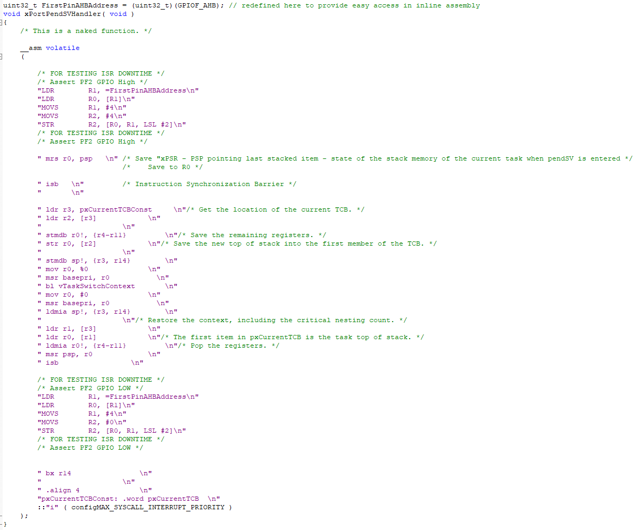
PendSV Handler
Set GPIO High
Context Switch
Set GPIO Low
Return
Not sure what’s going on here…

Slide 3
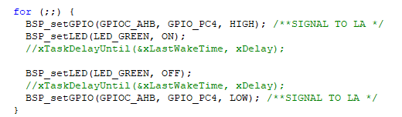
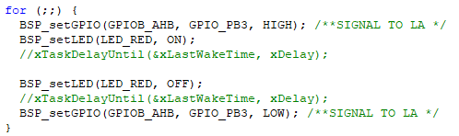
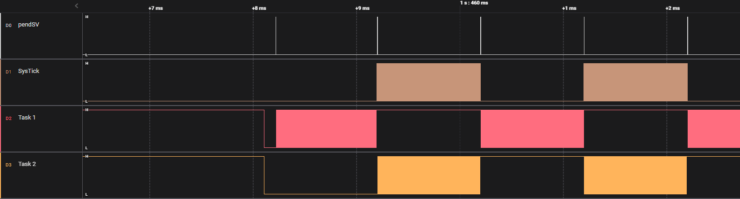
2 Tasks – GPIO Toggle without Delay
Task Snippets:
First Task begins
at first PendSV
1ms interval - excected
Why does SysTick fire so often during Task 2 execution?
1ms interval - excected
Execution Start
BSP Init set
GPIO outputs
Alternating Task
Alternating Task
Alternating Task

Slide 4
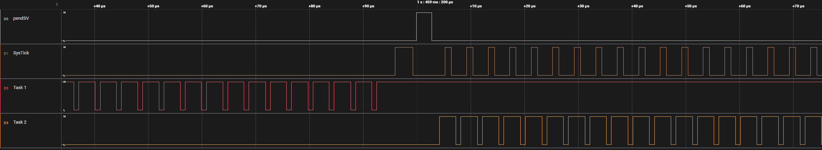
2 Tasks – GPIO Toggle without Delay
Close up

Slide 5
Updated Slide needed for previous 2 slides

Slide 6
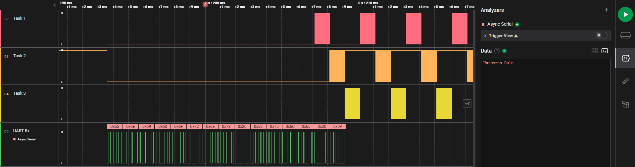
UART Working

