Slide 1
GenAI for AML &
Financial Fraud Investigations
Group Members
Shi Lintao
Ren Kaiyan
Wang Zhenghe
Zhao Wenzheng
May 13, 2026
A RAG & Knowledge Graph Driven Solution
MAIE6000B GenAI in Finance | Mini Project
Notes:
Hello everyone, and welcome to our presentation. Today, we will introduce our mini-project for MAIE6000B, titled "GenAI for AML and Financial Fraud Investigations." Our solution leverages a powerful combination of Retrieval-Augmented Generation, or RAG, and Knowledge Graphs to transform how financial institutions tackle Anti-Money Laundering and fraud detection. Let's dive in.

Slide 2
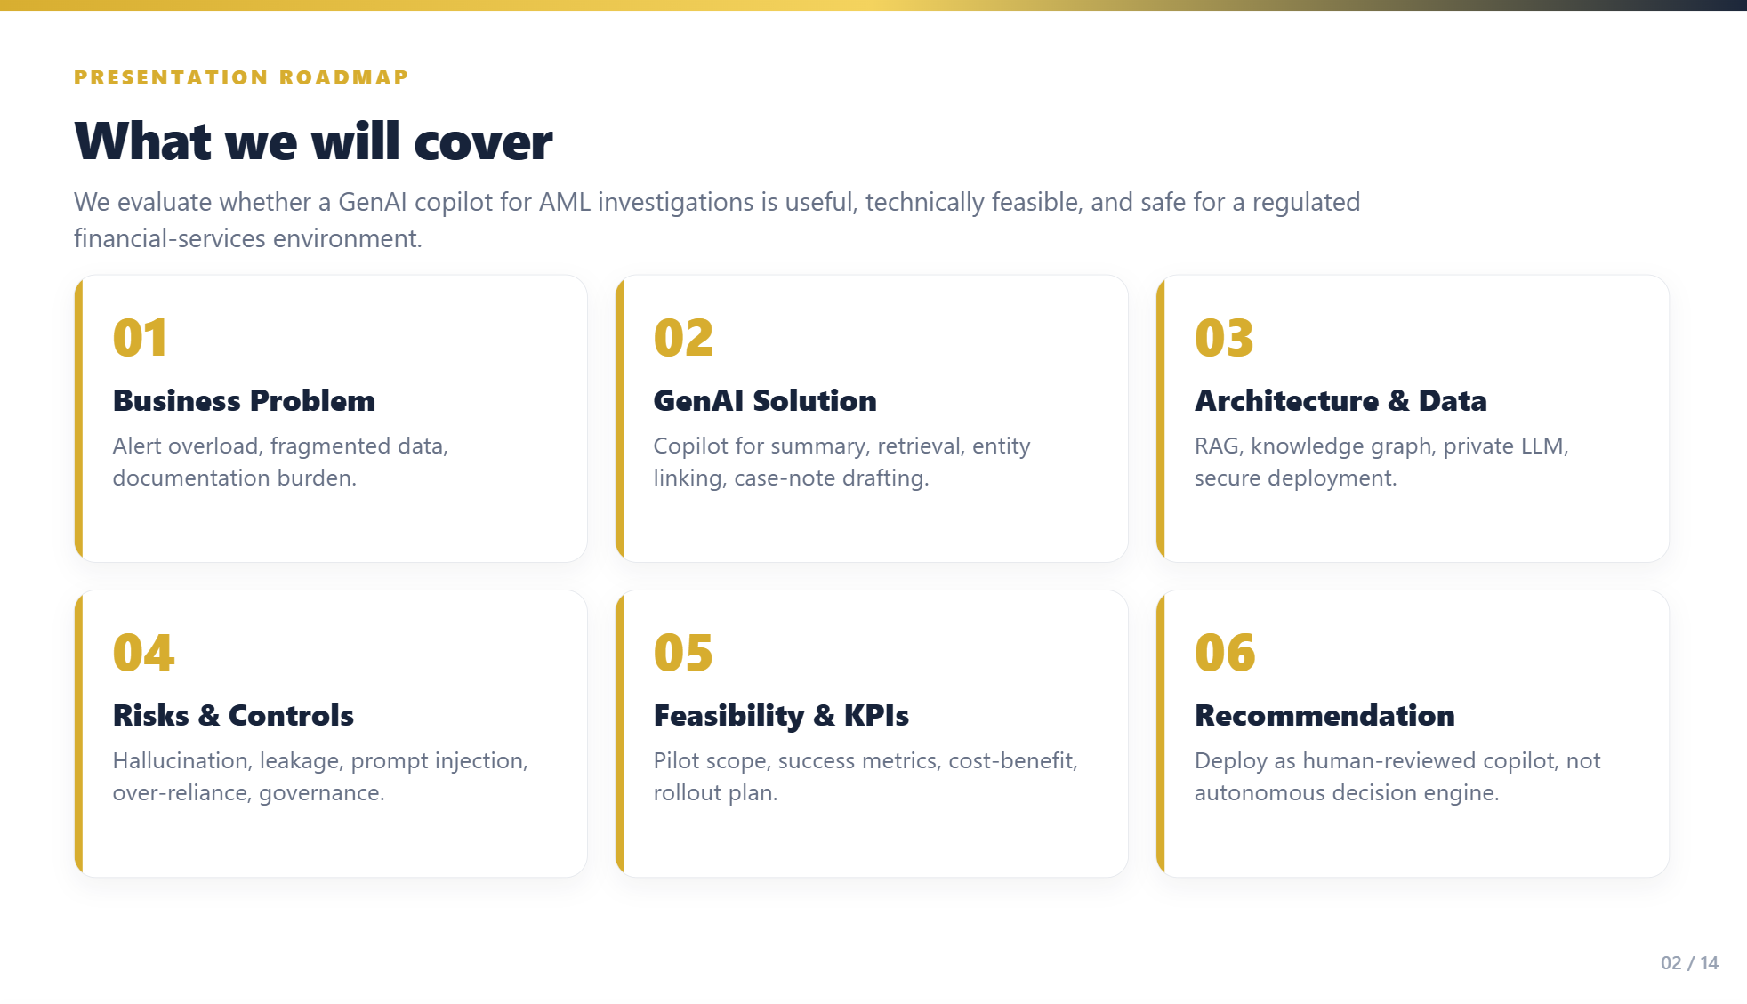

Slide 3
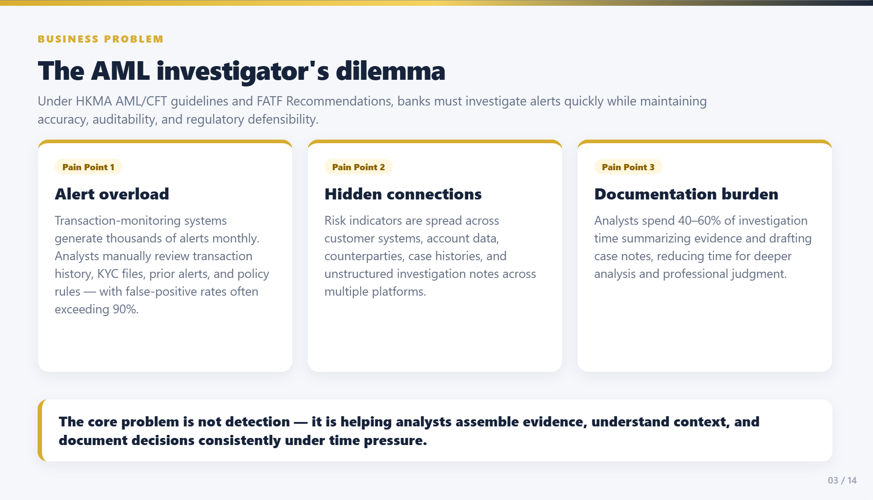

Slide 4
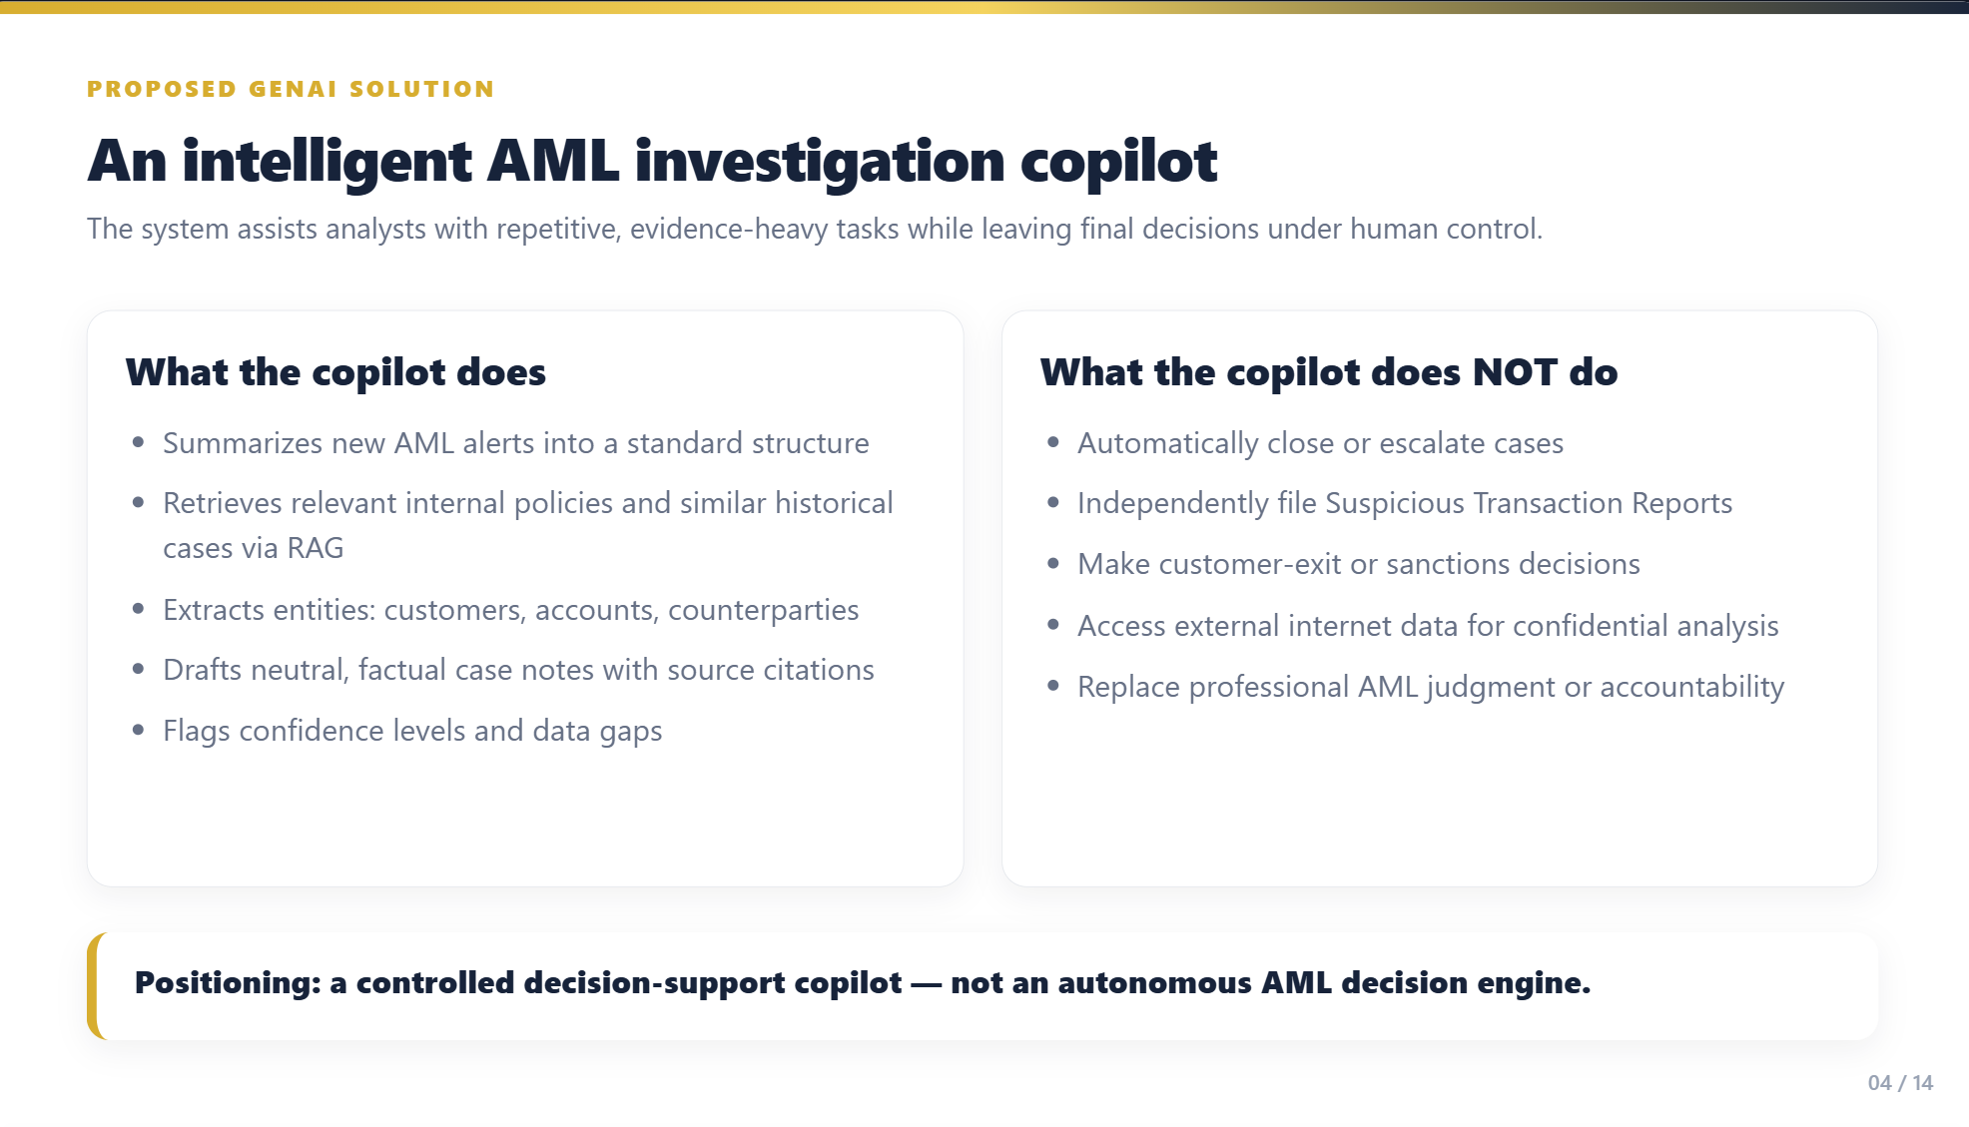

Slide 5
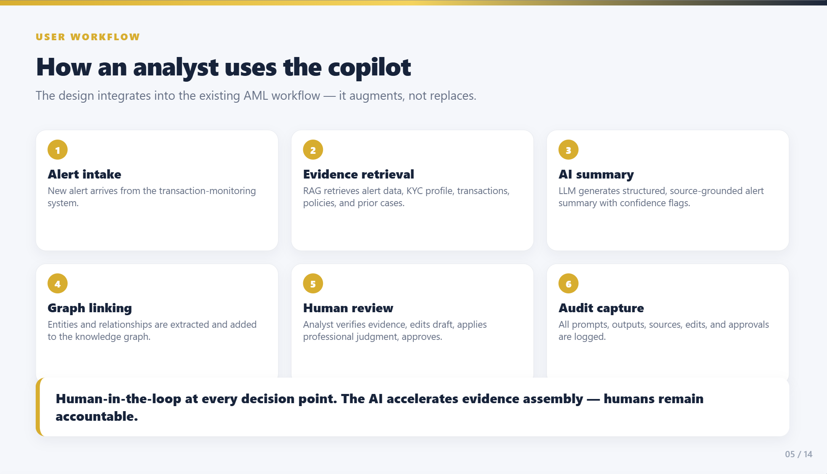

Slide 6
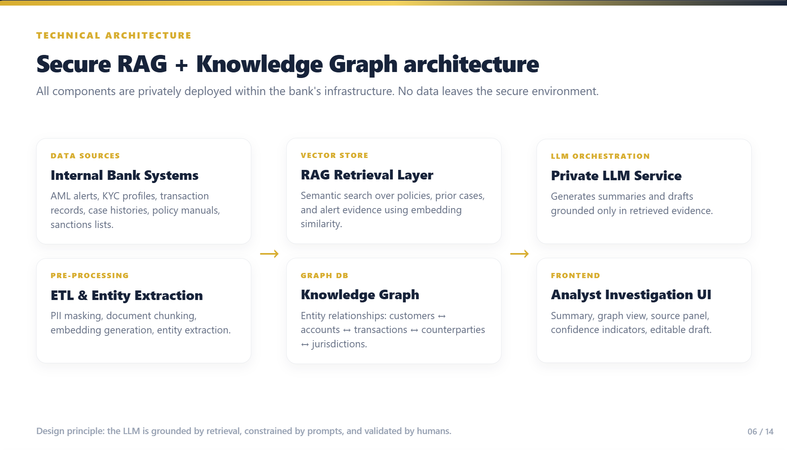

Slide 7
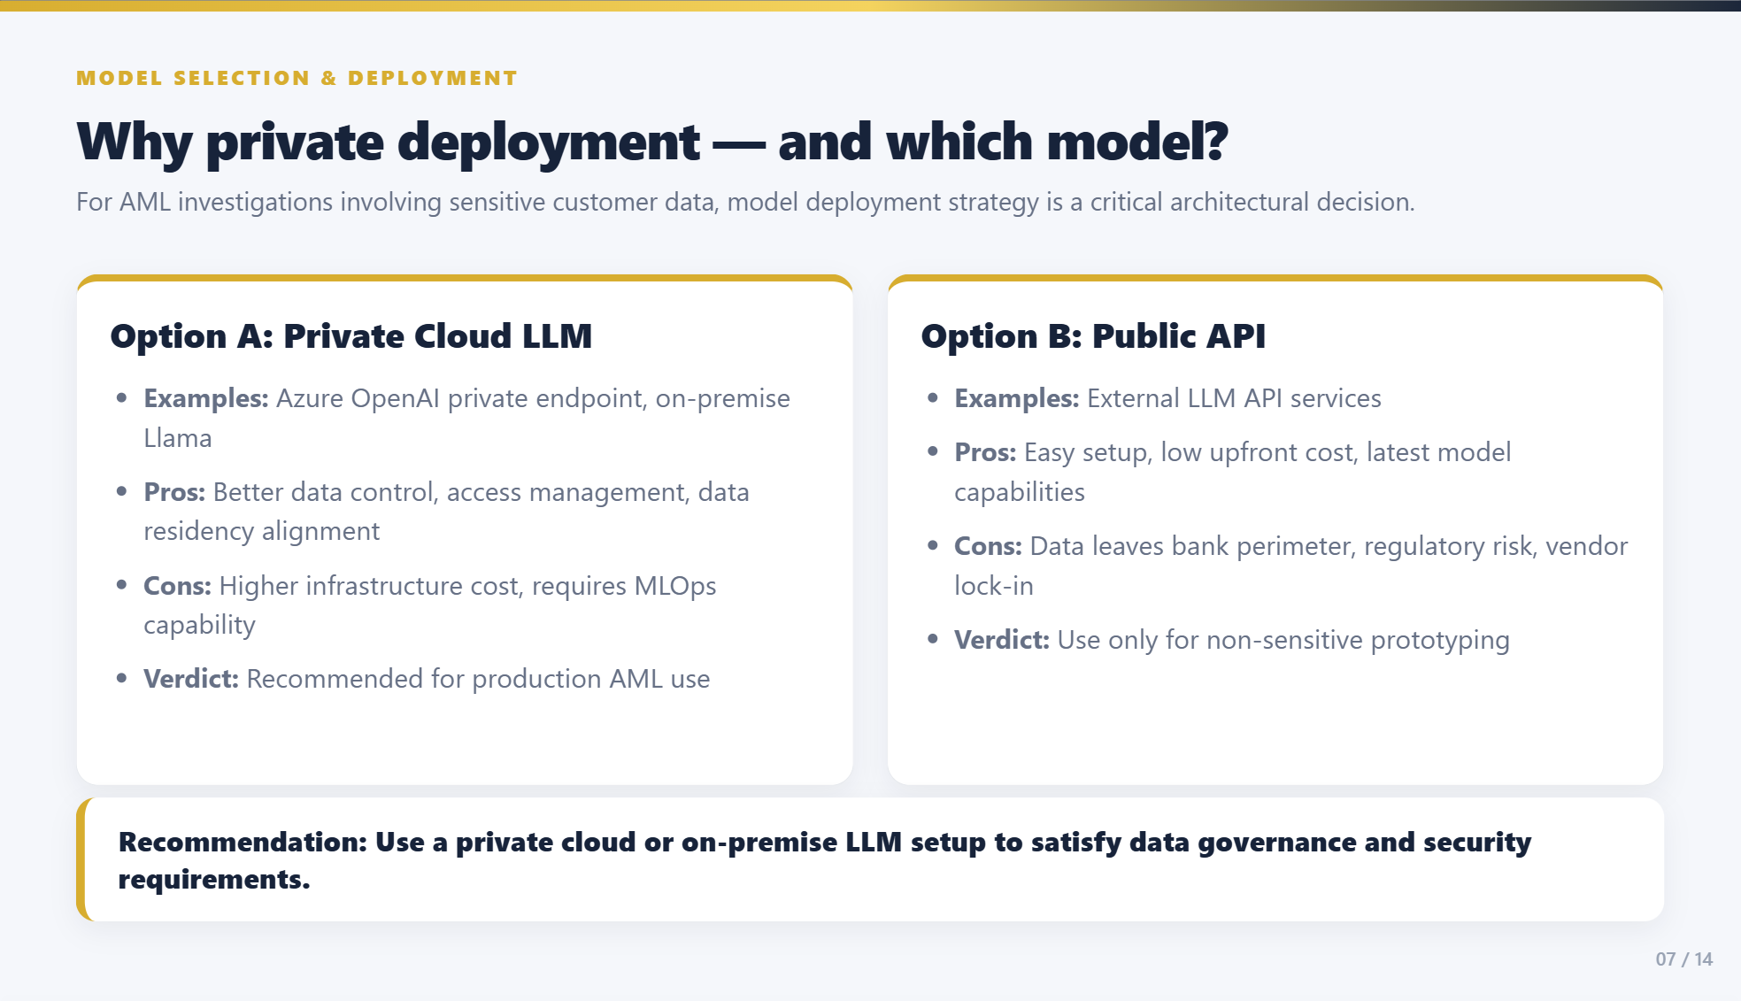

Slide 8
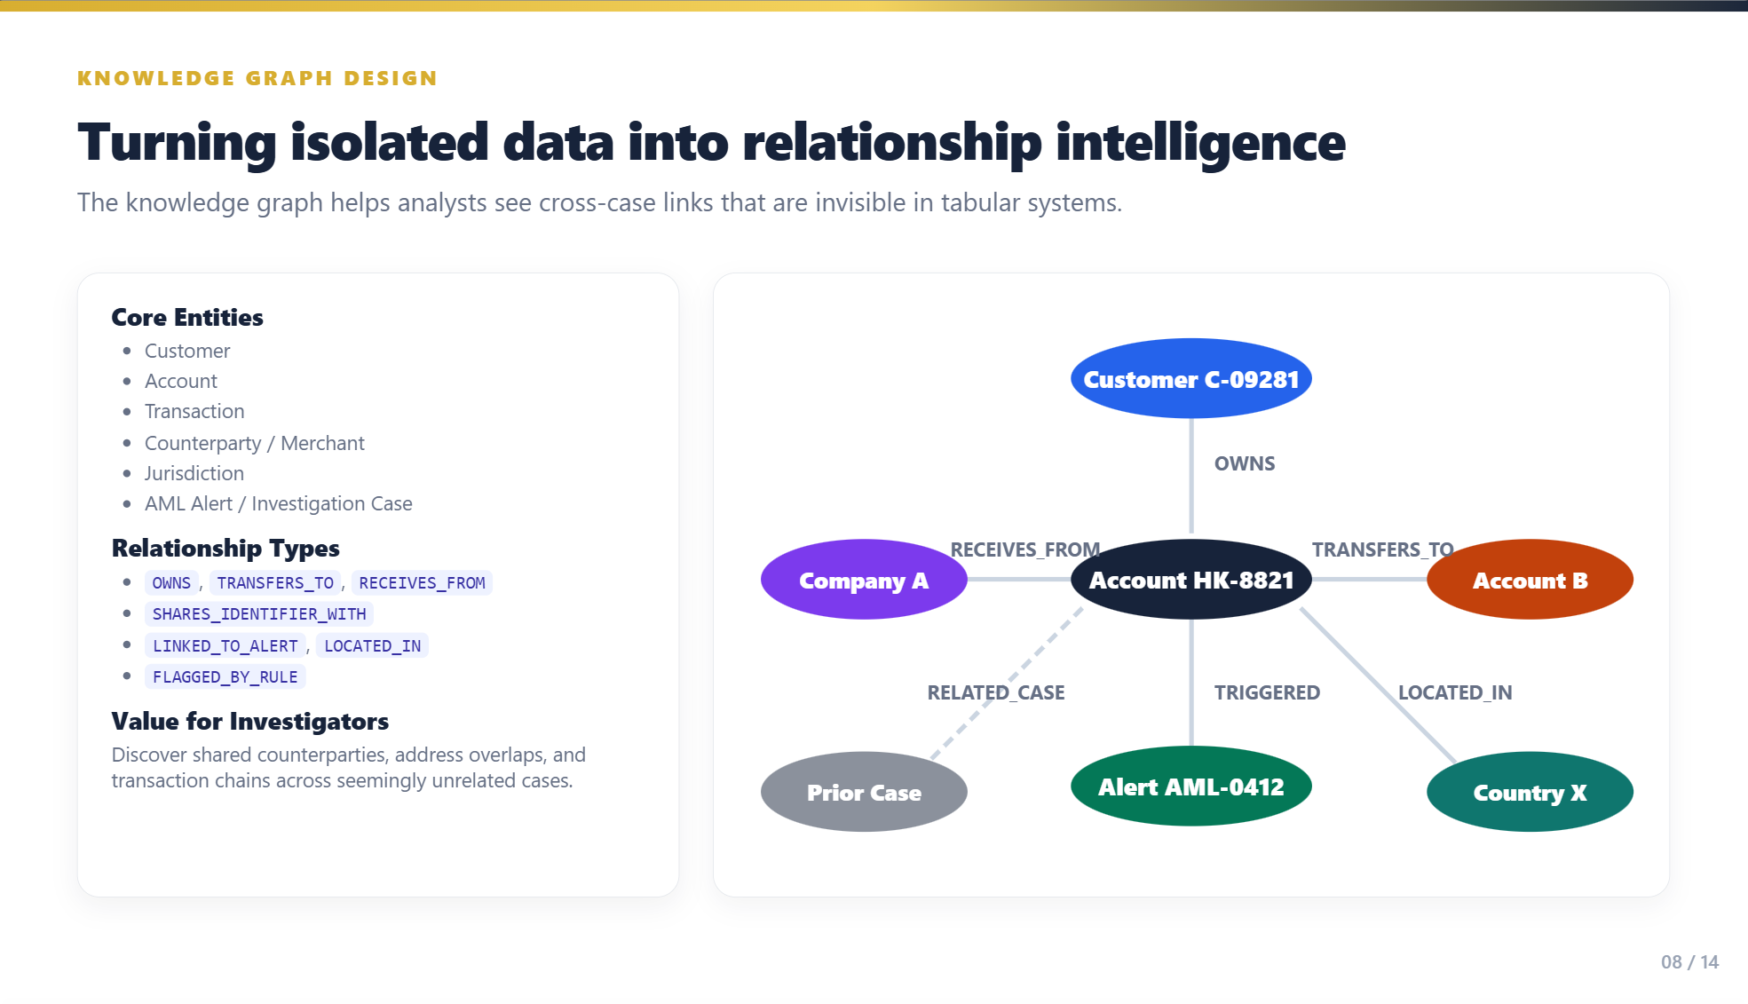

Slide 9
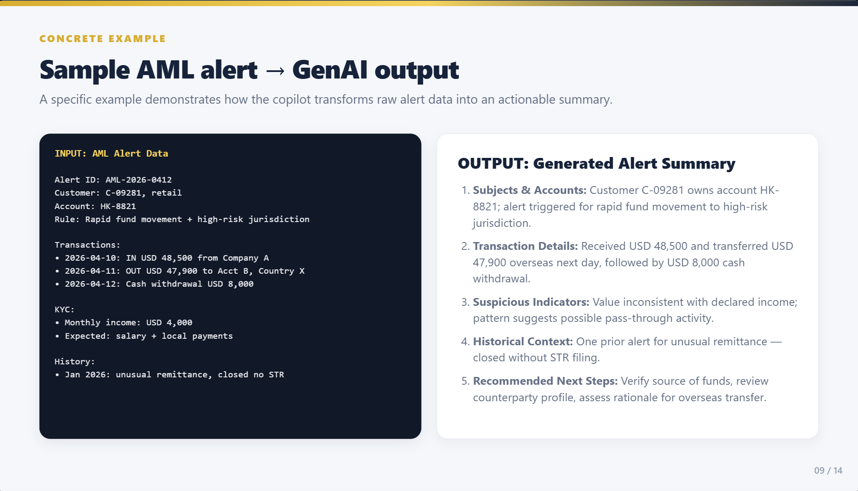

Slide 10
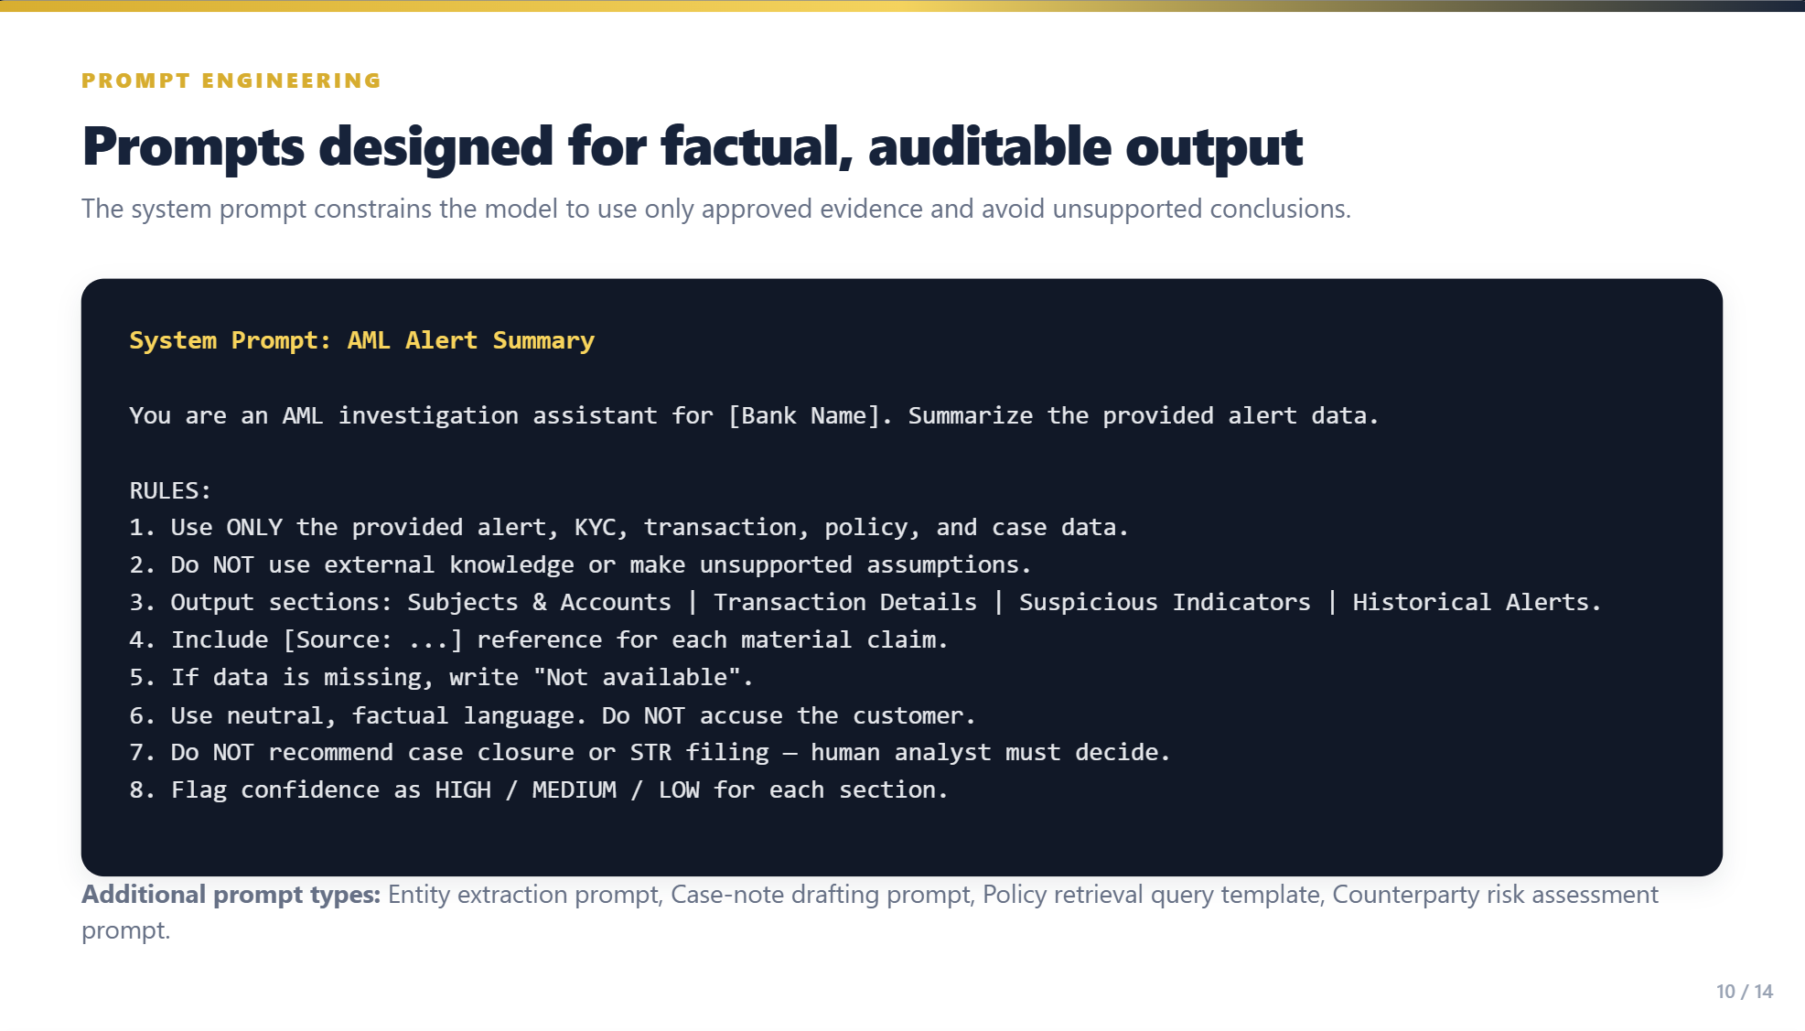

Slide 11
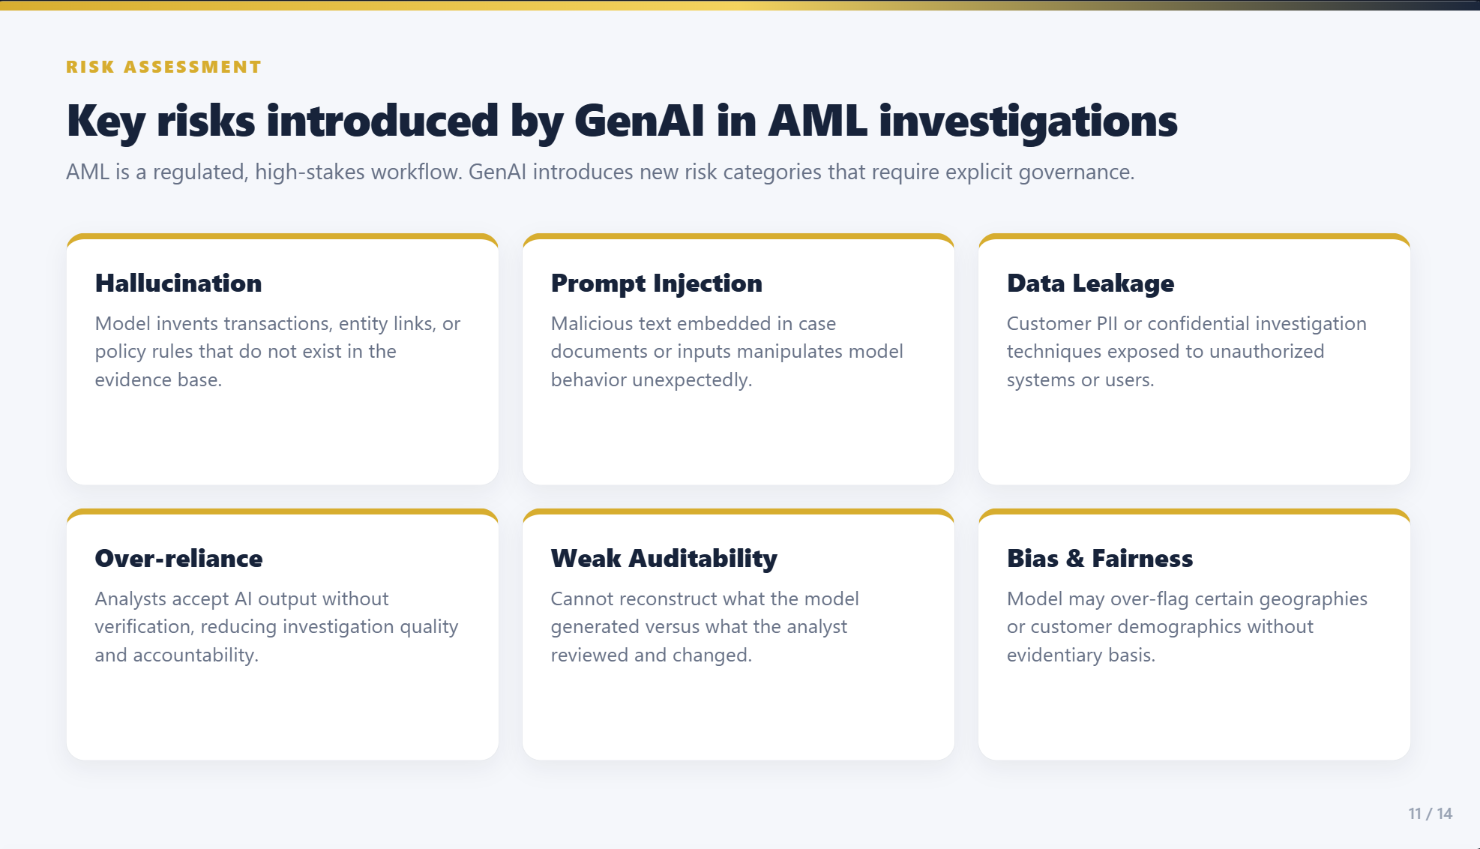

Slide 12
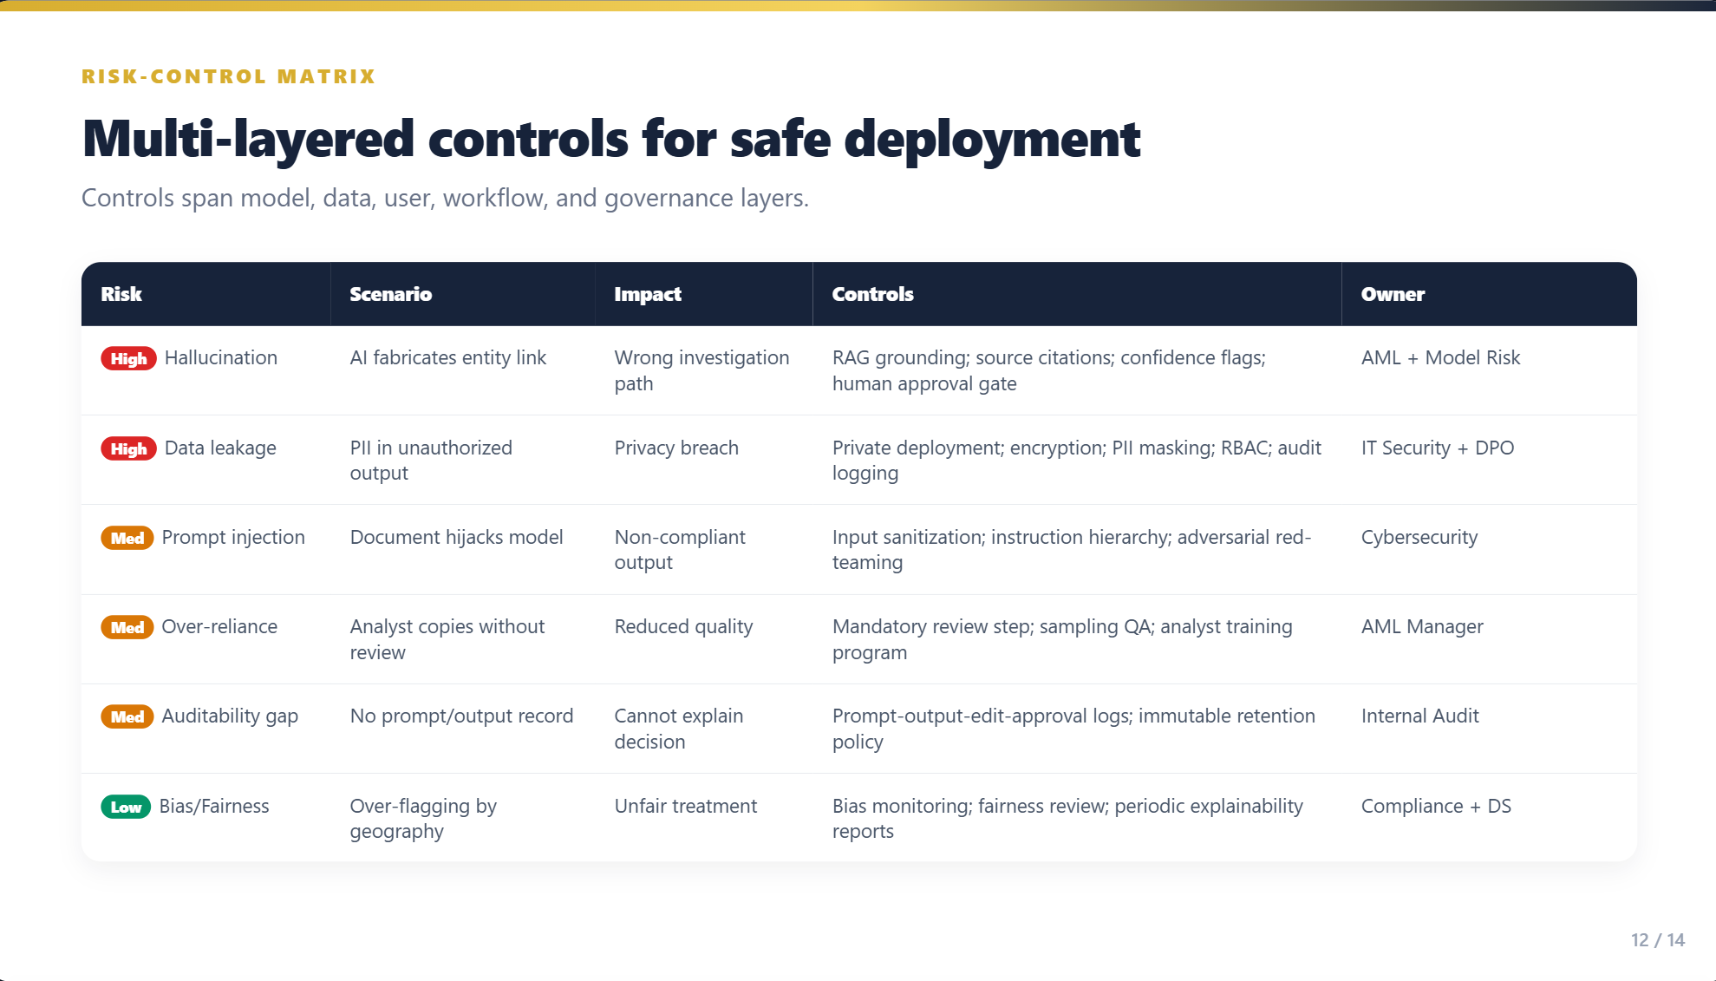

Slide 13
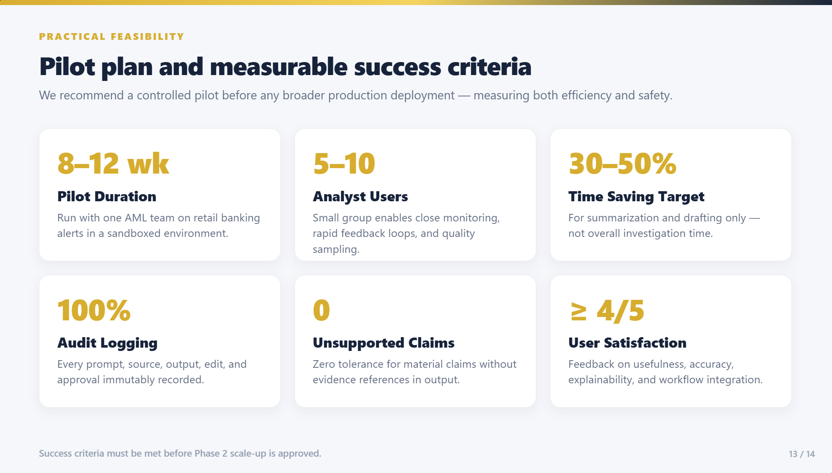

Slide 14
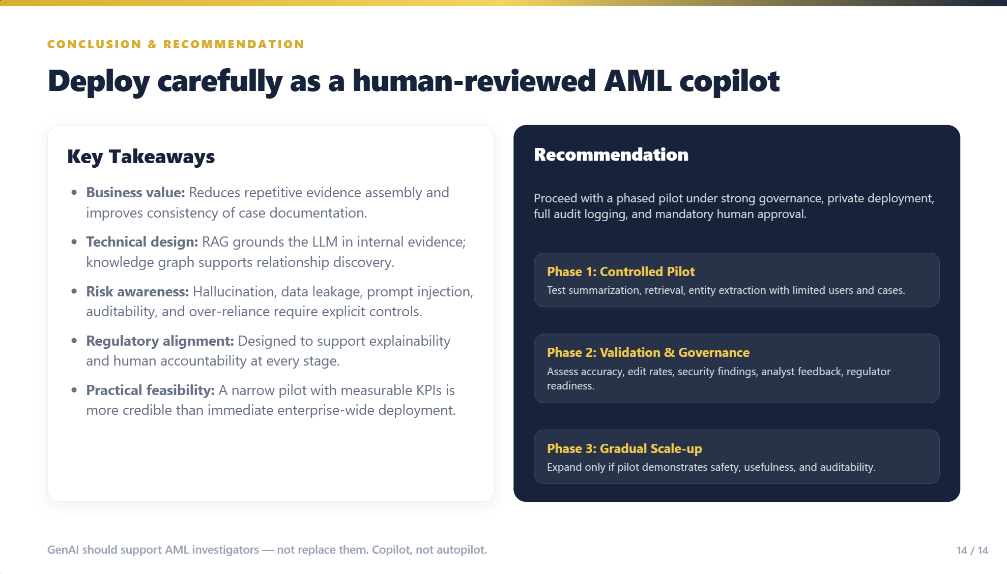

Slide 15
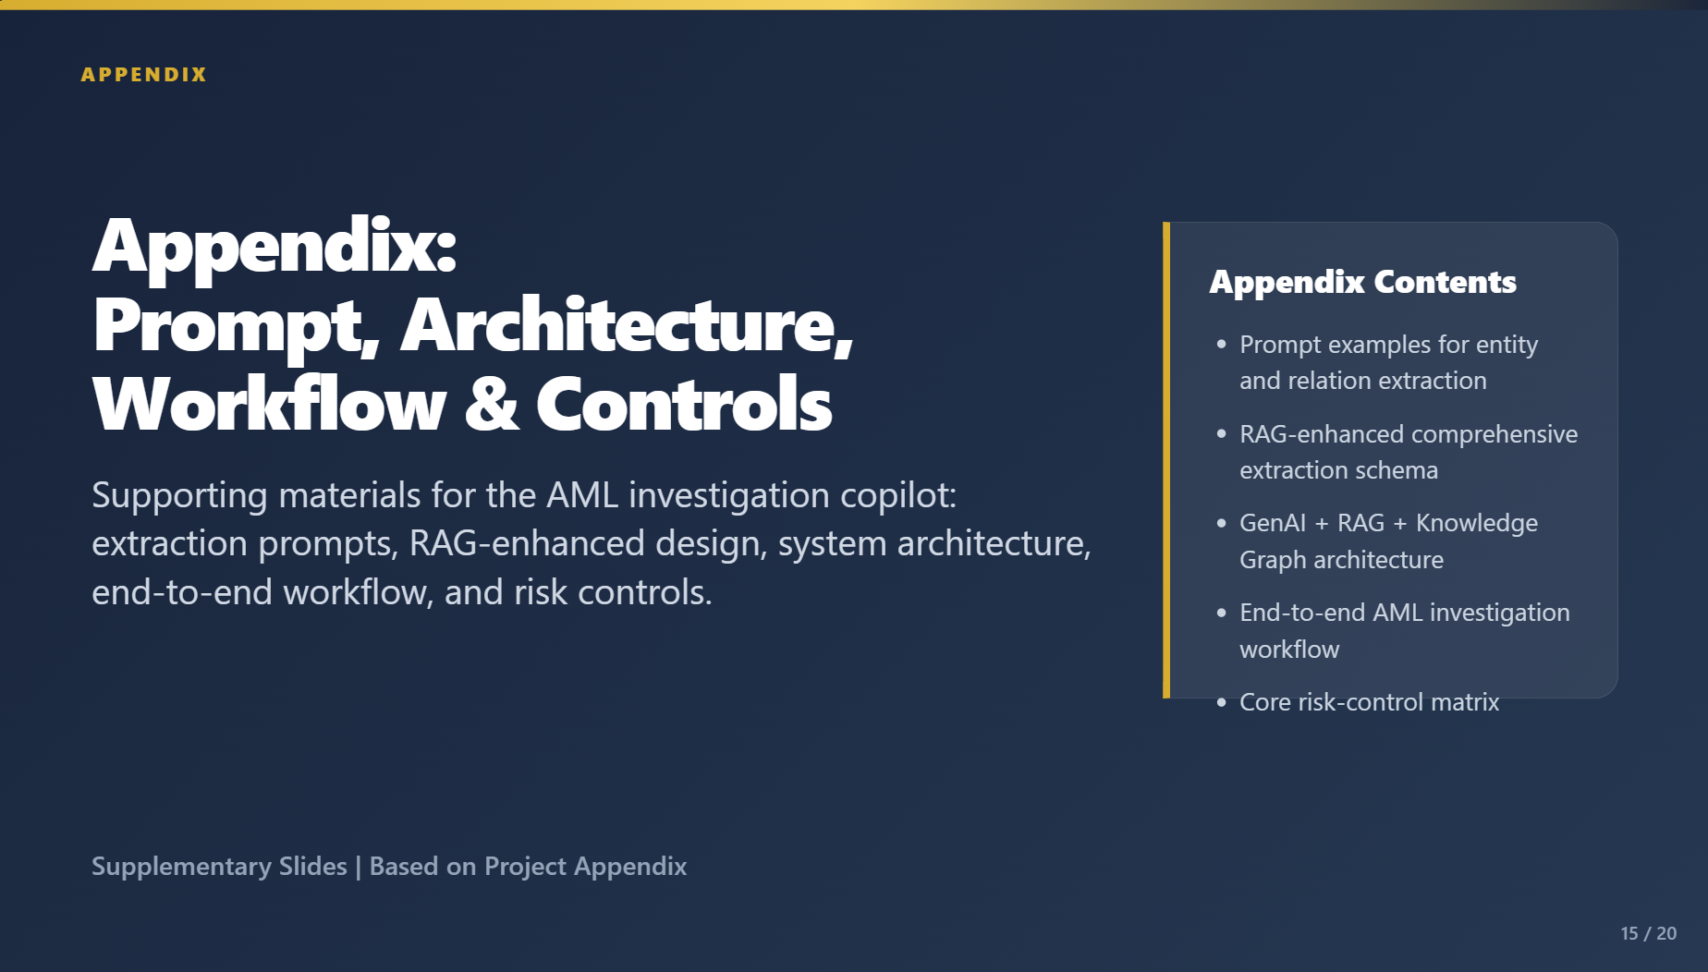

Slide 16
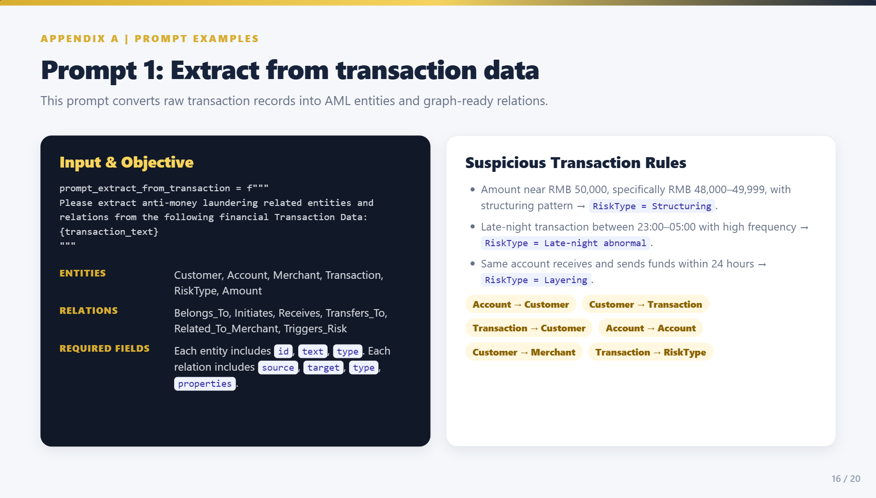

Slide 17
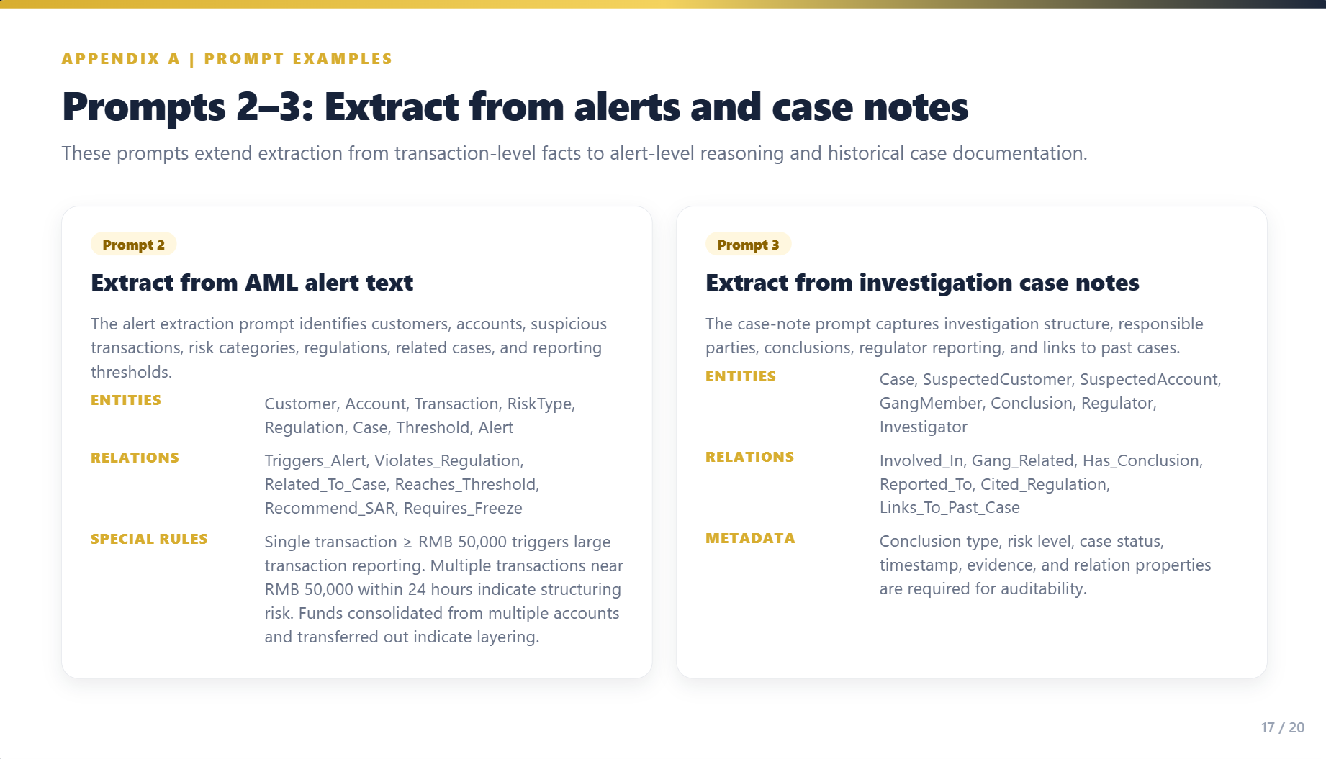

Slide 18
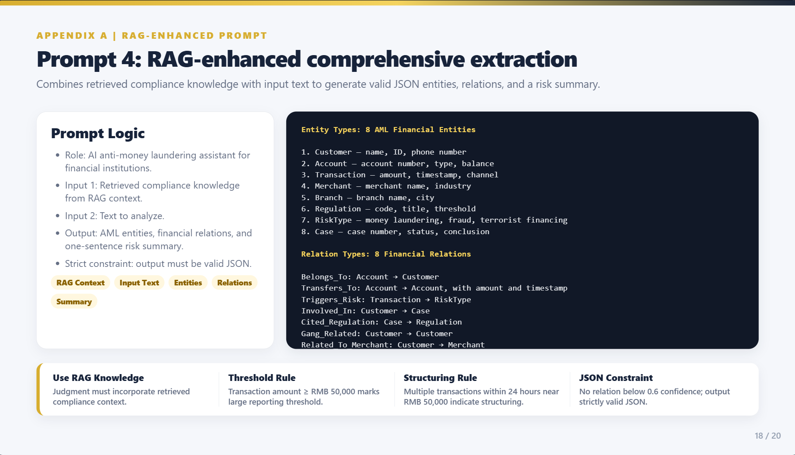

Slide 19
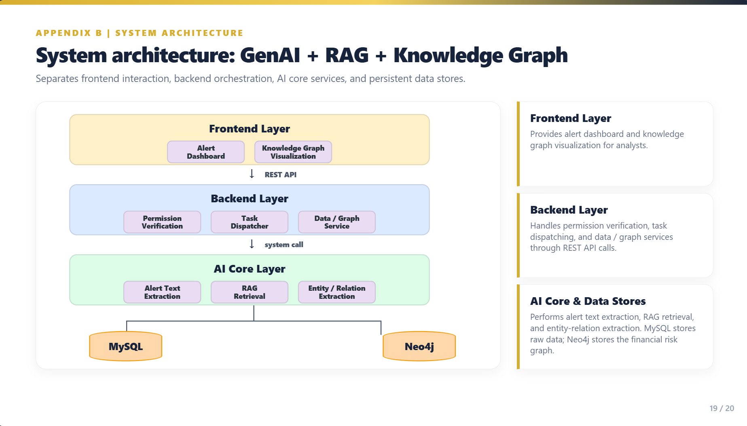

Slide 20
