Slide 1
VMCS with a new Perspective
SE-OODP Continuous Assessment
Part-Time Team 3

Slide 2
Design Problem
The current design mixes the controller operations at different stages of transaction. If a new transaction state is to be introduced, or the order of existing states to be altered (insert coins first, then select drink brand, versus select drink brand first, then insert coins), all transaction related methods in the TransactionController has to be modified, thus violating the Open Close Principle.

Slide 3


Candidate Patterns
State Pattern
Allow an object to alter its behavior when its internal state changes. The object will appear to change its class.
Strategy Pattern
Define a family of algorithms, encapsulate each one, and make them interchangeable. Strategy lets the algorithm vary independently from clients that use it.

Slide 4
Motivation
Strategy is a bind-once pattern, whereas State is more dynamic.
The implementation of the State pattern builds on the Strategy pattern. The difference between State and Strategy is in the intent. With Strategy, the choice of algorithm is fairly stable. With State, a change in the state of the “context” object causes it to select from its “palette” of Strategy objects.

Slide 5
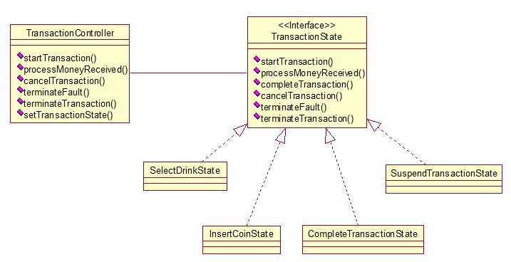
Structure

Slide 6
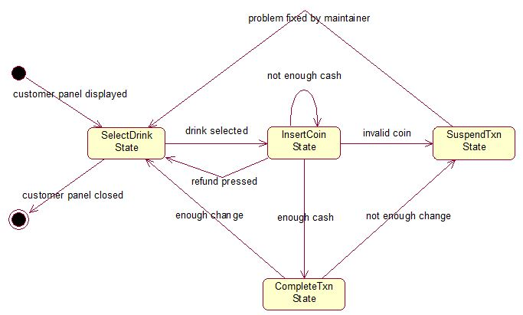
State Transition

Slide 7
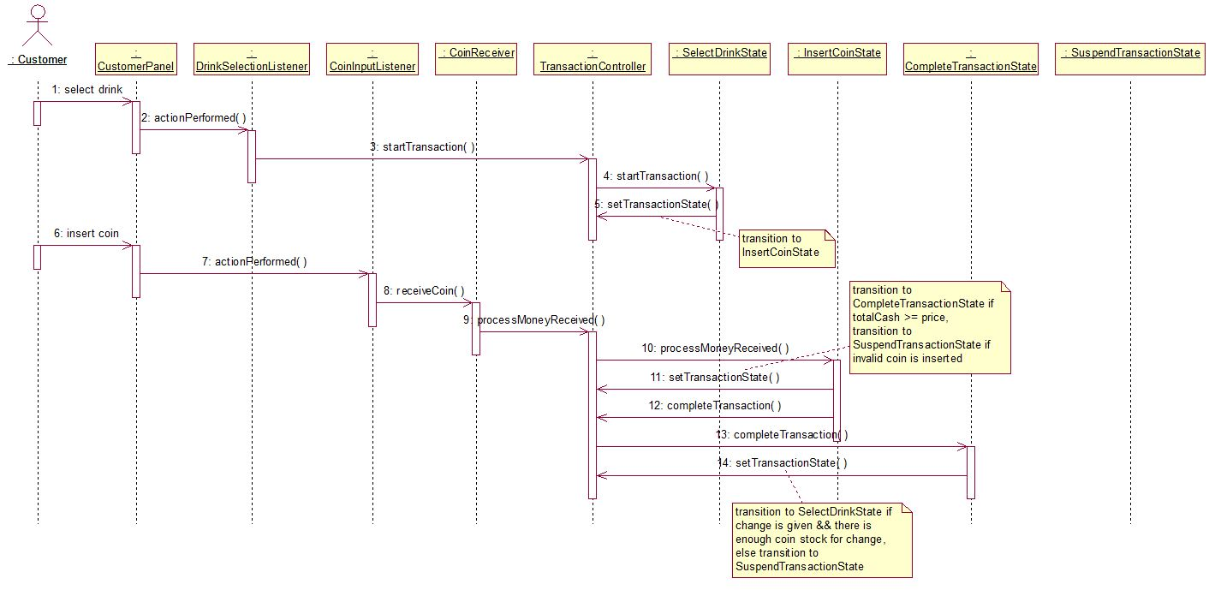
Collaborations

Slide 8
Implementation Decisions
Who defines the state transitions?
:Context defines. In our current implementation, which is TransactionController defines. Because for VMCS, the state transition is fixed.
2. A table-based alternative?
:For our implementation, table based state diagram is not needed since the state change is not so complex.
3. Creating and destroying State objects?
:Although create State objects only when they’re needed and destroy thereafter is preferred, we use the second way by creating them ahead of time until garbage collector destroy them. Since in Java, we cannot delete the objects on our own.
Using dynamic inheritance?
:We’re not using it since Java doesn’t specifically support this behavior.

