Slide 1
VMCS with a new Perspective
SE-OODP Continuous Assessment
Part-Time Team 3

Slide 2
Design Problem
The current design mixes the controller operations at different stages of transaction. If a new transaction state is to be introduced, or the order of existing states to be altered (insert coins first, then select drink brand, versus select drink brand first, then insert coins), all transaction related methods in the TransactionController has to be modified, thus violating the Open Close Principle.

Slide 3


Candidate Patterns
State Pattern
Allow an object to alter its behavior when its internal state changes. The object will appear to change its class.
Strategy Pattern
Define a family of algorithms, encapsulate each one, and make them interchangeable. Strategy lets the algorithm vary independently from clients that use it.

Slide 4
Motivation
Strategy is a bind-once pattern, whereas State is more dynamic.
The implementation of the State pattern builds on the Strategy pattern. The difference between State and Strategy is in the intent. With Strategy, the choice of algorithm is fairly stable. With State, a change in the state of the “context” object causes it to select from its “palette” of Strategy objects.

Slide 5
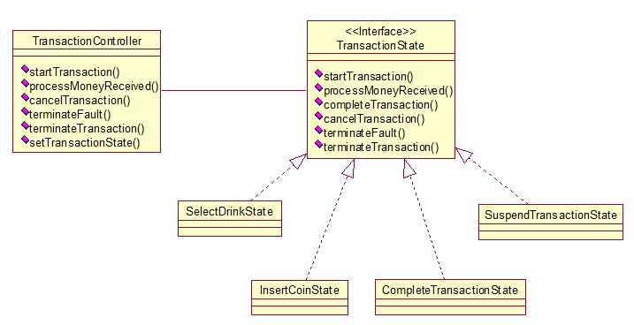
Structure

Slide 6
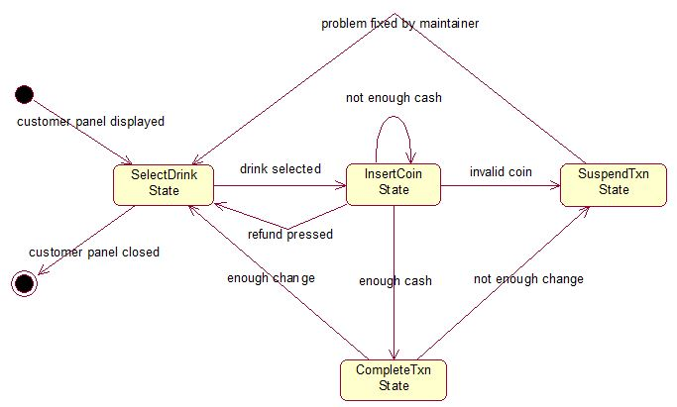
State Transition

Slide 7
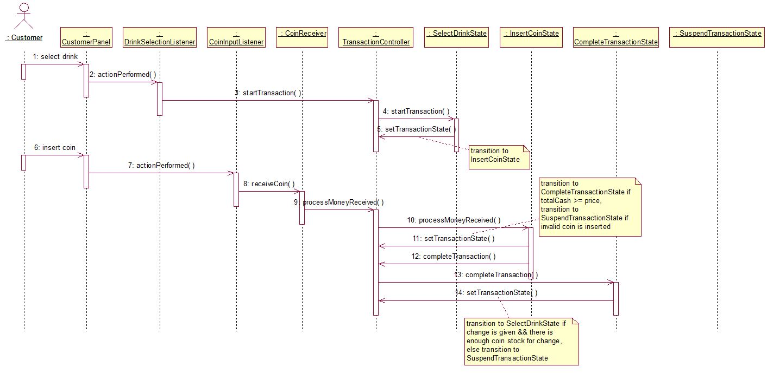
Collaborations

Slide 8
Implementation Decisions
Who defines the state transitions?
The State subclasses themselves define the transition, which is more flexible and appropriate as compared to defining transition criteria in the Context. An interface to set the context’s current state is provided.
2. A table-based alternative?
For our implementation, table based state diagram is not needed since the state change is not so complex.
3. Creating and destroying State objects?
We use the second way by creating the States ahead of time until garbage collector destroy them, as the state change occurs rapidly.
Using dynamic inheritance?
We’re not using it since Java doesn’t specifically support this behavior.

