Slide 1
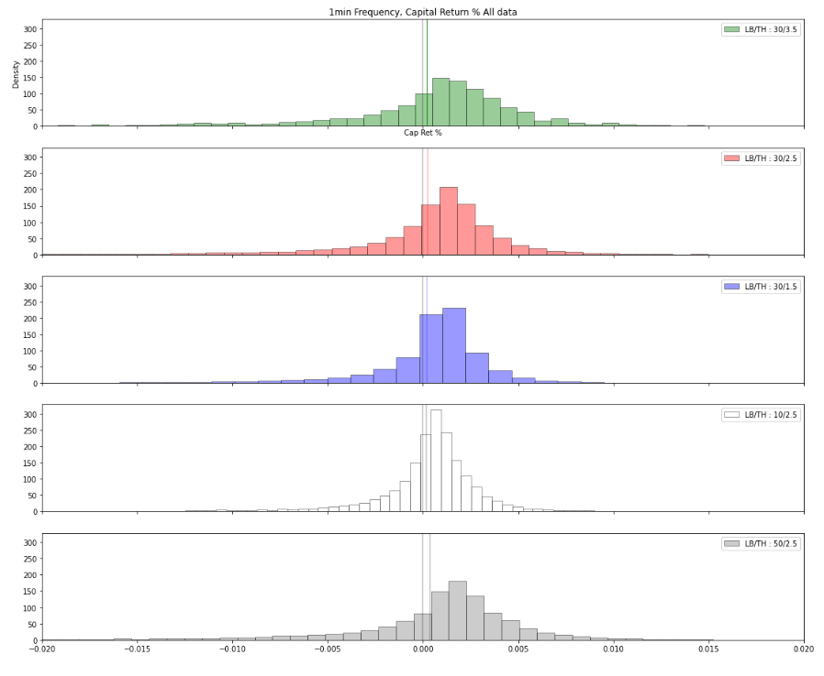
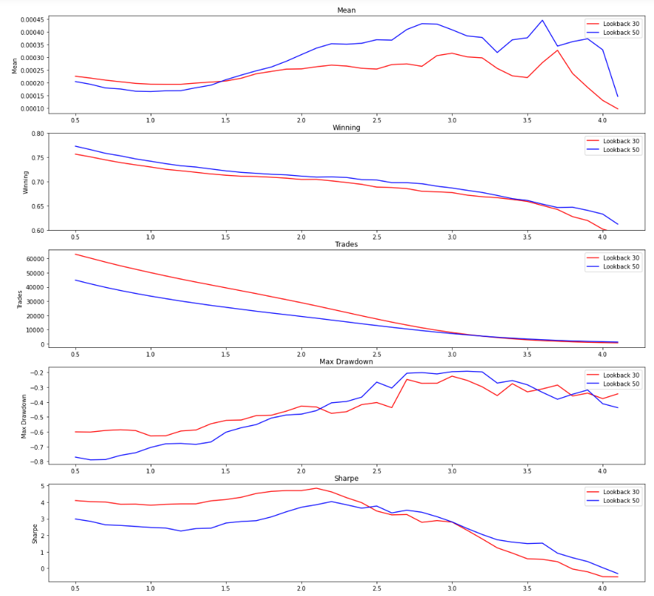
Return Profiles
Algo-Threshold Stress

Slide 2
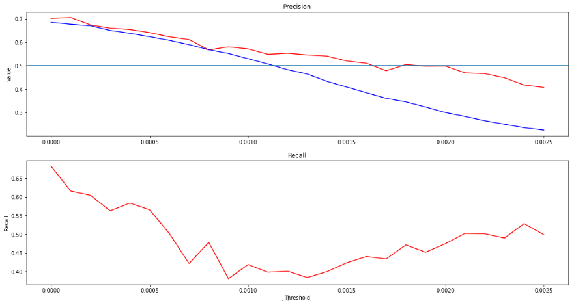
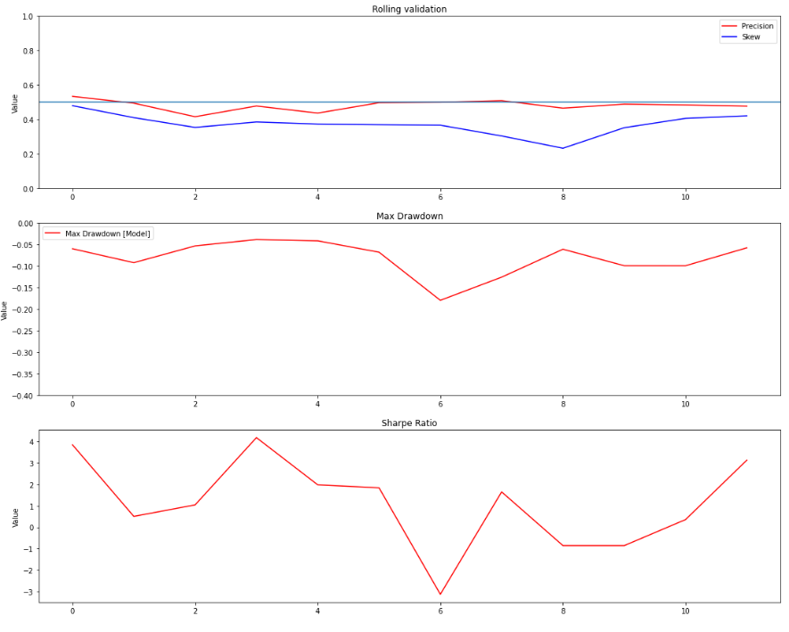
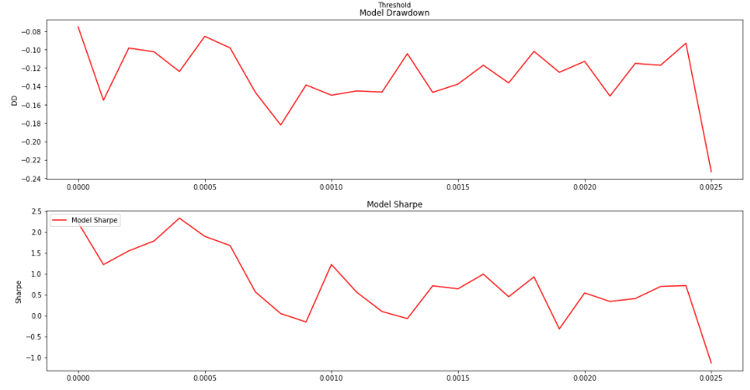
Threshold Stress
Same param as Rolling Validation
Rolling validation – Train 9mths and Test 3 mths
Period: 2021-05-01 to 2022-05-01
Lag: [60,180]
Depth: 6
Estimators: 10
Lookback: 50
Algo-Threshold: 2.5
Return threshold: 0.002

