Slide 1
Spectral Clustering of the Stock Market
Kevin Jin, Patrick Yuen

Slide 2
Investigation
Do companies in the same industry follow the same trends in stock prices?
Our belief: stock prices of similar companies react to the same events, but with different delays
Can ERP lag structures predict whether a time series consistently leads or lags another?
Stock trading strategy
Notes:
We went in asking two questions.

Slide 3
Edit distance with Real Penalty
ERP is an elastic distance metric. Chooses the lags (alignment) that minimizes the distance
Outputs (1) a single number, the distance between two time series
Outputs (2) the lag/lead structure of the two series that produces that distance

Slide 4
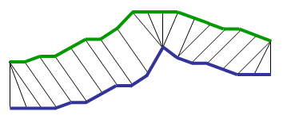
Alignment from series A to B
|A – B|_{erp} = (… + |3 – 5| + |4 – 6| + …)
A lead over B = < …, 8 – 6, 9 – 7, … >
<7,6>
<time, y-value>
<6,5>
B
<9,4>
<8,3>
A
Notes:
Note that if a step is advanced on time series A, you can’t go back to some earlier time. You must either stay at that timestep or move forward.
We also impose a maximum to the lead that A can have over B. We don’t expect that one stock price series will lead another by months for example, but more like 14 days.

Slide 5
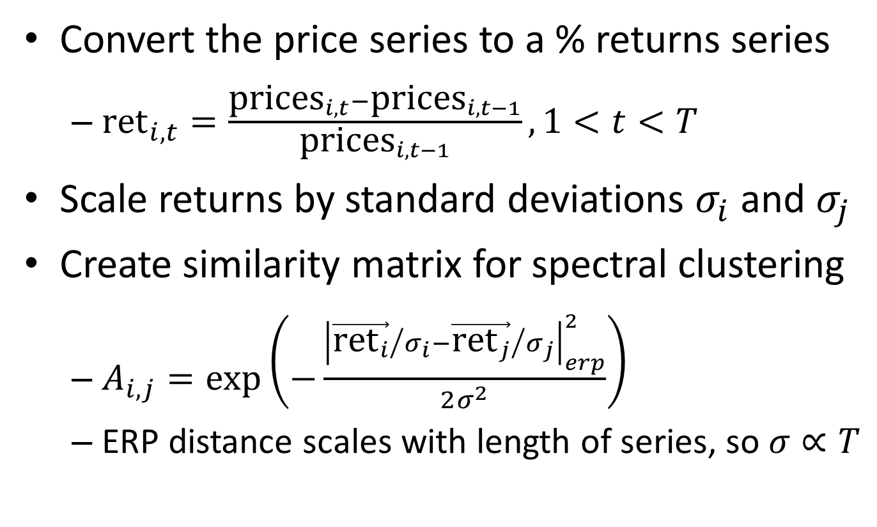
Gaussian ERP kernel
Convert the price series to a % returns series
${\text{ret}}_{i,t}=\frac{{\text{prices}}_{i,t}−{\text{prices}}_{i,t−1}}{{\text{prices}}_{i,t−1}},1<t<T$
Scale returns by standard deviations $σ_{i}$ and $σ_{j}$
Create similarity matrix for spectral clustering
$A_{i,j}=\exp\left(−\frac{{\left|{\vec{{\text{ret}}_{i}}}/{σ_{i}}−{\vec{{\text{ret}}_{j}}}/{σ_{j}}\right|}_{erp}^{2}}{2σ^{2}}\right)$
ERP distance scales with length of series, so $σ∝T$
Notes:
This is just the Gaussian kernel but replacing Euclidean distance with the ERP distance of the scaled returns series and the sigma with the length of the returns series.
This is not a true kernel because you can’t decompose it into two dot products on the returns series, so you can’t put this into SVM or anything. However, the values are conveniently scaled between 0 and 1 and a higher distance implies lower similarity. Because spectral clustering merely needs a similarity matrix, this measure is sufficient for our needs.

Slide 6
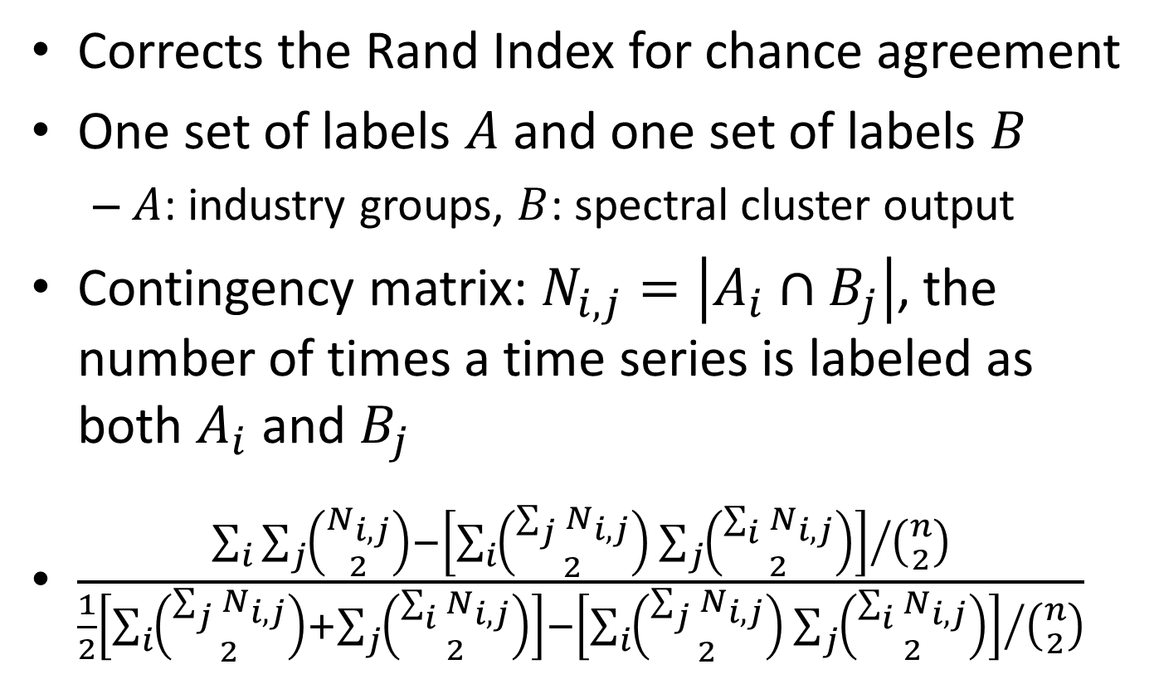
Adjusted Rand Index
Corrects the Rand Index for chance agreement
One set of labels $A$ and one set of labels $B$
$A$: industry groups, $B$: spectral cluster output
Contingency matrix: $N_{i,j}=\left|A_{i}∩B_{j}\right|$, the number of times a time series is labeled as both $A_{i}$ and $B_{j}$
$\frac{\sum_{i}{\sum_{j}{\left({N_{i,j} \atop 2}\right)}−{\left[\sum_{i}{\left({\sum_{j}{N_{i,j}} \atop 2}\right)}\sum_{j}{\left({\sum_{i}{N_{i,j}} \atop 2}\right)}\right]}/{\left({n \atop 2}\right)}}}{\frac{1}{2}\left[\sum_{i}{\left({\sum_{j}{N_{i,j}} \atop 2}\right)}+\sum_{j}{\left({\sum_{i}{N_{i,j}} \atop 2}\right)}\right]−{\left[\sum_{i}{\left({\sum_{j}{N_{i,j}} \atop 2}\right)}\sum_{j}{\left({\sum_{i}{N_{i,j}} \atop 2}\right)}\right]}/{\left({n \atop 2}\right)}}$
Notes:
Because we have 24 classes, we found that the number of agreements we had from wrong cluster assignments vastly overwhelmed the number of agreements from correct cluster assignments, which threw off our evaluation. Our Rand Index would be around 94% when the cluster assignment almost looked random, which went down to 8% with the Adjusted Rand Index.

Slide 7
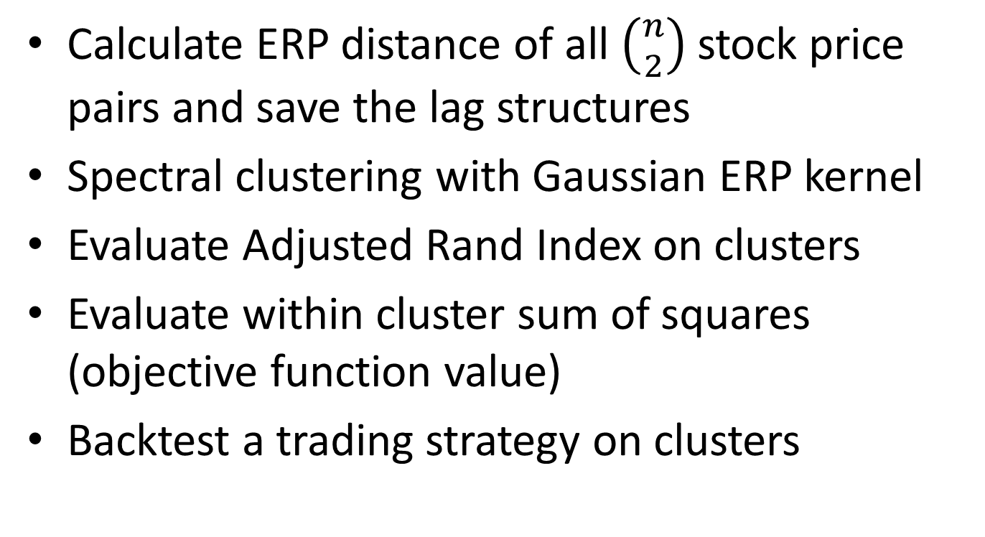
Procedure
Calculate ERP distance of all $\left({n \atop 2}\right)$ stock price pairs and save the lag structures
Spectral clustering with Gaussian ERP kernel
Evaluate Adjusted Rand Index on clusters
Evaluate within cluster sum of squares (objective function value)
Backtest a trading strategy on clusters
Notes:
Correlation
Pearson
Kmeans

Slide 8
Stock selection
Companies with any missing daily price data in the chosen time period are not considered
All price data is scaled and centered (z-scores). Companies with low correlations to average price series for industry are not considered
Sample 72 names (from today’s S&P 500 members), 3 in each of the 24 industry groups
Notes:
We make sure to eliminate outlier companies. The reason why we don’t want outliers is because those are following some idiosyncratic process that is not the one we’re trying to model. They can be companies suffering financial distress or data glitches, so they don’t react to events the same way.
We pick 72 companies and produce 24 clusters.
Subtract mean and divide by standard deviation.
Scale and centering: a posteriori selection bias
S&P 500: survivorship bias

Slide 9
Baseline clustering
Spectral clustering on correlations between stock price series
Compare the Adjusted Rand Index and objective function against those produced by the GERP kernel
Notes:
In the first step of our project, we will compare our ERP clusters against clusters produced by spectral clustering on the correlation matrix.

Slide 10
ERP trading strategy
For each cluster, leave out one company
For each lag structure between all pairs of companies in the cluster, compute mean of leads
Left out company has highest average lead against all other companies in the cluster
Scale and center left out returns (z-scores)
When left out return is above 80th percentile of the normal distribution, buy all the other companies in the cluster and sell after 14 days
Notes:
Let me remind you of the motivation of this exercise. We believe that spectral clustering by ERP distance will be superior in grouping together similar time series. We believe that a priori, industry groups will be pretty close to the resulting clusters of stocks, but this is no means a ground truth labeling that would allow us to perform a classification experiment. In order to truly evaluate the clusters, we have to see whether the time series in each cluster actually do follow each other.
Our idea is to find the company that leads the other companies in the cluster by the most time in stock price movements and trade the lagging companies in the cluster by following the leading company’s movements. We believe that when the leading company makes a very significant move up, the companies that lag after it will make a significant move up in the following days.
In a standard normal distribution, you expect most observations to fall around the mean of 0. Higher z-scores are rarer, and the 80th percentile is the z-score at which P(Z < z) = 0.80, which is approximately 0.84.
Scale and center: a posteriori bias, should do windowed sd/mean.

Slide 11
Baseline trading strategies
Perform the trading strategy using the ERP lag structures but with industry groups as clusters
Lag structures are between any pairs of time series; i.e. cluster algorithm independent
Perform the trading strategy using the ERP lag structures but with correlation based clusters
Buy-and-hold the companies for the whole period (passive strategy)
Notes:
ERP distances and lag structures are like eigenvalues and eigenvectors in that they are byproducts of one other but still separable. We will use the ERP lag structures and discard the ERP distance when doing the first two baselines.
The buy-and-hold strategy is basically our equivalent of the random guessing strategy. We calculate the returns resulting from buying ALL the stocks on day 1 and selling all of them on the last day. We hope that our active strategy has better performance than this baseline.

Slide 12
Clustering results
ARI of correlation spectral clustering: ~20-30%
ARI of ERP spectral clustering: ~10-20%
ERP within cluster sum of squares: ~2.96-3.15
Cor. within cluster sum of squares: ~2.55-2.75
Notes:
Things didn’t look too promising for ERP here. Relative to the correlation clusters, the ERP clusters look less like the industry groups and companies in the same cluster are farther apart in terms of Euclidean distance.

Slide 13
Industry group baseline
Individual cluster % returns: -5.38 11.47 39.05 -0.94 6.08 28.08 24.70 51.86 37.31 19.63 8.73 -3.21 9.39 26.23 -8.47 11.67 42.88 18.73 12.49 36.54 46.50 10.90 12.62 34.00
Notes:
Nonetheless, we continued with evaluating the trading strategy.
In all strategies, the balance starts with $1 on day 1. This balance grows and shrinks in value by the daily returns of the companies we invest in. Each day, we plotted the value of the active strategy balance minus the corresponding value of the buy-and-hold strategy balance. If the plot dips below 0, it underperforms the buy-and-hold strategy up to that day.
It’s clear that trading the ERP lags with industry groups performs much worse than the buy-and-hold strategy.
We trade between May 2004 and July 2005.

Slide 14
Correlation clustering baseline
Individual cluster % returns: 48.22 18.28 34.00 8.26 43.01 31.96 54.30 9.91 -8.07 19.33 51.86 43.22 36.78 55.14 28.43 -30.38 12.48 17.30 23.23 4.77 7.41
Notes:
Note that repeated iterations of spectral clustering on correlations and ERP, and hence trading performance, are non-deterministic because of the random initialization of cluster when performing k-means. The following two charts are pretty characteristic of what we have seen however.

Slide 15
ERP clustering
Individual cluster % returns: 5.25 9.67 57.90 27.26 33.41 18.88 20.13 48.22 -0.32 66.36 16.04 29.06 16.09 46.27 31.29 10.24 8.30 30.62 18.61 78.50 -1.79 11.27 51.86 -22.91

Slide 16
Conclusions
Adj Rand Index and objective function value have no bearing on trading strategy returns
More distinguishable clusters (in raw daily returns time series feature space) does not translate into consistent lead lag relationships
Clusters capture predictive information that industry groups do not
Repeated executions have varying returns
K-means struggles to find 24 “natural” clusters
Notes:
We found that Adjusted Rand Index is not a good predictor of trading performance and neither is the k-means objective function evaluated on the Euclidean distances of the time series in each cluster.
Because both cluster based strategies perform better than the industry group strategy, we have reason to believe that clusters capture predictive information that industry groups do not.
Correlation and ERP based clusters both perform very well returns wise, in the 24-28% annualized area, which puts them over the passive strategy’s annualized return of 22.54%. It’s too close to tell which is better until we can devise a way that holds cluster center initializations fixed.
Remember that spectral clustering does k-means and k-means requires initial cluster centers. Right now, our spectral clustering routine still picks random stocks as the initial cluster centers for all iterations.

Slide 17
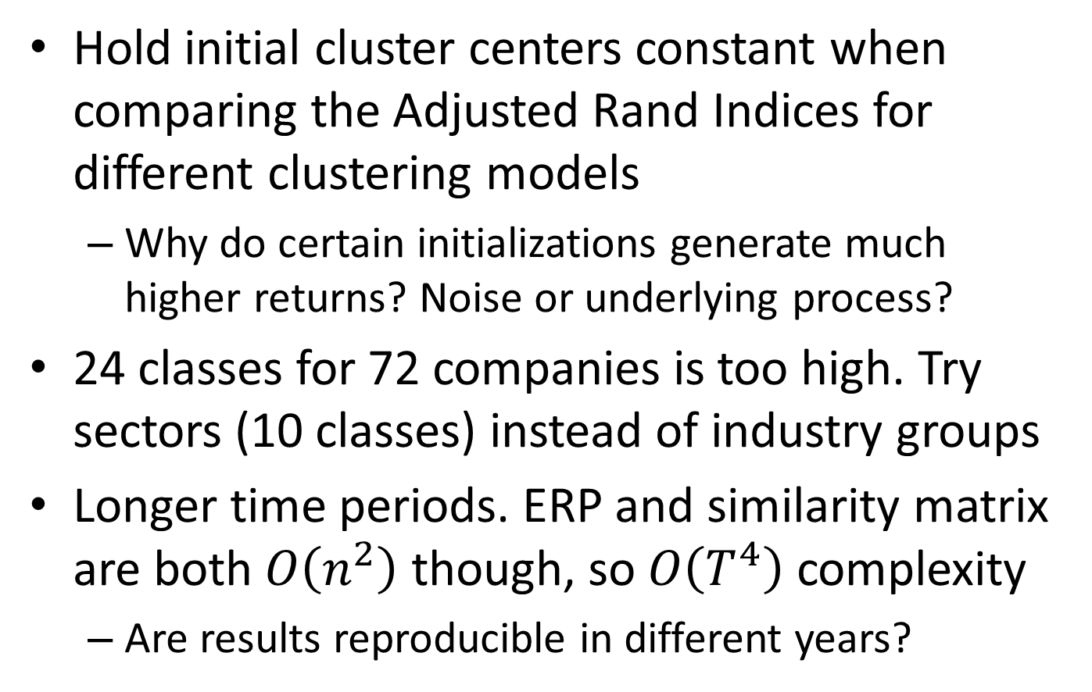
In the pipeline
Hold initial cluster centers constant when comparing the Adjusted Rand Indices for different clustering models
Why do certain initializations generate much higher returns? Noise or underlying process?
24 classes for 72 companies is too high. Try sectors (10 classes) instead of industry groups
Longer time periods. ERP and similarity matrix are both $O\left(n^{2}\right)$ though, so $O\left(T^{4}\right)$ complexity
Are results reproducible in different years?
Notes:
Our library makes it hard to specify the initial clusters for k-means in the eigenvector feature space. Once we hack in a solution, we think it might be interesting to see what happens when we initialize the cluster centers to the averages of each industry group in the eigenvector feature space.
We also want to scrutinize the companies in each cluster more closely and see why the companies in these clusters are more similar than those in the same industry groups.

