Slide 1
Evaluating Reporting in Behavioral Measures of Risk Taking
PSYC573 Final Project
Kevin Kapadia
In Collaboration with: Richard John and Coco Tang

Slide 2
What are Behavioral Measures of Risk Taking?
BMRT are game like tasks that measure an individual’s risk-taking propensity
Developed because they feel more natural than typical lottery-based scenarios
Example 100% chance for 20 dollars or 50% chance for 60 dollars
Participants play multiple rounds of a game and average score is typically used to assess how risky you are
No agreed upon way to score tasks

Slide 3
How BMRT Performance Is Measured
All BMRT have a primary variable measuring riskiness based on participant actions (number of pumps, number of cards turned over, number of times rod is cast)
Traditionally, higher scores on this primary variable indicate higher scores of riskiness
Every game has an optimal solution where based on the information provided one decision has the highest expected value
Scores above the optimal solution indicate participants are risk seeking, scores below indicate participants are risk averse

Slide 4
Why Should We Care?
BMRT have been shown to predict with numerous negative outcomes
Addiction (Dahne et al., 2013)
Impulsivity (Congdon et al., 2013, Lejuez et al., 2002, Courtney et al., 2012)
Risky health behavior (Szrek et al., 2012)
Problematic Drinking (Brailovskaia et al., 2018)
Smoking (Lejuez et al., 2003)

Slide 5
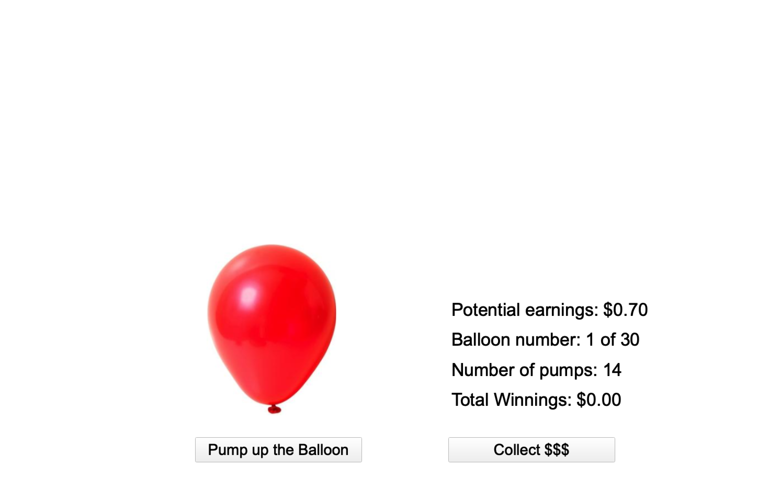
BART – Balloon Analogue Risk Task
There is a balloon you pump up (one trial is one pump)
Each pump results in a fixed reward
The balloon will randomly pop during one of the trials and you lose all of your earnings for that round
Maximum number of pumps in one round traditionally is 128
Unknown to participant

Slide 6
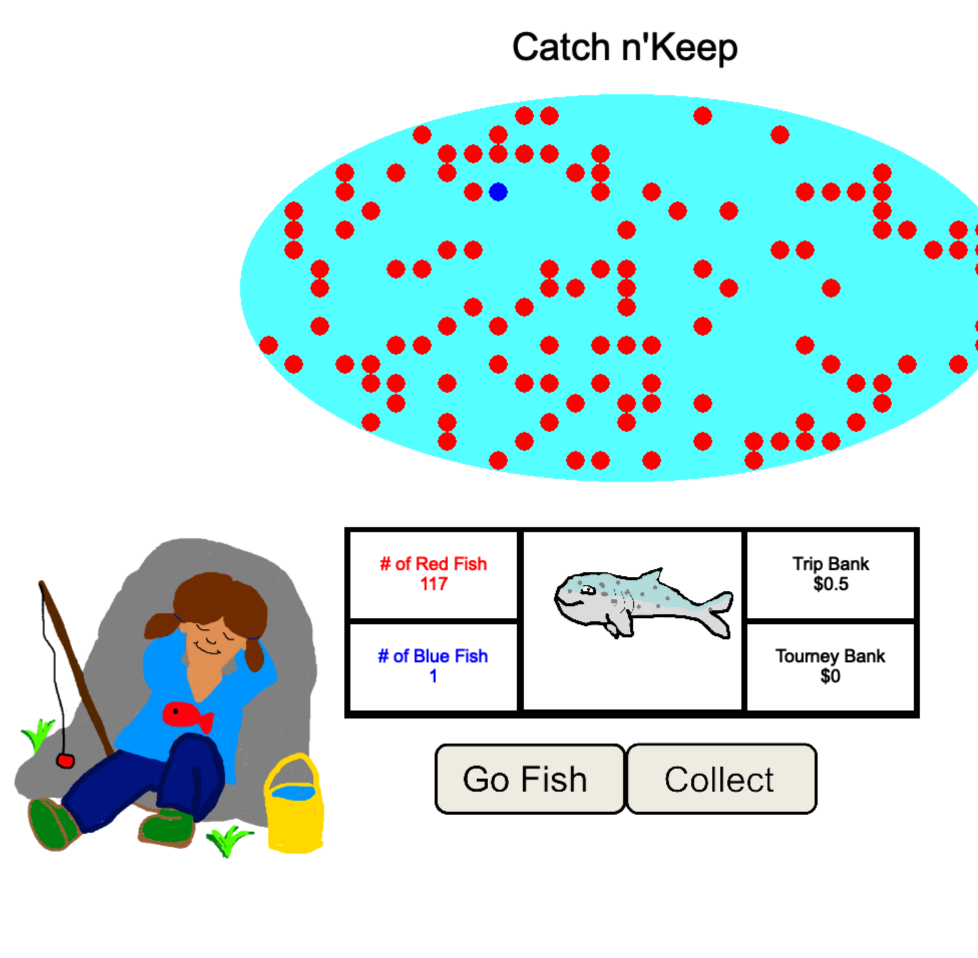
ART – Angling Risk Task
Players fish for red and blue fish in a pond
Catching a red fish adds points while catching a blue fish causes you to lose all your points for the round
You decide when to stop fishing for the round and save those points in a bank
Traditionally, game began with 127 red fish and 1 blue fish
Sunny version you know the number of fish, Cloudy version that information is kept from you
Standard version once a fish is caught it is removed, Catch and Release the fish is put back into the pond after each trial

Slide 7
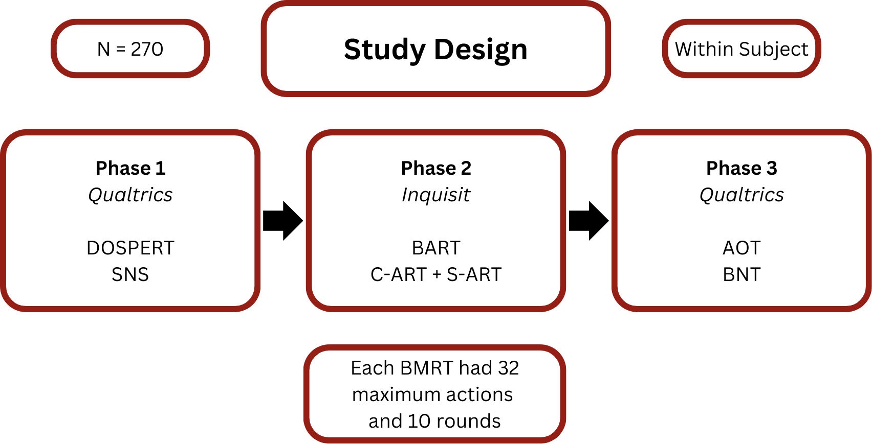

Slide 8
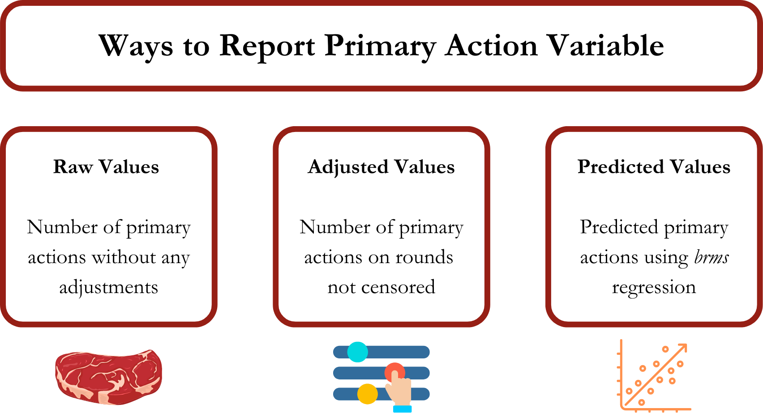

Slide 9
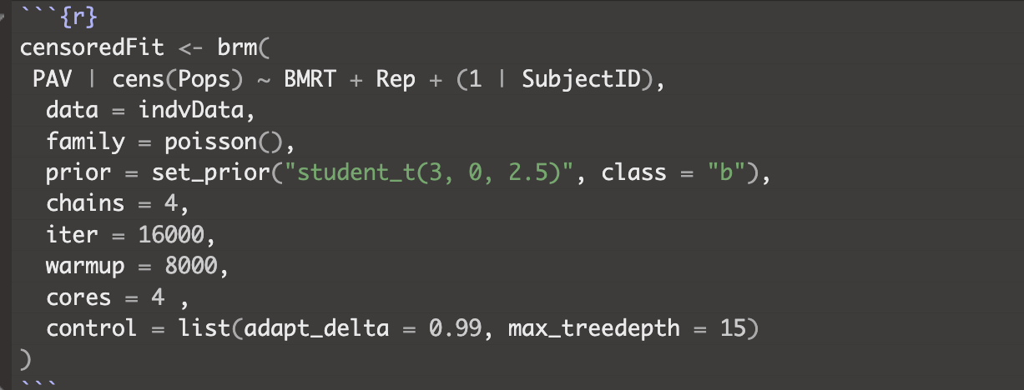
Using BRMS to predict censored rounds

Slide 10
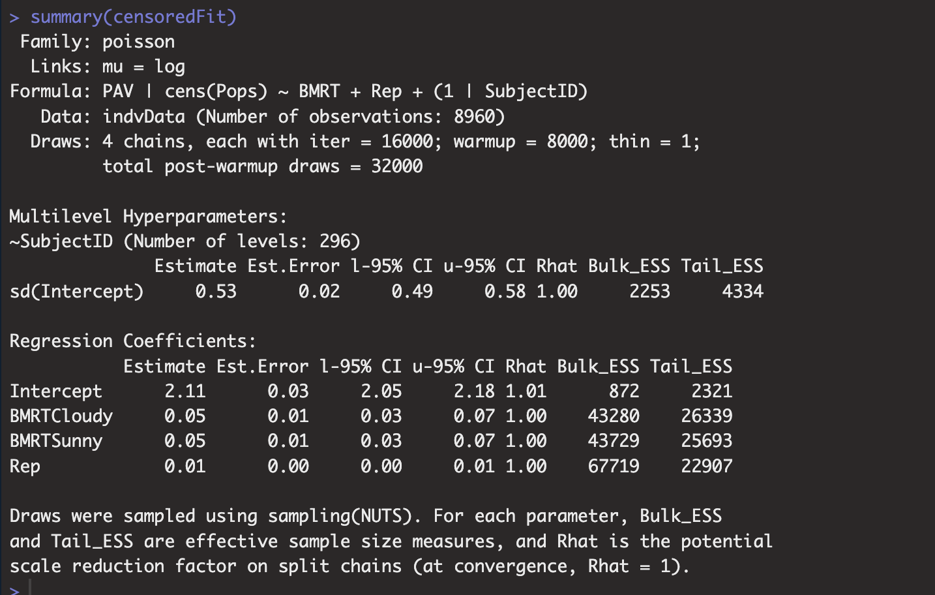
Convergence

Slide 11
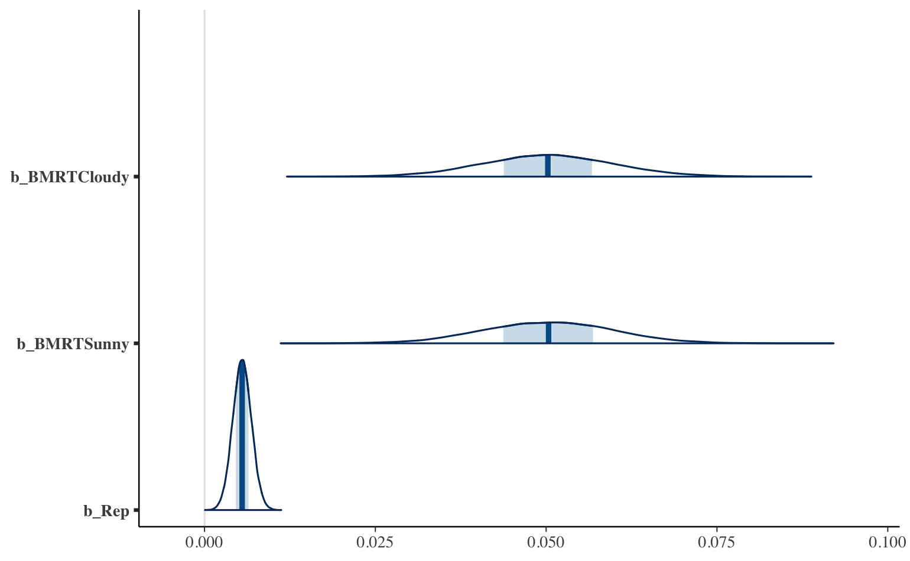
Posterior Distributions

Slide 12
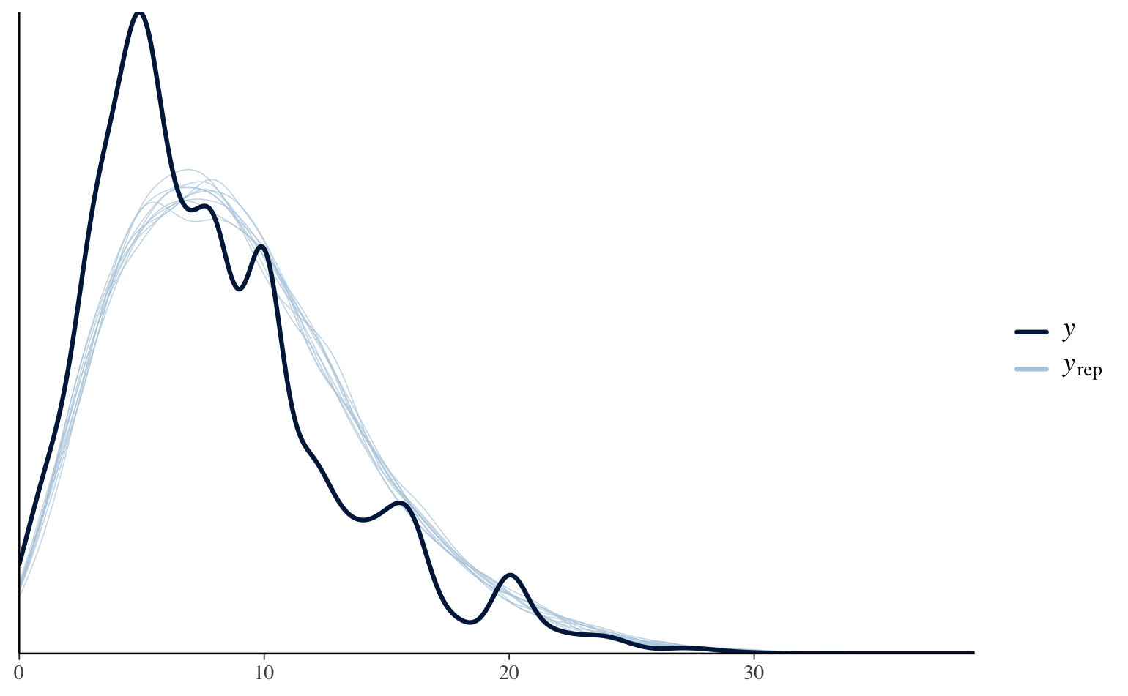
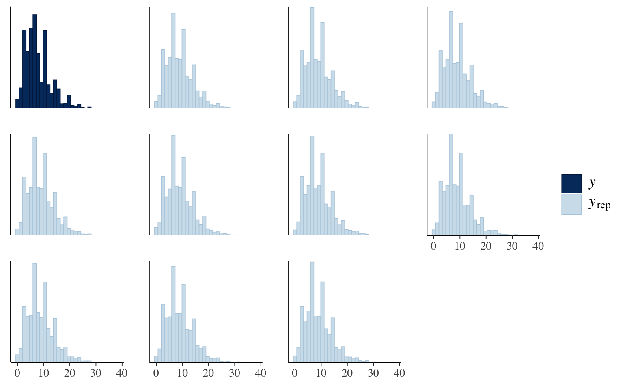
Fit of Model

Slide 13
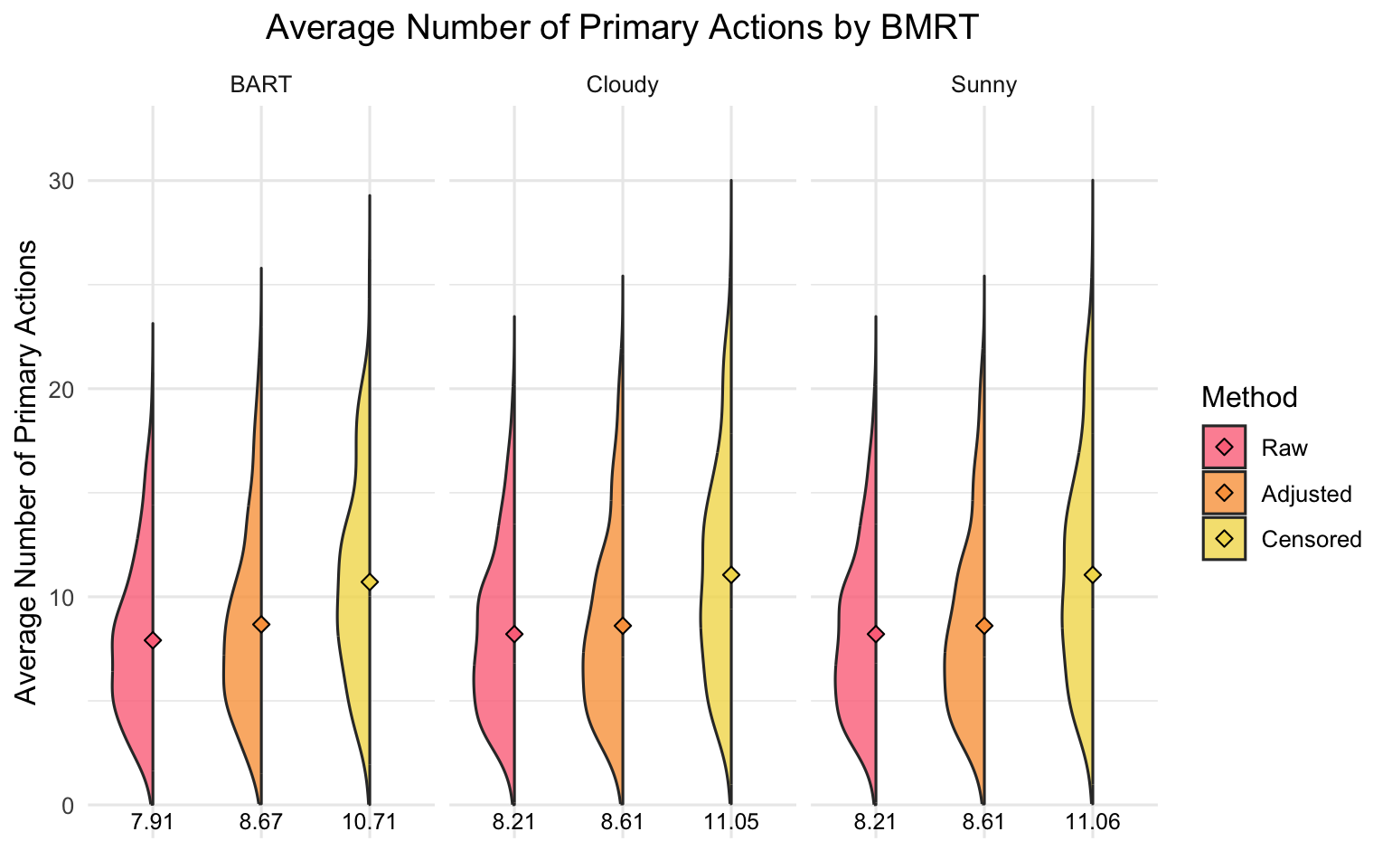

Slide 14
Correlation with External Measures
 | Raw Values | Adjusted Values | Censored Values
DOSPERT | 0.06 | 0.05 | 0.09
BNT | 0.16 | 0.20 | 0.20
SNS | 0.11 | 0.15 | 0.14
AOT | 0.12 | 0.15 | 0.14
Notes:
All 3 methods had a correlation above 0.90 with each other.

Slide 15
Takeaways
Accounting for censoring using a Bayesian regression appears to show an increase in the PAV of BMRT
This increase is slightly better correlated with alternate measures of risk-taking
BMRT in general may be too noisy for practical use
Always have low correlations with other risk-taking measures and each other
Lots of iterations needed to get chains to converge
Censored method having highest average PAV’s suggests even if non-censored rounds are used participant data is still being artificially shortened (risk-taking not accurately assessed)

Slide 16
Limitations and Future Directions
Modeling censored data could be improved with more informative priors
Also could function better in BMRT which have round and subject level parameters
In this study we aimed to model three BMRT per participants leading to high correlations between PAV responses across BMRT
Modeling may function better with only one BMRT at a time
Results should be compared to versions of BMRT where participants data is not censored to compare true predictive potential

Slide 17
References
Brailovskaia, J., Schillack, H., Assion, H.-J., Horn, H., & Margraf, J. (2018). Risk-taking propensity and (un)healthy behavior in Germany. Drug and Alcohol Dependence, 192, 324–328. https://doi.org/10.1016/j.drugalcdep.2018.08.027
Congdon, E., Bato, A., Schonberg, T., Mumford, J., Karlsgodt, K., Sabb, F., London, E., Cannon, T., Bilder, R., & Poldrack, R. (2013). Differences in neural activation as a function of risk-taking task parameters. Frontiers in Neuroscience, 7. https://www.frontiersin.org/articles/10.3389/fnins.2013.00173
Courtney, K. E., Arellano, R., Barkley-Levenson, E., Gálvan, A., Poldrack, R. A., MacKillop, J., David Jentsch, J., & Ray, L. A. (2012). The Relationship Between Measures of Impulsivity and Alcohol Misuse: An Integrative Structural Equation Modeling Approach. Alcoholism: Clinical and Experimental Research, 36(6), 923–931. https://doi.org/10.1111/j.1530-0277.2011.01635.x
Dahne, J., Richards, J. M., Ernst, M., MacPherson, L., & Lejuez, C. W. (2013). Assessment of Risk Taking in Addiction Research. In The Wiley-Blackwell Handbook of Addiction Psychopharmacology (pp. 209–231). John Wiley & Sons, Ltd. https://doi.org/10.1002/9781118384404.ch8
Lejuez, C. W., Read, J. P., Kahler, C. W., Richards, J. B., Ramsey, S. E., Stuart, G. L., Strong, D. R., & Brown, R. A. (2002). Evaluation of a behavioral measure of risk taking: The Balloon Analogue Risk Task (BART). Journal of Experimental Psychology: Applied, 8, 75–84. https://doi.org/10.1037/1076-898X.8.2.75
Lejuez, C. W., Aklin, W. M., Jones, H. A., Richards, J. B., Strong, D. R., Kahler, C. W., & Read, J. P. (20030210). The balloon analogue risk task (BART) differentiates smokers and nonsmokers. Experimental and Clinical Psychopharmacology, 11(1), 26. https://doi.org/10.1037/1064-1297.11.1.26
Szrek, H., Chao, L.-W., Ramlagan, S., & Peltzer, K. (2012). Predicting (un)healthy behavior: A comparison of risk-taking propensity measures. Judgment and Decision Making, 7(6), 716–727.

