Slide 1
Mini-Mote
Final Design
Kevin Kayser
Thomas O’Neil
Jeremy Rowe
Steve Rizor
Clayton Wilson

Slide 2
Device
Universal Remote Controller
Simple Interface
Easy transitions to new devices

Slide 3
Users
Entertainment
Utilities
Toys

Slide 4
Main Concerns
Visual Inconsistencies
Buttons change too frequently
User had hard time backtracking

Slide 5
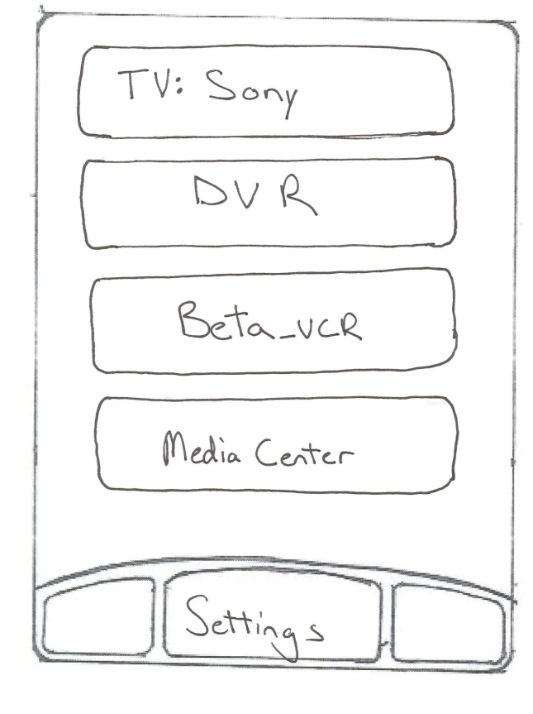
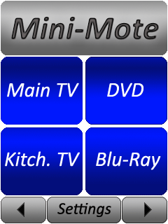
Visual Differences
Original Main Menu
Main Menu Revised

Slide 6
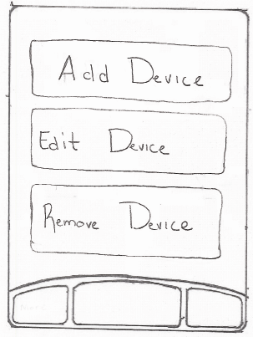
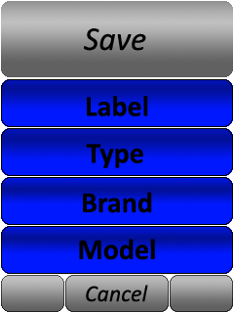
Visual Differences
Original Add/Edit Design
Adding/Editing Devices

Slide 7
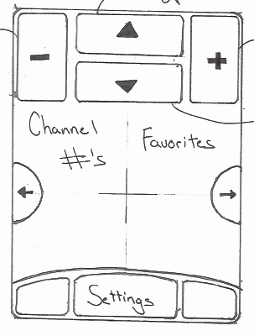
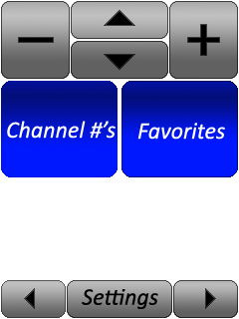
Visual Differences
Original TV Main
Revised TV Main

Slide 8
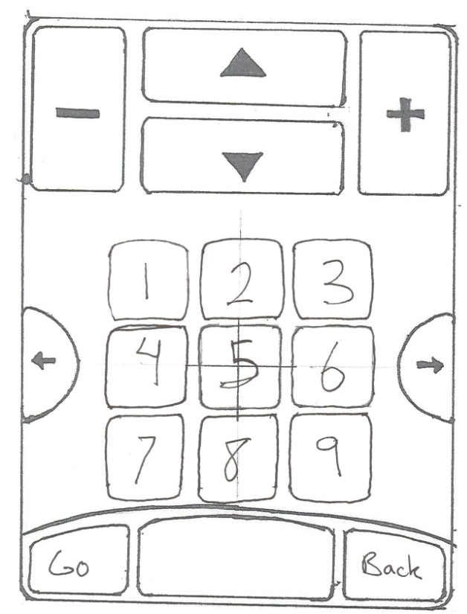
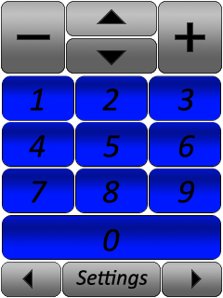
Visual Differences
Original Keypad
Revised Keypad

Slide 9
And for the demo…

