Slide 1
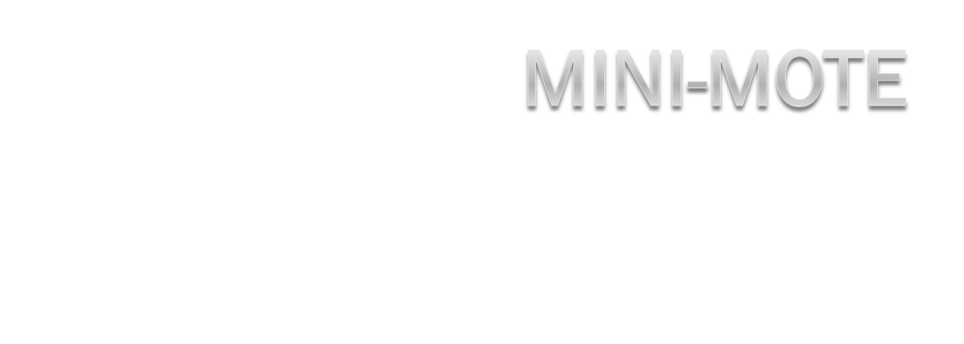
Universal Device Controller

Slide 2
System Goals
Simple Interface
Work with many devices
Easy transition between devices
Replace needs for multiple remote controllers

Slide 3
Users
Entertainment Enthusiasts
Totalitarianism Viewers
Simple Folk

Slide 4
Environment
Home Entertainment Systems
School or Office Functions
Presentation Control

Slide 5
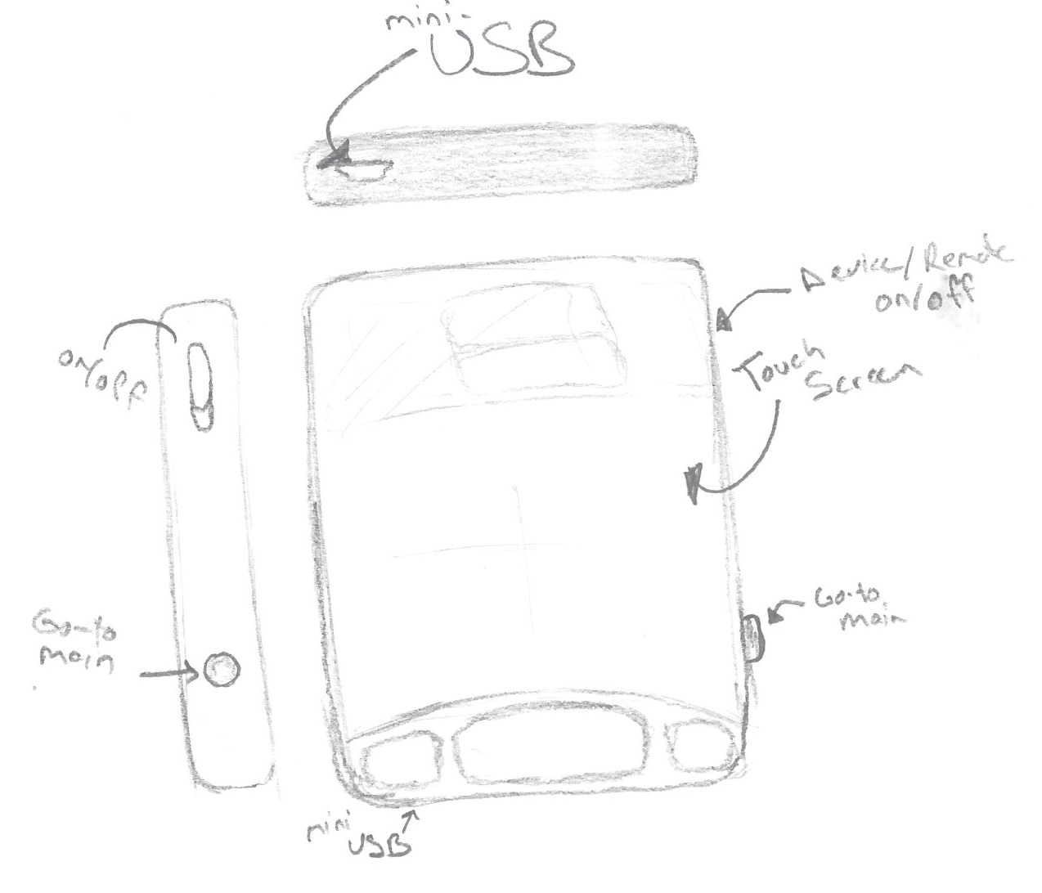
Mini-Mote

Slide 6
Object Interaction
Television
Home Stereo
DVD/VCR
Media Center PC/ DVR

Slide 7
Adding a Television
Power the TDA on
Select TV from the Main Menu
Press Settings on the touch screen

Slide 8
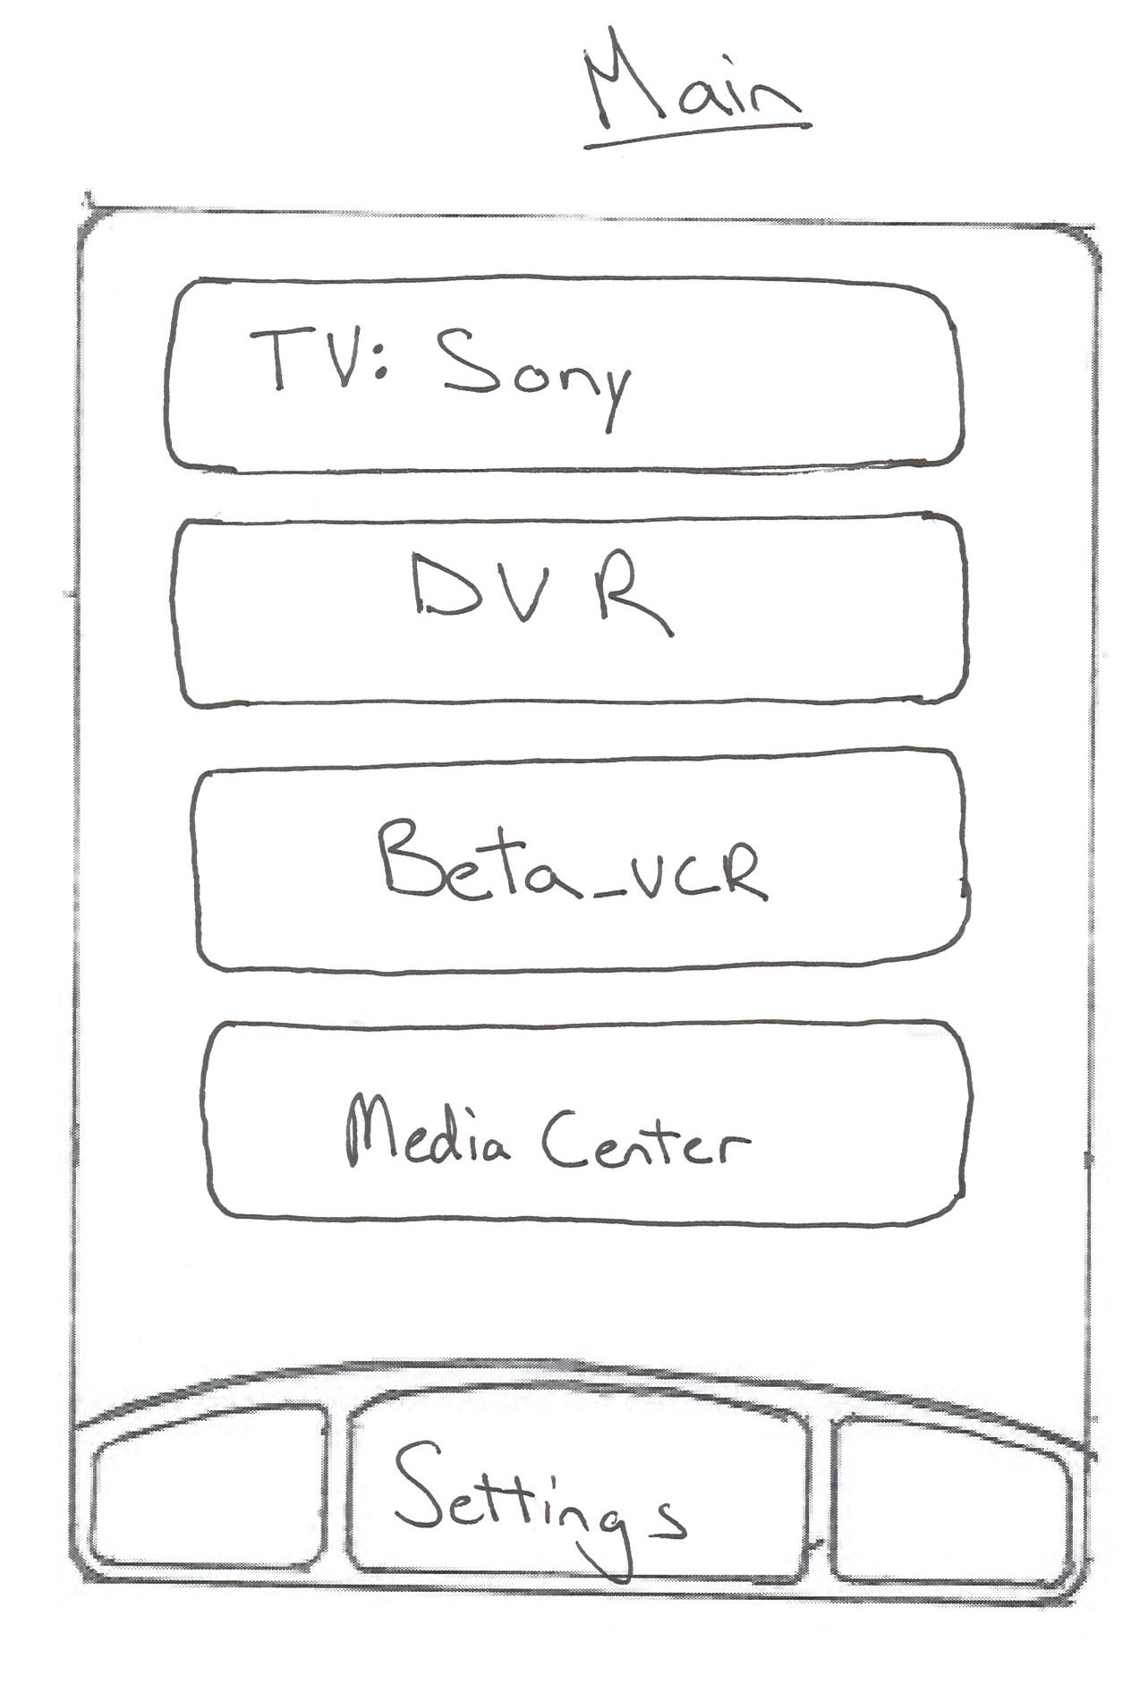
Walkthrough

Slide 9
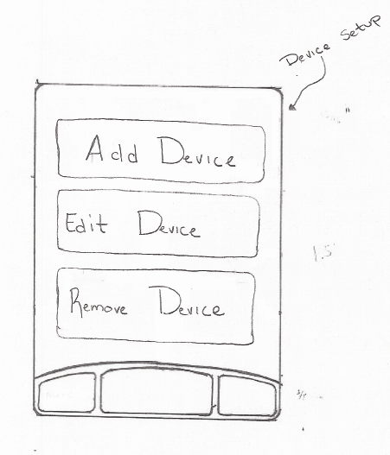

Slide 10
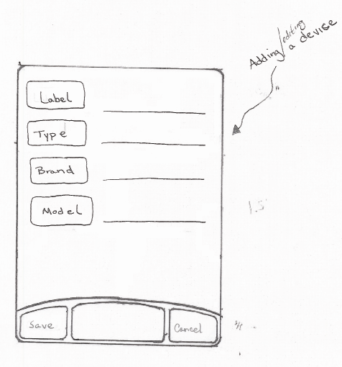

Slide 11
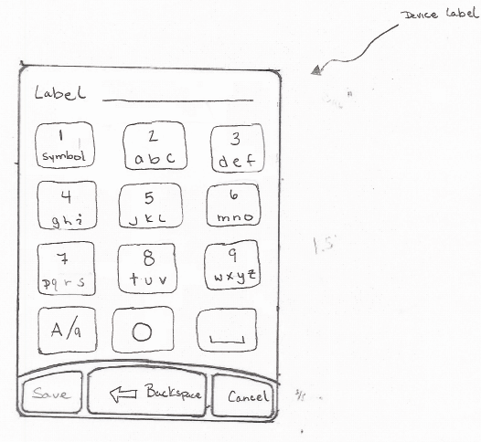

Slide 13
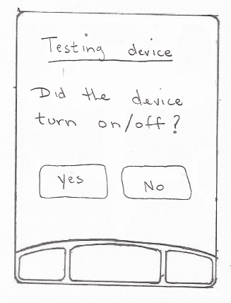

Slide 17
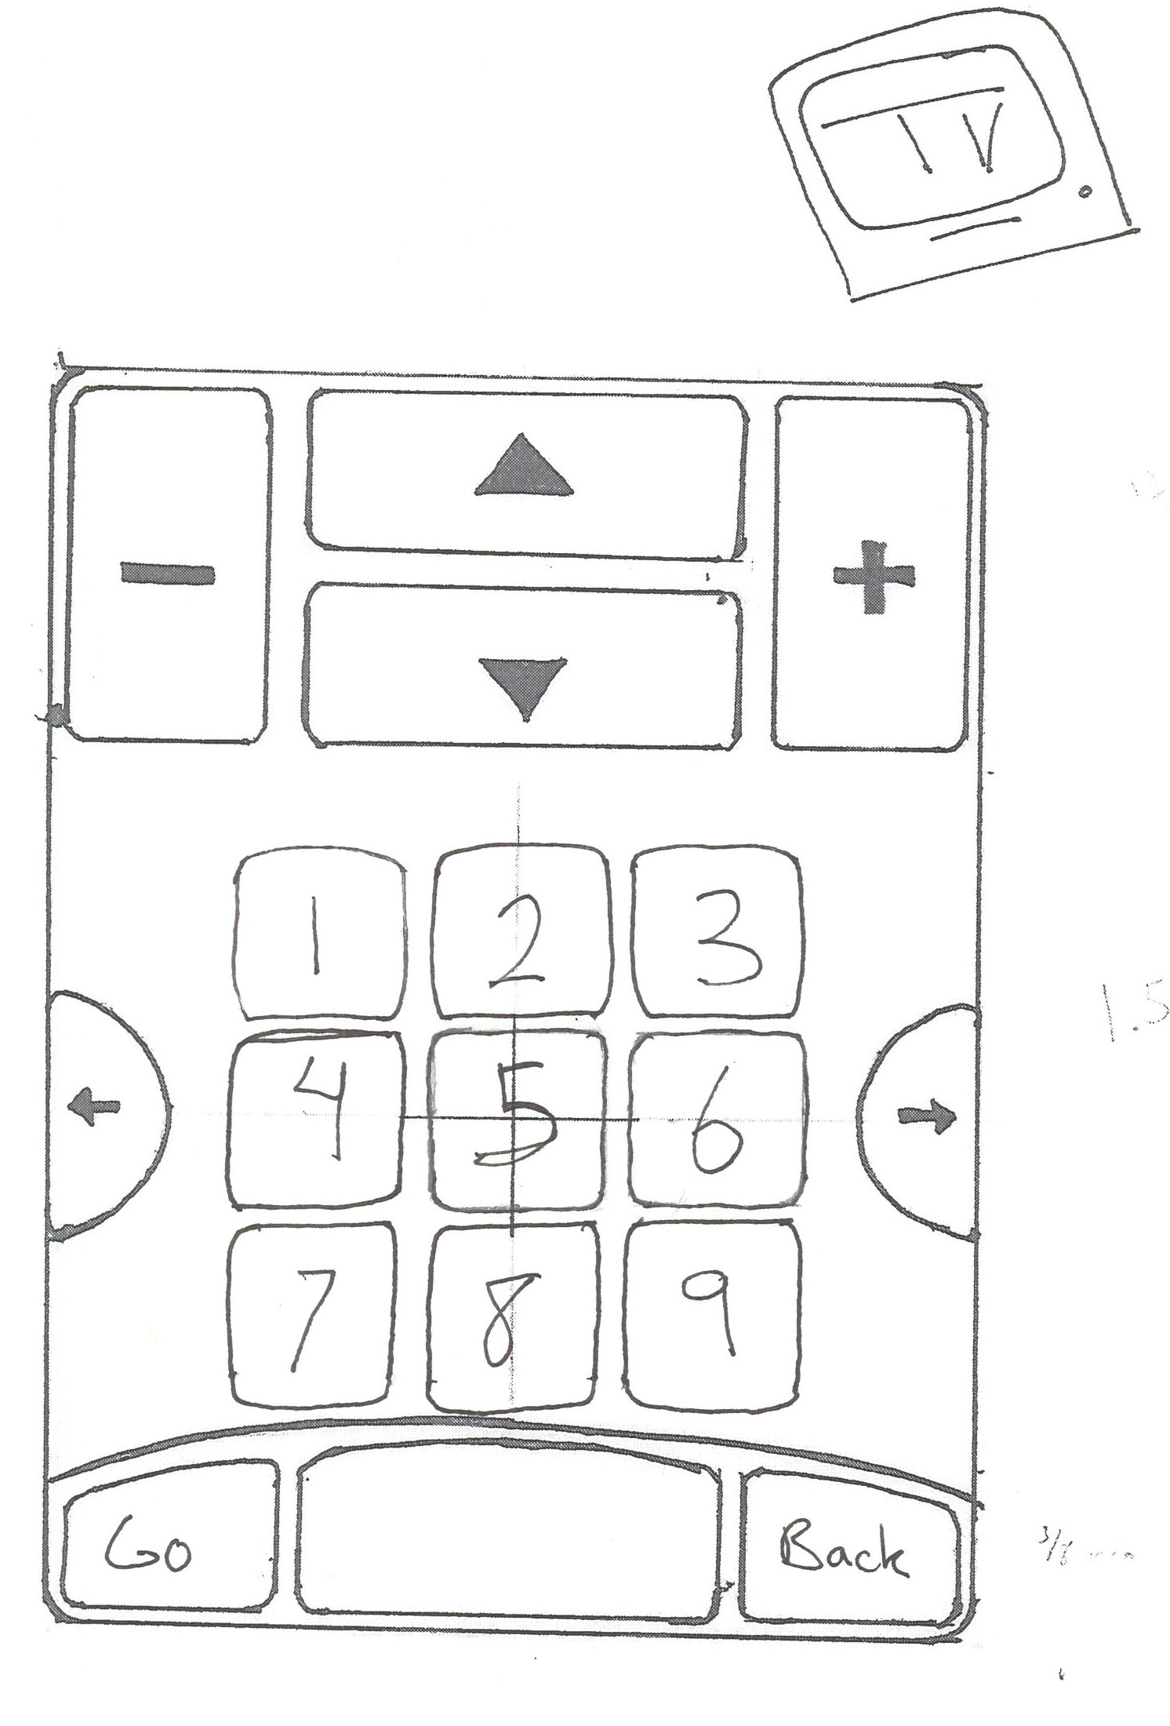

Slide 18
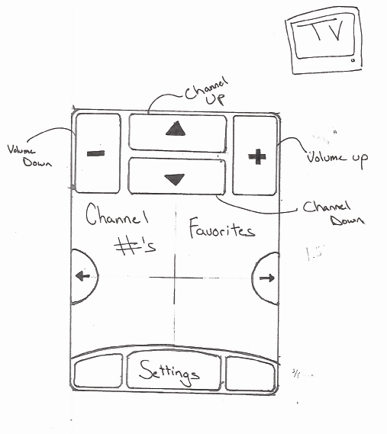

Slide 19
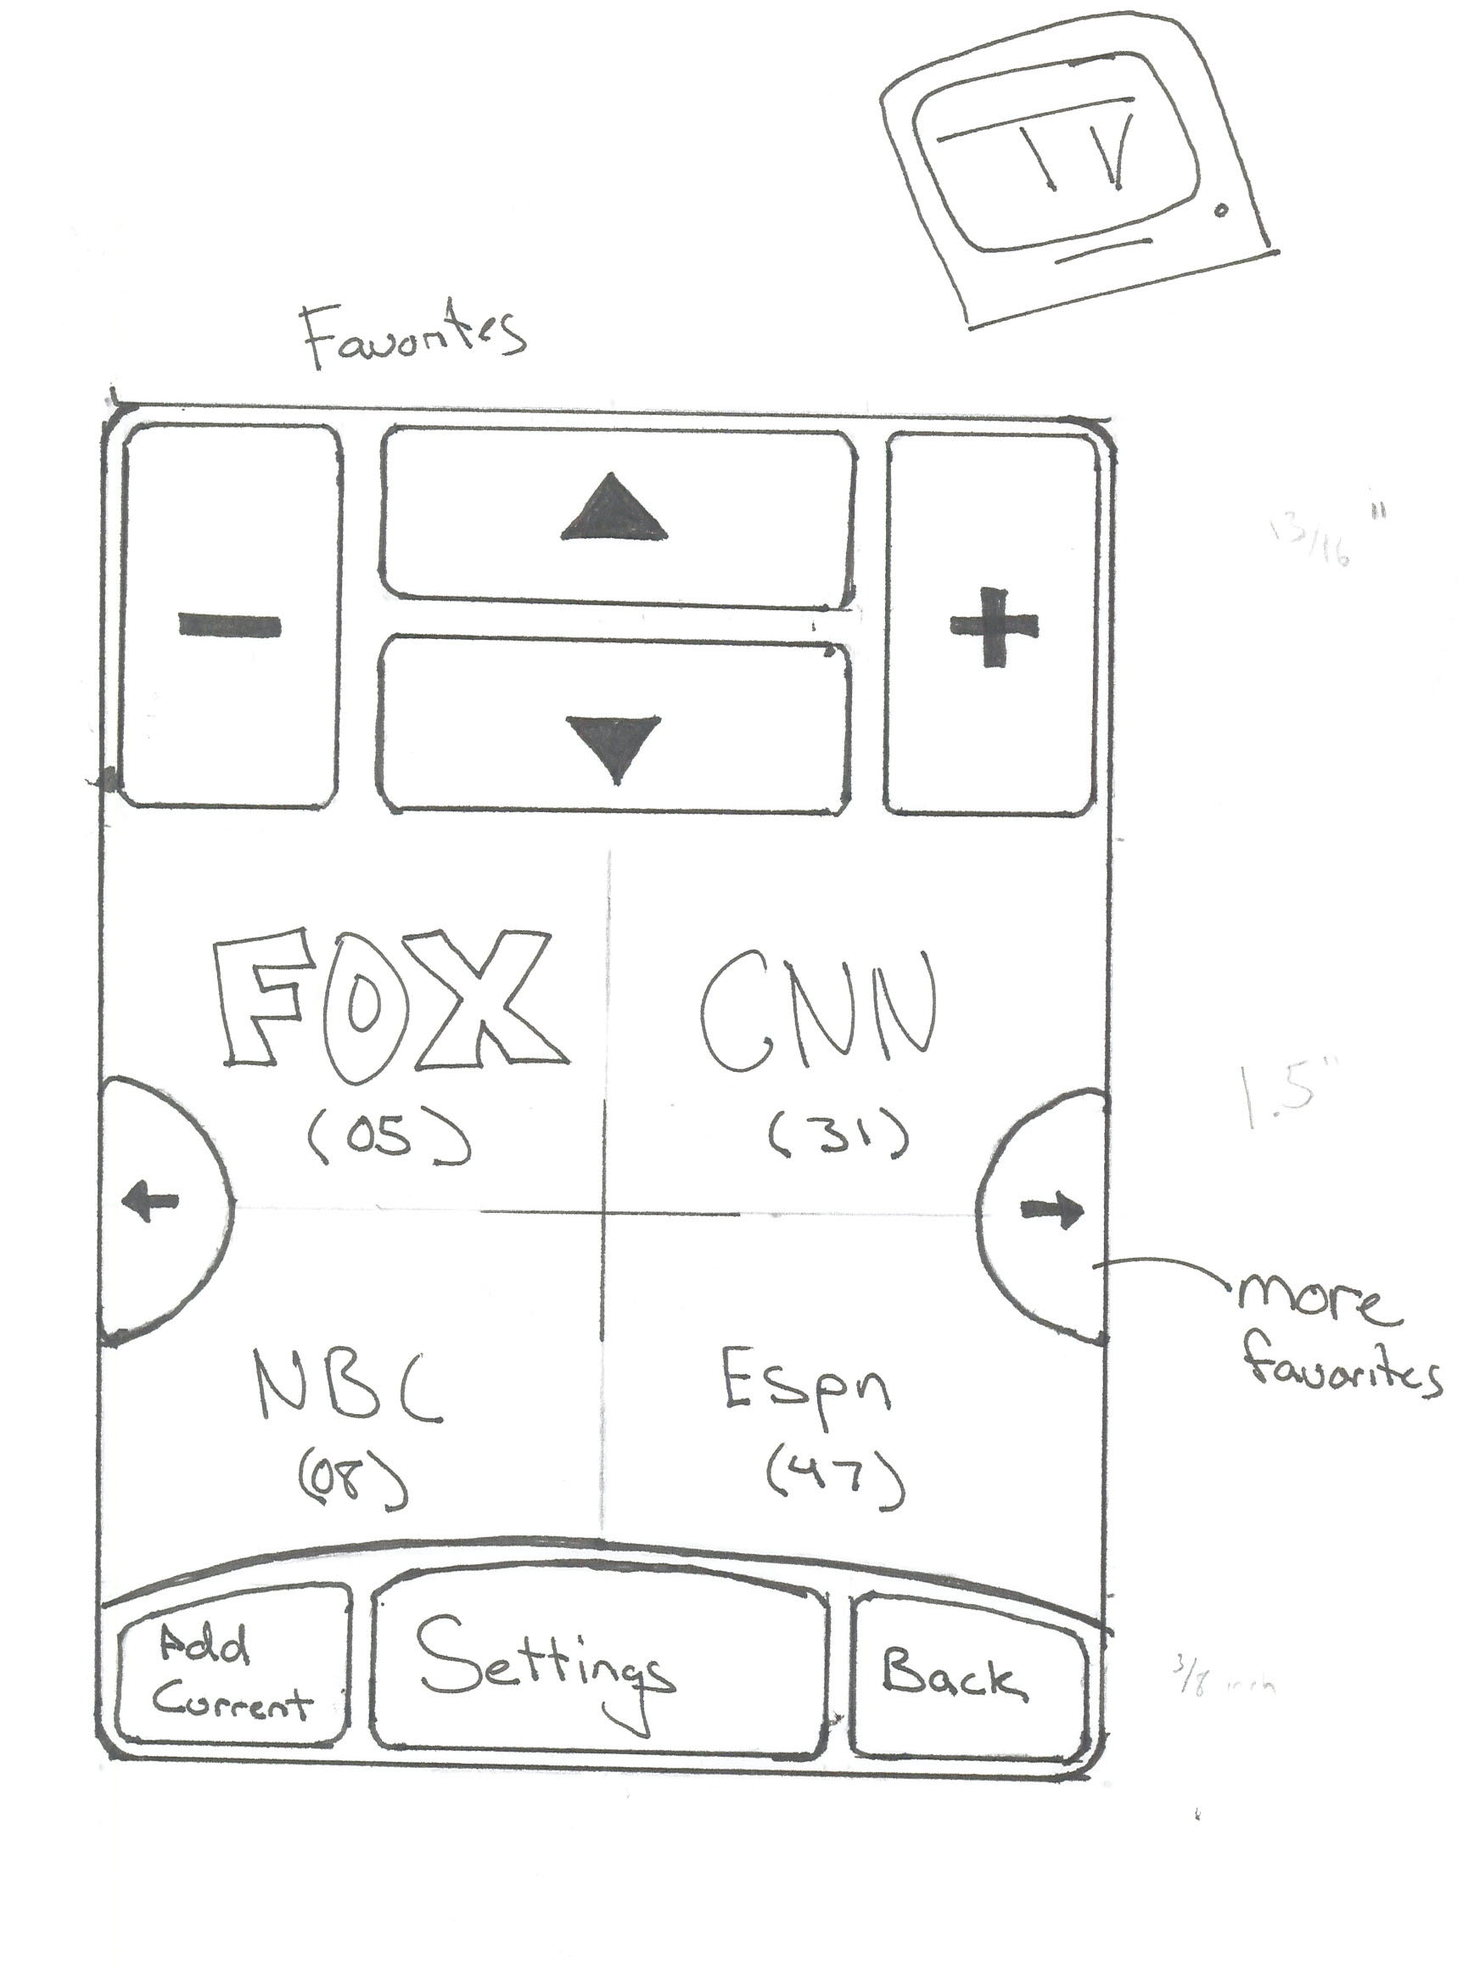

Slide 20
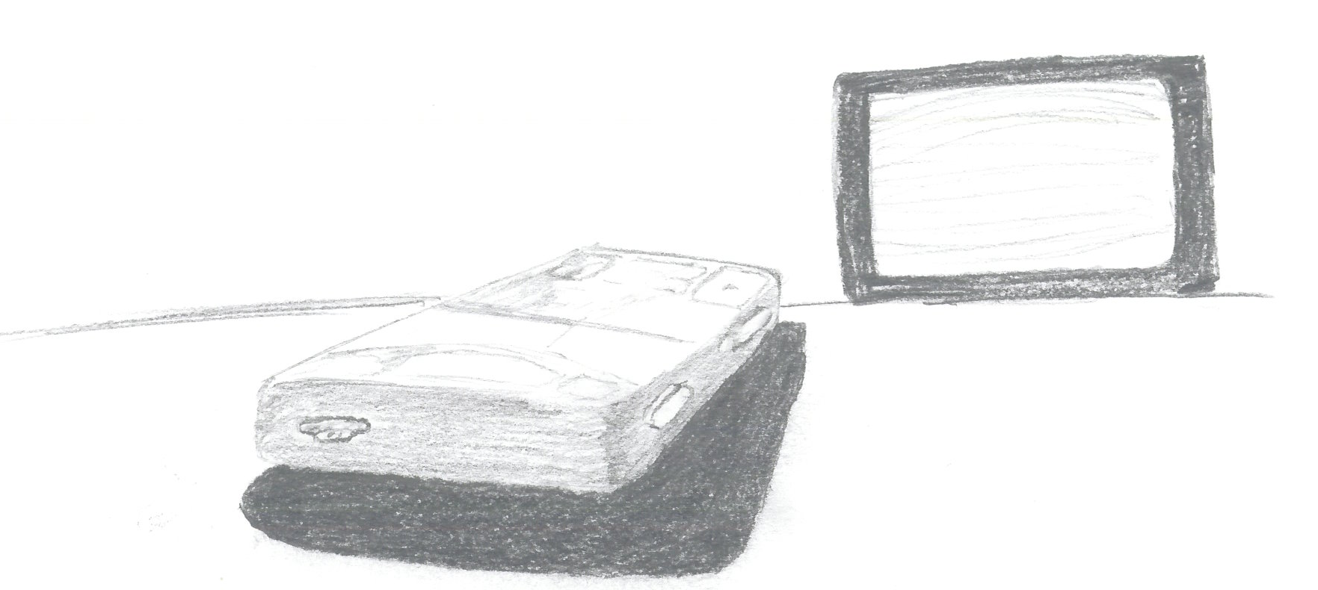
General Design

