Slide 1
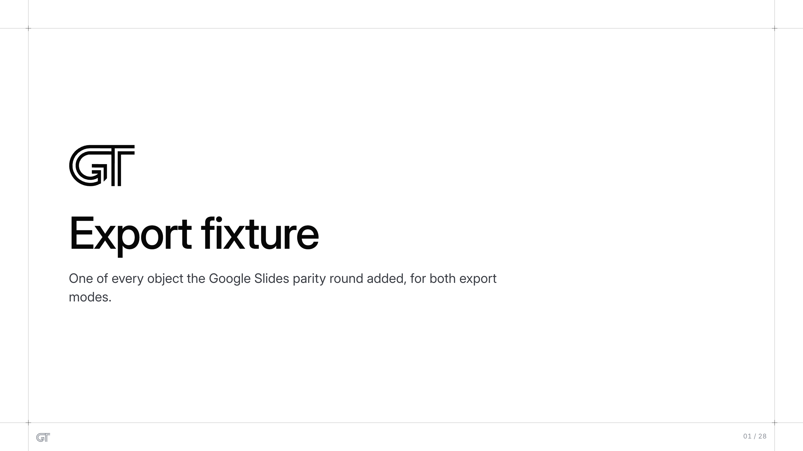
Export fixture
Export fixture
One of every object the Google Slides parity round added, for both export
modes.
01 / 28

Slide 2
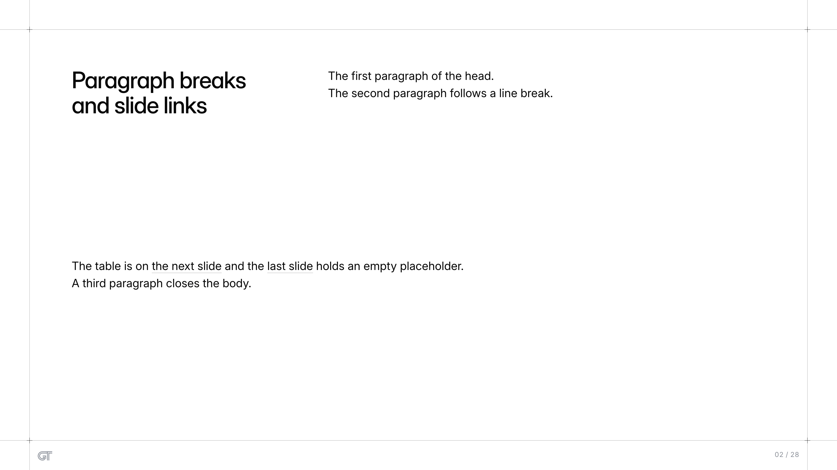
Paragraph breaks and slide links
The first paragraph of the head.
The second paragraph follows a line break.
Paragraph breaks
and slide links
The table is on the next slide and the last slide holds an empty placeholder.
A third paragraph closes the body.
02 / 28

Slide 3
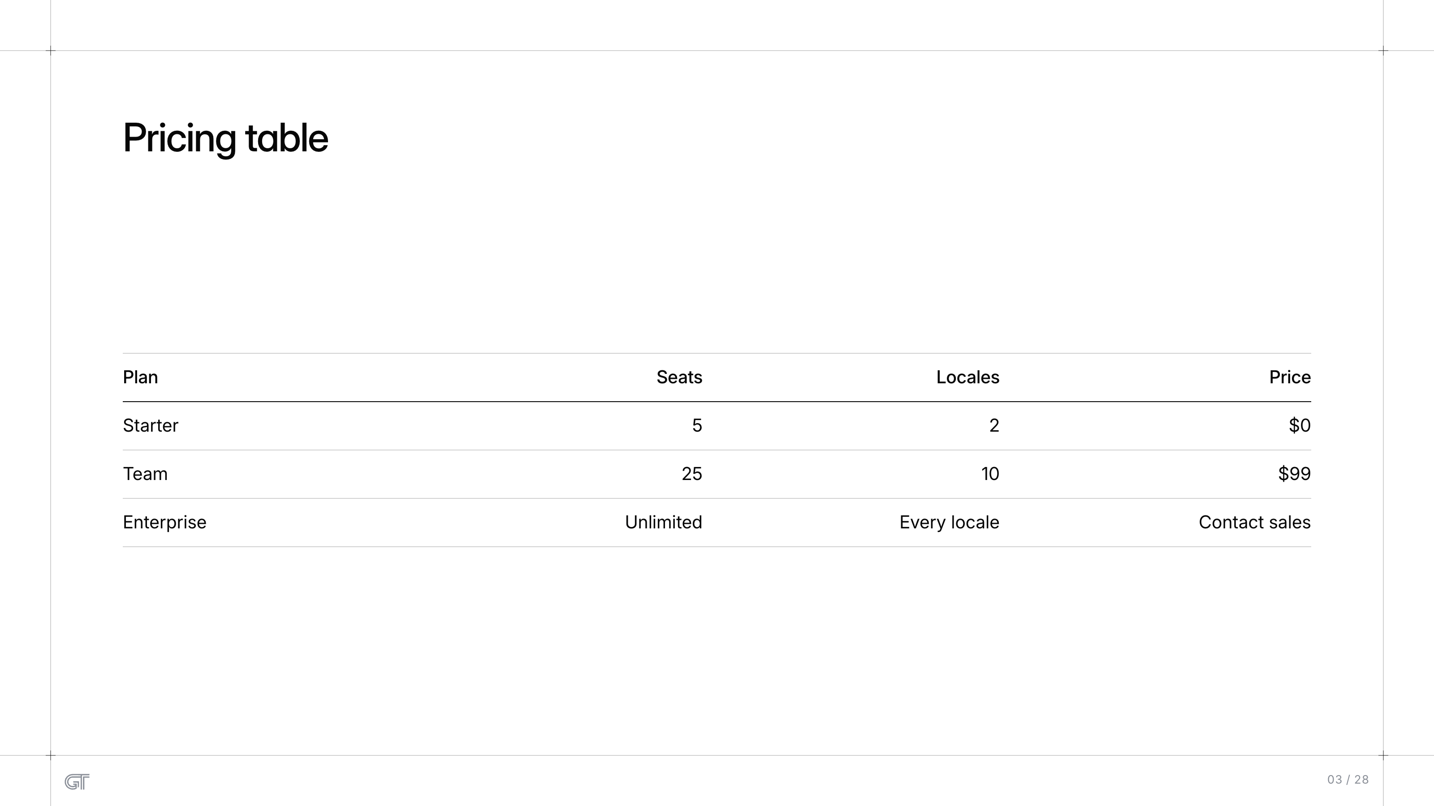
Pricing table
Pricing table
Plan
Seats
Locales
Price
Starter
5
2
$0
Team
25
10
$99
Enterprise
Unlimited
Every locale
Contact sales
03 / 28

Slide 4
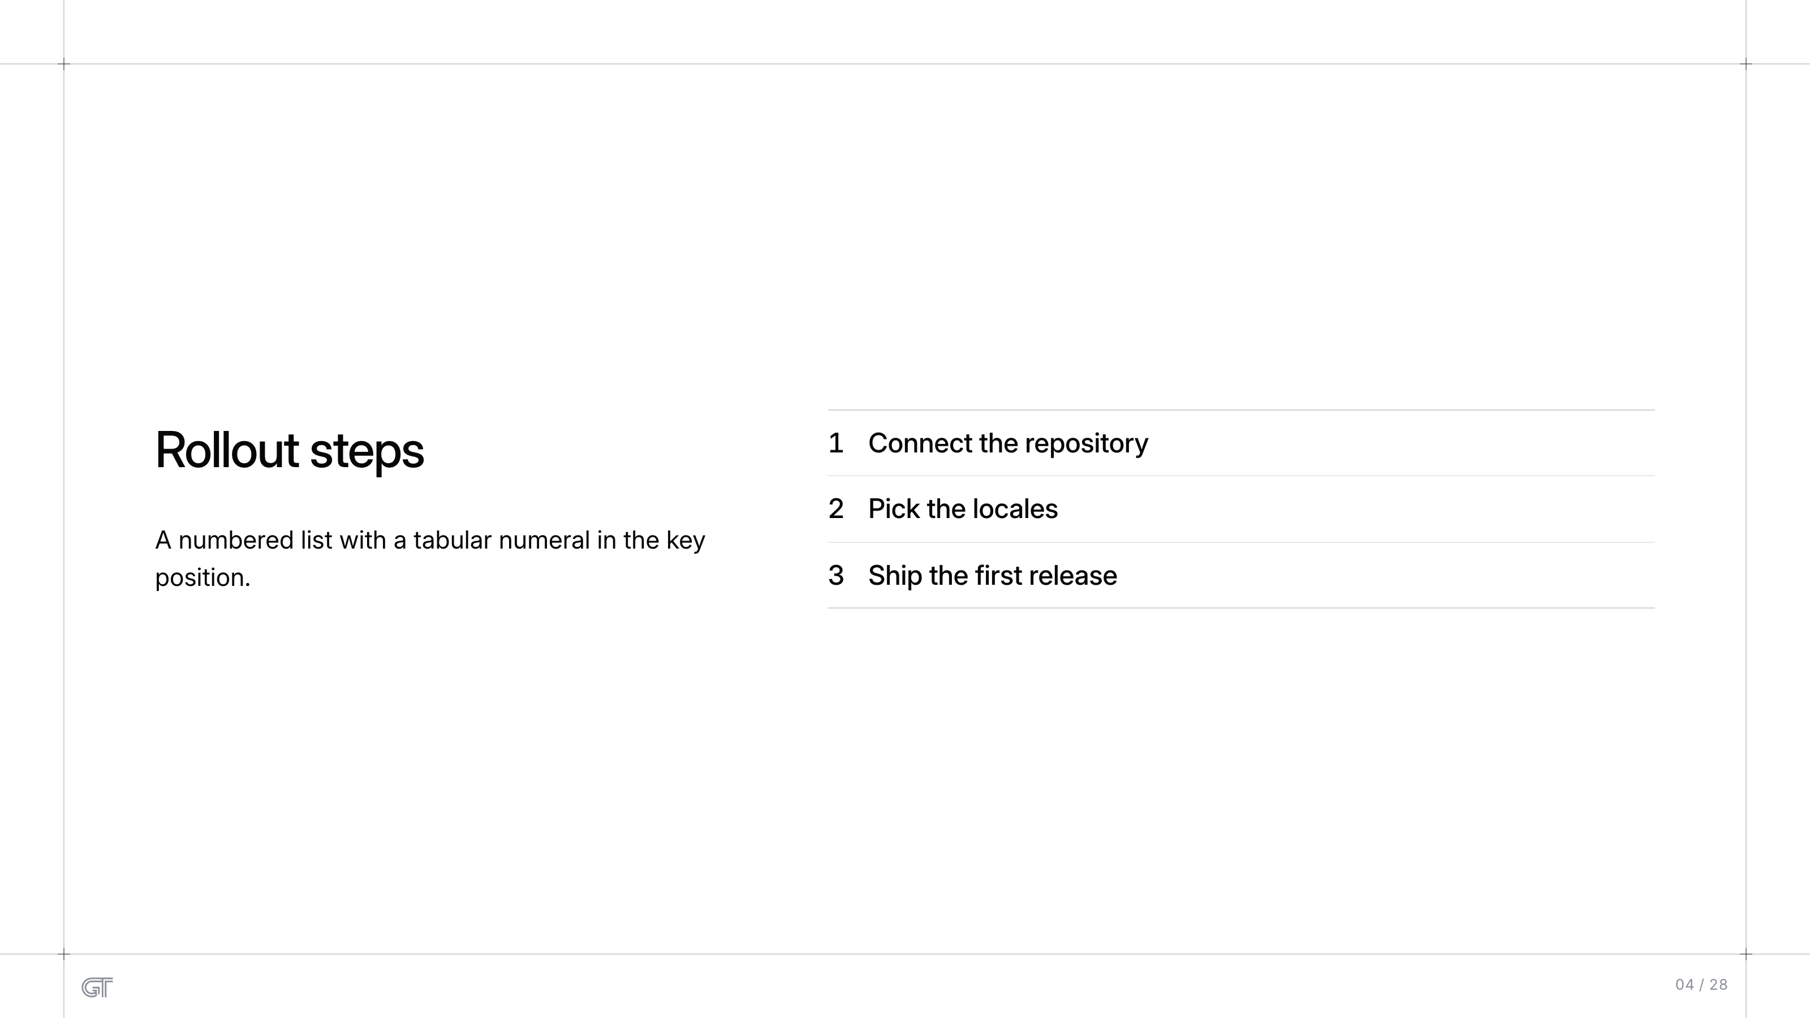
Rollout steps
1
Connect the repository
Rollout steps
2
Pick the locales
A numbered list with a tabular numeral in the key
position.
3
Ship the first release
04 / 28

Slide 5
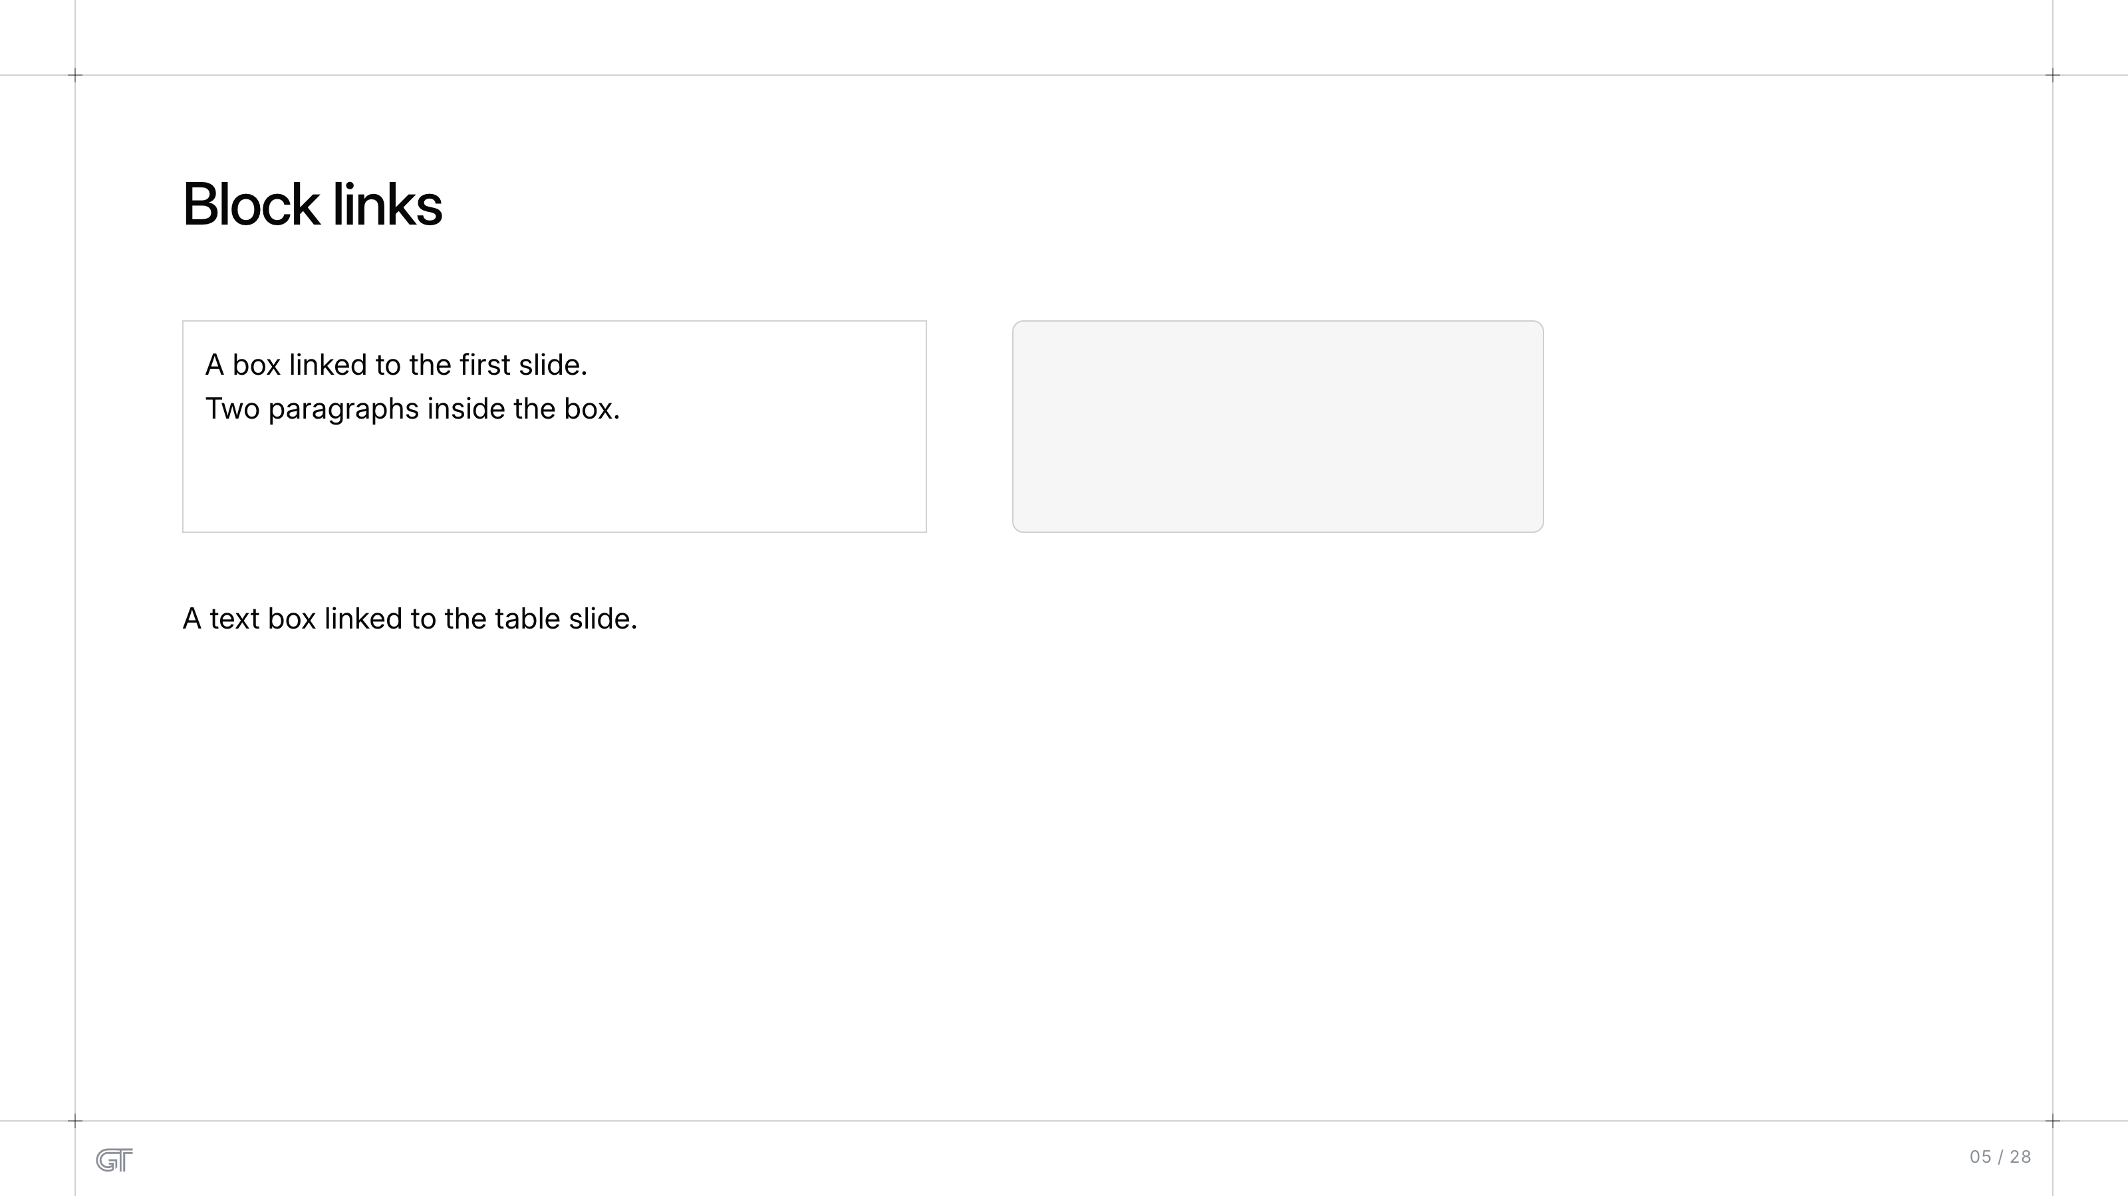
Block links
Block links
A box linked to the first slide.
Two paragraphs inside the box.
A text box linked to the table slide.
05 / 28

Slide 6

Slide 6
06 / 28

Slide 7
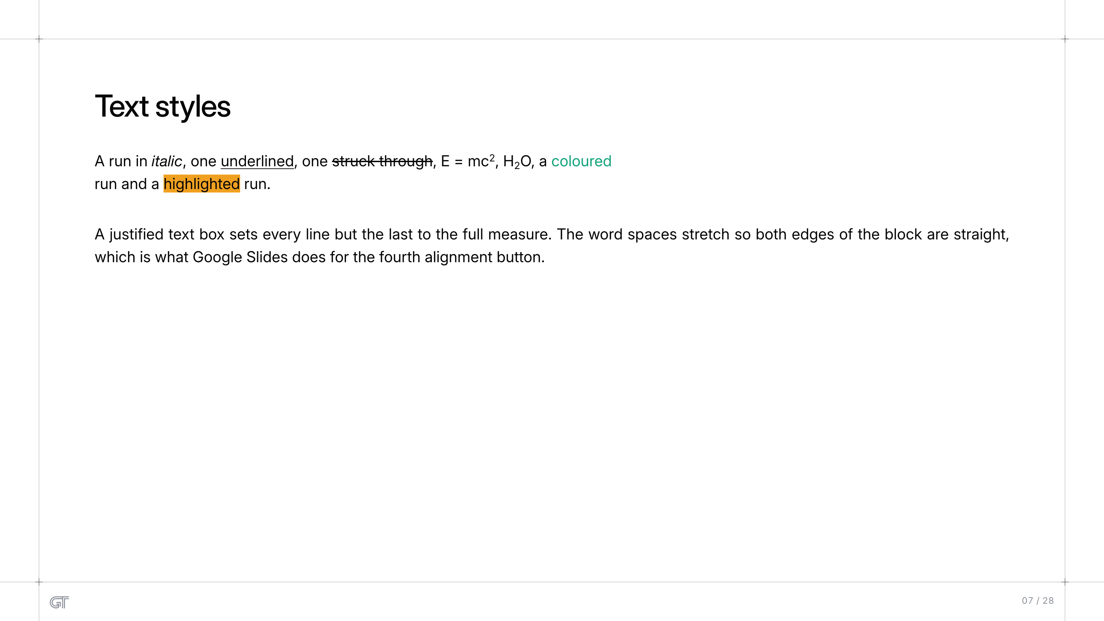
Text styles
Text styles
A run in italic, one underlined, one struck through, E = mc², H₂O, a coloured
run and a highlighted run.
A justified text box sets every line but the last to the full measure. The word spaces stretch so both edges of the block are straight,
which is what Google Slides does for the fourth alignment button.
07 / 28

Slide 8
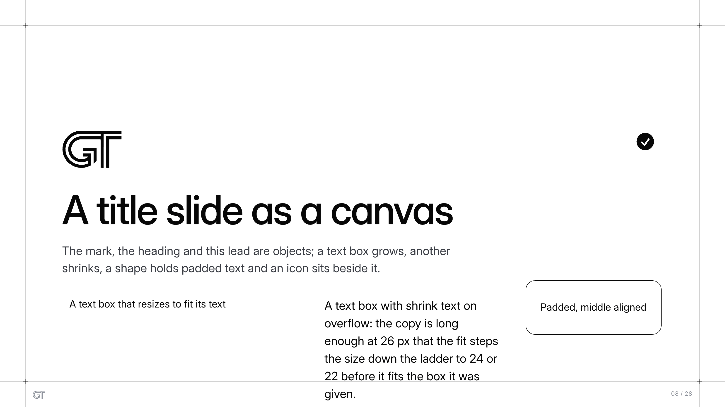
A title slide as a canvas
A title slide as a canvas
The mark, the heading and this lead are objects; a text box grows, another
shrinks, a shape holds padded text and an icon sits beside it.
A text box that resizes to fit its text
A text box with shrink text on
overflow: the copy is long
enough at 26 px that the fit steps
the size down the ladder to 24 or
22 before it fits the box it was
given.
Padded, middle aligned
08 / 28

Slide 9
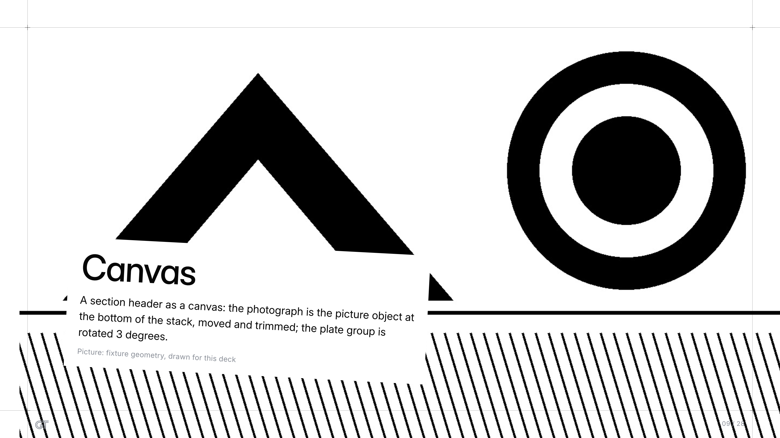
Canvas
Canvas
A section header as a canvas: the photograph is the picture object at
the bottom of the stack, moved and trimmed; the plate group is
rotated 3 degrees.
Picture: fixture geometry, drawn for this deck
09 / 28

Slide 10
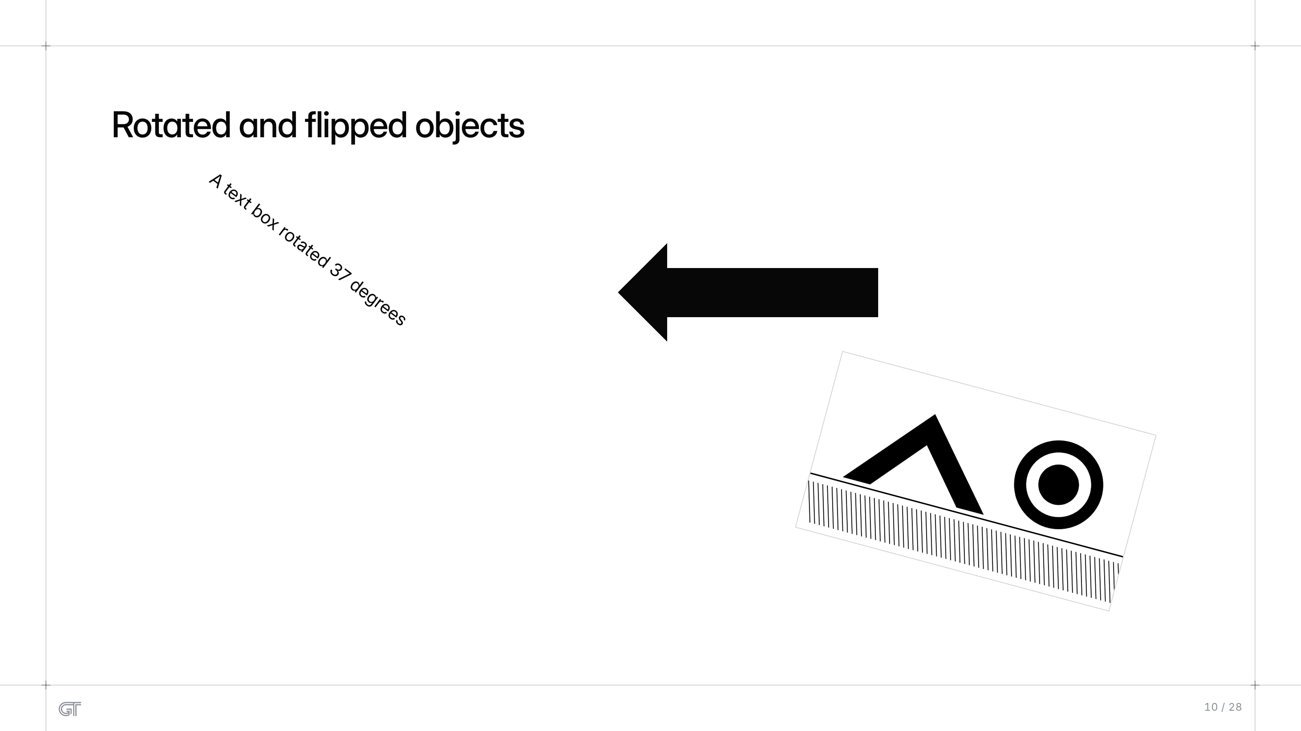
Rotated and flipped objects
Rotated and flipped objects
A text box rotated 37 degrees
10 / 28

Slide 11
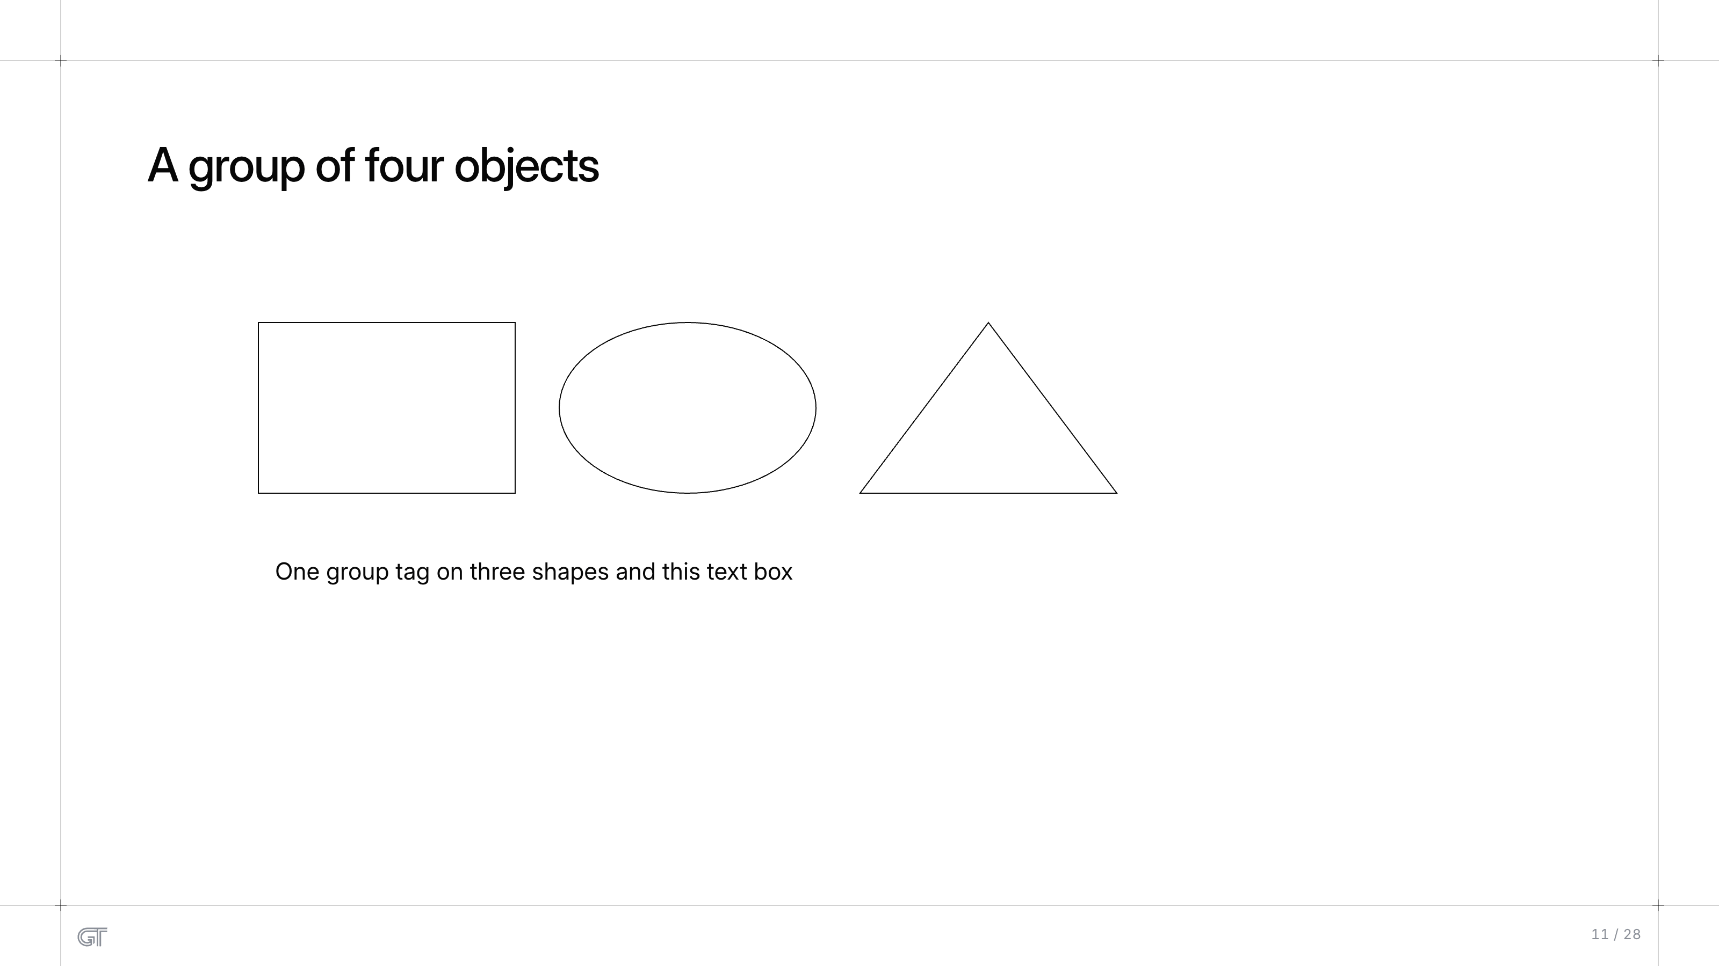
A group of four objects
A group of four objects
One group tag on three shapes and this text box
11 / 28

Slide 12
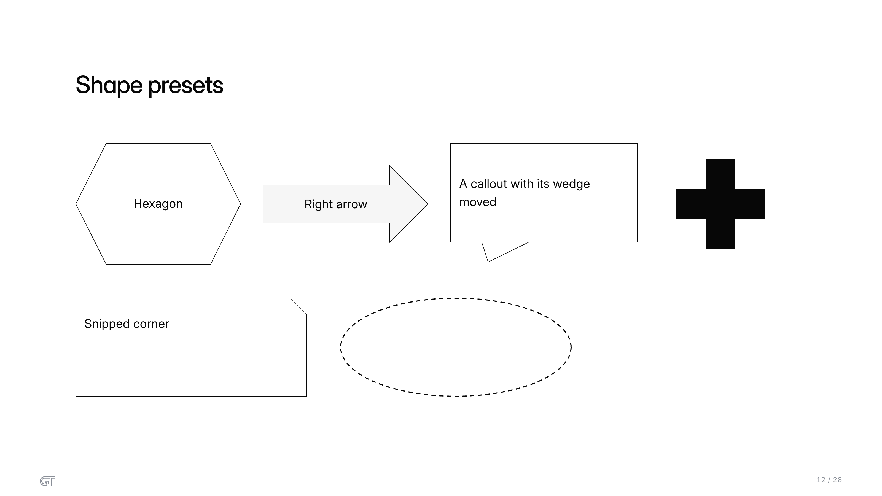
Shape presets
Shape presets
A callout with its wedge
moved
Hexagon
Right arrow
Snipped corner
12 / 28

Slide 13
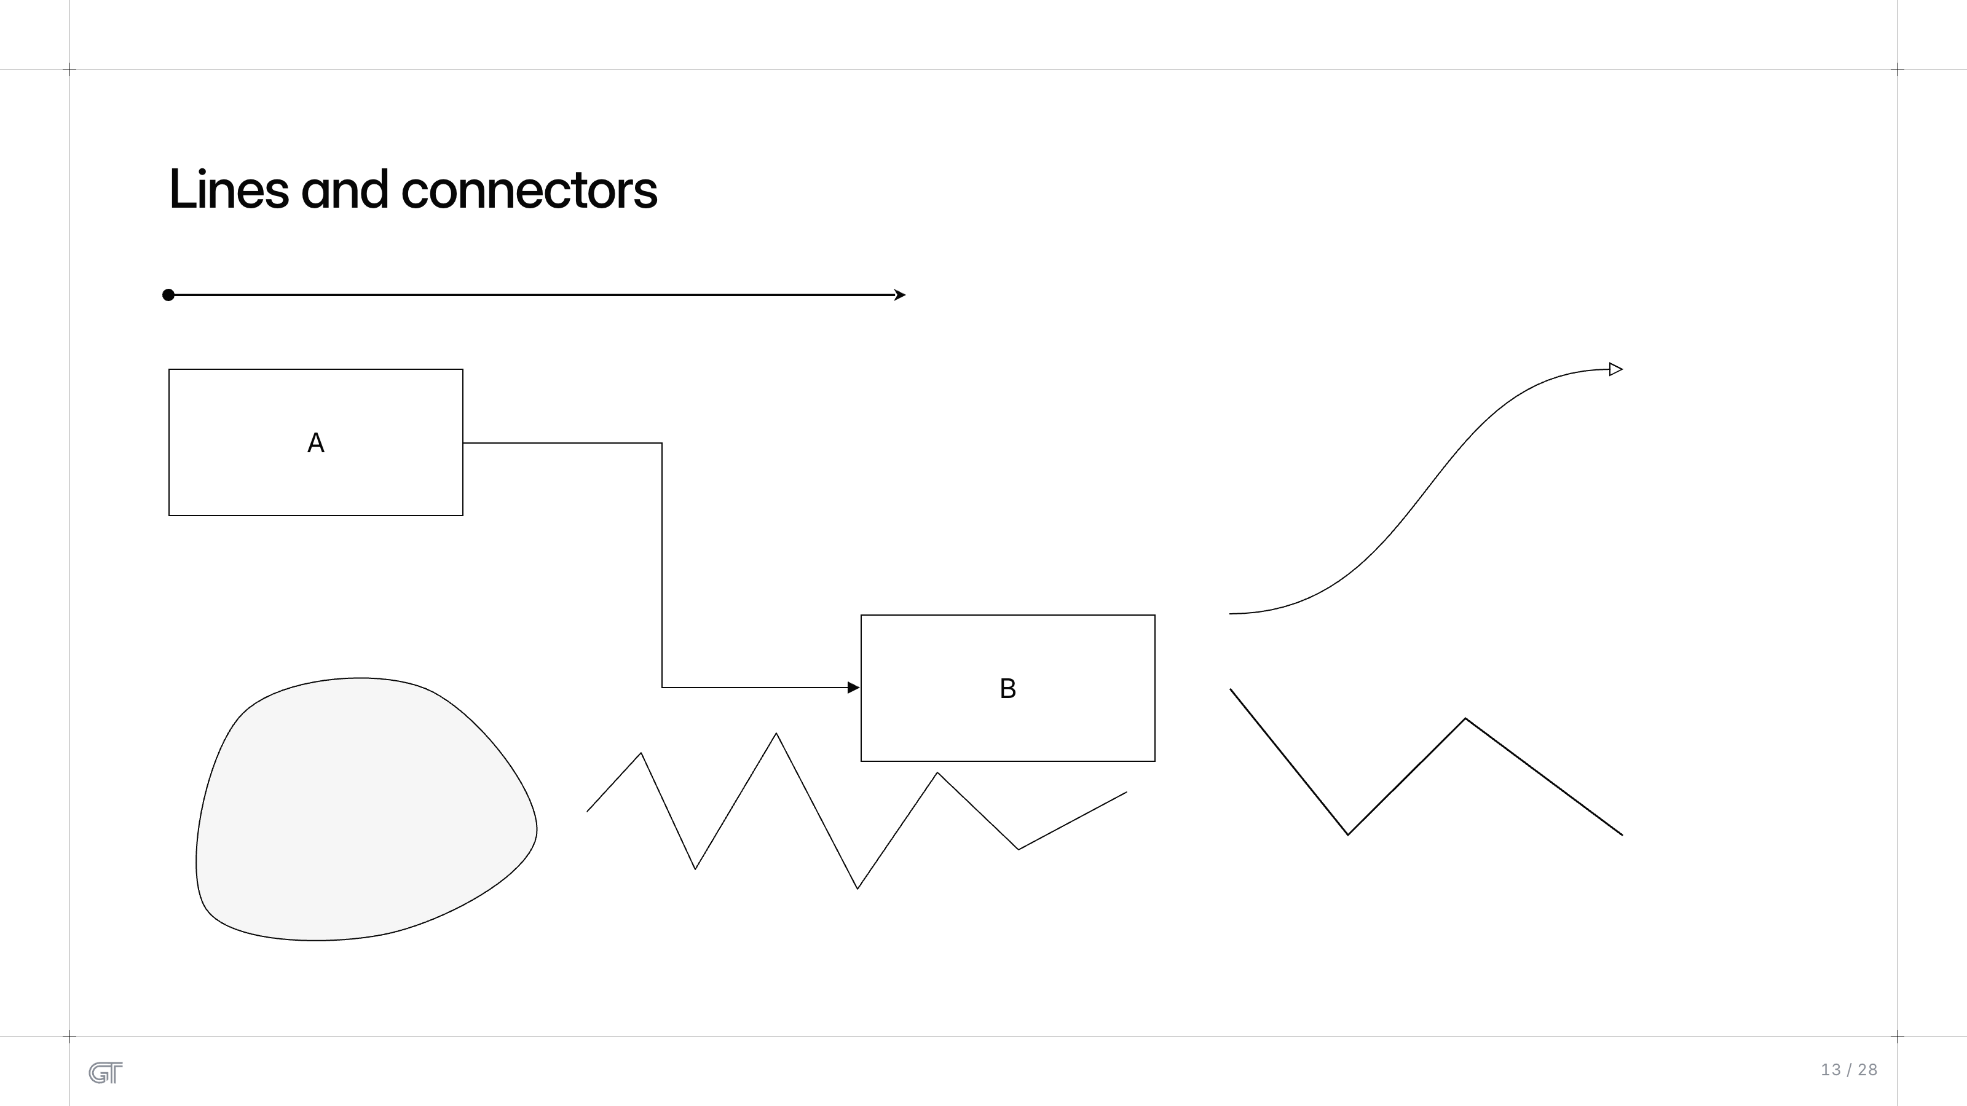
Lines and connectors
Lines and connectors
A
B
13 / 28

Slide 14
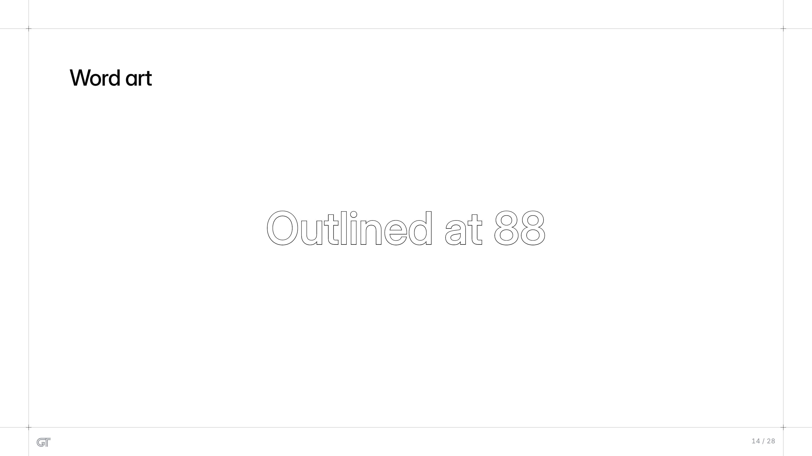
Word art
Word art
Outlined at 88
14 / 28

Slide 15
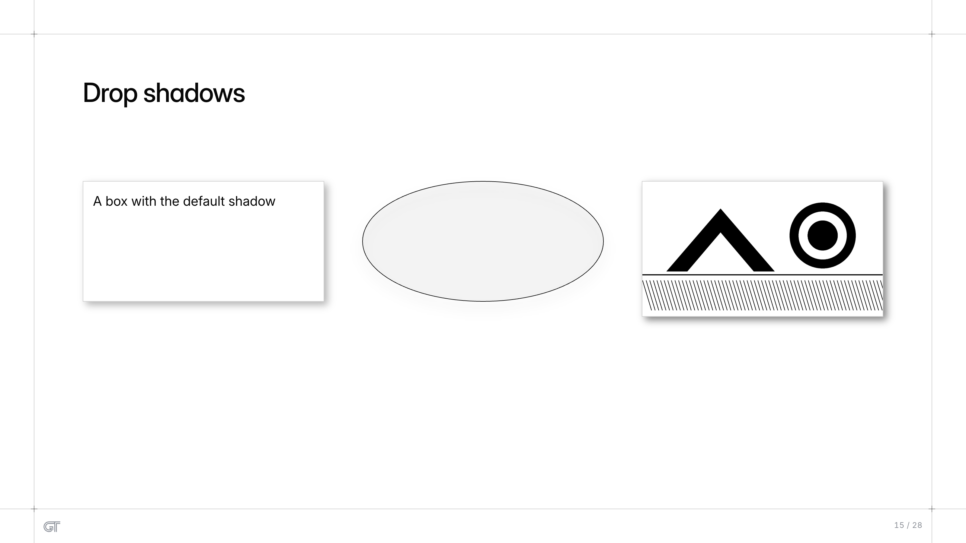
Drop shadows
Drop shadows
A box with the default shadow
15 / 28

Slide 16
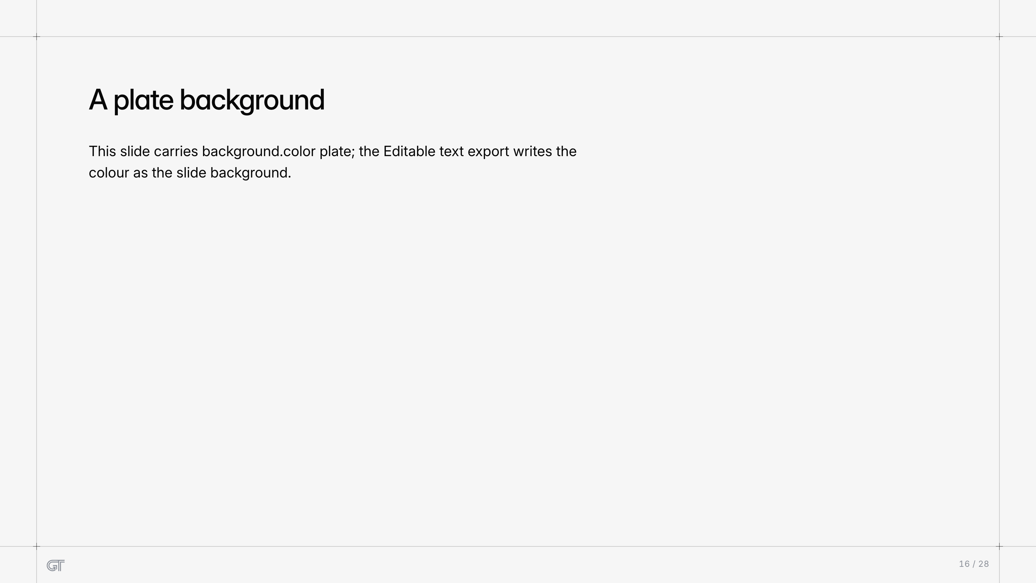
A plate background
A plate background
This slide carries background.color plate; the Editable text export writes the
colour as the slide background.
16 / 28

Slide 17
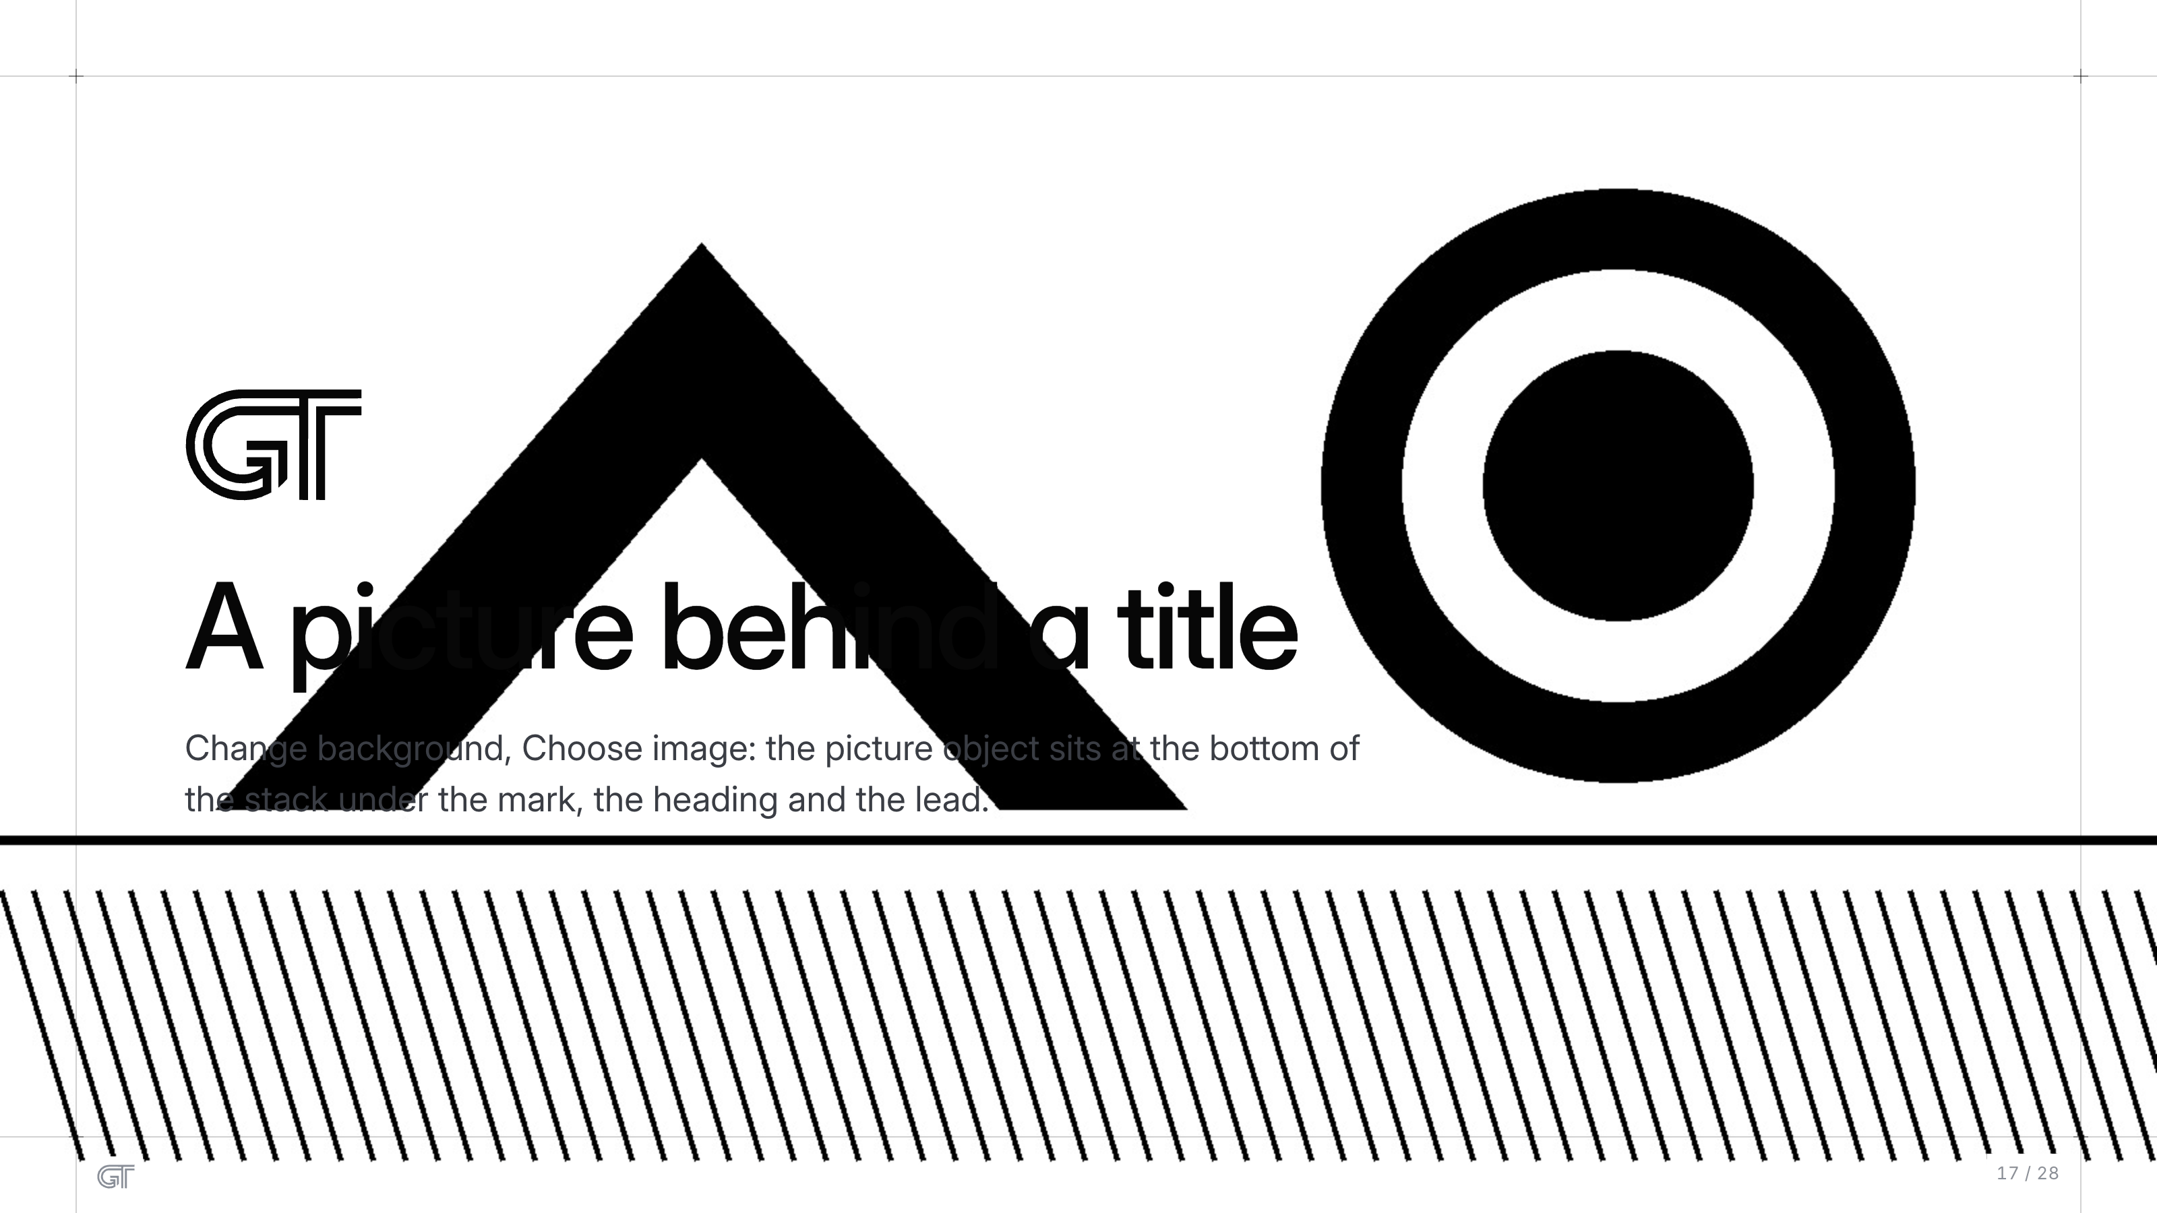
A picture behind a title
A picture behind a title
Change background, Choose image: the picture object sits at the bottom of
the stack under the mark, the heading and the lead.
17 / 28

Slide 18
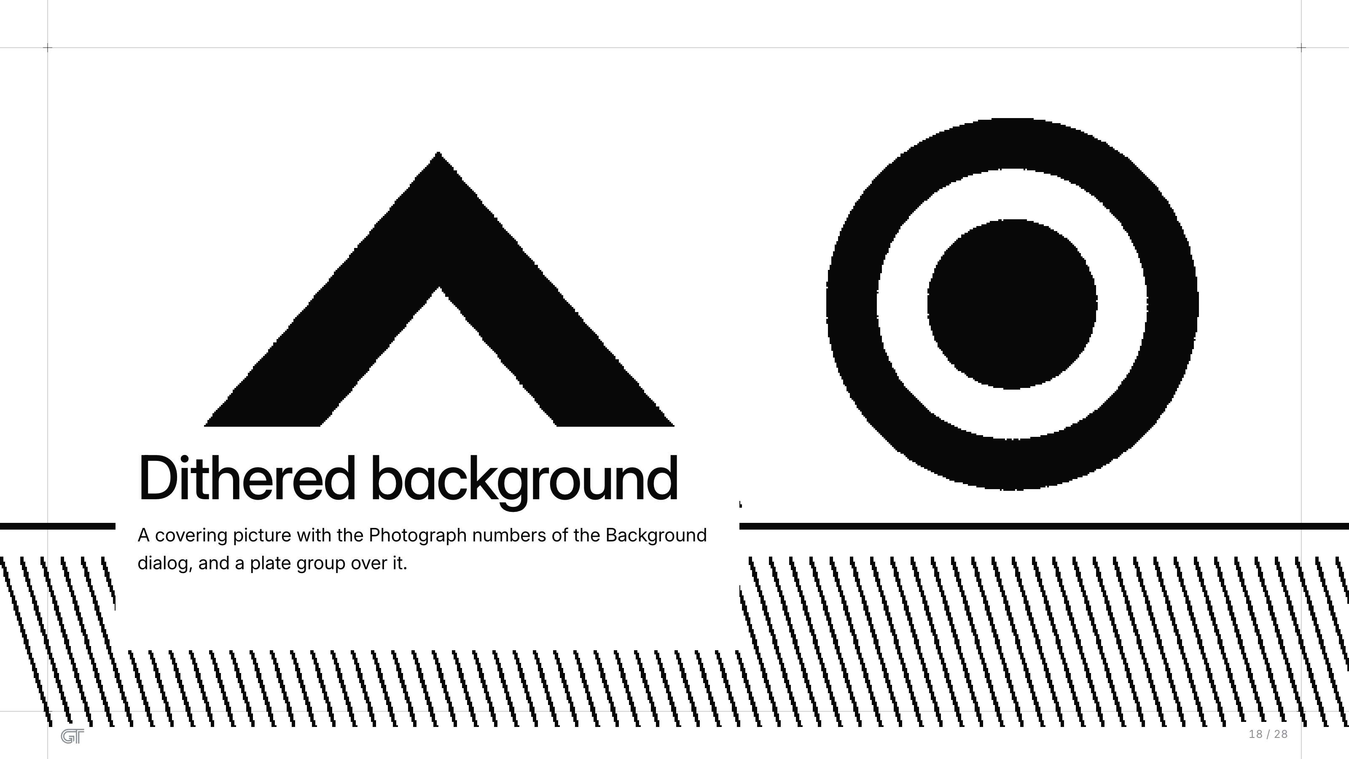
Dithered background
Dithered background
A covering picture with the Photograph numbers of the Background
dialog, and a plate group over it.
18 / 28

Slide 19
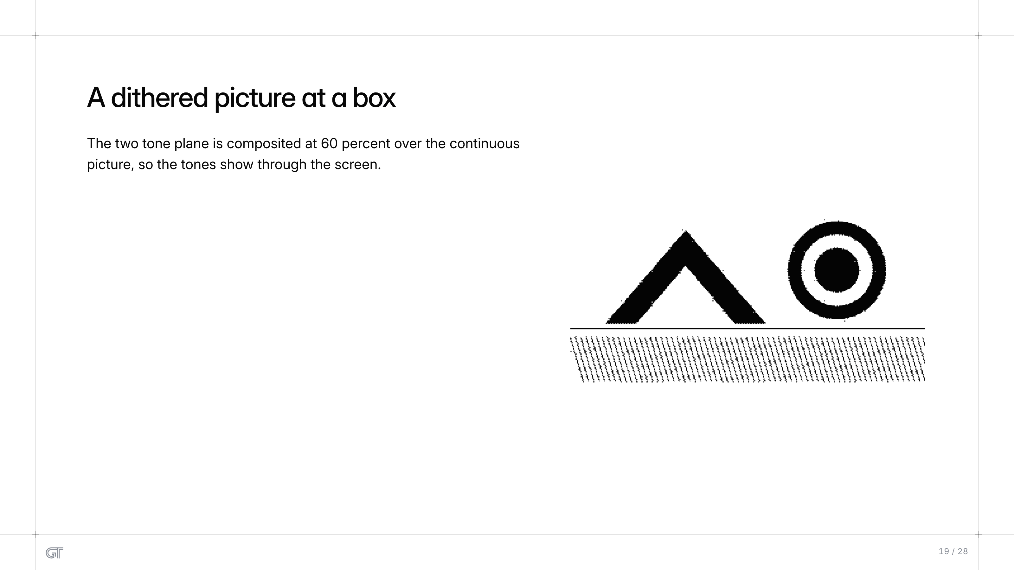
A dithered picture at a box
A dithered picture at a box
The two tone plane is composited at 60 percent over the continuous
picture, so the tones show through the screen.
19 / 28

Slide 20
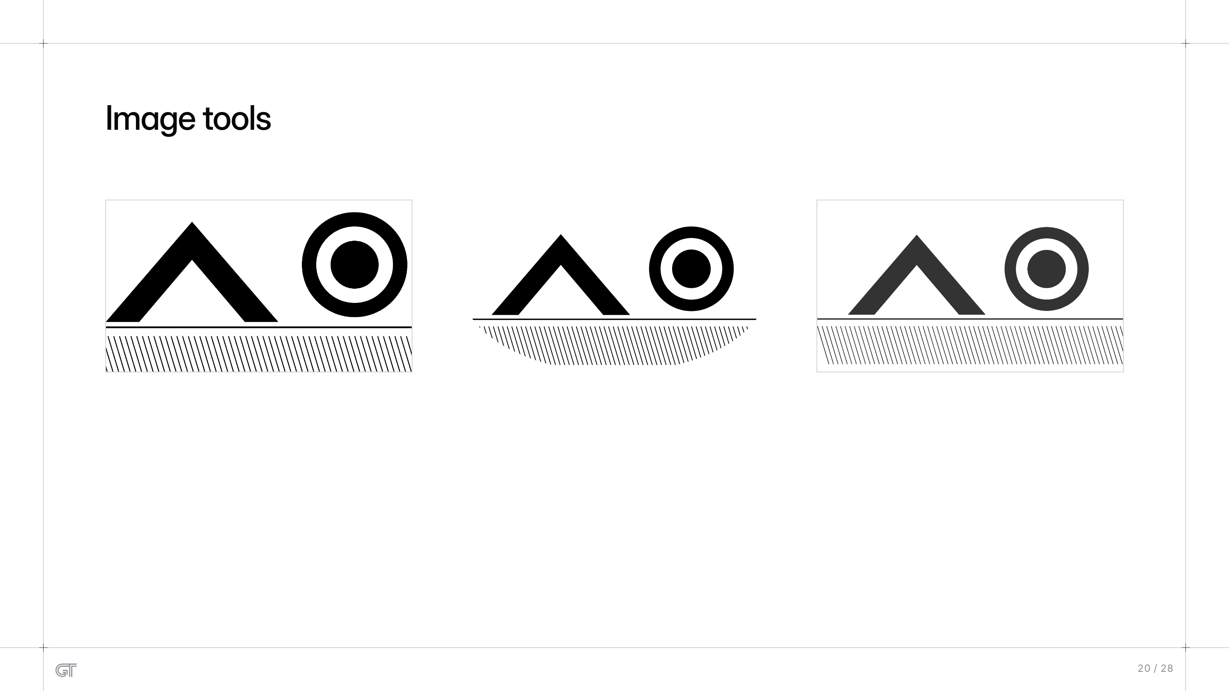
Image tools
Image tools
20 / 28

Slide 21
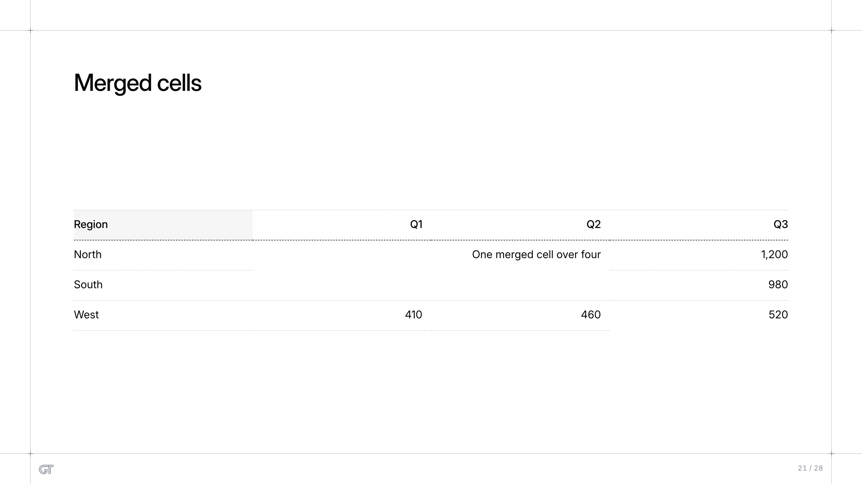
Merged cells
Merged cells
Region
Q1
Q2
Q3
North
One merged cell over four
1,200
South
980
West
410
460
520
21 / 28

Slide 22
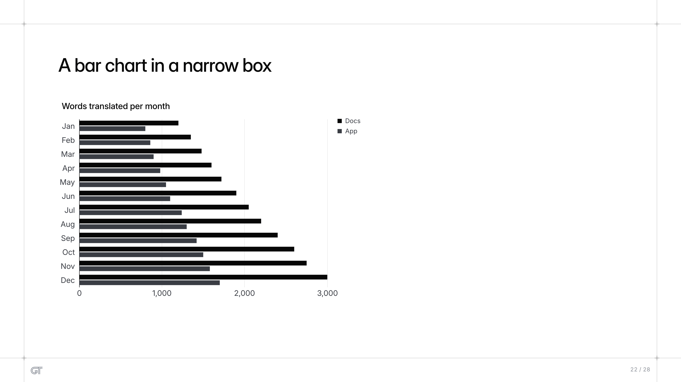
A bar chart in a narrow box
A bar chart in a narrow box
Words translated per month
22 / 28

Slide 23
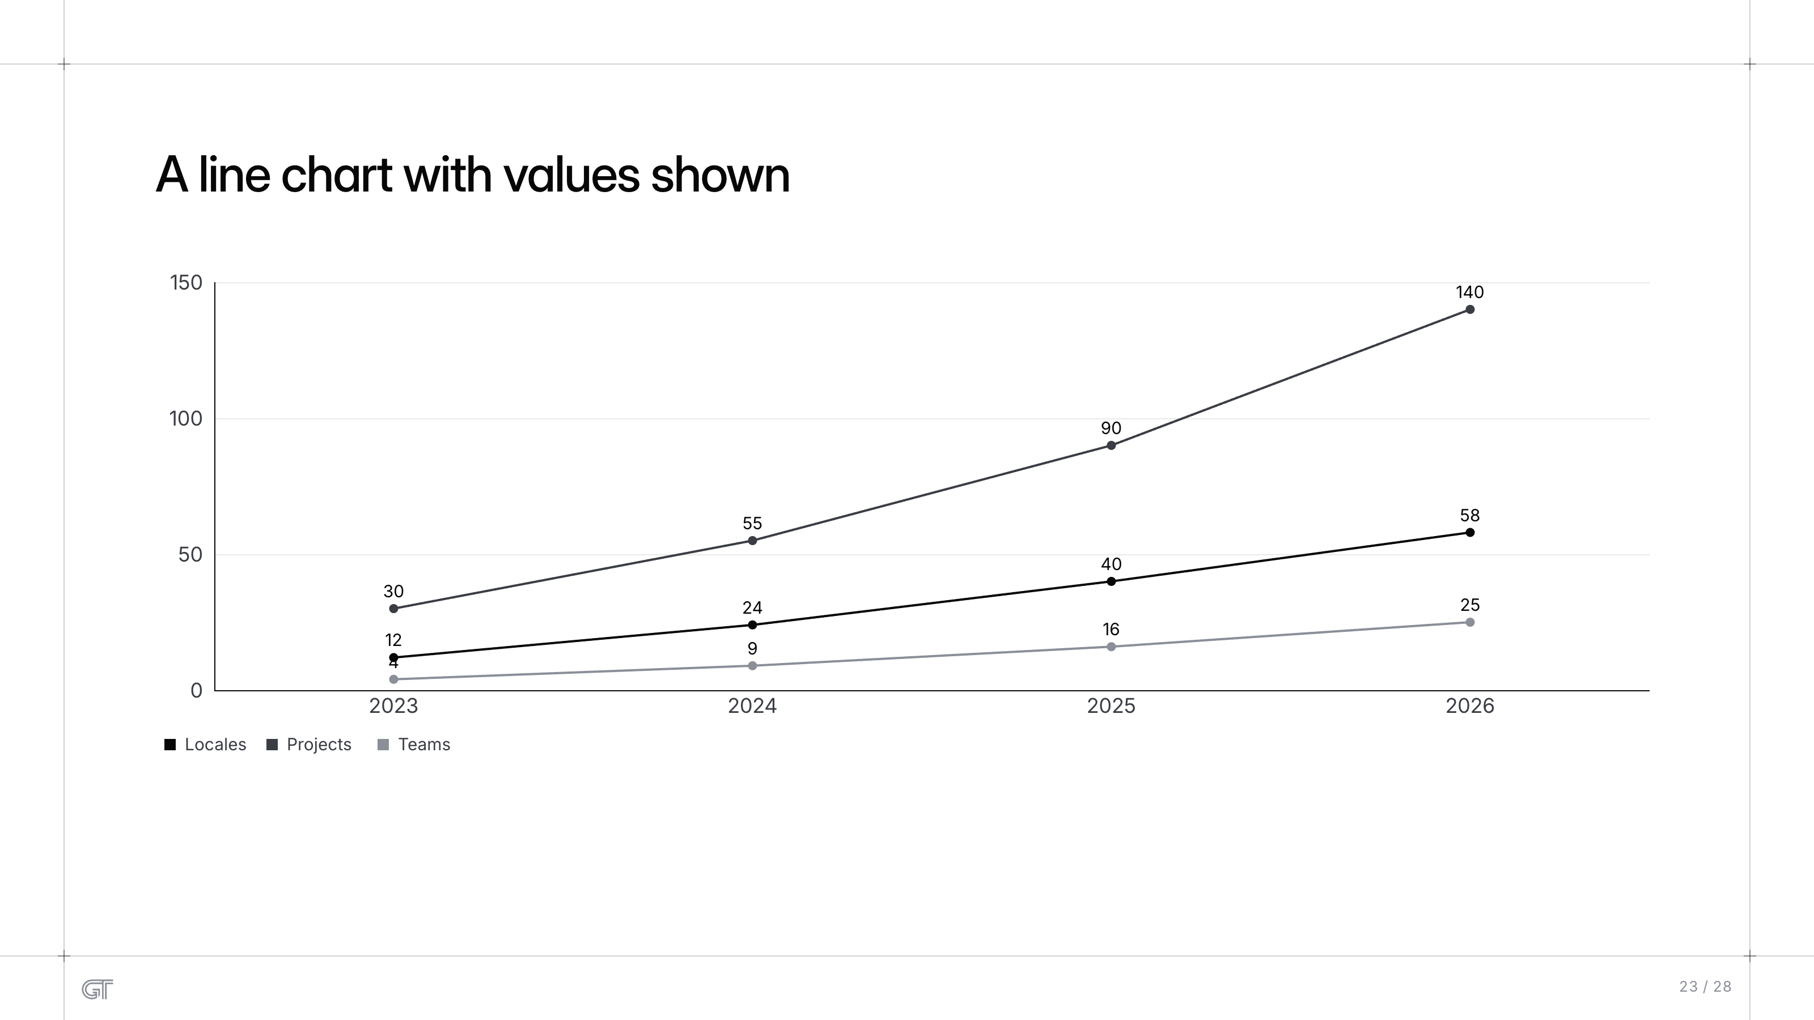
A line chart with values shown
A line chart with values shown
23 / 28

Slide 24
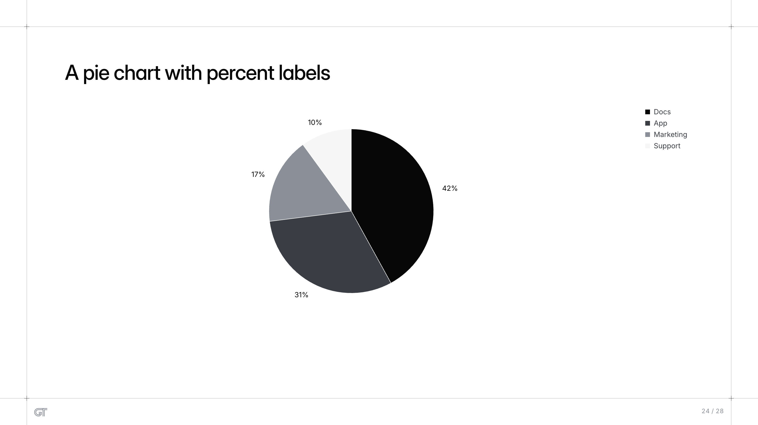
A pie chart with percent labels
A pie chart with percent labels
24 / 28

Slide 25
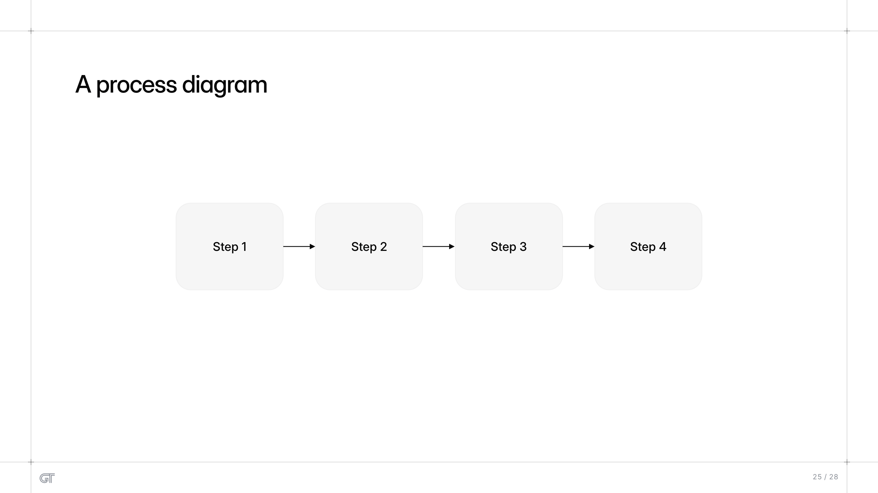
A process diagram
A process diagram
Step 1
Step 2
Step 3
Step 4
25 / 28

Slide 26
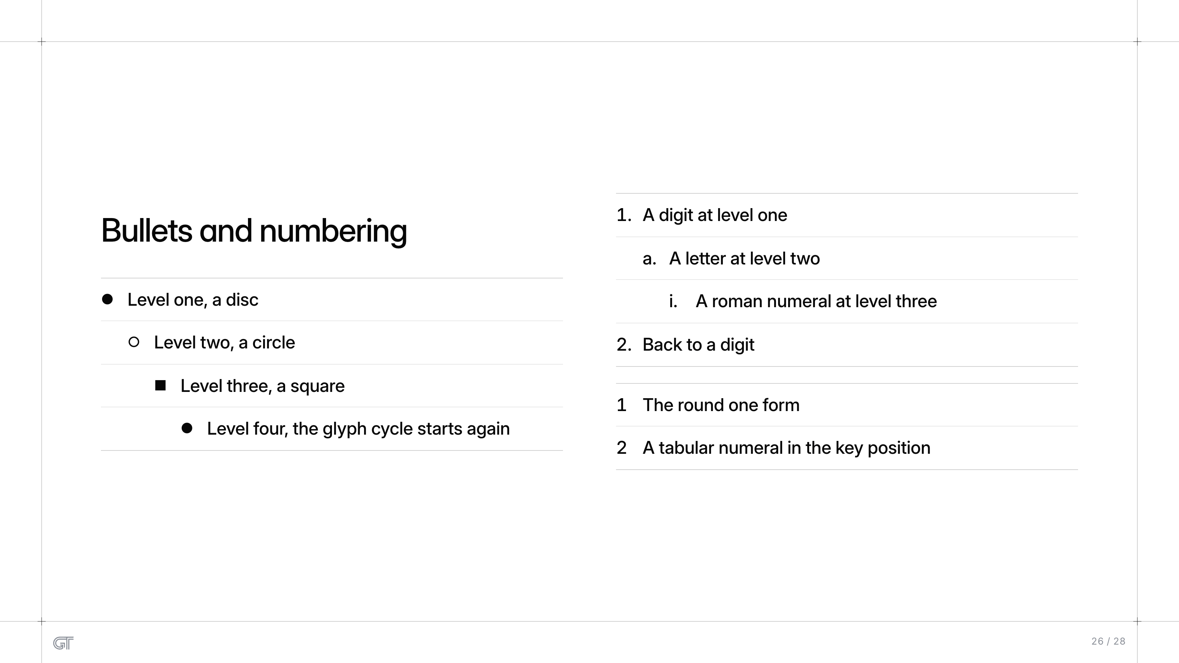
Bullets and numbering
A digit at level one
Bullets and numbering
  A letter at level two
Level one, a disc
    A roman numeral at level three
  Level two, a circle
Back to a digit
    Level three, a square
1
The round one form
      Level four, the glyph cycle starts again
2
A tabular numeral in the key position
26 / 28

Slide 27
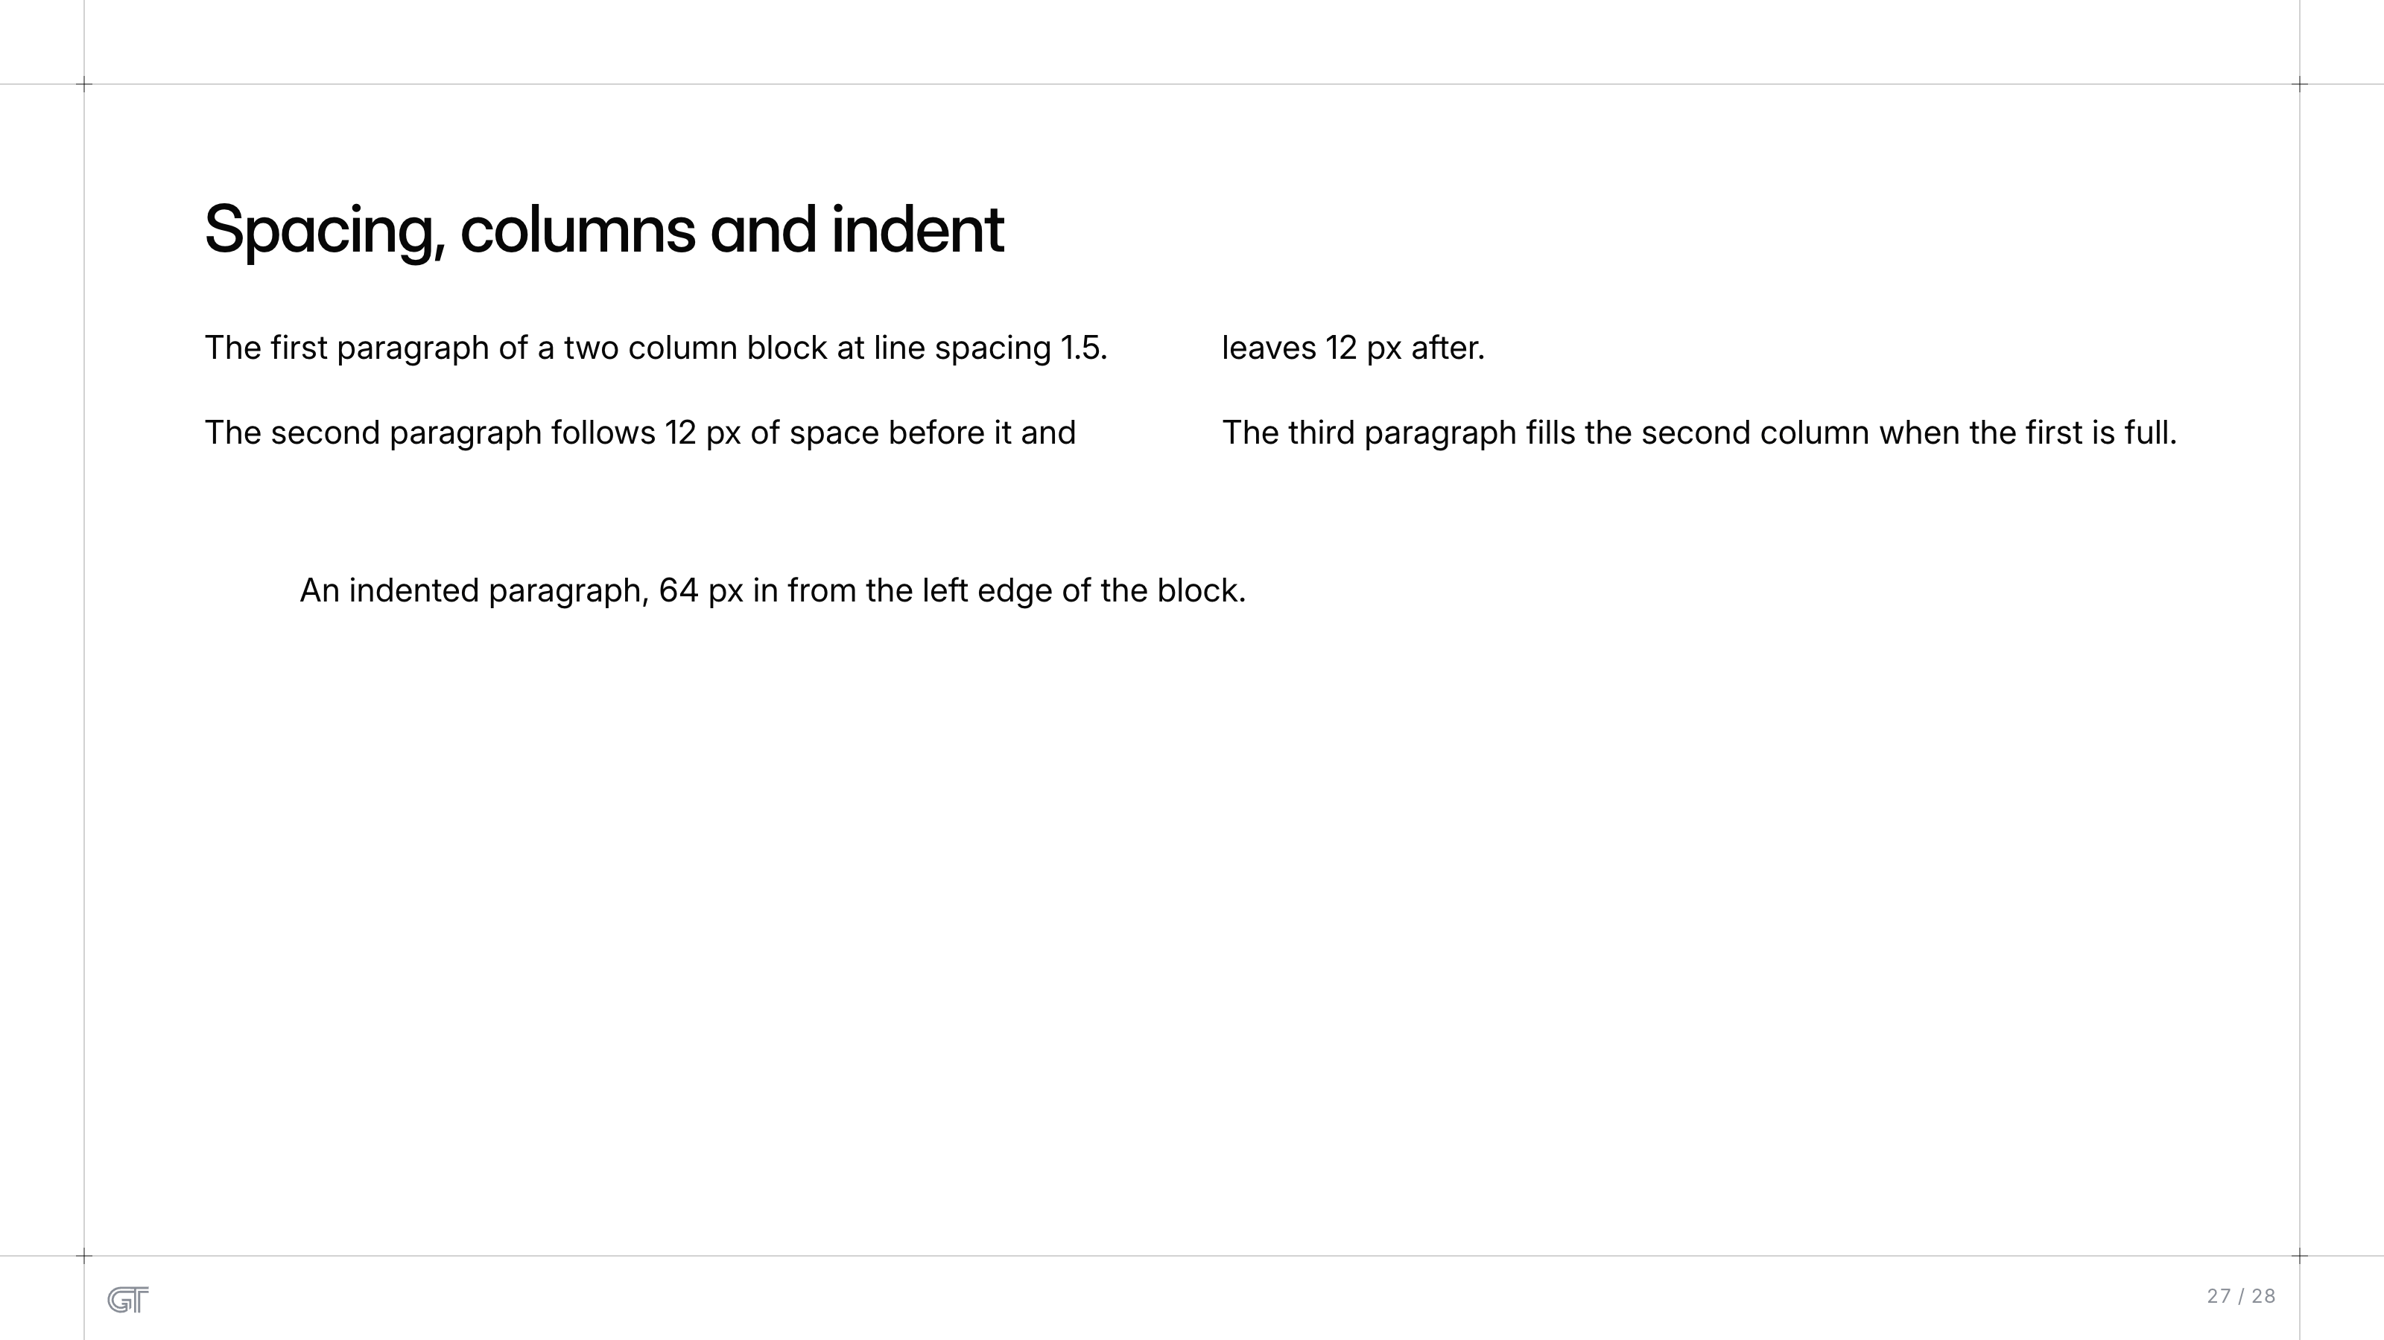
Spacing, columns and indent
Spacing, columns and indent
The first paragraph of a two column block at line spacing 1.5.
The second paragraph follows 12 px of space before it and
leaves 12 px after.
The third paragraph fills the second column when the first is full.
An indented paragraph, 64 px in from the left edge of the block.
27 / 28

Slide 28
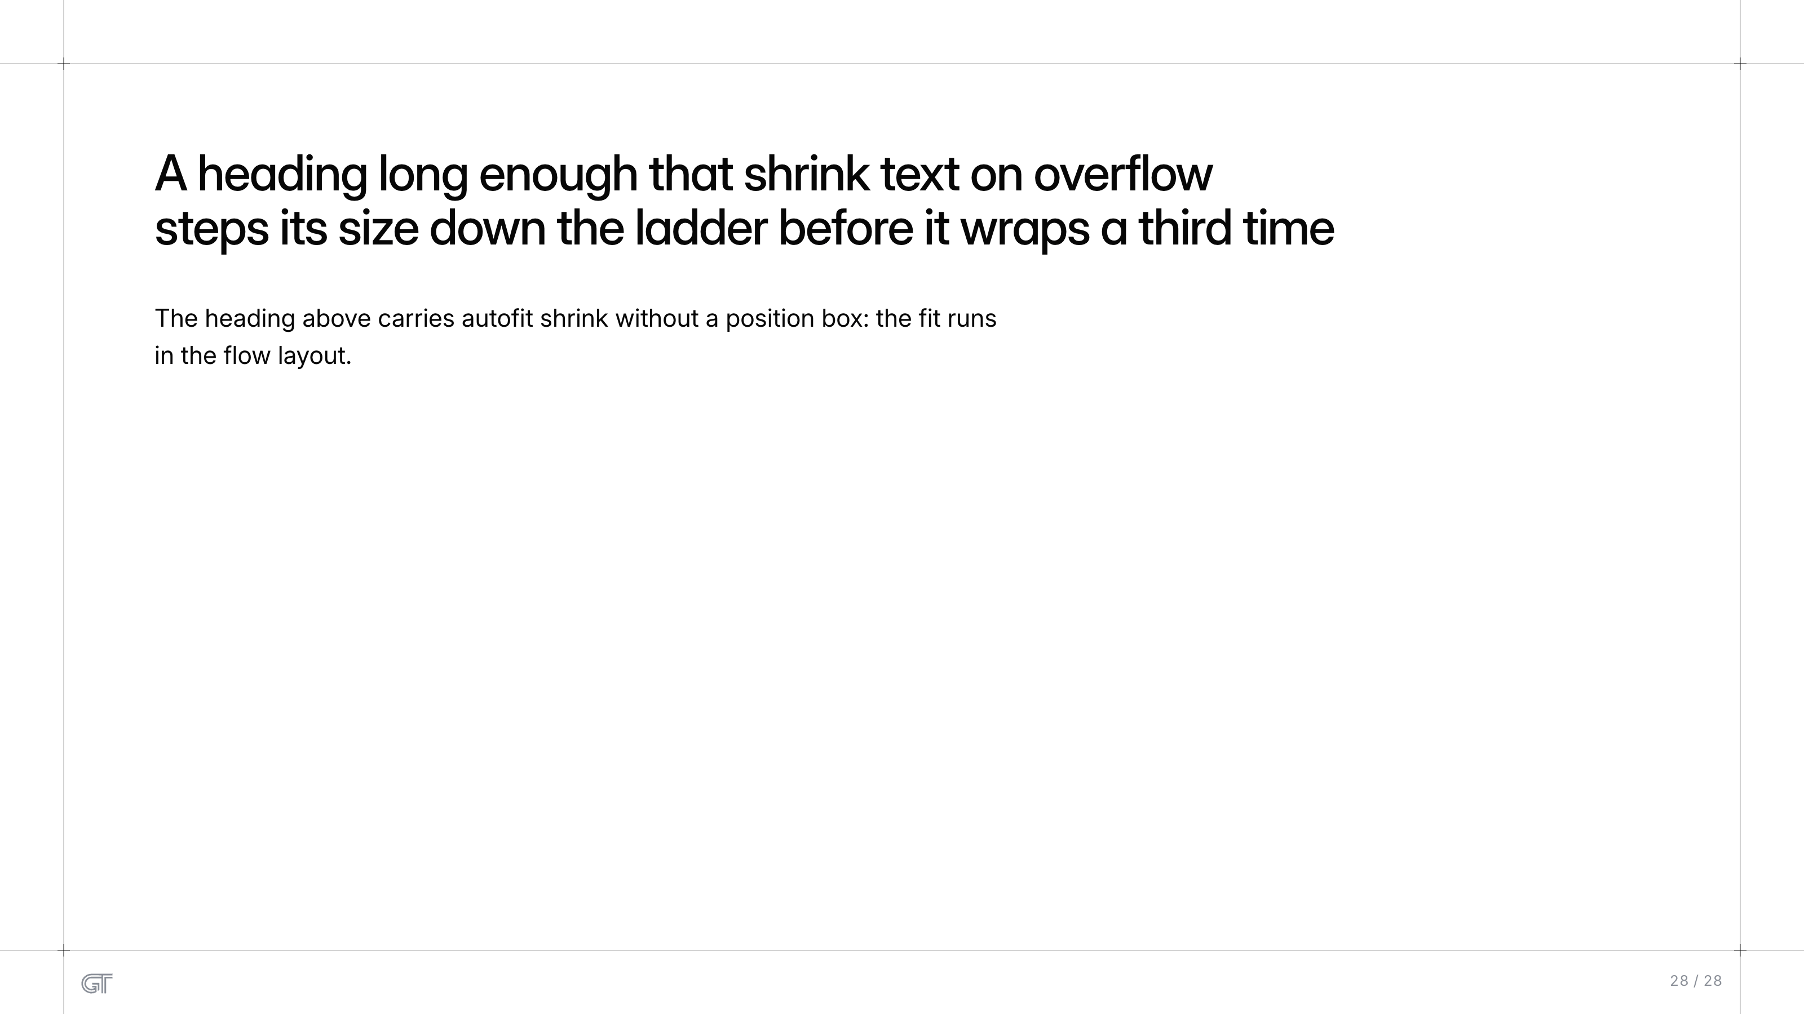
A heading long enough that shrink text on overflow steps its size...
A heading long enough that shrink text on overflow
steps its size down the ladder before it wraps a third time
The heading above carries autofit shrink without a position box: the fit runs
in the flow layout.
28 / 28

