Slide 1
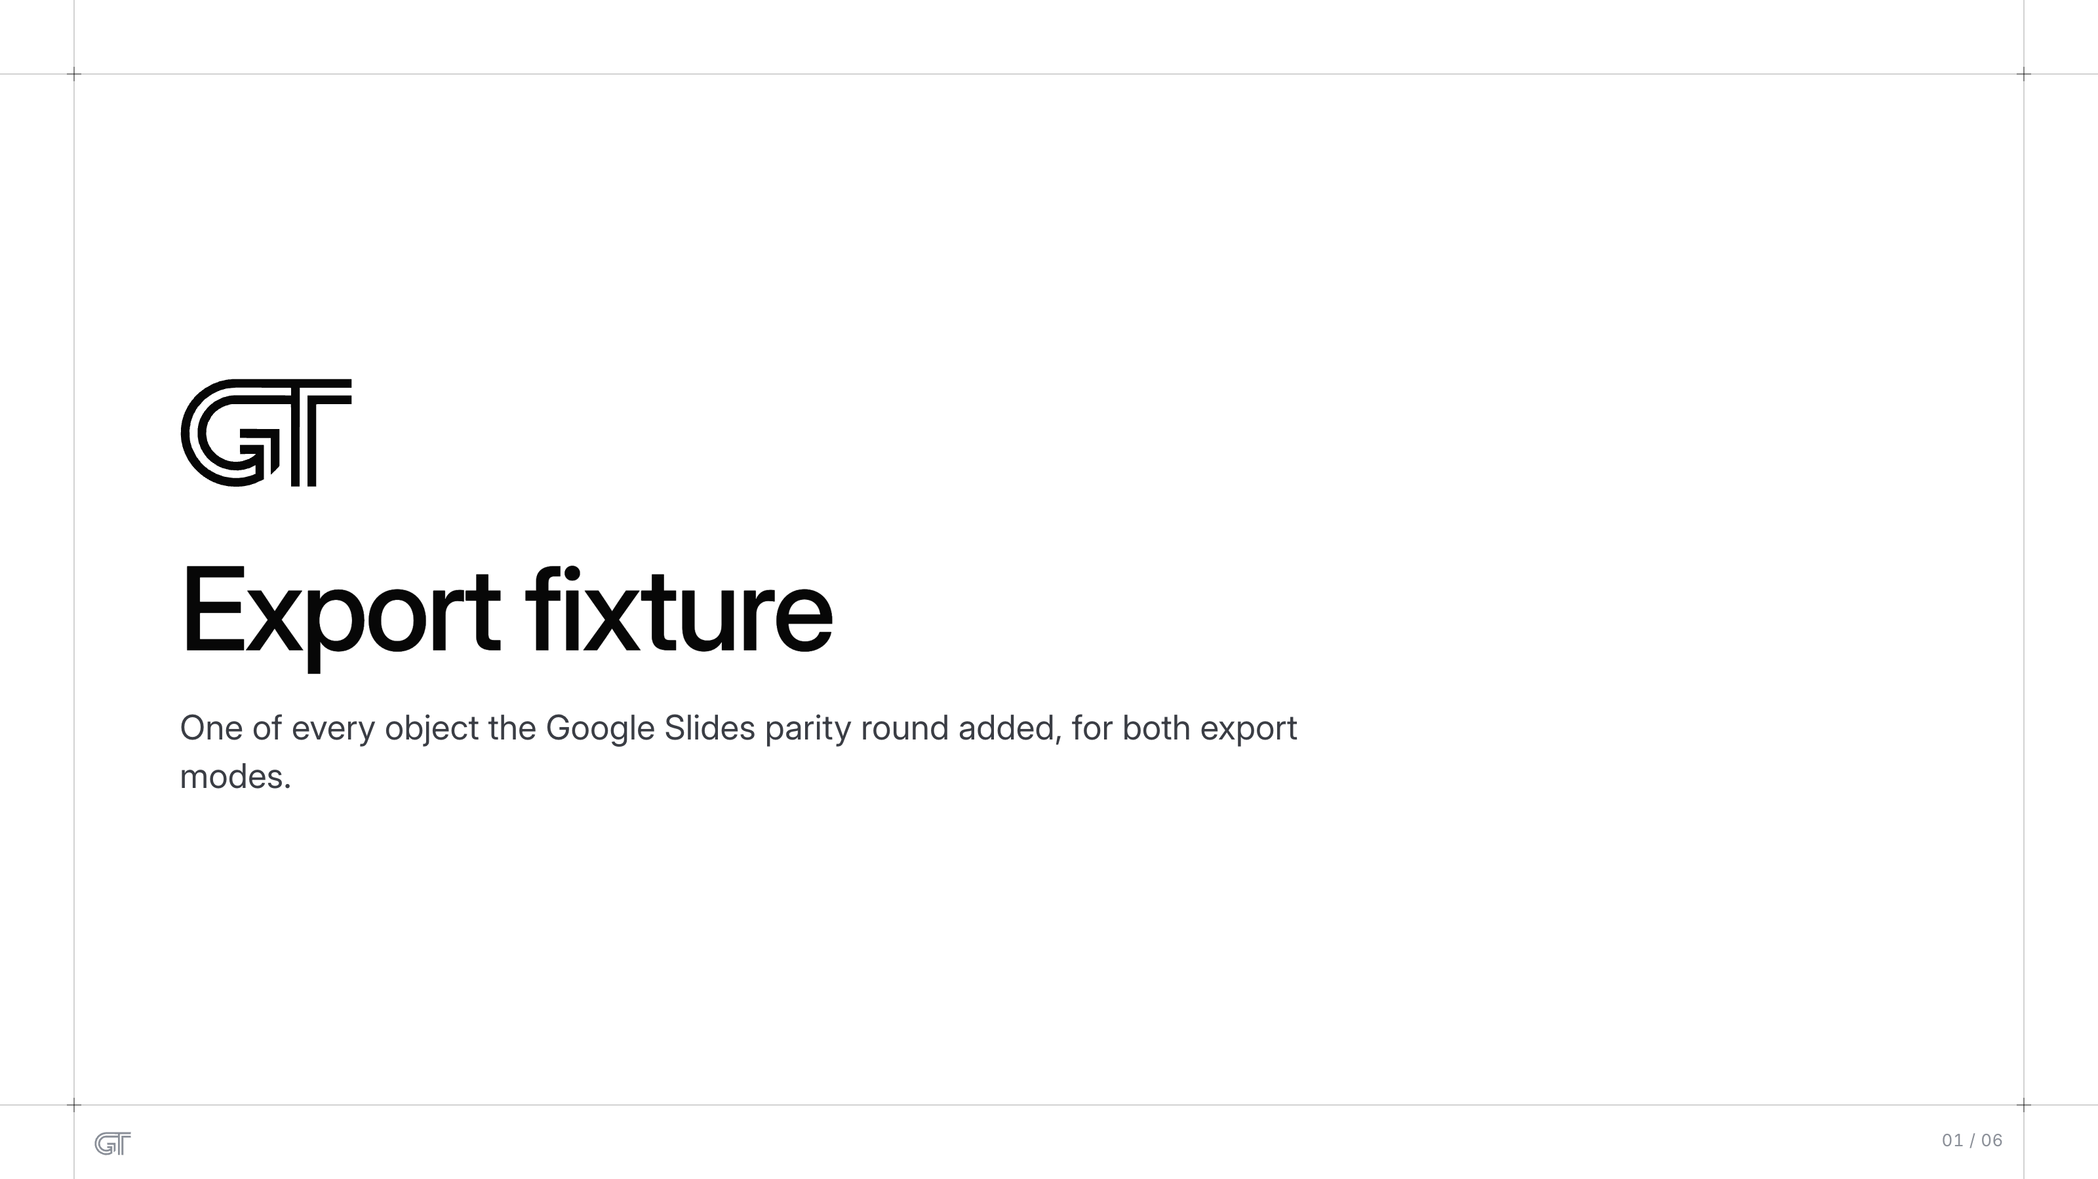
Export fixture
Export fixture
One of every object the Google Slides parity round added, for both export
modes.
01 / 06

Slide 2
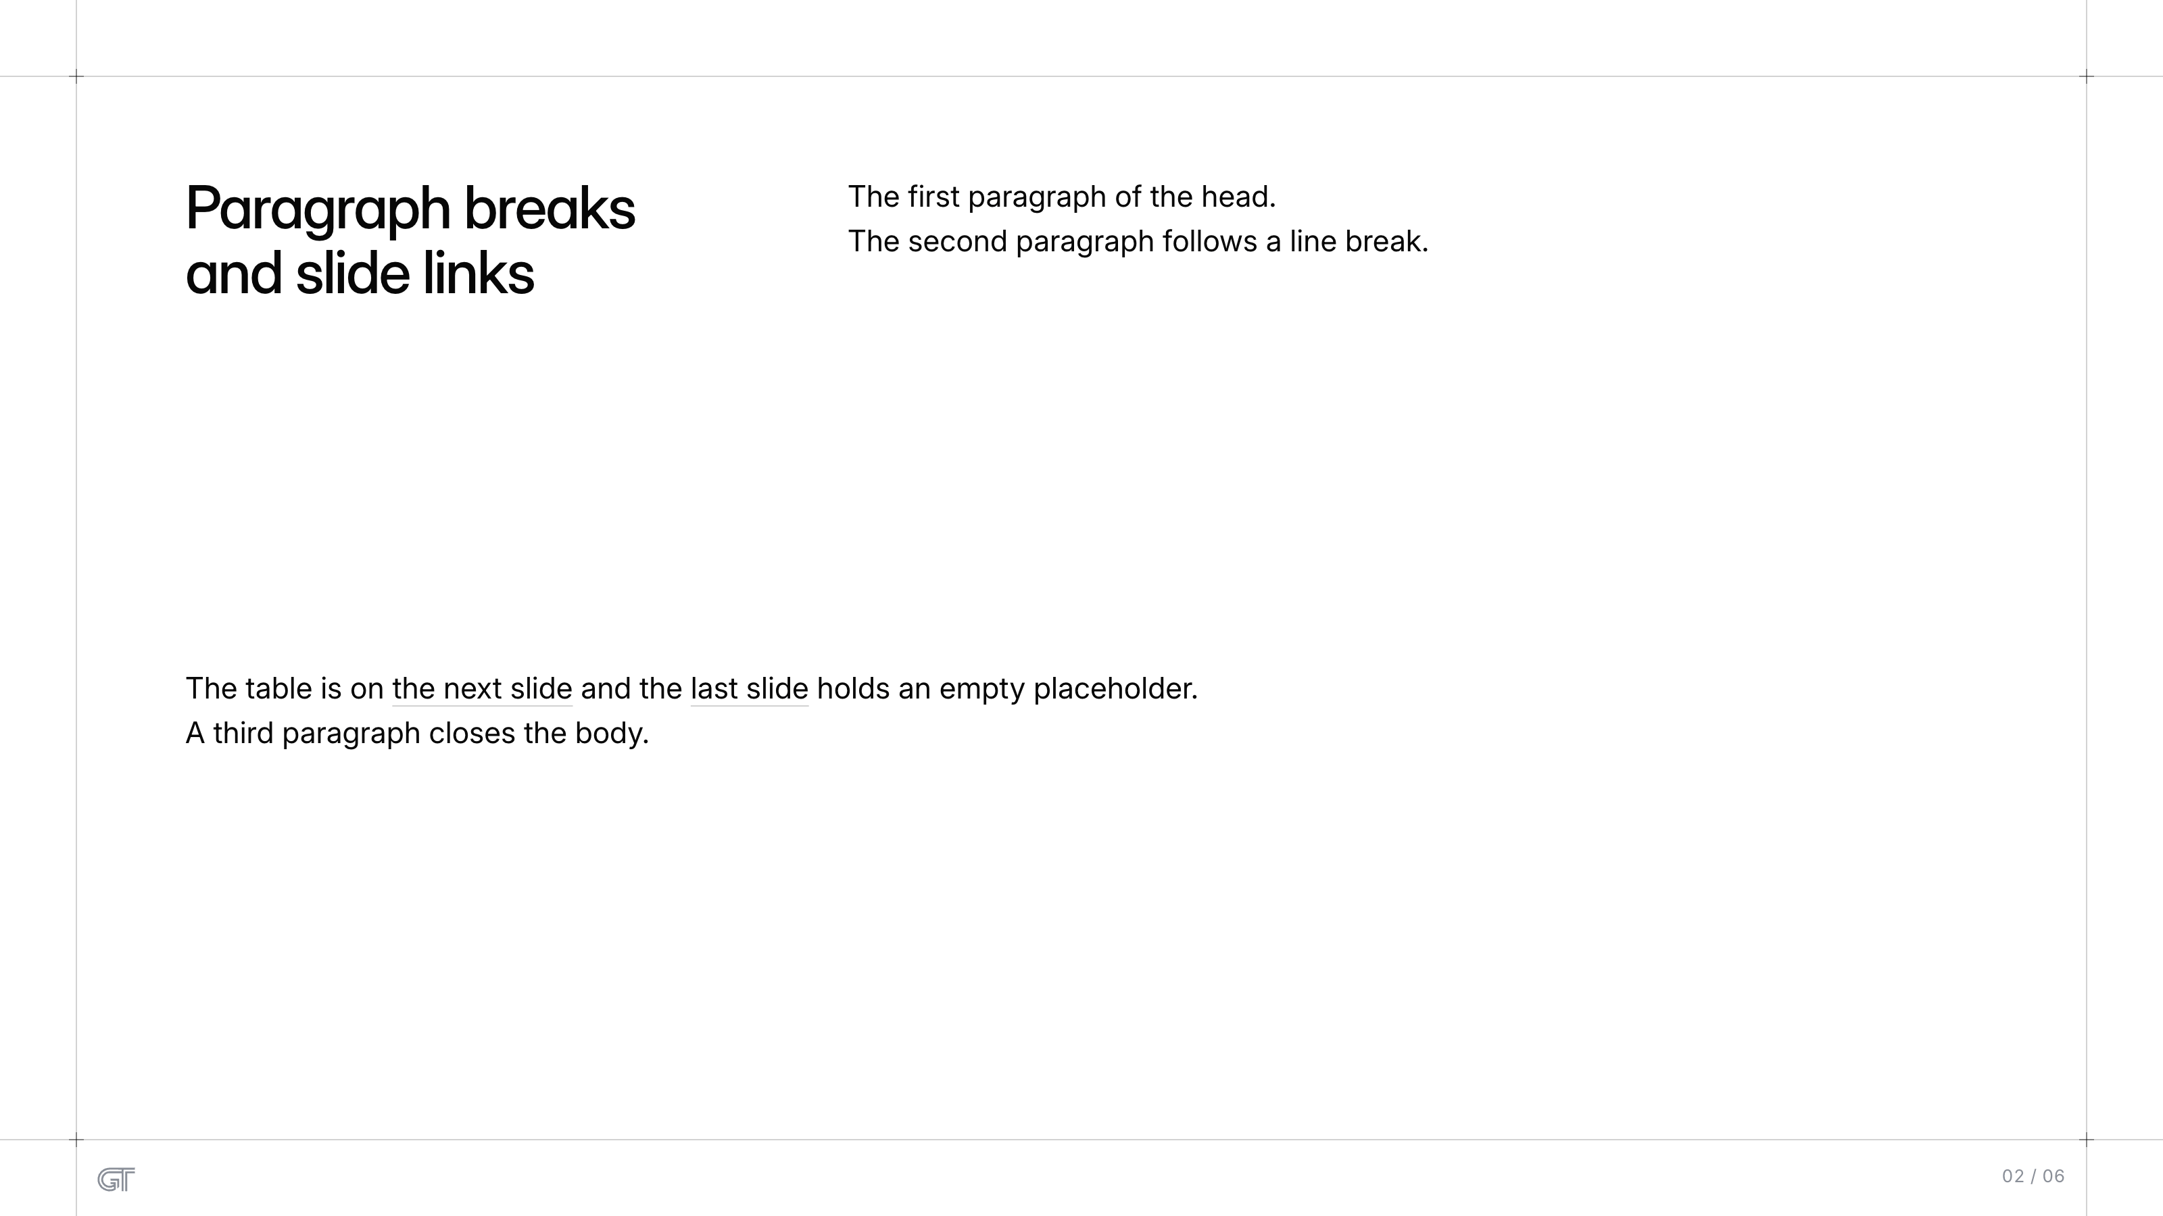
Paragraph breaks and slide links
The first paragraph of the head.
The second paragraph follows a line break.
Paragraph breaks
and slide links
The table is on the next slide and the last slide holds an empty placeholder.
A third paragraph closes the body.
02 / 06

Slide 3
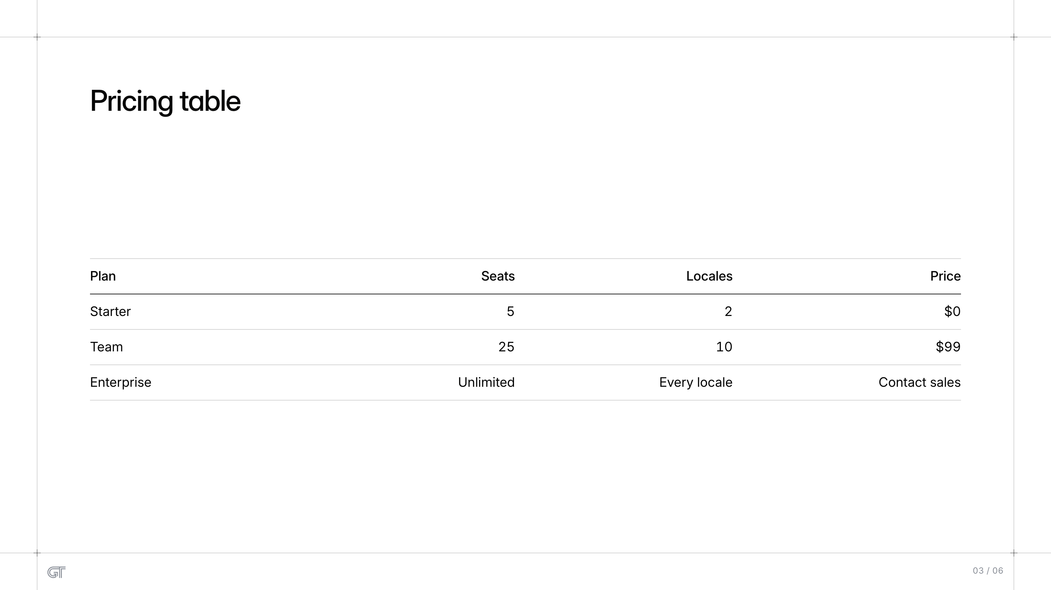
Pricing table
Pricing table
Plan
Seats
Locales
Price
Starter
5
2
$0
Team
25
10
$99
Enterprise
Unlimited
Every locale
Contact sales
03 / 06

Slide 4
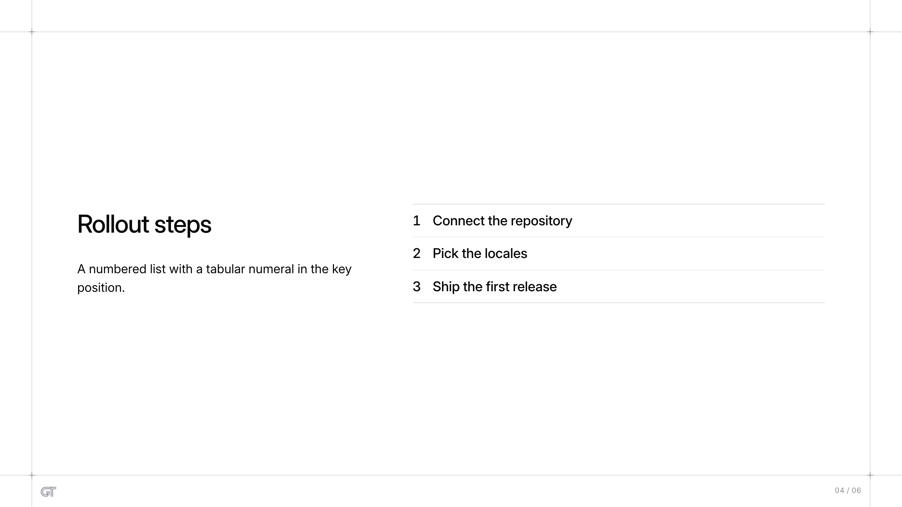
Rollout steps
1
Connect the repository
Rollout steps
2
Pick the locales
A numbered list with a tabular numeral in the key
position.
3
Ship the first release
04 / 06

Slide 5
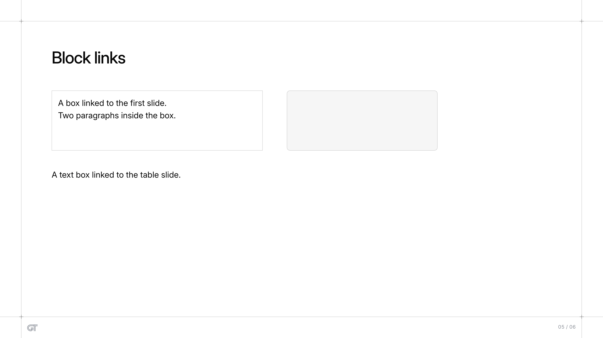
Block links
Block links
A box linked to the first slide.
Two paragraphs inside the box.
A text box linked to the table slide.
05 / 06

Slide 6

Slide 6
06 / 06

