Slide 1
LPS (Logic-based Production System) with CLOUT (Computational LOgic for Use in Teaching)
Robert Kowalski and Fariba Sadri
Imperial College London
Miguel Calejo
Interprolog.com

Slide 2
LPS/CLOUT Overview of the Workshop
Introduction
Demo of LPS/CLOUT examples
LPS in relation to computer science
Hands-on use of LPS/CLOUT
LPS in relation to Computational and Logical Thinking
Feedback and advice

Slide 3
LPS/CLOUT Overview of the Workshop
Introduction
Demo of LPS/CLOUT examples
LPS in relation to computer science
Hands-on use of LPS/CLOUT
LPS in relation to Computational and Logical Thinking
Feedback and advice

Slide 4
What is CLOUT?
An open-source, web-based prototype of LPS,
to support the new computing curriculum at key stages 3 and 4
LPS is a logic-based, textual computer language for
programming
databases
AI (intelligent agent) applications.
LPS combines
logic programming (as in Prolog)
production systems (as a model of human thinking).
LPS teaches both
computational thinking and
logical thinking

Slide 5
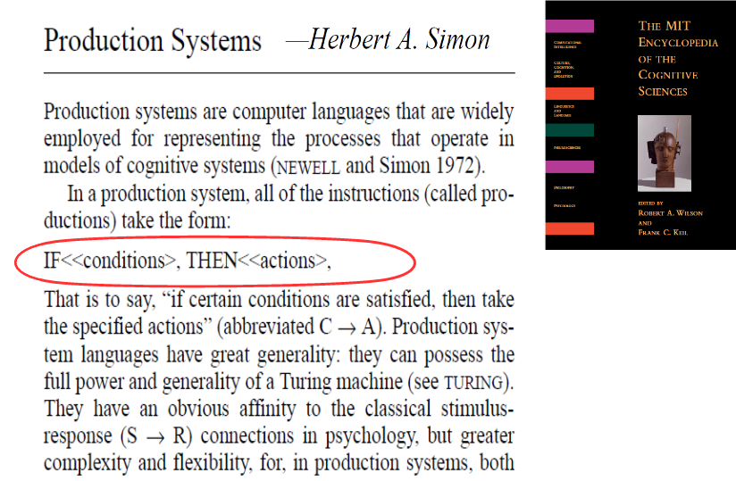

Slide 6
Production systems
States described by a working memory of facts.
State transitions represented by condition-action rules.
Popular
for implementing expert systems
as a computational model of human thinking
(e.g. SOAR, ACTR, Steven Pinker’s How the Mind Works)

Slide 7
Production systems do not have a logical semantics.
fire ⇒ deal-with-fire
deal-with-fire ⇒ eliminate
deal-with-fire⇒ escape
Adding fire to working memory.
Triggers two candidate actions eliminate and escape.
Conflict resolution decides between them.

Slide 8
LPS combines reactive rules, logic programs
and causal theories
Reactive rule: if fire then deal-with-fire.
Logic program: deal-with-fire if eliminate.
deal-with-fire if escape.
Causal theory: eliminate terminates fire.
Adding fire to the current state.
Generates two alternative actions eliminate or escape.
Generates alternative sequences of states (worlds)
to make the reactive rule true:
eliminate
escape
escape
Q
fire
or
fire
fire
fire

Slide 9
Computation generates actions to make reactive rules true
The current state is updated.
Actions are
chosen and
combined with
external events
Reactive rules whose conditions are true
are triggered.
External events
Logic programs
reduce goals to
subgoals and actions

Slide 10
Computation generates actions to make reactive rules true
Updates are destructive
The current state is updated.
Actions are
chosen and
combined with
external events
Reactive rules whose conditions are true
are triggered.
External events
Logic programs
reduce goals to
subgoals and actions

Slide 11
The syntax of LPS is Fluid
Reactive rules in First-order logic (FOL):
∀X [antecedent → ∃ Y consequent]
or for all X [antecedent → there exists Y consequent]
or antecedent → consequent
or if antecedent then consequent
Clauses in logic programming form:
∀X [conditions→ conclusion]
or conclusion← conditions
or conclusion if conditions

Slide 12
The logic of LPS is model-generation
Computation performs actions
to generate a model of the world
described by logic programs
to make reactive rules true.
Logic programs represent an agent’s beliefs.
Reactive rules represent the agent’s goals.

Slide 13
Worlds are sequences of states, actions and external events, described by atomic sentences
without time stamps
for efficiency
States are sets of facts (also called fluents):
fire
Events (including actions) cause state transitions:
eliminate
with time stamps
for logical semantics
fire(10:15)
eliminate(10:15, 10:16)

Slide 14
The Syntax of LPS is fluid
without time stamps
for readability
Reactive rules:
if fire
then deal-with-fire.
Logic programs:
deal-with-fire
if eliminate.
with time stamps
for logical semantics
if fire at T1
then deal-with-fire fromT2 to T3,
T1≤ T2.
deal-with-fire from T1 to T2
if eliminate fromT1 to T2.

Slide 15
State transitions are described by a “programmable” causal theory
Postconditions (effects):
ignite(Object) initiates fire if flammable(Object).
eliminate terminates fire.
Preconditions (constraints):
false eliminate, fire, not water.
Persistence (inertia):
A fact/fluent persists from the time it is initiated to the time it is terminated.

Slide 16
LPS/CLOUT Overview of the Workshop
Introduction
Demo and discussion of LPS/CLOUT examples
LPS in relation to computer science
Hands-on use of of LPS/CLOUT
LPS in relation to Computational and Logical Thinking

Slide 17
Examples
Fire
Trash
Map colouring
Dining philosophers
Bubble sort
Bank transfer
Quicksort
Turing
Prisoner’s dilemma

Slide 18
% Fire Example
% Declarations
fluents fire.
actions eliminate, escape.
% Initial state
initially fire.
% Goals: Reactive Rules
if fire at T1 then deal-with-fire from T1 to T2.
% Beliefs: Logic Programs
deal-with-fire from T1 to T2 if eliminate from T1 to T2.
deal-with-fire from T1 to T2 if escape from T1 to T2.
% Causal theory
eliminate terminates fire.

Slide 19
Fire example with keywords underlined
% Fire Example
% Declarations
fluents fire.
actions eliminate, escape.
% Initial state
initially fire.
% Goals: Reactive Rules
if fire at T1 then deal-with-fire from T1 to T2.
% Beliefs: Logic Programs
deal-with-fire from T1 to T2 if eliminate from T1 to T2.
deal-with-fire from T1 to T2 if escape from T1 to T2.
% Causal theory
eliminate terminates fire.

Slide 20
Fire example extended
maxTime(10).
fluents fire, water.
actions eliminate, escape, ignite(_).
initially water.
% Time-independent information
flammable(sofa).
flammable(bed).
% Observations
observe ignite(sofa) from 1 to 2.
observe ignite(bed) from 4 to 5.
% Goals: Reactive Rules
if fire at T1
then deal_with_fire from T2 to T3. % Notice change of times

Slide 21
% Beliefs: Logic Programs
deal_with_fire from T1 to T2 if eliminate from T1 to T2.
deal_with_fire from T1 to T2 if escape from T1 to T2.
% Causal theory
ignite(Object) initiates fire
if flammable(Object).
eliminate terminates fire.
eliminate terminates water.
false eliminate, fire, not water.

Slide 22
Trash Example
In LPS state transitions are achieved by:
Actions: Under the control of the agent
Events: External and observed and assimilated by the agent
In principle and in later implementations
events can be observed dynamically.
Here, for simplicity, we add them to the program at the start.

Slide 23
% simplified_trash.lps
maxTime(10).
fluents locked(_), trash(_), bin(_).
actions dispose(_,_).
events unlock(_).
initially locked(container1), trash(bottle1), bin(container1), bin(container2).
observe unlock(container1) from 4 to 5.
if trash(Object) at T1
then bin(Container) at T1, dispose(Object, Container) from T2 to T3.
unlock(Container) terminates locked(Container).
dispose(Object, Container) terminates trash(Object).
false dispose(Object, Container), locked(Container).
/* What’s wrong with
if trash(Object) at T1, bin(Container) at T1
then dispose(Object, Container) from T2 to T3.
*/

Slide 24
Compare
if trash(Object) at T1
then bin(Container) at T1,
dispose(Object, Container) from T2 to T3.
with
if trash(Object) at T1, bin(Container) at T1
then dispose(Object, Container) from T2 to T3.
You can check your understanding of ∀ and ∃ by trying both programs and observing the different outcomes.

Slide 25
Recall: Syntax of reactive rules
Reactive rules in First-order logic (FOL):
∀X [ if antecedent then ∃ Y [consequent]]
The variables X can occur in both antecedent and consequent.
The variables Y occur only in consequent.

Slide 26
Actions can be executed concurrently: here we have two items of rubbish.
% concurrent action trash.lps
maxTime(10).
fluents locked(_), trash(_), bin(_).
actions dispose(_,_).
events unlock(_).
initially locked(container1), trash(bottle1), trash(bottle2),
bin(container1), bin(container2).
observe unlock(container1) from 4 to 5.
if trash(Object) at T1
then bin(Container) at T1,
dispose(Object, Container) from T2 to T3.
unlock(Container) terminates locked(Container).
dispose(Object, Container) terminates trash(Object).
false dispose(Object, Container), locked(Container).

Slide 27
Map Colouring example
More concurrent actions.
Here simply combining a reactive rule and a causal theory with an action precondition solves this problem.

Slide 28
% The map colouring problem.
maxTime(5).
actions paint(_, _).
country(sweden).
country(norway).
country(finland).
country(russia).
colour(red).
colour(yellow).
colour(blue).
adjacent(sweden, norway).
adjacent(sweden, finland).
adjacent(norway, finland).
adjacent(norway, russia).
adjacent(finland, russia).
sweden
norway
finland
russia

Slide 29
% The map colouring problem.
maxTime(5).
actions paint(_, _).
country(iz).
country(oz).
country(az).
country(uz).
colour(red).
colour(yellow).
colour(blue).
adjacent(az, iz).
adjacent(az, oz).
adjacent(iz, oz).
adjacent(iz, uz).
adjacent(oz, uz).
az
iz
oz
uz

Slide 30
% The map colouring problem
% For every country X, there exists a colour C.
if country(X)
then colour(C), paint(X, C) from 1 to 2.
% Two adjacent countries cannot be painted the same colour.
false paint(X, C), adjacent(X, Y), paint(Y, C).
/* We can also write
if country(X)
then colour(C), paint(X, C) from T1 to T2.
*/

Slide 31
% The map colouring problem.
maxTime(5).
actions paint(_, _).
country(iz).
country(oz).
country(az).
country(uz).
colour(red).
colour(yellow).
colour(blue).
adjacent(az, iz).
adjacent(az, oz).
adjacent(iz, oz).
adjacent(iz, uz).
adjacent(oz, uz).
if country(X)
then colour(C), paint(X, C) from 1 to 2.
false paint(X, C), adjacent(X, Y), paint(Y, C).

Slide 32
Compare
% For every country X, there exists a colour C
% Paint every country some colour.
if country(X)
then colour(C), paint(X, C) from 1 to 2.
With
% For every country X, and every colour C, paint X, C.
% That is paint every country every colour.
if country(X), colour(C)
then paint(X, C) from T1 to T2.
In terms of specification is there anything logically missing from the program?

Slide 33
Map Colouring: What do you think will happen with this program?
maxTime(5).
actions paint(_, _).
country(iz). country(oz).
country(az). country(uz).
colour(red).
colour(yellow).
colour(blue).
adjacent(az, iz). adjacent(az, oz).
adjacent(iz, oz). adjacent(iz, uz).
adjacent(oz, uz).
if country(X)
then colour(C), paint(X, C) from T1 to T2.
false paint(X, C), adjacent(X, Y), paint(Y, C).
% You cannot paint more than one country at a time.
false paint(X1, C1), paint(X2, C2), not X1=X2.

Slide 34
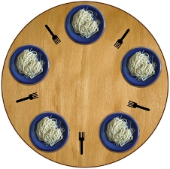
The Dining Philosophers

Slide 35
maxTime(7).
fluents available(_).
actions pickup(_,_), putdown(_,_).
initially available(fork1), available(fork2), available(fork3), available(fork4), available(fork5).
philosopher(socrates).
philosopher(plato).
philosopher(aristotle).
philosopher(hume).
philosopher(kant).
adjacent(fork1, socrates, fork2).
adjacent(fork2, plato, fork3).
adjacent(fork3, aristotle, fork4).
adjacent(fork4, hume, fork5).
adjacent(fork5, kant, fork1).

Slide 36
% dining philosophers
if philosopher(P)
then dine(P) from T1 to T2.
dine(P) from T1 to T3 if
adjacent(F1, P, F2),
pickup(P, F1) from T1 to T2,
pickup(P, F2) from T1 to T2,
putdown(P, F1) from T2 to T3,
putdown(P, F2) from T2 to T3 .
pickup(P, F) terminates available(F).
putdown(P, F) initiates available(F).
false pickup(P, F), not available(F).
false pickup(P1, F), pickup(P2, F), P1 \= P2.

Slide 37
maxTime(7).
fluents available(_).
actions pickup(_,_), putdown(_,_).
initially available(fork1), available(fork2), available(fork3), available(fork4), available(fork5).
philosopher(socrates).
philosopher(plato).
philosopher(aristotle).
philosopher(hume).
philosopher(kant).
adjacent(fork1, socrates, fork2).
adjacent(fork2, plato, fork3).
adjacent(fork3, aristotle, fork4).
adjacent(fork4, hume, fork5).
adjacent(fork5, kant, fork1).
if philosopher(P)
then dine(P) from T1 to T2.
dine(P) from T1 to T3 if
adjacent(F1, P, F2),
pickup(P, F1) from T1 to T2,
pickup(P, F2) from T1 to T2,
putdown(P, F1) from T2 to T3,
putdown(P, F2) from T2 to T3 .
pickup(P, F) terminates available(F).
putdown(P, F) initiates available(F).
false pickup(P, F), not available(F).
false pickup(P1, F), pickup(P2, F), P1 \= P2.

Slide 38
What happens if we replace:
dine(P) from T1 to T3 if
adjacent(F1, P, F2),
pickup(P, F1) from T1 to T2,
pickup(P, F2) from T1 to T2,
putdown(P, F1) from T2 to T3,
putdown(P, F2) from T2 to T3.
with:
dine(P) from T1 to T5 if
adjacent(F1, P, F2),
pickup(P, F1) from T1 to T2,
pickup(P, F2) from T2 to T3,
putdown(P, F1) from T3 to T4,
putdown(P, F2) from T4 to T5.

Slide 39
Bubble sort
Keep swapping adjacent elements that are out of order until the array is ordered.
d c b a
c d b a
c b d a
And so on …..
a b c d

Slide 40
% bubble sort with relational data structure .
maxTime(5).
fluents location(_, _).
actions swap(_,_,_,_).
initially location(d, 1), location(c, 2), location(b, 3), location(a,4).
if location(X, N1) at T1, N2 is N1 +1, location(Y, N2) at T1, Y@<X
then swapped(X, N1, Y, N2) from T2 to T3.
% swapped may not work if the order of the two clauses below is
% reversed. Perhaps for good reasons.
swapped(X, N1, Y, N2) from T1 to T2
if location(X, N1) at T1, location(Y, N2) at T1,
Y@<X, swap(X, N1, Y, N2) from T1 to T2.
swapped(X, N1, Y, N2) from T to T
if location(X, N1) at T, location(Y, N2) at T, X@<Y.
swap(X, N1, Y, N2) initiates location(X, N2).
swap(X, N1, Y, N2) initiates location(Y, N1).
swap(X, N1, Y, N2) terminates location(X, N1).
swap(X, N1, Y, N2) terminates location(Y, N2).
false swap(X, N1, Y, N2), swap(Y, N2, Z, N3).

Slide 41
LPS executes actions concurrently
Time 1
d c b a
Time 2
c d a b
Time 3
c a d b
a c b d
Time 4
Time 5
a b c d

Slide 42
Teleo-reactivity
If later an object is moved, the same program will sort them again.
observe swap(a,1,c,3) from 11 to 12.
observe swap(b,2,c,3) from 15 to 16.
a b c d
Time 11
c b a d
Time 12
b c a d
b a c d
a b c d
Time 15
a c b d
Time 16
a b c d

Slide 43
maxTime(20).
fluents location(_, _).
actions swap(_,_,_,_).
observe swap(a,1,c,3) from 11 to 12. %new
observe swap(b,2,c,3) from 15 to 16. %new
initially location(d, 1), location(c, 2), location(b, 3), location(a,4).
if location(X, N1) at T1, N2 is N1 +1, location(Y, N2) at T1, Y@<X
then swapped(X, N1, Y, N2) from T2 to T3.
% swapped may not work if the order of the two clauses below is
% reversed. Perhaps for good reasons.
%
swapped(X, N1, Y, N2) from T1 to T2
if location(X, N1) at T1, location(Y, N2) at T1,
Y@<X, swap(X, N1, Y, N2) from T1 to T2.
swapped(X, N1, Y, N2) from T to T
if location(X, N1) at T, location(Y, N2) at T, X@<Y.
swap(X, N1, Y, N2) initiates location(X, N2).
swap(X, N1, Y, N2) initiates location(Y, N1).
swap(X, N1, Y, N2) terminates location(X, N1).
swap(X, N1, Y, N2) terminates location(Y, N2).
false swap(X, N1, Y, N2), swap(Y, N2, Z, N3).

Slide 44
Bank Transfer Example
How we can program database transactions in LPS
transfer(From, To, Amount)
is an atomic action with multiple consequences:
The source account balance is decreased
The destination account balance is increased
No need for transaction management/rollback.
Most of the work is done by the Causal Theory.

Slide 45
% bankTransfer
maxTime(9).
actions transfer(From, To, Amount).
fluents balance(Person, Amount).
initially balance(bob, 0), balance(fariba, 100).
observe transfer(fariba, bob, 10) from 0 to 1.
if transfer(fariba, bob, X) from T1 to T2
then transfer(bob, fariba, 10) from T2 to T3.
if transfer(bob, fariba, X) from T1 to T2
then transfer(fariba, bob, 20) from T2 to T3.

Slide 46
% bankTransfer – the Causal Theory.
transfer(From, To, Amount) initiates balance(To, New)
if balance(To, Old), New is Old + Amount.
transfer(From, To, Amount) terminates balance(To, Old).
transfer(From, To, Amount) initiates balance(From, New)
if balance(From, Old), New is Old - Amount.
transfer(From, To, Amount) terminates balance(From, Old).
false transfer(From, To, Amount), balance(From, Old), Old < Amount.
false transfer(From, To1, Amount1),
transfer(From, To2, Amount2), To1 \=To2.
false transfer(From1, To, Amount1),
transfer(From2, To, Amount2), From1 \= From2.

Slide 47
% bankTransfer
maxTime(9).
actions transfer(From, To, Amount).
fluents balance(Person, Amount).
initially balance(bob, 0), balance(fariba, 100).
observe transfer(fariba, bob, 10) from 0 to 1.
if transfer(fariba, bob, X) from T1 to T2
then transfer(bob, fariba, 10) from T2 to T3.
if transfer(bob, fariba, X) from T1 to T2
then transfer(fariba, bob, 20) from T2 to T3.
transfer(From, To, Amount)initiates balance(To, New)
if balance(To, Old), New is Old + Amount.
transfer(From, To, Amount) terminates balance(To, Old).
transfer(From, To, Amount) initiates balance(From, New)
if balance(From, Old), New is Old - Amount.
transfer(From, To, Amount) terminates balance(From, Old).
false transfer(From, To, Amount), balance(From, Old), Old < Amount.
false transfer(From, To1, Amount1),
transfer(From, To2, Amount2), To1 \=To2.
false transfer(From1, To, Amount1),
transfer(From2, To, Amount2), From1 \= From2.

Slide 48
Classic Quicksort Example – LPS can call Prolog
LPS is implemented in XSB Prolog, SWI Prolog and SWISH.
LPS programs are Prolog “facts”.
LPS inherits Prolog conventions for variables,
including _, _T, etc. for “anonymous“ variables
that occur only once in the same clause or rule.
Prolog programs can be called from LPS.

Slide 49
maxTime(2).
events request(_).
actions announce(_).
observe request(sort([2,1,4,3]) from 0 to 1.
if request(sort(X)) from T1 to T2
then quicksort(X, Y), announce(sorted(Y)) from T2 to T3.
quicksort([X|Xs],Ys) :-
partition(Xs,X,Left,Right),
quicksort(Left,Ls),
quicksort(Right,Rs),
append(Ls,[X|Rs],Ys).
quicksort([],[]).
partition([X|Xs],Y,[X|Ls],Rs) :-
X =< Y, partition(Xs,Y,Ls,Rs).
partition([X|Xs],Y,Ls,[X|Rs]) :-
X > Y, partition(Xs,Y,Ls,Rs).
partition([],Y,[],[]).

Slide 50
Before we continue with more examples, let us summarise the LPS language.
maxTime( ).
fluents … .
actions … .
events … .
initially … .
observe … .
if … then … .
… if … .
… :- … .
… initiates … if … .
… terminates … if … .
false … .
Declarations
Inputs
Reactive rules
Clauses
Causal theory

Slide 51
Natural language grammars can be represented by logic programs
sentence -> nounphrase, verbphrase
nounphrase -> adjective, noun
nounphrase -> noun
verbphrase -> verb, nounphrase
verbphrase -> verb
adjective -> my
adjective -> your
noun -> name
noun -> what
noun -> bob
verb -> is
-> is the opposite of logical if.

Slide 52
% sentences as complex events and as complex plans
maxTime(10).
observe say(turing, what) from 0 to 1.
observe say(turing, is) from 1 to 2.
observe say(turing, your) from 2 to 3.
observe say(turing, name) from 3 to 4.
if saying(turing, sentence) from T1 to T2
then saying(robot, sentence) from T3 to T4.
saying(Agent, sentence) from T1 to T3 if
saying(Agent, nounphrase) from T1 to T2,
saying(Agent, verbphrase) from T2 to T3.

Slide 53
saying(Agent, nounphrase) from T1 to T3 if
saying(Agent, adjective) from T1 to T2,
saying(Agent, noun) from T2 to T3.
saying(Agent, nounphrase) from T1 to T2 if
saying(Agent, noun) from T1 to T2.
saying(Agent, verbphrase) from T1 to T3 if
saying(Agent, verb) from T1 to T2,
saying(Agent, nounphrase) from T2 to T3.
saying(Agent, verbphrase) from T1 to T2 if
saying(Agent, verb) from T1 to T2.
saying(Agent, adjective) from T1 to T2 if say(Agent, my) from T1 to T2.
saying(Agent, adjective) from T1 to T2 if say(Agent, your) from T1 to T2.
saying(Agent, noun) from T1 to T2 if say(Agent, name) from T1 to T2.
saying(Agent, noun) from T1 to T2 if say(Agent, what) from T1 to T2.
saying(Agent, noun) from T1 to T2 if say(Agent, bob) from T1 to T2.
saying(Agent, verb) from T1 to T2 if say(Agent, is) from T1 to T2.

Slide 54
fluents said(_,_).
actions say(_,_).
initially said(turing, []), said(robot, []).
say(Agent, Word) initiates said(Agent, NewPhrase)
if said(Agent, OldPhrase),
append(OldPhrase, [Word], NewPhrase).
say(Agent, Word) terminates said(Agent, OldPhrase)
if said(Agent, OldPhrase).
false say(Agent, Word1),
say(Agent, Word2),
Word1 \= Word2.

Slide 55
maxTime(10).
fluents said(_,_).
actions say(_,_).
observe say(turing, what) from 0 to 1.
observe say(turing, is) from 1 to 2.
observe say(turing, your) from 2 to 3.
observe say(turing, name) from 3 to 4.
if saying(turing, sentence) from T1 to T2 then saying(robot, sentence) from T3 to T4.
saying(Agent, sentence) from T1 to T3 if saying(Agent, nounphrase) from T1 to T2,
saying(Agent, verbphrase) from T2 to T3.
saying(Agent, nounphrase) from T1 to T3 if saying(Agent, adjective) from T1 to T2,
saying(Agent, noun) from T2 to T3.
saying(Agent, nounphrase) from T1 to T2 if saying(Agent, noun) from T1 to T2.
saying(Agent, verbphrase) from T1 to T3 if saying(Agent, verb) from T1 to T2,
saying(Agent, nounphrase) from T2 to T3.
saying(Agent, verbphrase) from T1 to T2 if saying(Agent, verb) from T1 to T2.
saying(Agent, adjective) from T1 to T2 if say(Agent, my) from T1 to T2.
saying(Agent, adjective) from T1 to T2 if say(Agent, your) from T1 to T2.
saying(Agent, noun) from T1 to T2 if say(Agent, name) from T1 to T2.
saying(Agent, noun) from T1 to T2 if say(Agent, what) from T1 to T2.
saying(Agent, noun) from T1 to T2 if say(Agent, bob) from T1 to T2.
saying(Agent, verb) from T1 to T2 if say(Agent, is) from T1 to T2.
initially said(turing, []), said(robot, []).
say(Agent, Word) initiates said(Agent, NewPhrase) if said(Agent, OldPhrase), append(OldPhrase, [Word], NewPhrase).
say(Agent, Word) terminates said(Agent, OldPhrase) if said(Agent, OldPhrase).
false say(Agent, Word1), say(Agent, Word2), Word1 \= Word2.

Slide 56
LPS/CLOUT Overview of the Workshop
Introduction
Demo of LPS/CLOUT examples
LPS in relation to computer science
Hands-on use of LPS/CLOUT
LPS in relation to Computational and Logical Thinking
Feedback and advice

Slide 57
LPS - a Logic-based Computer Language for Programming Databases Knowledge Representation and Problem Solving in AI
The Problem: Two kinds of system with no obvious relationship:
Logic-based systems
State transition systems
The Solution: Reactive rules and logic programs
Computation generates a model of the world
described by logic programs (beliefs),
to make reactive rules (goals) true.

Slide 58
Logic-based Systems (“declarative”)
if A then B means if A is true then B is true.
Programming
Prolog
Functional programming
Databases
Relational databases
Datalog
AI
Knowledge representation
Causal theories, etc.

Slide 59
Logic-based systems have the Frame Problem
e
Q
Q
e initiates q
e terminates p
p, u, v, w
q, u, v, w
time t
time t+1
It is necessary to reason that
u is true at time t+1 because u was true at time t
and u was not terminated from t to t+1.
v is true at time t+1 because v was true at time t
and v was not terminated from t to t+1.
59
w is true at time t+1 because w was true at time t
and w was not terminated from t to t+1.

Slide 60
State transition systems can be described by reactive rules (“imperative”)
if A then B means change of state. e.g.
If A holds then do B. (“imperative”)
Programming
state charts
abstract state machines
Databases
active databases
AI
production systems
agent languages
if A then B
does not have a logical interpretation
States change destructively.

Slide 61
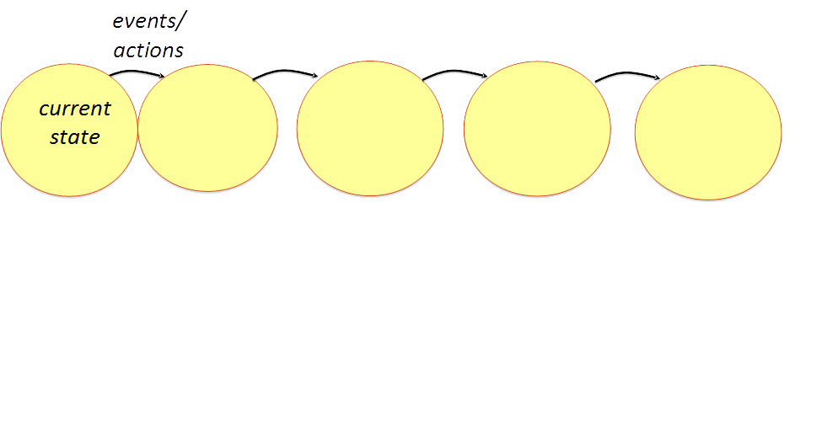
State Transition Systems are common to all areas of Computing
Programming languages:
States are variable/value pairs.
Events are assignment statements.

Slide 62
State Transition Systems are common to all areas of Computing
Relational databases (e.g. SQL):
States are tuples representing “facts”.
Events are updates.

Slide 63
State Transition Systems are common to all areas of Computing
Artificial Intelligence:
States are theories or “facts”
representing an agent’s beliefs.
Events initiate and terminate facts (or beliefs).

Slide 64
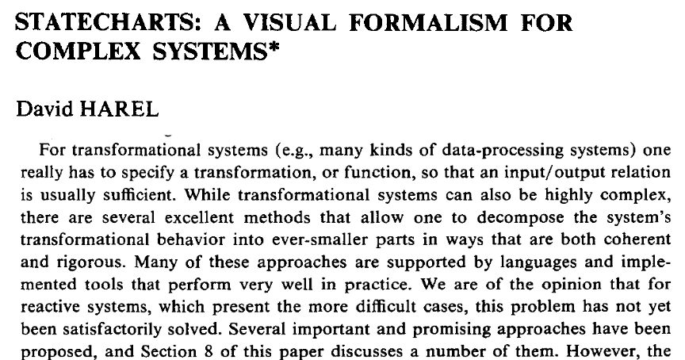

Two kinds of systems
logic programs in LPS
reactive rules in LPS

Slide 65
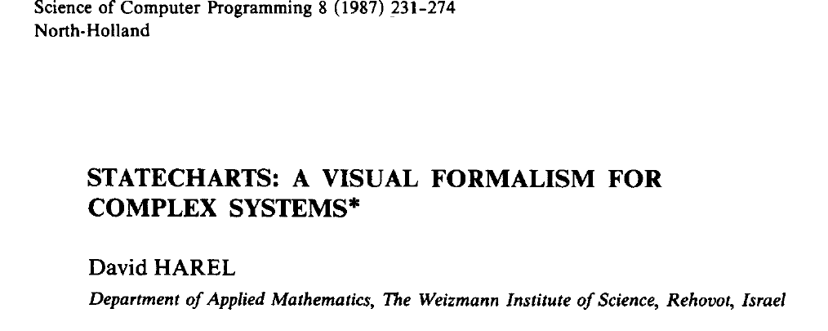
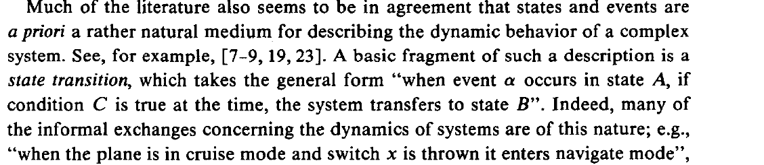
reactive rule

Slide 66
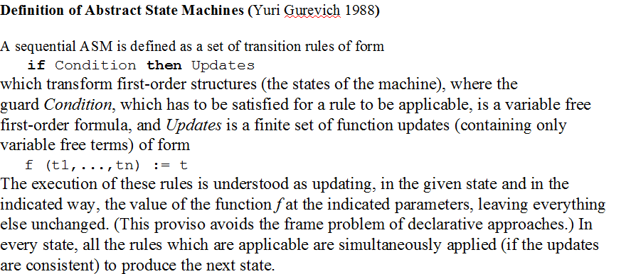

From Abstract State Machine Tutorial presented by Egon Börger
not logical
if-then

Slide 67
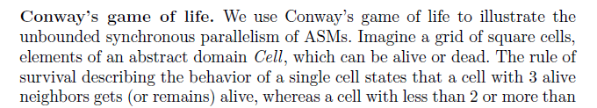
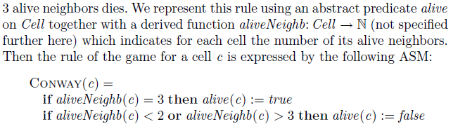

https://en.wikipedia.org/wiki/Conway%27s_Game_of_Life

Slide 68
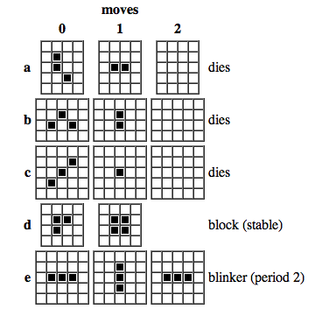

Slide 69
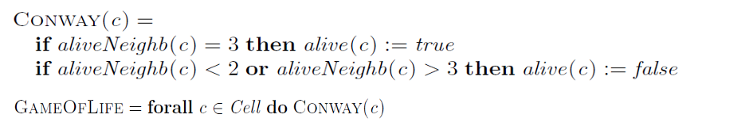
LPS and Abstract State Machines Compared
Reactive Rules in LPS:
if aliveNeighb(C, 3) at T
then make-alive(C) from T to T+1.
if aliveNeighb(C, N) at T, N ≠ 2, N ≠ 3
then unmake-alive(C) from T to T+1.

Slide 70
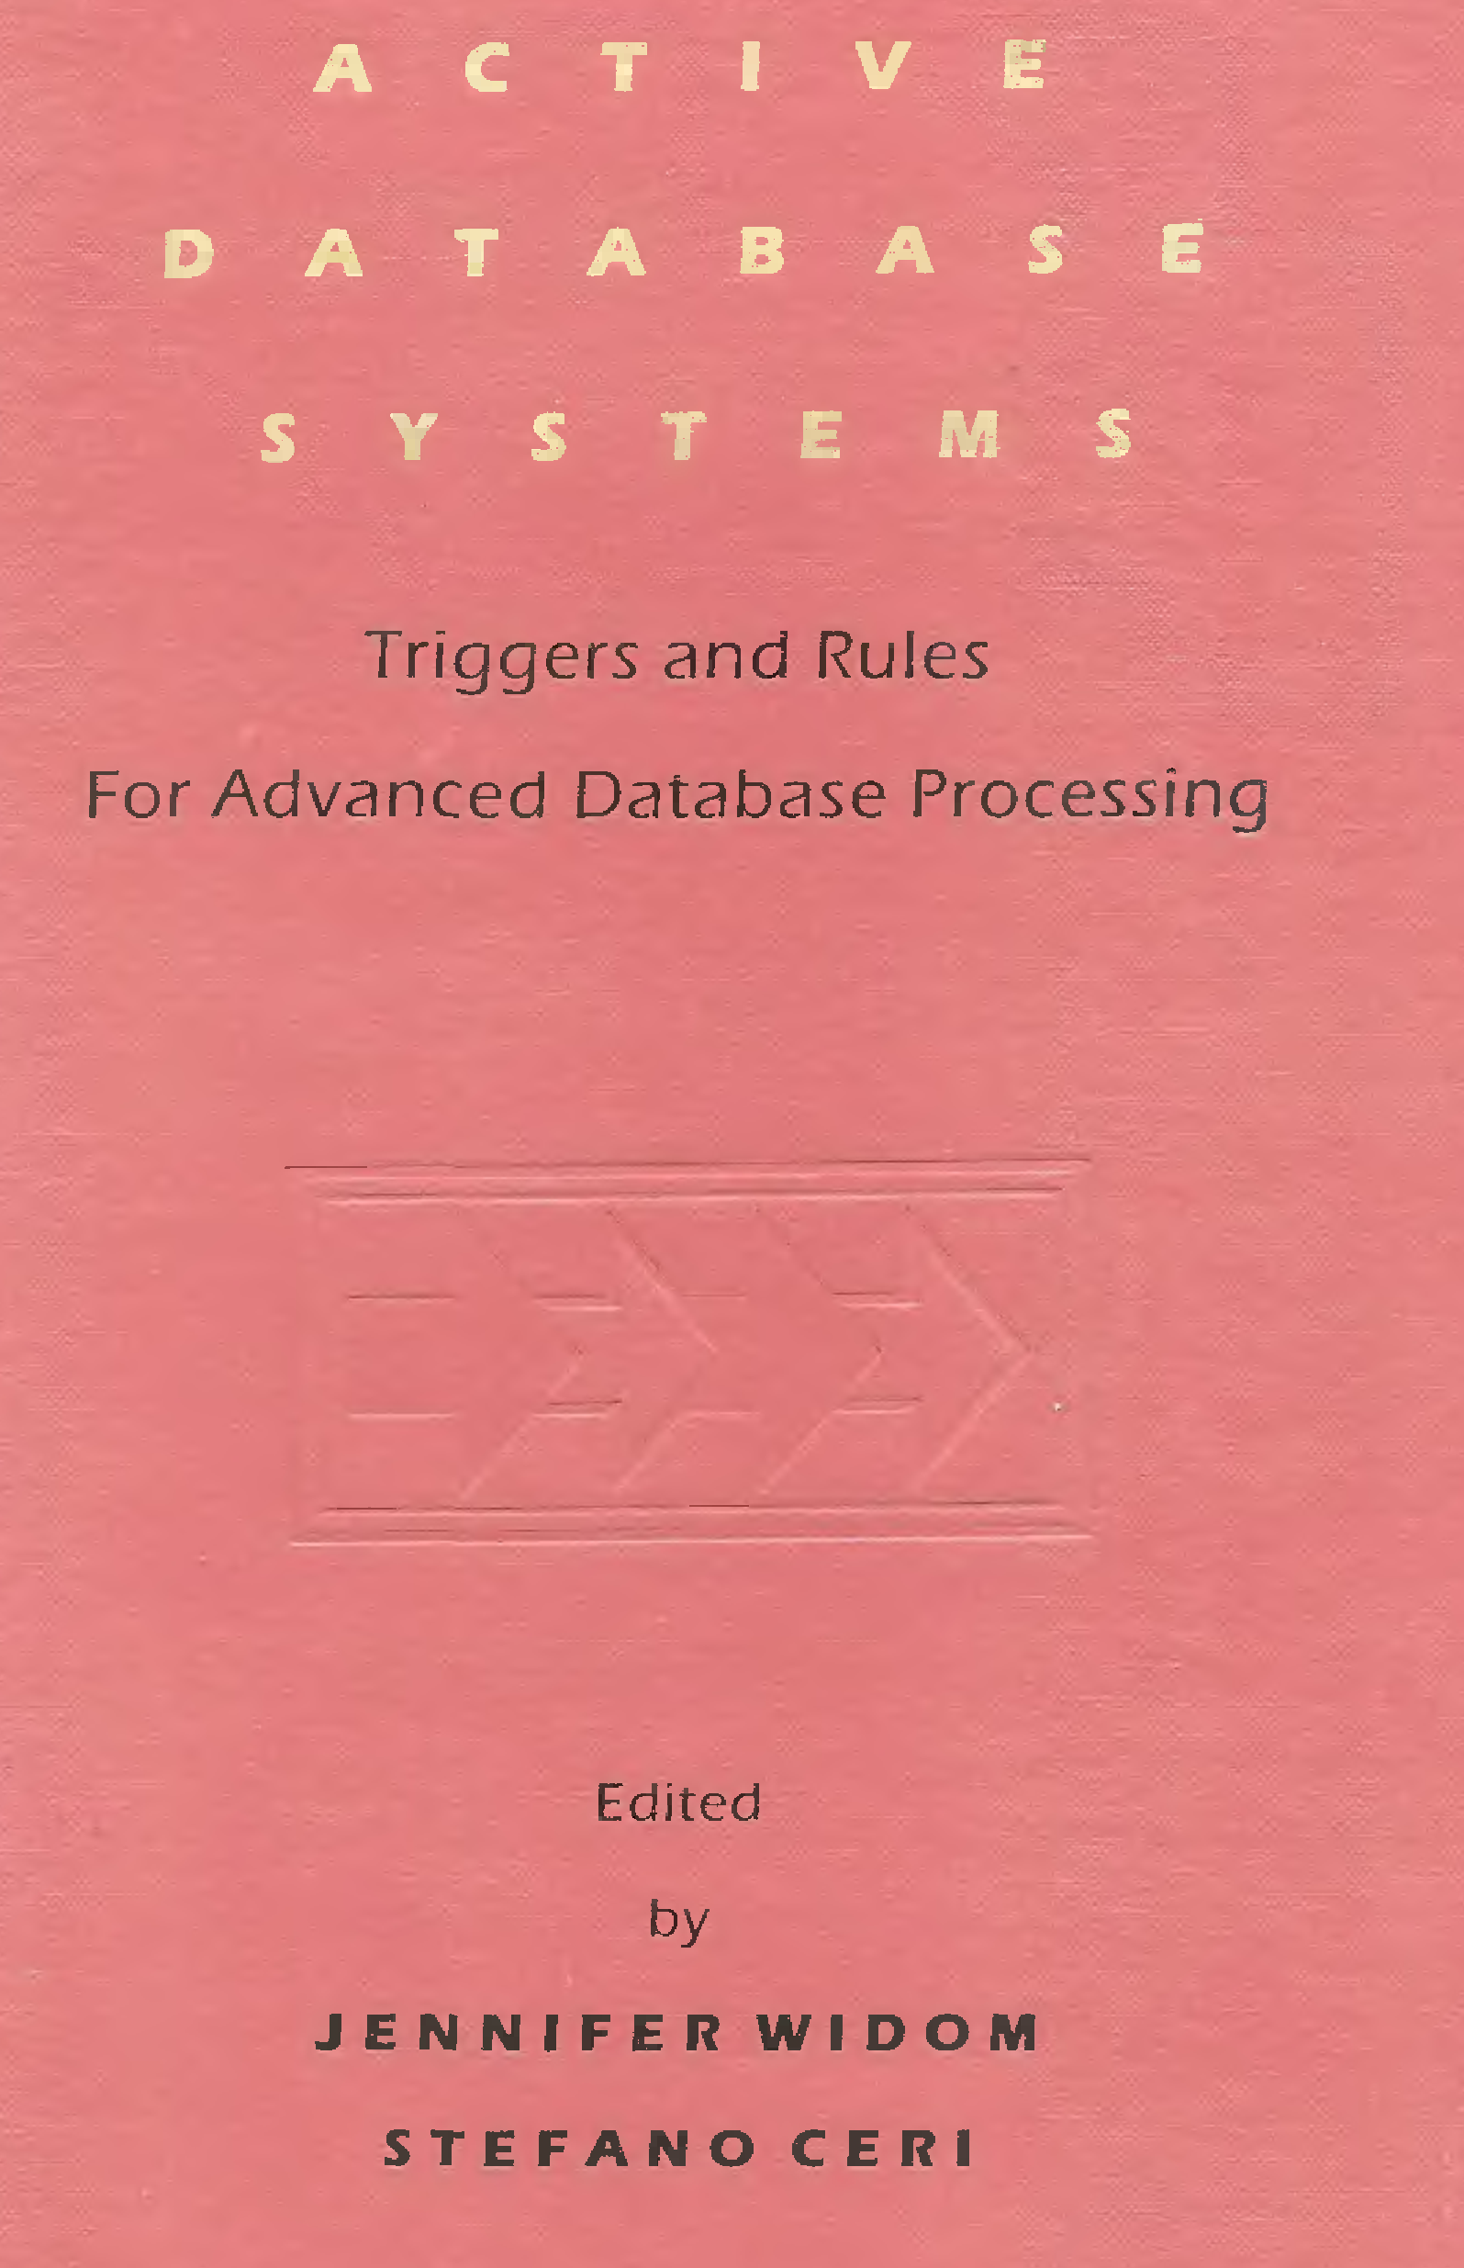

Slide 71
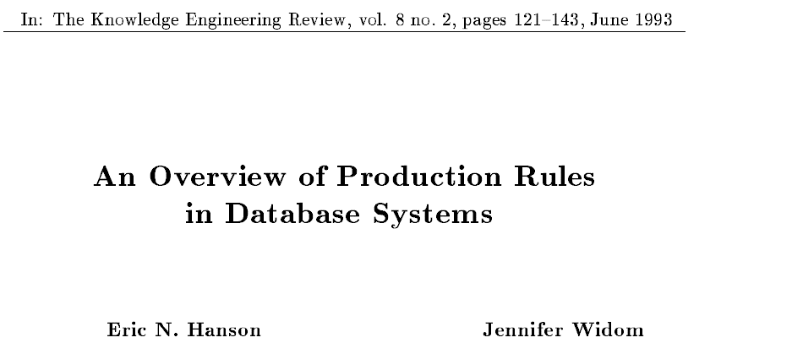
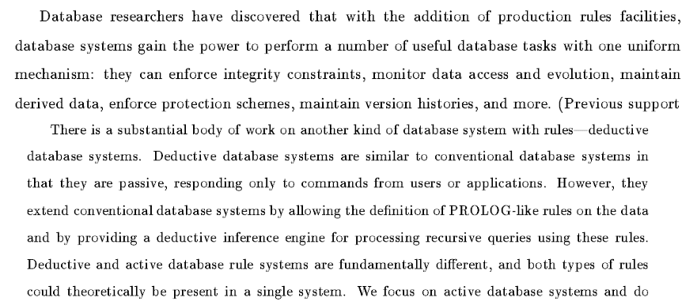

Slide 73
Transaction Logic Programming
State transitions are defined by logic programs.
States are sets of fluents (trivial logic programs).
Intensional predicates are defined by logic programs.
States are updated destructively.
“Atomicity” is achieved by explicit “roll-back”.
No reactive rules.
But transactions are like consequents of reactive rules.
Computation is model generation to make transactions true.

Slide 74
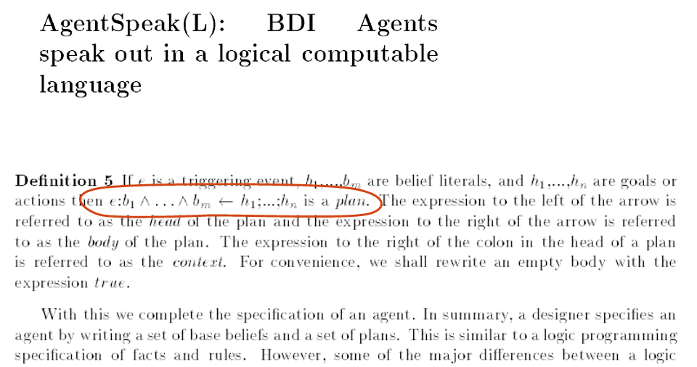
Reactive rules and logic programs:
It can be hard to tell the difference

Slide 75
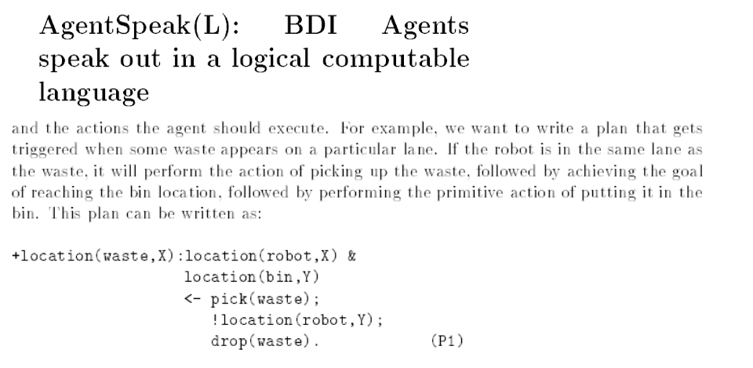
← is the opposite of logical if.

Slide 76
Conclusions
LPS combines and reconciles
declarative and imperative languages.
LPS combines and reconciles programming, databases and
AI knowledge representation and problem solving languages.
LPS combines logic with destructive updates.

Slide 77
LPS/CLOUT Overview of the Workshop
Introduction
Demo of LPS/CLOUT examples
LPS compared with other computer languages
Hands-on use of LPS/CLOUT
LPS in relation to Computational and Logical Thinking

Slide 78
Fire Example – avoid the repeated escapes in the model
Notice that the model has repeated escapes.
So we have to improve the logic of the example.
Which is best:
escape terminates fire?
change the goal to:
if fire at T1, danger at T1 then deal_with_fire from T2 to T3?
add locations, and a precondition that you do not escape if your location is not the location of the fire?

Slide 79
Fire example slightly extended to avoid multiple escapes
maxTime(10).
fluents fire, water, danger.
actions eliminate, escape, ignite(_).
initially water.
flammable(sofa).
flammable(bed).
observe ignite(sofa) from 1 to 2.
observe ignite(bed) from 4 to 5.
if fire at T1, danger at T1 then deal_with_fire from T2 to T3.
deal_with_fire from T1 to T2 if eliminate from T1 to T2.
deal_with_fire from T1 to T2 if escape from T1 to T2.
ignite(Object) initiates fire if flammable(Object).
ignite(Object) initiates danger if flammable(Object).
eliminate terminates fire.
eliminate terminates water.
escape terminates danger.
false eliminate, fire, not water.

Slide 80
Trash example extended with container capacity
Add a capacity to each container, initially, say two items each.
Make sure capacity is taken care of in the causality theory.
Observe 3 trash bottles at different times,
say times 1 to 2, 2 to 3, and 3 to 4.

Slide 81
% simplified bubble sort. Too simple. But what's wrong with it?
% Interesting behaviour, nonetheless.
maxTime(5).
fluents location(_, _).
actions swap(_,_,_,_).
initially location(d, 1), location(c, 2), location(b, 3), location(a,4).
if location(X, N1) at T1, N2 is N1 +1, location(Y, N2) at T1, Y@<X
then swap(X, N1, Y, N2) from T2 to T3.
swap(X, N1, Y, N2) initiates location(X, N2).
swap(X, N1, Y, N2) initiates location(Y, N1).
swap(X, N1, Y, N2) terminates location(X, N1).
swap(X, N1, Y, N2) terminates location(Y, N2).
false swap(X, N1, Y, N2), swap(Y, N2, Z, N3).

Slide 82
LPS/CLOUT Overview of the Workshop
Introduction
Demo of LPS/CLOUT examples
LPS compared with other computer languages
Hands-on use of of LPS/CLOUT
LPS in relation to Computational and
Logical Thinking
Feedback and advice

Slide 83
LPS combines
Algorithmic thinking
by state transitions
Goals and beliefs
Problem decomposition
by backwards reasoning
Top down versus bottom up reasoning
= analysis versus synthesis
Computational
thinking
Logical
thinking

Slide 84
logic programs
in LPS
reactive rules
in LPS

Slide 85
Goals and Beliefs
It can be hard to tell them apart.
All humans are mortal.
All humans are kind.

Slide 86

Goals and beliefs form a pyramid

Slide 87
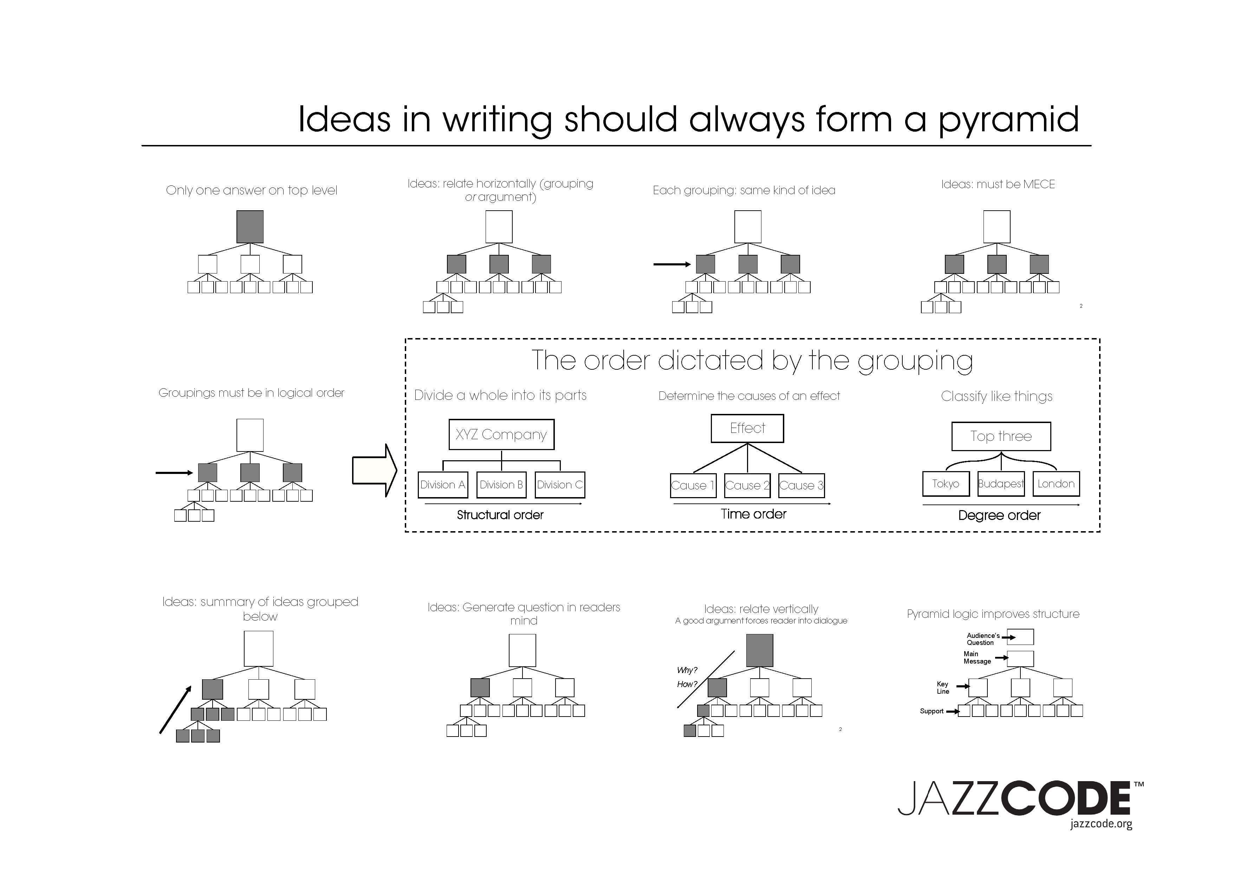

Slide 88
Logic programs have the shape of a pyramid or triangle.
The goal is at the top. (But only an achievement goal.) Reactive rules are “maintenance goals”.

Slide 89
The task of an intelligent agent is to make its goals true.
Goals
Beliefs
Observations
Actions
The world

Slide 90
forward + backward reasoning
Goals
Beliefs
Observations
Actions
The world

Slide 91
Production Systems
Conditions
Actions

Slide 93

Confusion about the relationship between logic and human thinking
“Rules are if-then structures...
very similar to the conditionals...
but they have very different
representational and computational properties.”

Slide 94
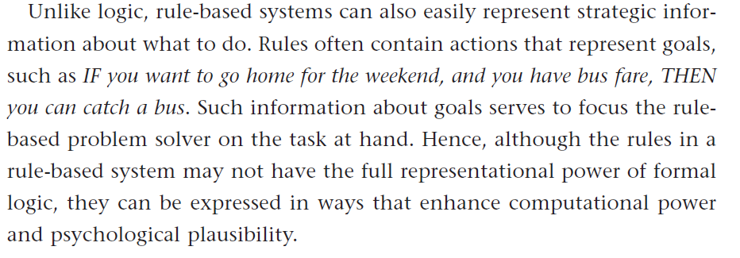

Reactive rules and logic programs:
It can be hard to tell the difference
Logic Program in LPS:
You go home from T1 to T2
if you have the bus fare at T1,
you catch a bus from T1 to T2.
More precisely and more generally:
go(Agent, Destination) from T1 to T3
if at(Agent, Location) at T1,
busRoute(Bus, Location, Destination),
catch(Agent, Bus, Location) from T1 to T2.
disembark(Agent, Bus, Destination) from T2, to T3.

Slide 95
Logic as the representation of human thought
A communication is easy to understand
if it is expressed in a form that
is close to the reader’s mental representation.
A communication about how to behave in an emergency
should be easy to understand.
Therefore, a communication about how to behave in an emergency
should be expressed in a form that
is close to the reader’ mental representation.
.

Slide 96
Emergencies
Press the alarm signal button
to alert the driver.
The driver will stop
if any part of the train is in a station.
If not, the train will continue to the next station,
where help can more easily be given.
There is a 50 pound penalty
for improper use.
1
2
3
4

Slide 97
The logic of sentence 1 is hidden by the imperative manner of expression
Press the alarm signal button
to alert the driver.
The hidden logic:
you alert the driver
if you press the alarm signal button.
Backward reasoning decomposes the problem to a subproblem.

Slide 98
The logic of sentence 2 (and 3) is (almost) obvious
The driver will stop
if any part of the train is in a station.

Slide 99
The logic of sentence 2 (and 3) is (almost) obvious
The driver will stop
if any part of the train is in a station.
Logic Program:
the driver will stop the train in a station
if you alert the driver
and any part of the train is in the station.

Slide 100
The logic of sentence 2 (and 3) is (almost) obvious
The driver will stop
if any part of the train is in a station.
Logic Program:
the driver will stop the train in a station
if you alert the driver
and any part of the train is in the station.
Forward reasoning derives
logical consequences of alerting the driver.

Slide 101
The logic of sentence 4 is hidden
There is a 50 pound penalty
for improper use.
The hidden logic:
You may receive a £50 penalty
if you use the alarm signal button improperly
Forward reasoning derives logical consequences.
Backward reasoning decomposes problems into subproblems.
press the alarm signal button improperly
to receive a 50 pound penalty

Slide 102

As Sherlock Holmes explained to Dr. Watson

Slide 103
As Sherlock Holmes explained to Dr. Watson
“In solving a problem of this sort,
the grand thing is to be able to reason backward.
That is a very useful accomplishment,
and a very easy one,
but people do not practise it much.

Slide 104
As Sherlock Holmes explained to Dr. Watson
“In solving a problem of this sort,
the grand thing is to be able to reason backward.
That is a very useful accomplishment,
and a very easy one,
but people do not practise it much.
In the everyday affairs of life,
it is more useful to reason forward,
and so the other comes to be neglected.”

Slide 105

Jonathan Baron “Thinking and Deciding”
(Fourth edition, 2008, page 6)

Slide 106
Jonathan Baron “Thinking and Deciding”
(Fourth edition, 2008, page 6)
“Thinking about actions,
beliefs and personal goals
can all be described in terms of
a common framework,

Slide 107
Jonathan Baron “Thinking and Deciding”
(Fourth edition, 2008, page 6)
“Thinking about actions,
beliefs and personal goals
can all be described in terms of
a common framework,
which asserts that
thinking consists of search and inference.

Slide 108
Jonathan Baron “Thinking and Deciding”
(Fourth edition, 2008, page 6)
“Thinking about actions,
beliefs and personal goals
can all be described in terms of
a common framework,
which asserts that
thinking consists of search and inference.
We search for certain objects and then make inferences
from and about the objects we have found.”

Slide 109
Jonathan Baron “Thinking and Deciding”
(Fourth edition, 2008, page 6)
“Thinking about actions,
beliefs and personal goals
can all be described in terms of
a common framework,
which asserts that
thinking consists of search and inference.
We search for certain objects and then make inferences
from and about the objects we have found.”
And then we decide.

Slide 110
Prisoner’s Dilemma
Classic example of decision making.
Illustrates that co-operation is better than selfishness.
You and I are arrested.
If we betray each other,
then we both get 2 years in prison.
If we both remain silent,
then we both get 1 year in prison.
If I betray you, but you remain silent,
then I get 0 years in prison,
and you get 3 years in prison (and vice versa).
goals?
or
beliefs?

Slide 111
maxTime(5).
actions refuses(_), bears_witness(_), gets(_,_).
fluents total_years_in_jail(_,_).
initially total_years_in_jail(me,0), total_years_in_jail(you,0).
observe refuses(you) from 0 to 1.
observe bears_witness(me) from 0 to 1.
if bears_witness(P) from T1 to T2, refuses(Q) from T1 to T2
then gets(P,0) from T2 to T3, gets(Q,3) from T2 to T3.
if bears_witness(P) from T1 to T2, bears_witness(Q) from T1 to T2, other(P,Q)
then gets(P,2) from T2 to T3.
if refuses(P) from T1 to T2, refuses(Q) from T1 to T2, other(P,Q)
then gets(P,1) from T2 to T3.
if refuses(O) from T1 to T2, other(I,O)
then refuses(I) from T2 to T3.
if bears_witness(O) from T1 to T2, other(I,O)
then bears_witness(I) from T2 to T3.
other(me,you).
other(you,me).
gets(Prisoner,Years) initiates total_years_in_jail(Prisoner,NewYears)
if total_years_in_jail(Prisoner,OldYears), NewYears is OldYears+Years.
gets(Prisoner,Years) terminates total_years_in_jail(Prisoner, OldYears).

Slide 112
There can be many ways to make the same goals true. Typically, some ways are better than others.
LPS provides only limited ability to represent preferences (order of clauses).
LPS does not provide forward reasoning from candidate actions to derive their likely consequences, to help determine preferences between different candidate actions.
LPS can make reactive rules true only by actively making their consequents true when their antecedents become true.
LPS cannot make rules true proactively by making their consequents true before their antecedents become true, or preventively by making their antecedents false.

Slide 113
Conclusions
LPS combines
computational thinking and
logical thinking.
LPS is a practical, logical framework for computing.
LPS is not a full-scale framework for intelligent thinking,
but it can be extended.

Slide 114
LPS/CLOUT Overview of the Workshop
Introduction
Demo of LPS/CLOUT examples
LPS in relation to computer science
Hands-on use of LPS/CLOUT
LPS in relation to Computational and Logical Thinking
Feedback and advice

Slide 115
The End

