Slide 1
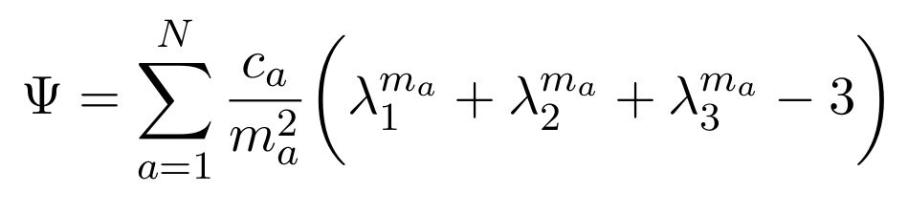

You know that Ogden hyperelastic formulation right?

Slide 2

Hmm it is difficult to see how it works as a material law

Slide 3

Let’s explore the “anatomy” of the Ogden formulation

Slide 4

First let’s distribute the -3 as several -1’s

Slide 5
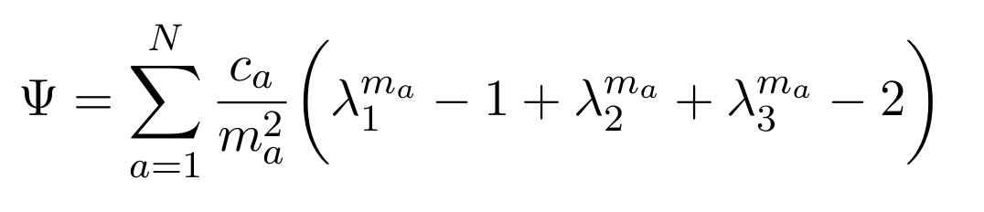

Yep, thats one, let’s do another...

Slide 6
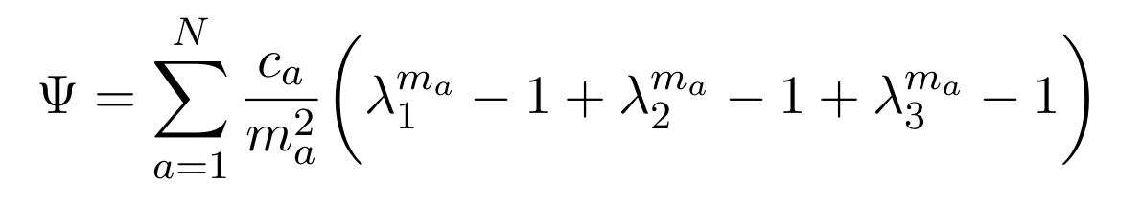
Got it

Slide 7
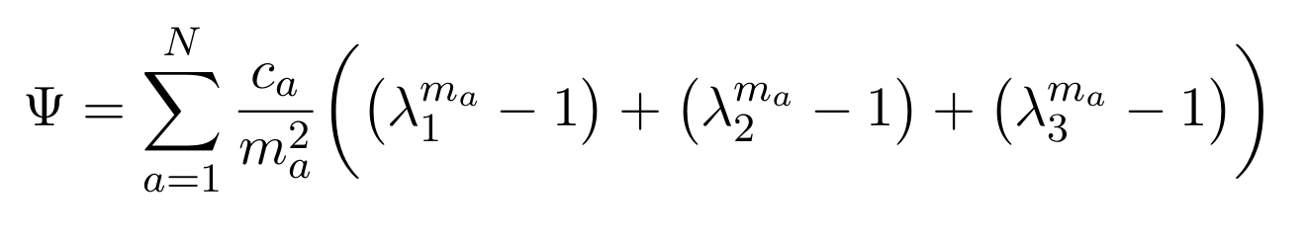

Okay, great so now we can group a bunch of
“stretch minus onezy” bits

Slide 8
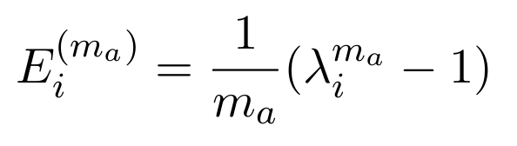

Hold on. Now lets factor out

Slide 9
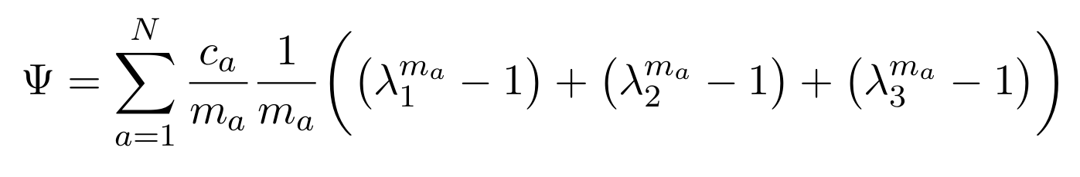

Cool now work that in front of each of the“stretch minus onezy bits”

Slide 10
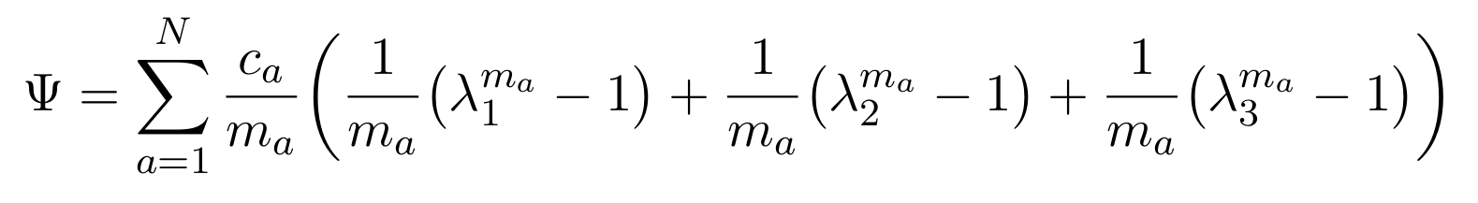
Got it!

Slide 11

Wait those look strangely like strains!

Slide 12

Yep! The Seth-Hill class of strains

Slide 13

Which allows you to pick a strain flavour

Slide 14
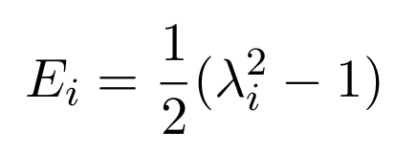
Like chocolate or strawberry or Green-Lagrange strain if you use m=2 (Neo-Hookean!)

Slide 15
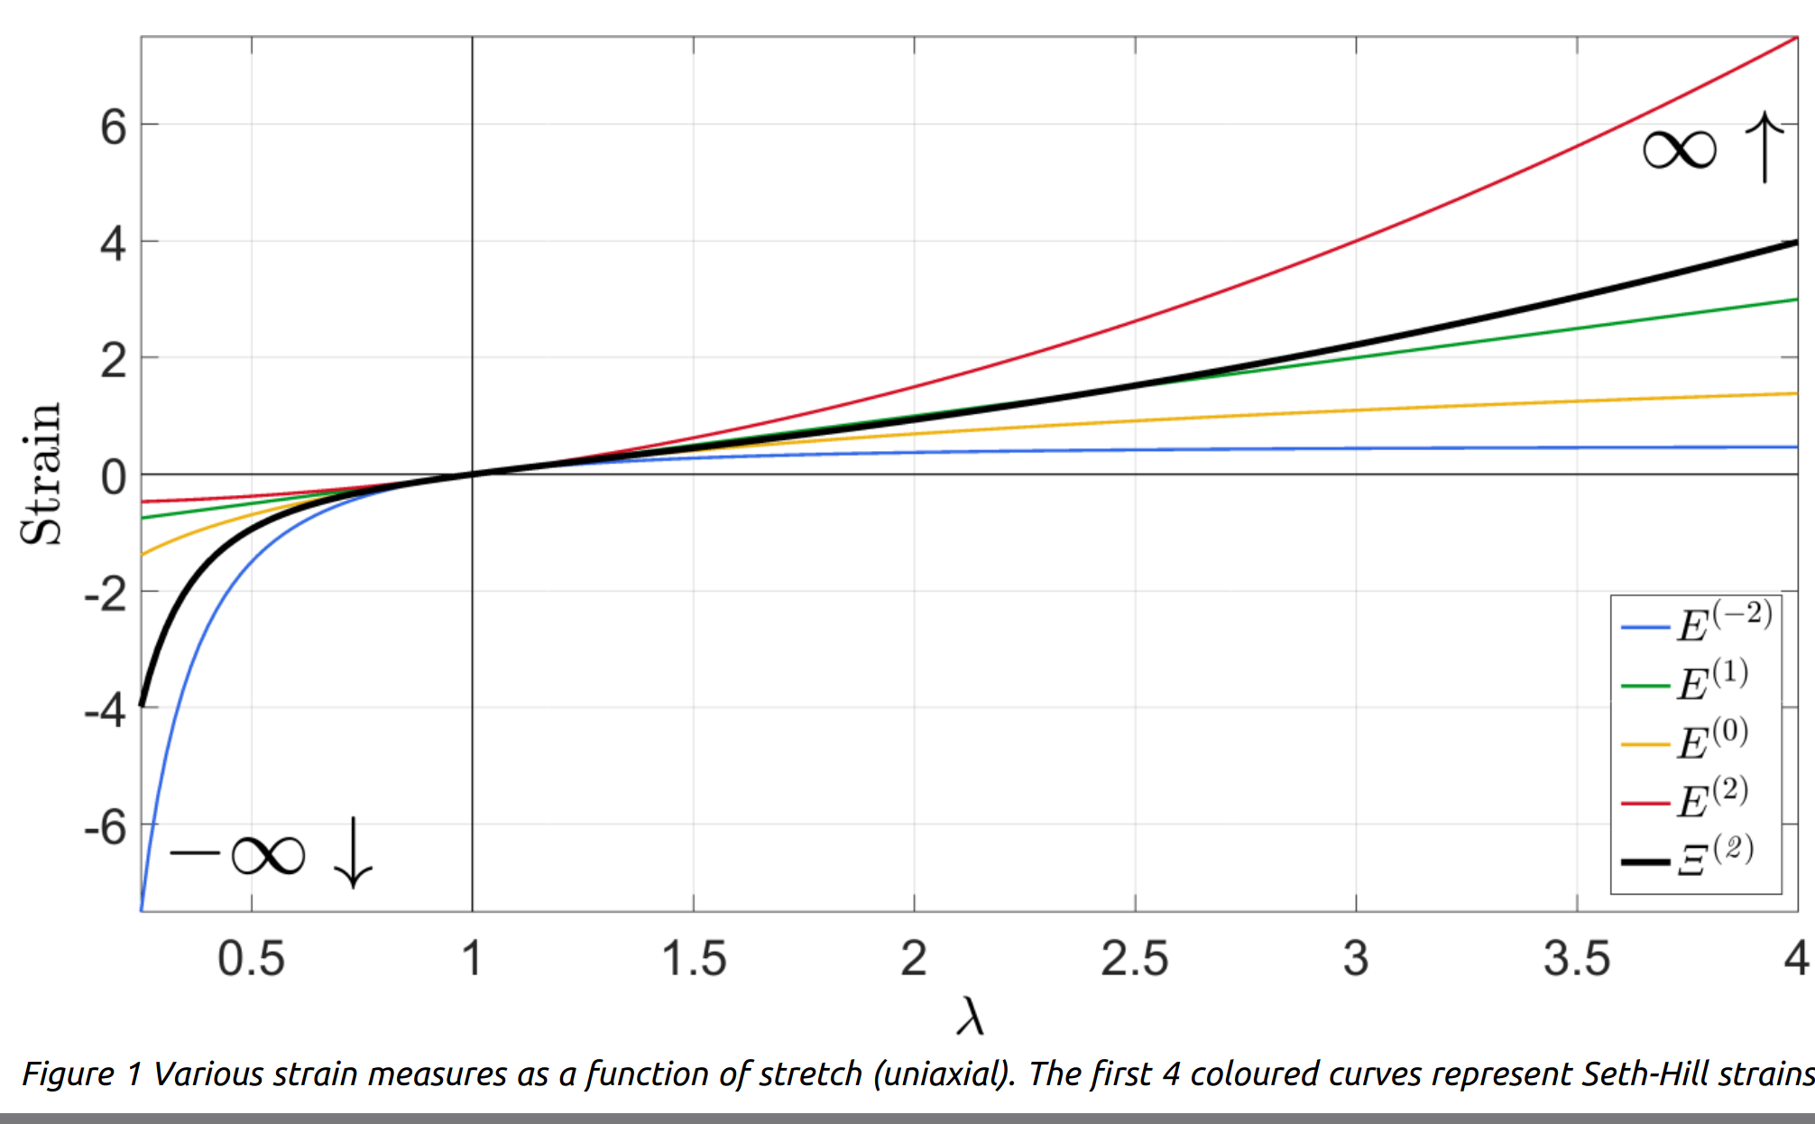
Postive/negative m’s favour tension/compression

Slide 16
But we can clean this up a bit again. Let’s use summation for those three strains.

Slide 17
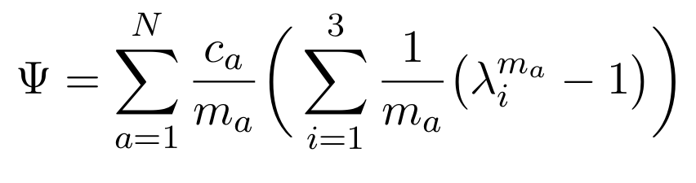

Ahhh... that is so much better

Slide 18
Wait.. we’re using principal stretches.... so those are principal strains....

Slide 19

So we are summing all three principal strains of

Slide 20
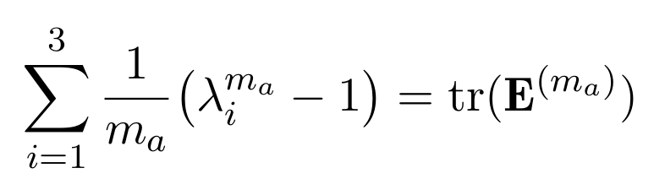
But that is the trace of that strain tensor!

Slide 21
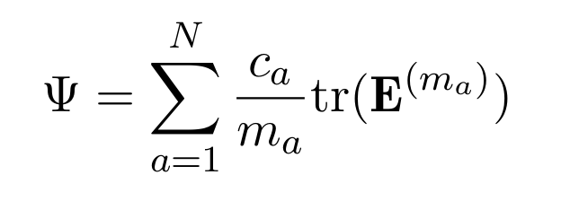

Wow so Ogden features:
“a bunch of traces of desired strain flavours”

