Slide 1
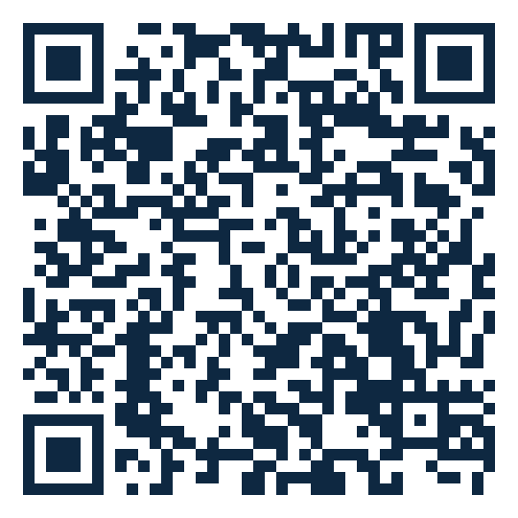

Nuna-Edu-Toolkit
OPEN TOOLKIT · AIoT LAB · CUHK
Collect & annotate first-person audio — and turn it into research datasets.
SCAN TO DOWNLOAD & TRY
Capture wearable audio streamed to your own server, sliced into 1-minute segments
Recall pluggable ASR previews (bring your own model) speed up annotation
Annotate event-driven block + point labels — a swappable, multi-granularity schema
Open self-hostable, privacy-first, free for non-commercial use
Demo · App · Source — one link
kevin-pal.github.io/nuna-edu-toolkit-release
Anlan Peng · Ruihan Xie · Yihang Su · Siyang Jiang · Zhiyuan Xie · Zhenyu Yan · Guoliang Xing — AIoT Lab · The Chinese University of Hong Kong
Contact Anlan Peng · pa025@ie.cuhk.edu.hk aiot.ie.cuhk.edu.hk

