Slide 1


Discovering Health Trends in Recipe Data
EDA of recipes scraped from Allrecipes.com
By Kaelynn Rose

Slide 2
Introduction
People are often encouraged to cook more if they want to eat healthy, but do recipes found online really meet nutritional guidelines?
Goal: To determine if there are any health trends in recipes from Allrecipes.com, the largest and most viewed recipe website, and how they compare to recommended nutrition.
Data: Recipe pages scraped from Allrecipes.com
Recipes from 1997 - 2021
38,156 recipes (rows)
71 features per recipe (recipe name, ingredients, category, instructions, nutrition info, etc).

Slide 3
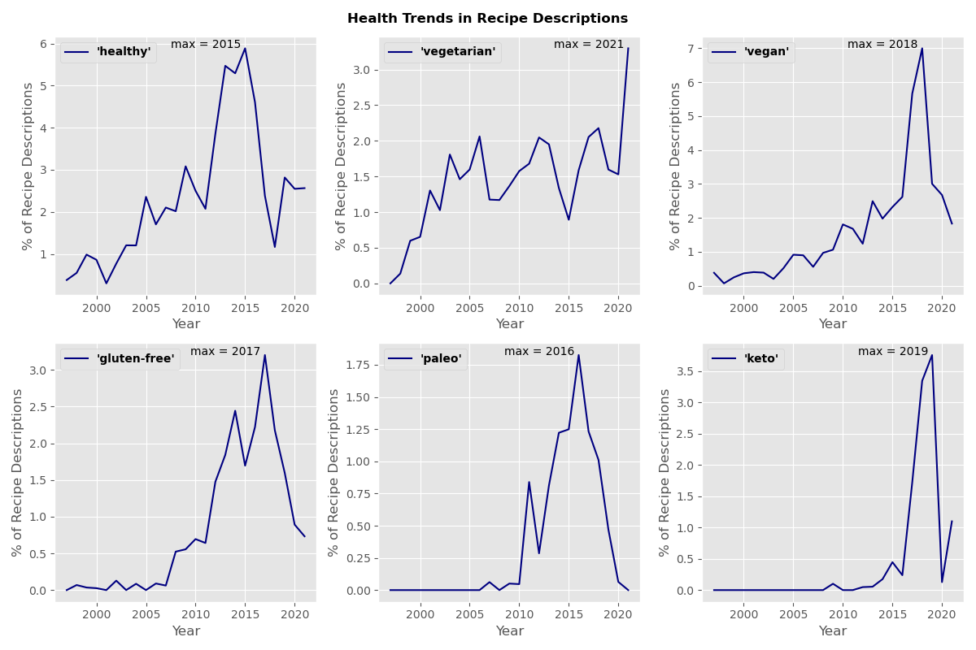
Recipe Description Trends

Slide 4
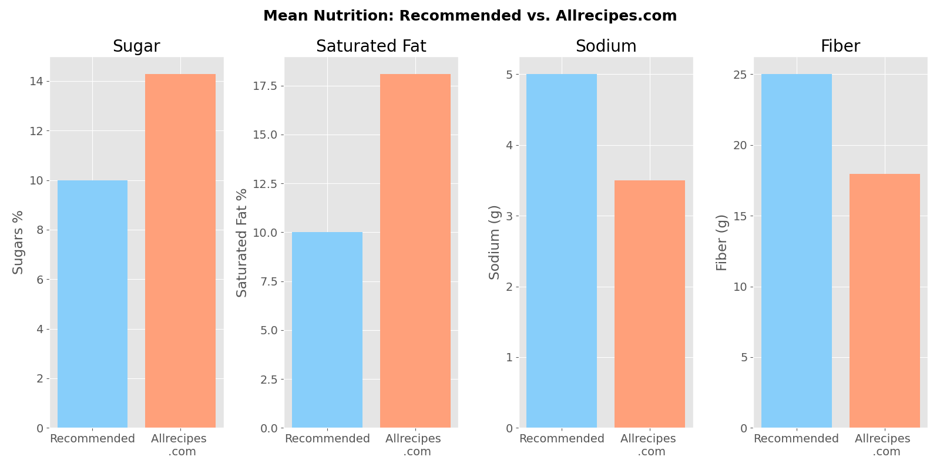
Mean Recipe Nutrition
World Health Organization recommends that adults get:
< 10% of their daily calories from sugar
< 10% from saturated fat
< 5 g salt per day
> 25 g fiber per day

Slide 5
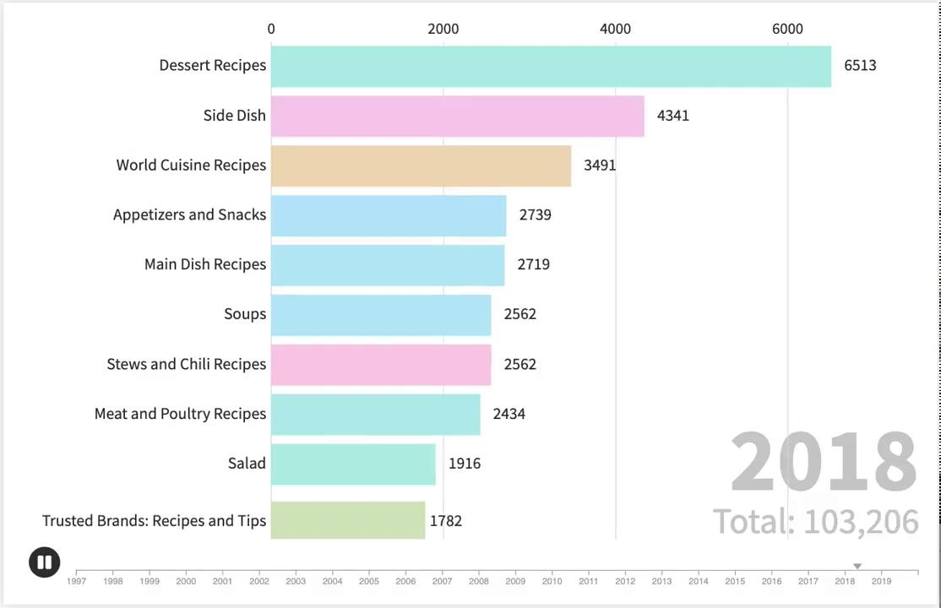
Recipe Categories Over Time
Animation created using Flourish (app.flourish.studio)

Slide 6
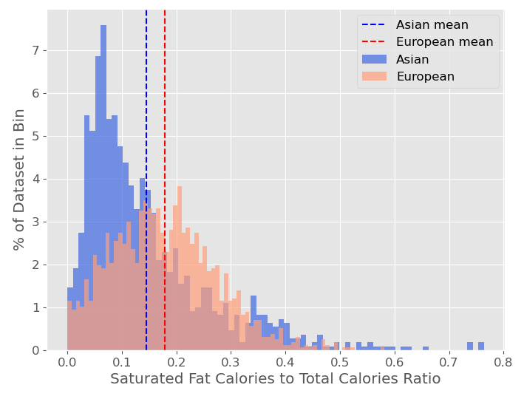
Hypothesis Testing
H₀: The recipe category does not influence the saturated fat calories to total calories ratio per serving
H_{A}: That the recipes in the 'Asian' category will have a different saturated fat calories to total calories ratio than the 'European' category
2-tailed t-test, α = 0.05
Asian Category (1106 recipes):
Mean = 0.14
Var = 0.014
European Category (1598 recipes):
Mean = 0.18
Var = 0.009
The p-value is 3.24e-14, so we reject the null hypothesis

Slide 7
Conclusions
Diet trends can be seen in recipe descriptions
People cooking from home to eat healthier should try to choose recipe options that are lower in fat and sugar and higher in fiber
There is a decrease in proportion of dessert recipes over time
Hypothesis testing of this dataset can be used to choose “healthier” options between recipe categories

Slide 8
Questions?

Slide 9
Extra Slides

Slide 10
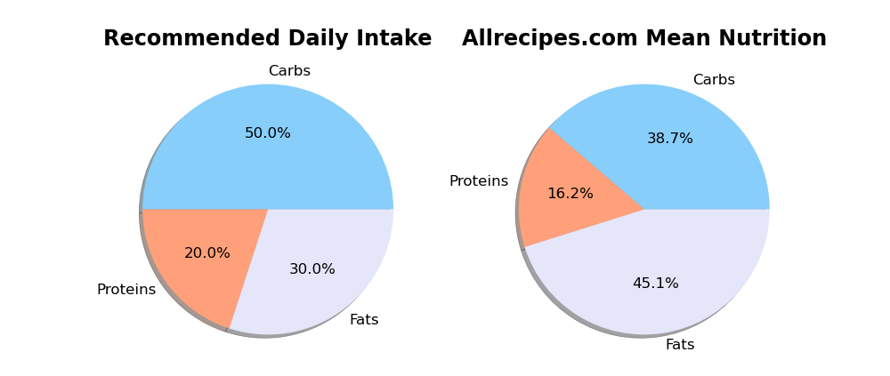
Recommended Daily Nutrition vs. Allrecipes

Slide 11
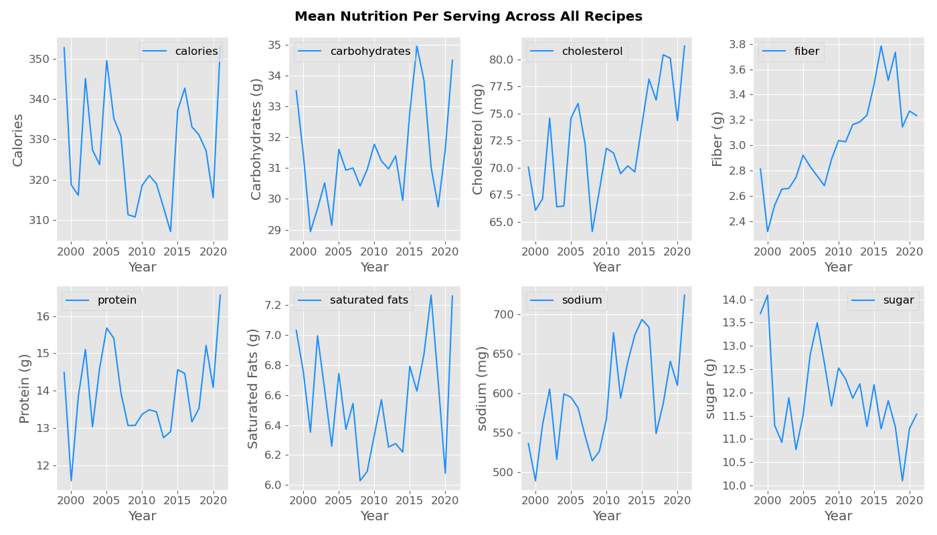
Mean Recipe Nutrition Over Time

Slide 12
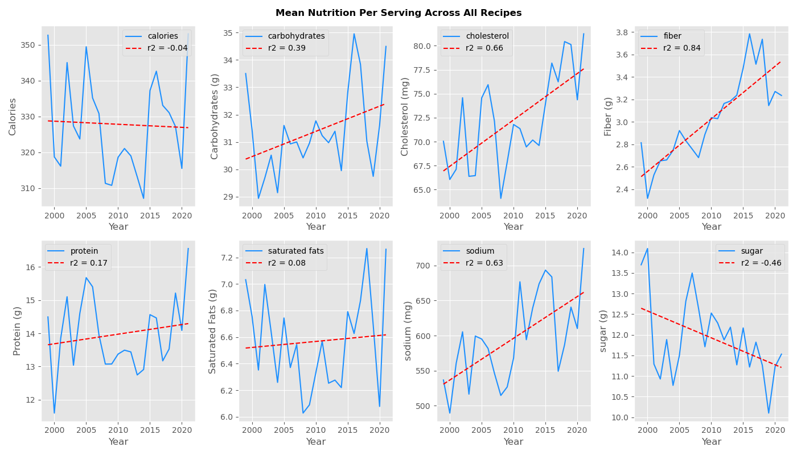
Mean Recipe Nutrition Over Time

Slide 13
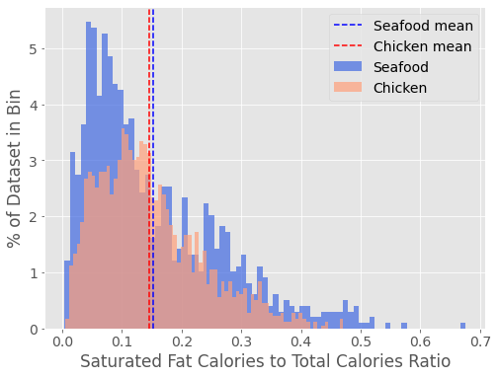
Hypothesis Testing
H0: The recipe category does not influence the saturated fat calories to total calories ratio
HA: That the recipes in the 'Seafood' category will have a different saturated fat calories to total calories ratio than the 'Chicken’' category
2-tailed t-test, alpha = 0.05
Seafood Category:
Mean = 0.152
Var = 0.013
Chicken Category:
Mean = 0.146
Var = 0.008
The p-value is 0.115, so we cannot reject the null hypothesis

Slide 14
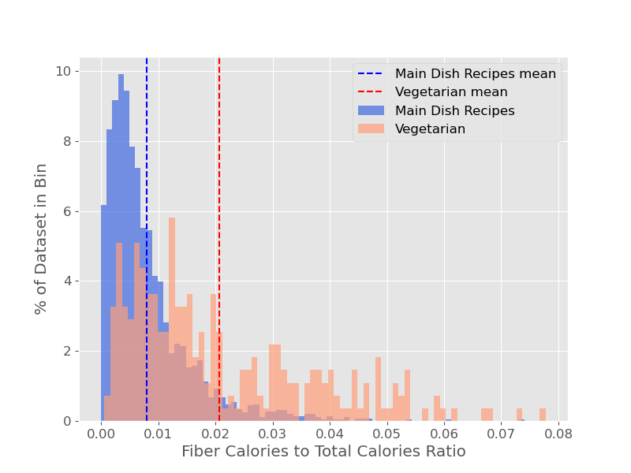
Hypothesis Testing
H0: The recipe category does not influence the fiber to calories ratio
HA: That the recipes in the 'Main Dish' category will have a different fiber to calories ratio than the 'Vegetarian' category
2-tailed t-test, alpha = 0.05
Main Dish Category:
Mean = 0.008
Var = 0.000055
Vegetarian Category:
Mean = 0.021
Var = 0.000263
The p-value is 0.0, so we reject the null hypothesis

Slide 15
