Slide 1


Discovering Health Trends in Recipe Data
EDA of recipes scraped from Allrecipes.com
By Kaelynn Rose

Slide 2
Introduction
People are often encouraged to cook more if they want to eat healthy, but do recipes found online really meet nutritional guidelines?
Goal: To determine if there are any health trends over time in recipes from Allrecipes.com, the largest and most viewed recipe website, and how they compare to recommended nutrition.
Data: scraped recipe pages from Allrecipes.com
Recipes from 1997 - 2021
38,156 recipes (rows)
71 features (recipe name, ingredients, category, instructions, nutrition info, etc).

Slide 3
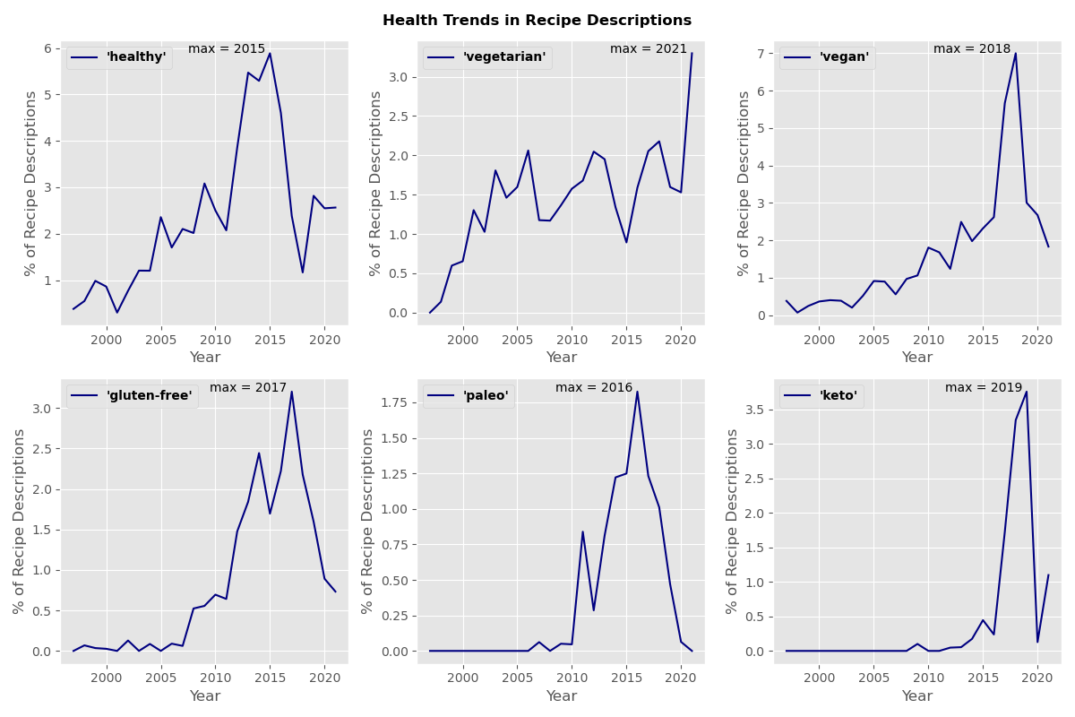
Recipe Description Trends

Slide 4
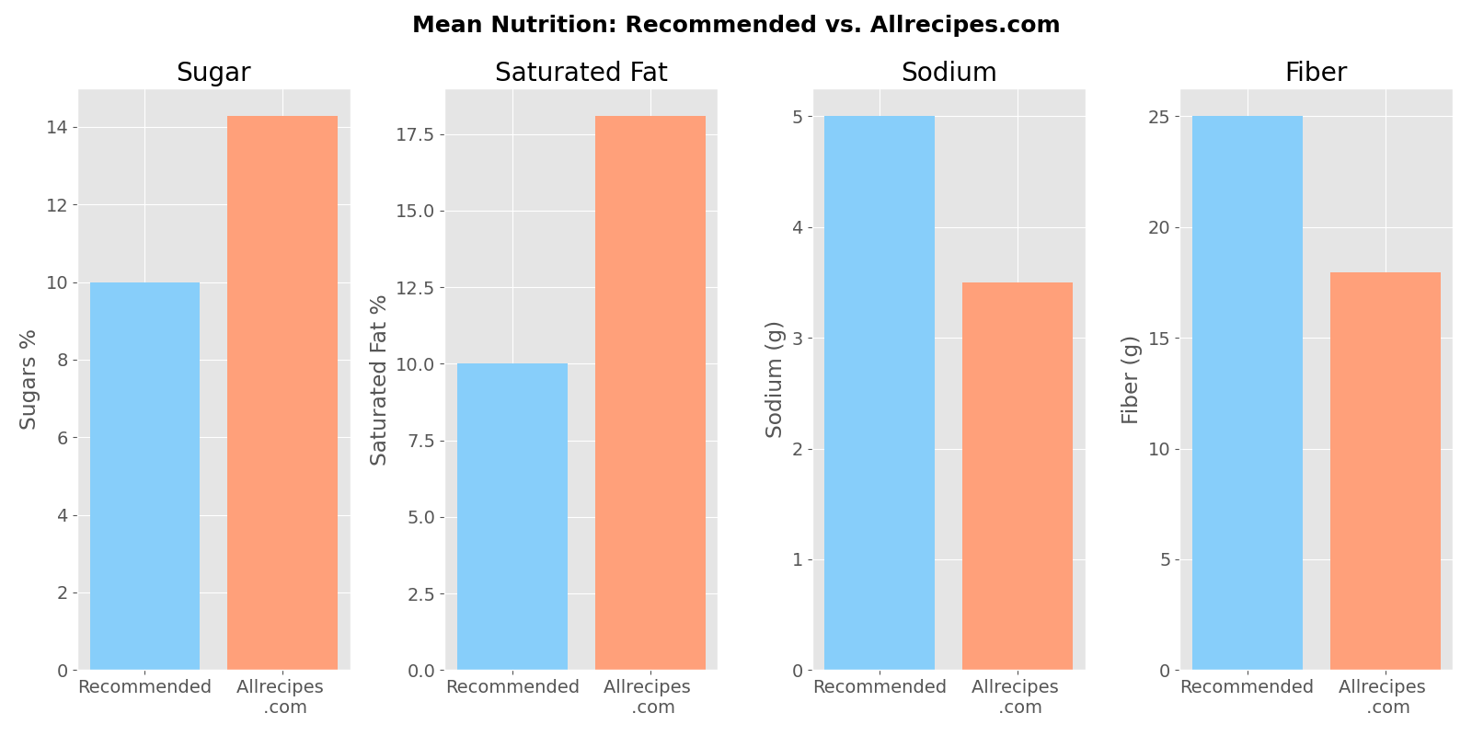
Mean Recipe Nutrition
World Health Organization recommends that adults get:
< 10% of their daily calories from sugar
< 10% from saturated fat
< 5 g salt per day
> 25 g fiber per day

Slide 5
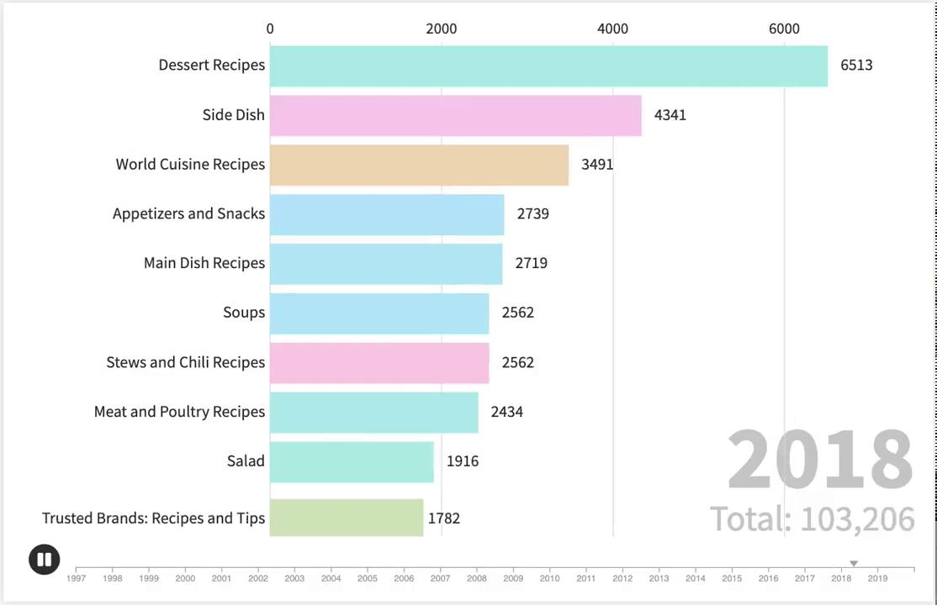
Recipe Categories Over Time
Animation created using Flourish (app.flourish.studio)

Slide 6
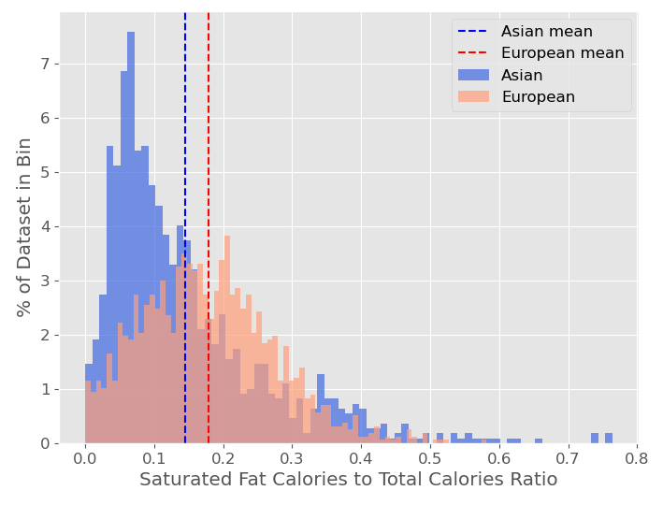
Hypothesis Testing
H0: The recipe category does not influence the saturated fat calories to total calories ratio
HA: That the recipes in the 'Asian' category will have a different saturated fat calories to total calories ratio than the 'European' category
2-tailed t-test, alpha = 0.05
Asian Category (1106 recipes):
Mean = 0.14
Var = 0.014
European Category (1598 recipes):
Mean = 0.18
Var = 0.009
The p-value is 0.0, so we reject the null hypothesis

Slide 7
Conclusions
People cooking from home to eat healthier should try to choose recipe options that are lower in fat and sugar and higher in fiber
An online business centered on health foods and recipes could use this dataset and hypothesis testing as a tool to improve the nutrition of their own recipe content and compare with recommended values

Slide 8
Extra Slides

Slide 9
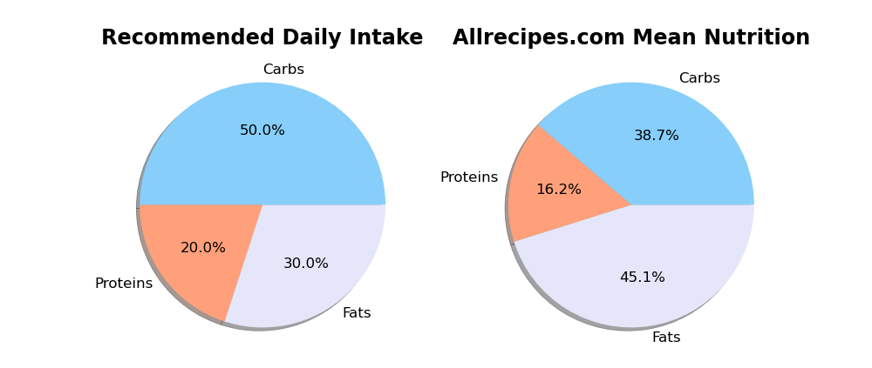
Recommended Daily Nutrition vs. Allrecipes

Slide 10
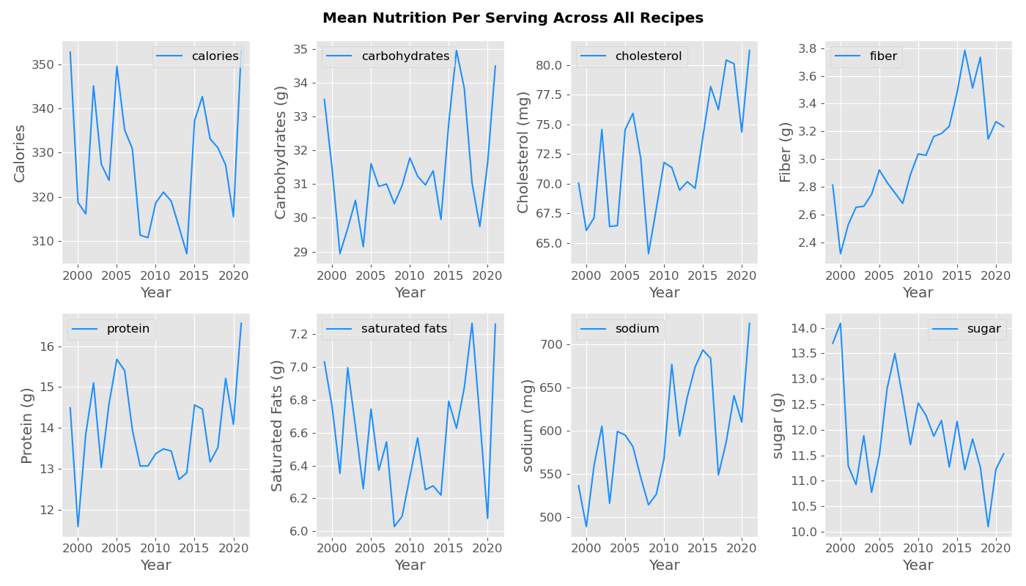
Mean Recipe Nutrition Over Time

Slide 11
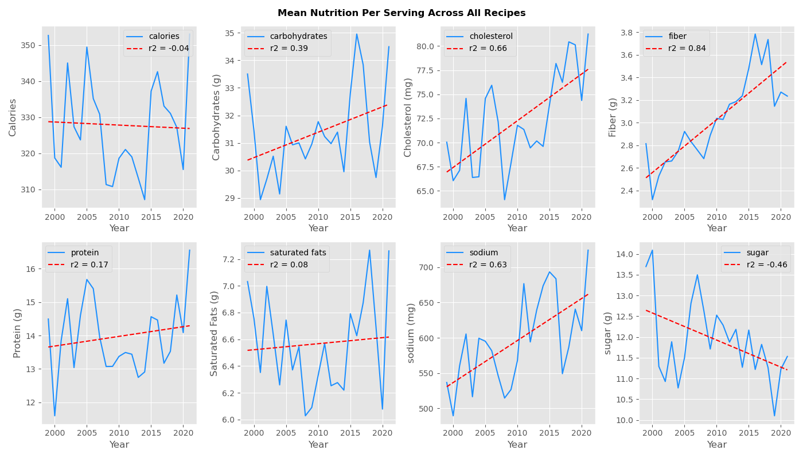
Mean Recipe Nutrition Over Time

Slide 12
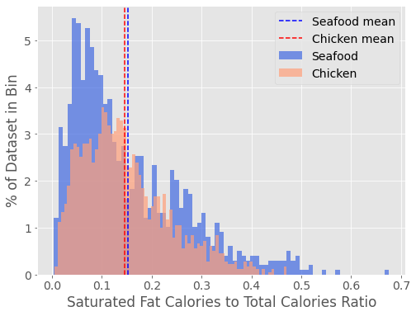
Hypothesis Testing
H0: The recipe category does not influence the saturated fat calories to total calories ratio
HA: That the recipes in the 'Seafood' category will have a different saturated fat calories to total calories ratio than the 'Chicken’' category
2-tailed t-test, alpha = 0.05
Seafood Category:
Mean = 0.152
Var = 0.013
Chicken Category:
Mean = 0.146
Var = 0.008
The p-value is 0.115, so we cannot reject the null hypothesis

Slide 13
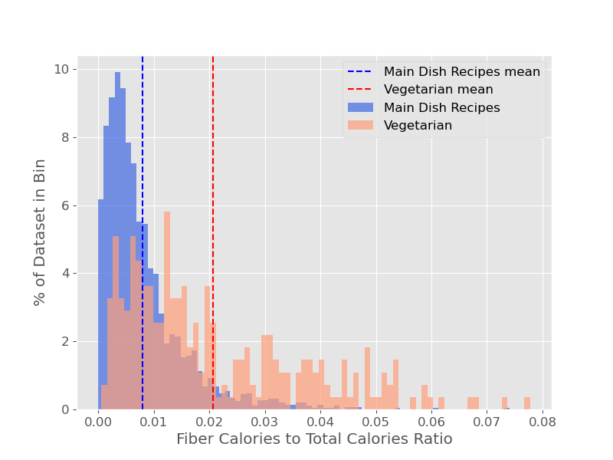
Hypothesis Testing
H0: The recipe category does not influence the fiber to calories ratio
HA: That the recipes in the 'Main Dish' category will have a different fiber to calories ratio than the 'Vegetarian' category
2-tailed t-test, alpha = 0.05
Main Dish Category:
Mean = 0.008
Var = 0.000055
Vegetarian Category:
Mean = 0.021
Var = 0.000263
The p-value is 0.0, so we reject the null hypothesis

Slide 14
