Slide 1


UAV object detection using artificial intelligence
EE6008-48 Group
Dear Mentors:
Jianjun
Ruoyu
Speaker: Hu Kaiwei
Fang Yanlin
Hou Shixiang
Huo Aidong
Notes:
明天可以汇报一下项目的background， objective，related work 包括dataset 还有接下来的计划

Slide 2
Parts
Background
Dataset and model
Objective and further plan

Slide 3
Background: Difference between UAV object detection and Ground Object detection
Perspective(Horizontal, Vertical perspective)
Scale Variability(On the ground, the scale will be smaller and as for the UAV, the scale will be vaster, and the object will be smaller)
Environmental Factors(Less Complex Background and fewer overlapped objects)
They share some similarities, but both have own specific high-level features

Slide 4
Introduction to Project Statement
Dataset: VisDrone
Task 1: Object Detection in Images
Task 2: Object Detection in Videos
Task 3: Single-Object Tracking
Task 4: Multi-Object Tracking
Task 5: Crowd Counting
Pretrained Model: YOLO11
Notes:
Our project is highly based on the dataset, and the VisDrone datset provides five different dataset, so we will choose one of them to study further

Slide 5
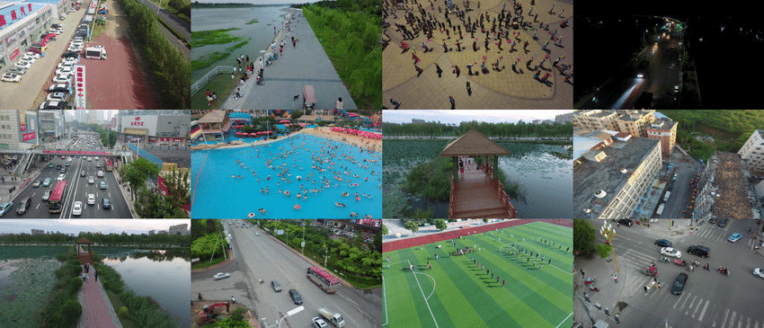
VisDrone Dataset
Images and annotations
Annotations contain the position of bounding box and classification id as well as the attributes
(We choose this VisDrone dataset because it is supported by the YOLO official website, providing the yaml configuration file and making us be able to focus more on benchmarking the performance of the model)

Slide 6
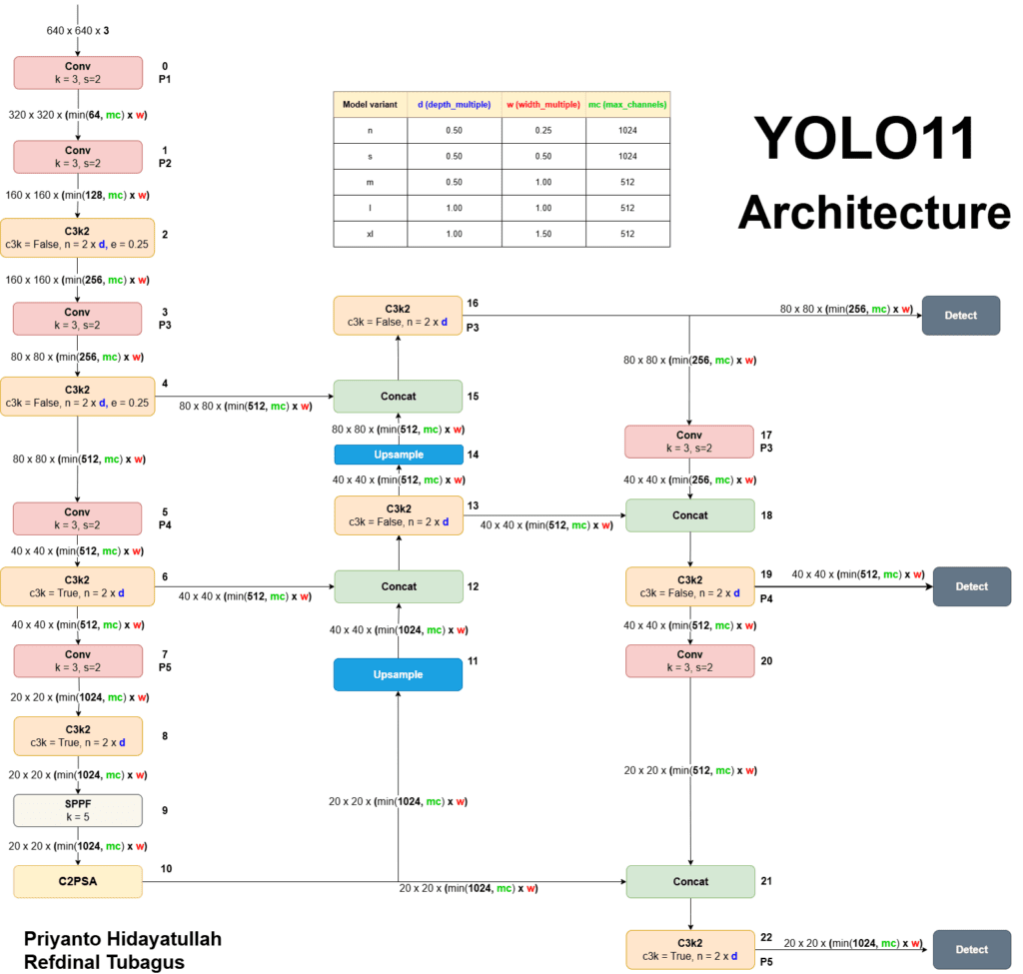
YOLO11
YOLO11 models are versatile and support a wide range of computer vision tasks, including:
Object Detection
Instance Segmentation
Image Classification:
Pose Estimation:
Oriented Object Detection (OBB):
Because of its maturity and convenience for modifying, we choose YOLO11 as the model to do the experiment

Slide 7
Objective and Overall Pipeline
Finish one of the task using the fine-tuned model and compare the performance with the sota AI methods proposed by the research paper, if it is possible we will implement the method in the corresponding research paper
Fine-tune
Get classification id and track the object as well as counting the amount of different types of objects
VisDrone
DataSet
best.pt
Pretrained YOLO11

Slide 8
Related work
1. Environment Setup
2.Download and Preparethe VisDrone Dataset
3. Configure the YOLOv11 Model
4. Train the Model
5. Test and Evaluate

Slide 9
Next step
Train and Fine-tune the Model
Review Existing Literature and Explore Model Improvements

Slide 10
Thank Y u! :)
Produced by UAV group

