Slide 1


UAV Object detection Using Artificial Intelligence
EE6008-48 Group
Supervisor: Yap Kim Hui
Speaker: Hu Kaiwei
Teammate:
Fang Yanlin
Hou Shixiang
Wang Chengtian
Hu Kaiwei
Huo Aidong

Slide 2
What have we learned and done?
Experimental comparison according to the papers
Train the model based on some hyperparameters
Analysis of the different performance
Confusions

Slide 3
Experiment comparison
Last week

Slide 4
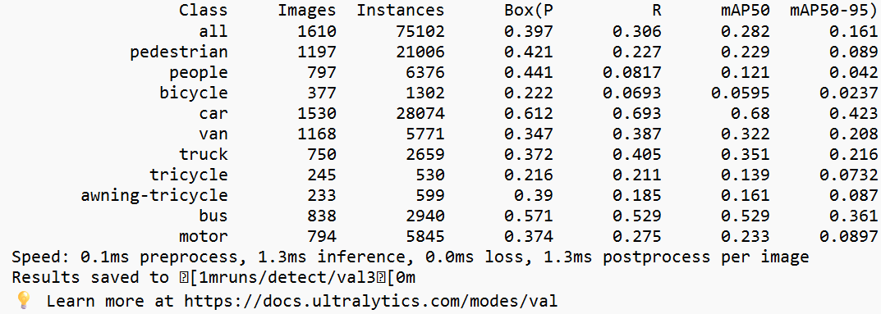
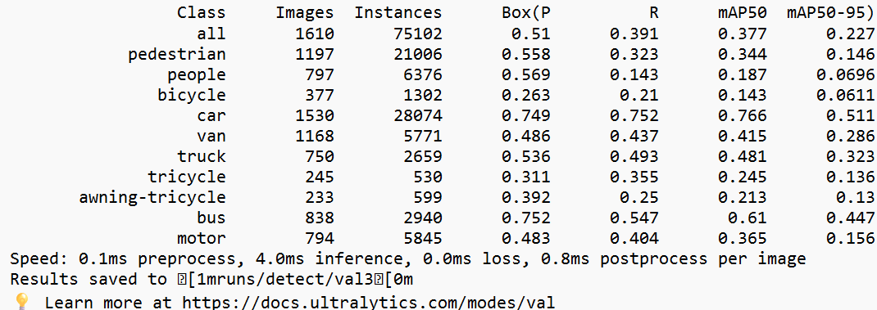
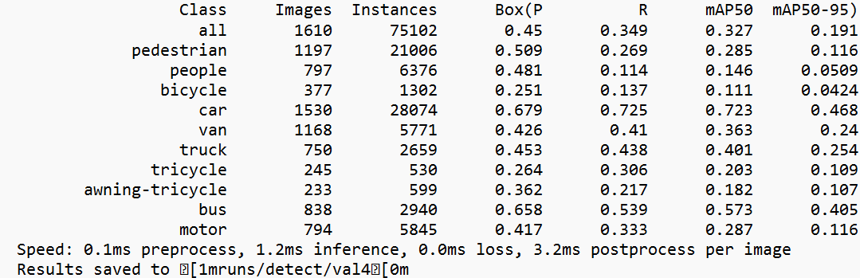
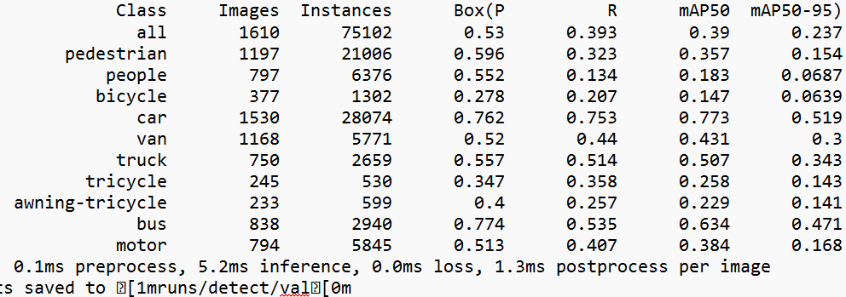
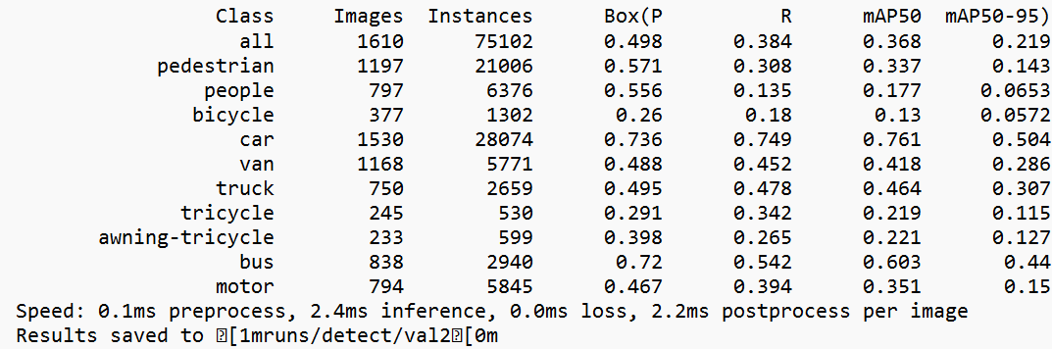
testing result of yolo11nano
testing result of yolo11large
testing result of yolo11xtra
testing result of yolo11small
testing result of yolo11middle
Last week:
Image_size=640
Epoch=100
Initial learning rate = 0.01
Highest mAP50 = 39%
Highest mAP = 23.7%

Slide 5
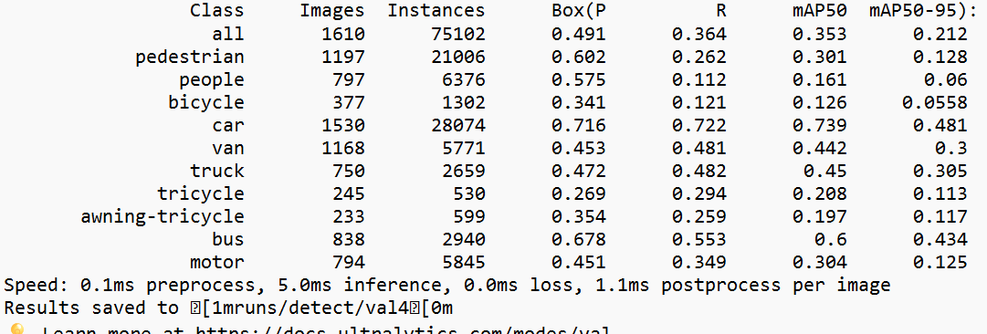
Comparison of yolo11x testing results between epochs=100 and epochs=200
testing result of yolo11xtra with epochs=100
testing result of yolo11xtra with epochs=200
Last week, we also tested 200 epochs on yolo11x model, but the performance is still bad

Slide 6
At first, we refer to the available VisDrone challenge paper on 2018, 2019, 2021
2018
VisDrone-DET2018: The Vision Meets Drone Object Detection in Image Challenge Results
2019
VisDrone-DET2019: The Vision Meets Drone Object Detection in Image Challenge Results
2021
VisDrone-DET2021: The Vision Meets Drone Object detection Challenge Results
We follow the instructions given by professor to refer to some papers, then we notice that we indeed have done something wrong during training the model compared to other models.

Slide 7
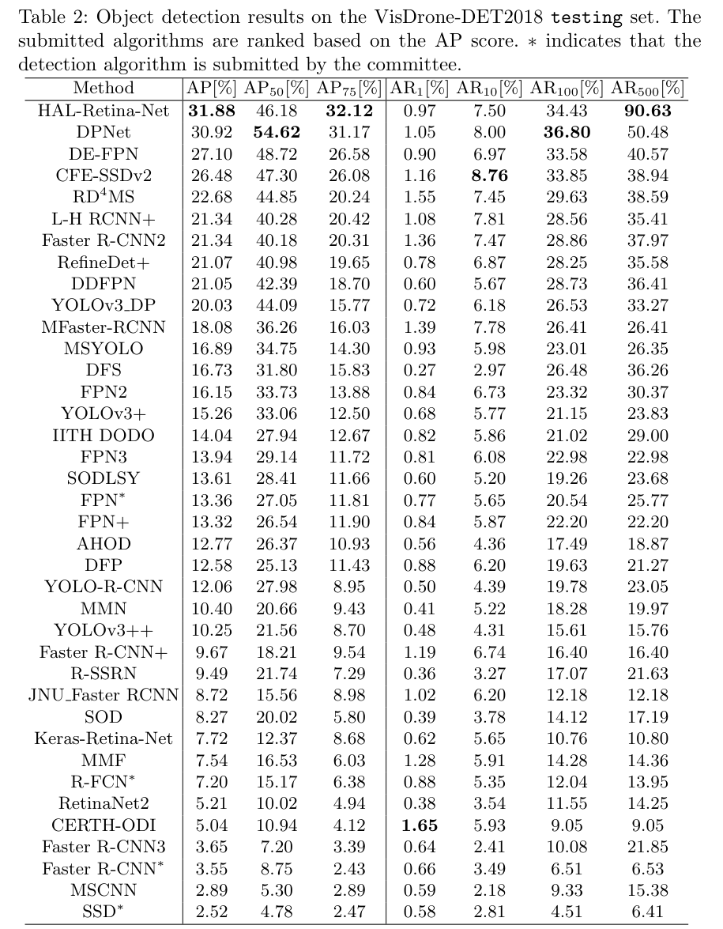
VisDrone-DET2018
HAL-Retina-Net and DPNet are the only two algorithms achieving more than 30% AP score.
Whereas our highest mAP = 23.7%

Slide 8
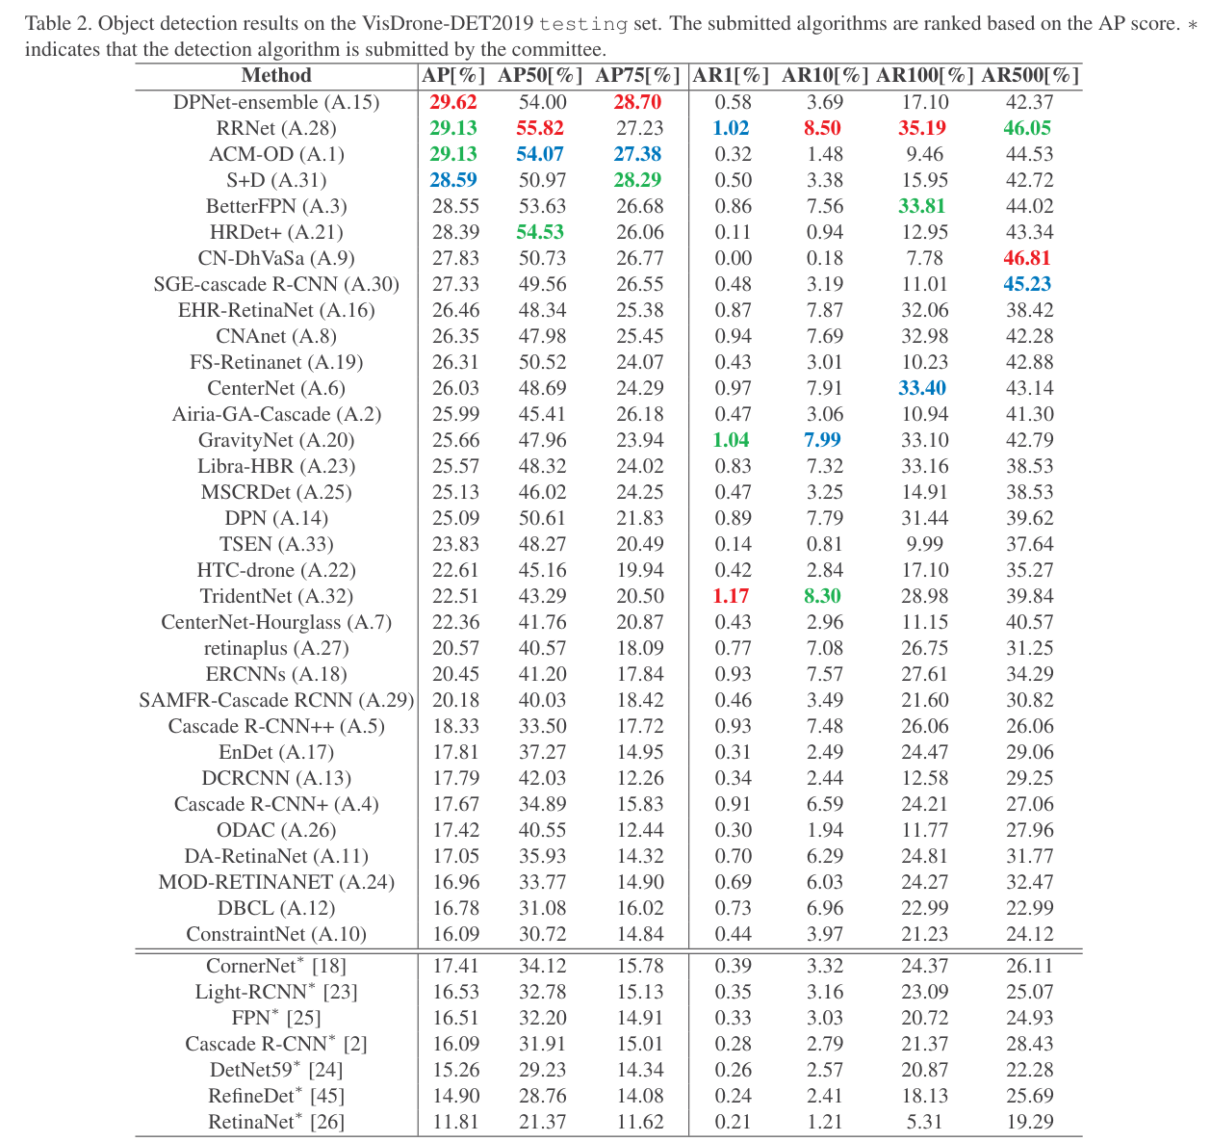
VisDrone-DET2019
DPNet-ensemble (A.15) achieves the best 29.62% AP score, which is worse than the previous competition.
Whereas our highest mAP = 23.7%

Slide 9
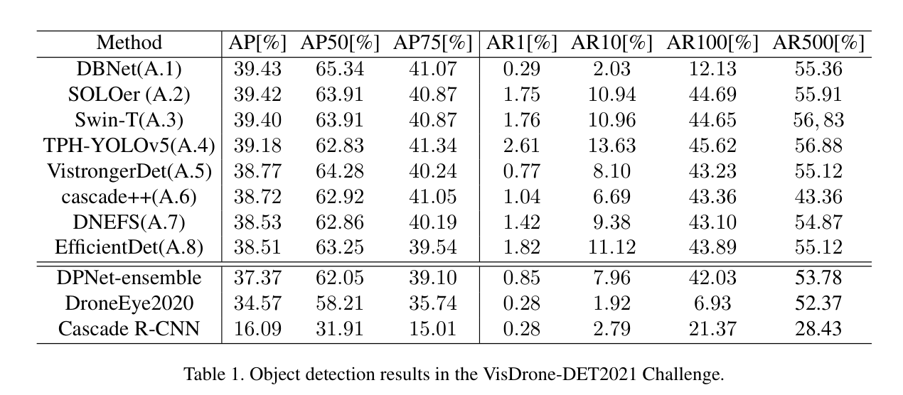
VisDrone-DET2021
DBNet achieves around 40% mAP
Whereas our highest mAP = 23.7%

Slide 10
We have done something wrong…
We noticed that we have done something wrong
Then we found this paper
VisDrone-DET 학습데이터를 활용 YOLO 버전별 분류 정확도 변화 비교 연구
(Comparison of changes in classification accuracy by YOLO version using VisDrone-DET training data)

Slide 11
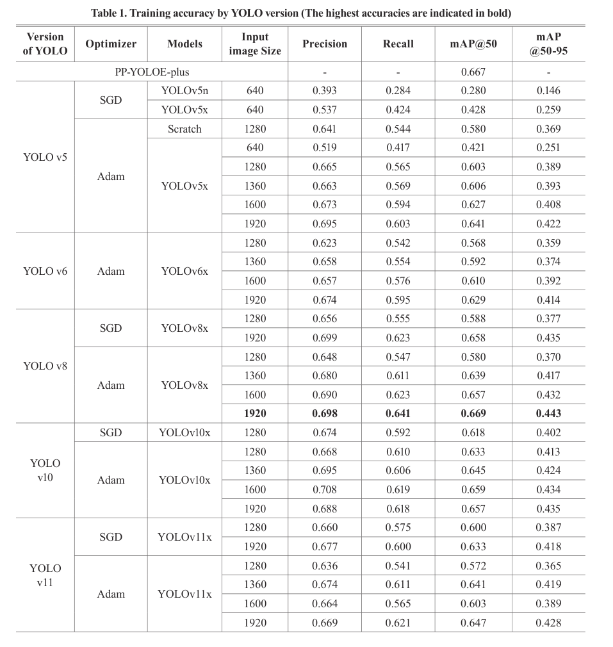
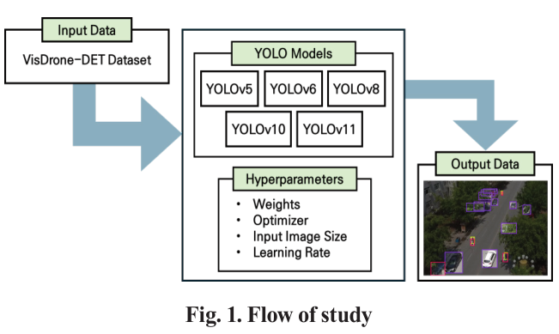
Comparison of changes in classification accuracy by YOLO version using VisDrone-DET training data
It states that
Image size is a high-performance parameter
Then we notice we should change the image size to 1920 and the learning rate, things are going to be changed

Slide 12
New Training

Slide 13
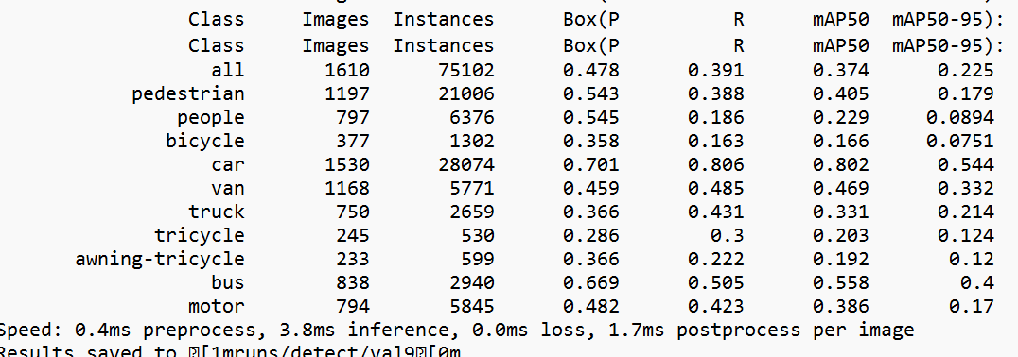
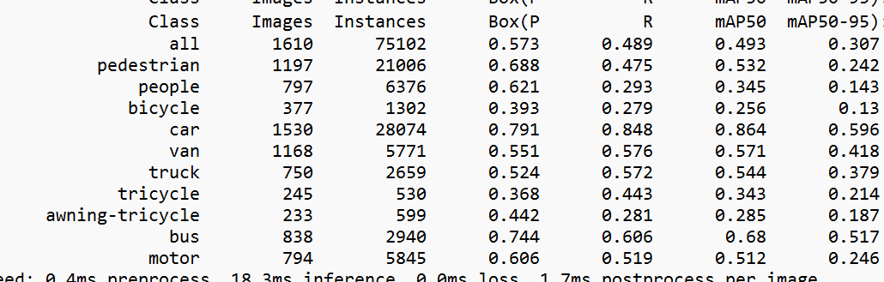
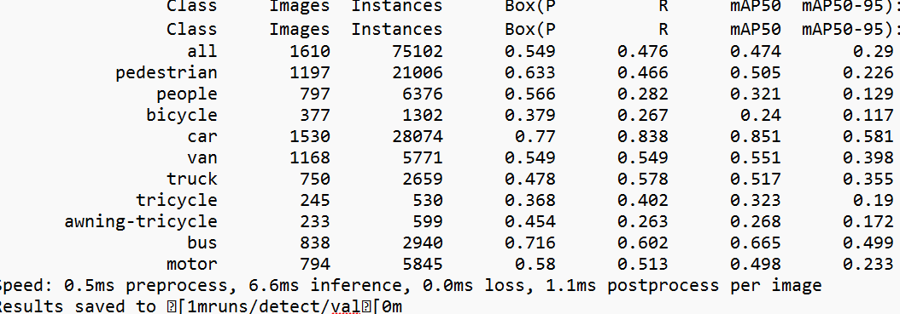
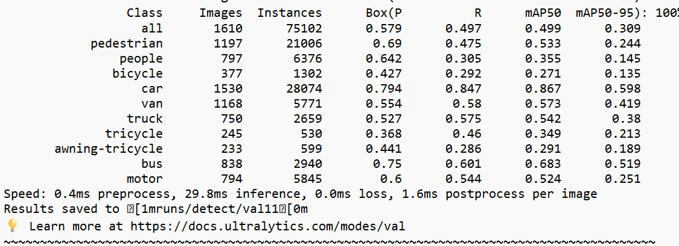
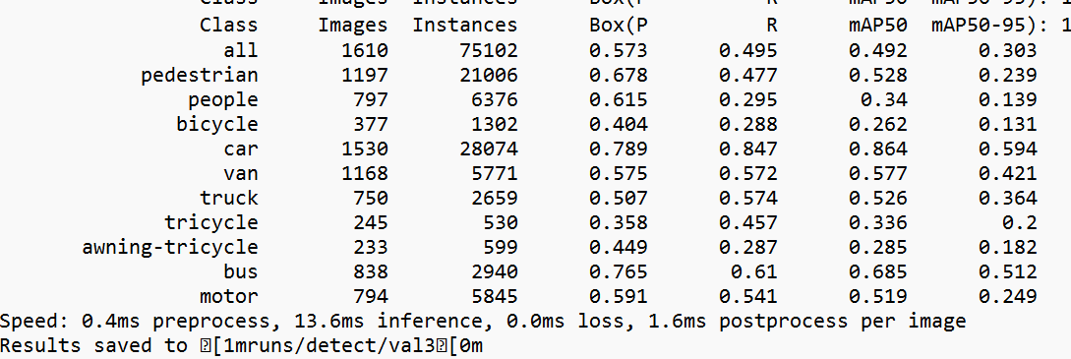
testing result of yolo11nano
testing result of yolo11large mAP
testing result of yolo11xtra
testing result of yolo11small
testing result of yolo11middle
This week:
Image_size=1920
Epoch=100
Initial learning rate = 0.01
Highest mAP50 = 49.9%
Highest mAP = 30.9%
The result improves a lot!
Last week:
Image_size=640
Epoch=100
Initial learning rate = 0.01
Highest mAP50 = 39%
Highest mAP = 23.7%

Slide 14
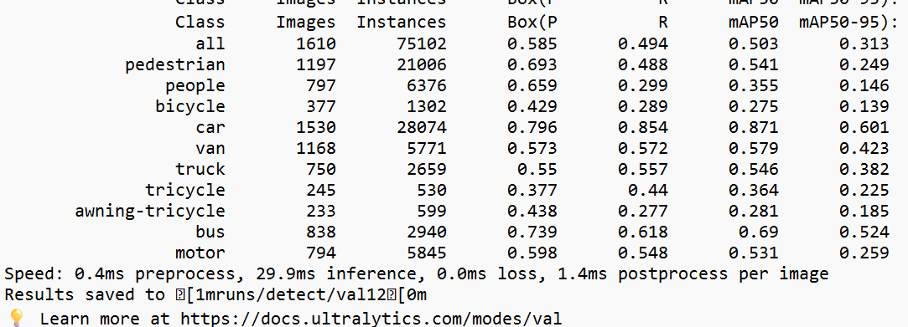
Testing results of Yolo11x epoch = 100 and epoch = 150, others are same, lr0=0.01
testing result of yolo11xtra with epochs=100
mAP50=49.9%, mAP=30.9%
testing result of yolo11xtra with epochs=150
mAP50=50.3%, mAP=31.3%
This week, after we train it in 150 epochs, result gets better

Slide 15
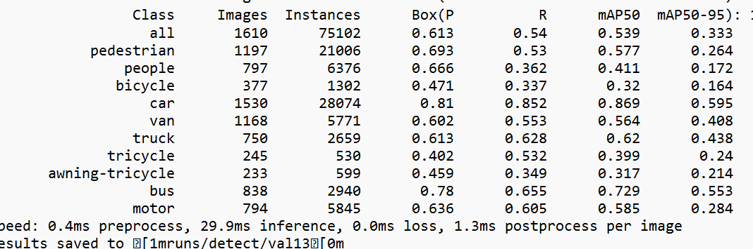
Testing results of Yolo11x lr0 = 0.01 and lr0 = 0.001, others are same, epoch=100
testing result of yolo11xtra with lr0=0.01
mAP50=49.9%, mAP=30.9%
testing result of yolo11xtra with lr0=0.001
mAP50=53.9%, mAP=33.3%
This week, after we train it using initial learning rate 0.001, result gets much better

Slide 16
Analysis

Slide 17
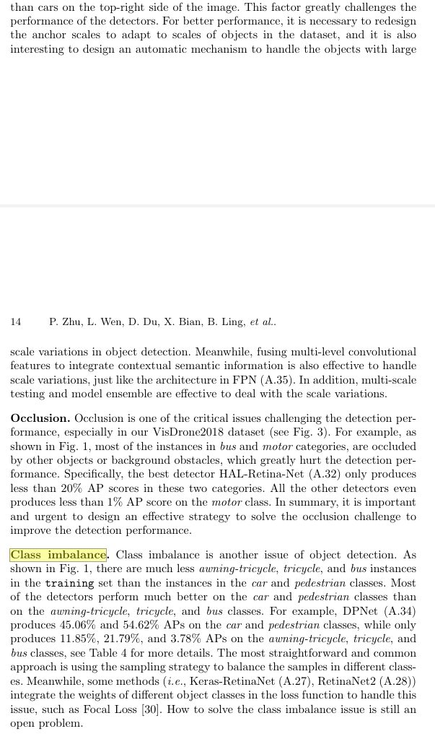
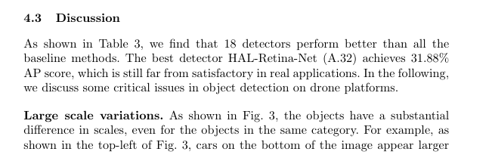
IMAGE SIZE MATTERS IN DRONE-BASED OBJECT DETECTION
Large scale variations
Occlusion
Class imbalance

Slide 18
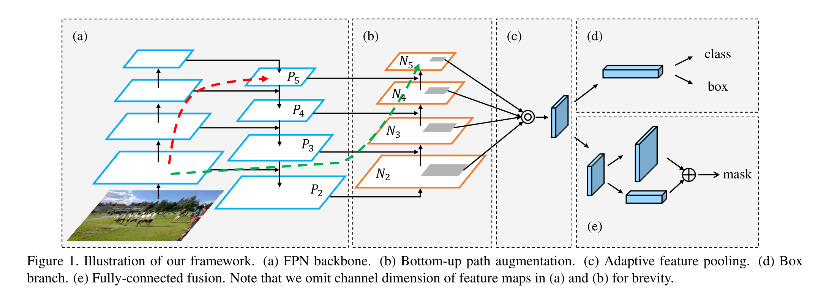
Feature fusion
The neck is designed to extract as much information as possible from the backbone feature maps
So if the localization and semantic features are bad, what the neck aggregated are also bad
That’s why we need to improve the image size, otherwise the feature maps all contain low semantics and low spatial information
Image from Path Aggregation Network for Instance Segmentation

Slide 19
Our best testing result on yolo11x

Slide 20
Confusions
Phenomenon:
Even though we reselect the hyperparameters: image size = 1920, optimizer = ‘Adam’, learning rate = 0.001, epoch = 200, our testing result is still worse than the results shown in the paper
Q: What possible reasons cause this situation?

Slide 21
Thank Y u! :)
Presented by UAV group

