Slide 1


UAV Object detection Using Artificial Intelligence
EE6008-48 Group
Supervisor: Yap Kim Hui
Speaker: Hu Kaiwei
Teammate:
Fang Yanlin
Hou Shixiang
Wang Chengtian
Hu Kaiwei
Huo Aidong

Slide 2
What have we learned and done?
We choose Task 1: Object Detection in Images from VisDrone dataset
Yolo command
NSCC PBS script
Testing

Slide 3
Comparison
> Furthermore, we use the evaluation protocol in MS COCO [27] to evaluate the results of detection algorithms, including AP, AP50, AP75, AR1, AR10, AR100, and AR500 metrics. Specifically, AP is computed by averaging over all 10 Intersection over Union (IoU) thresholds (i.e., in the range [0.50 : 0.95] with the uniform step size 0.05) of all categories, which is used as the primary metric for ranking.

Slide 4
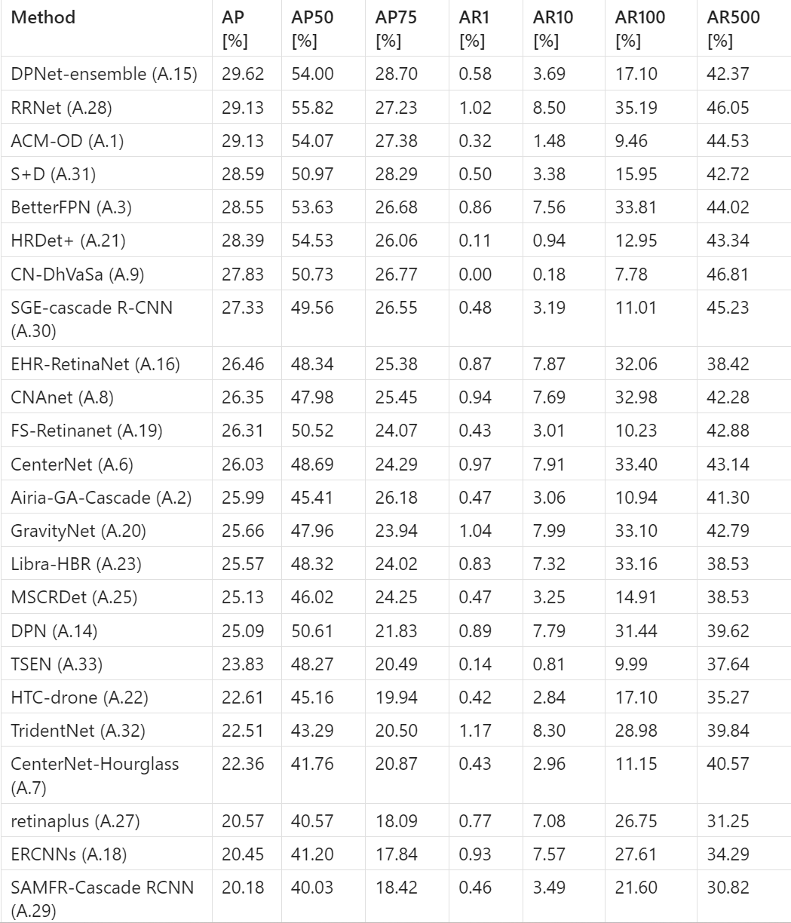
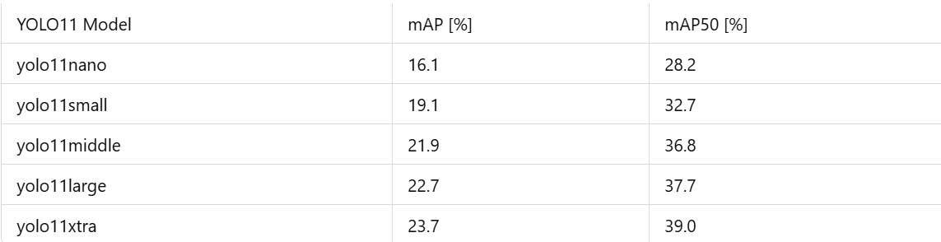

Slide 5
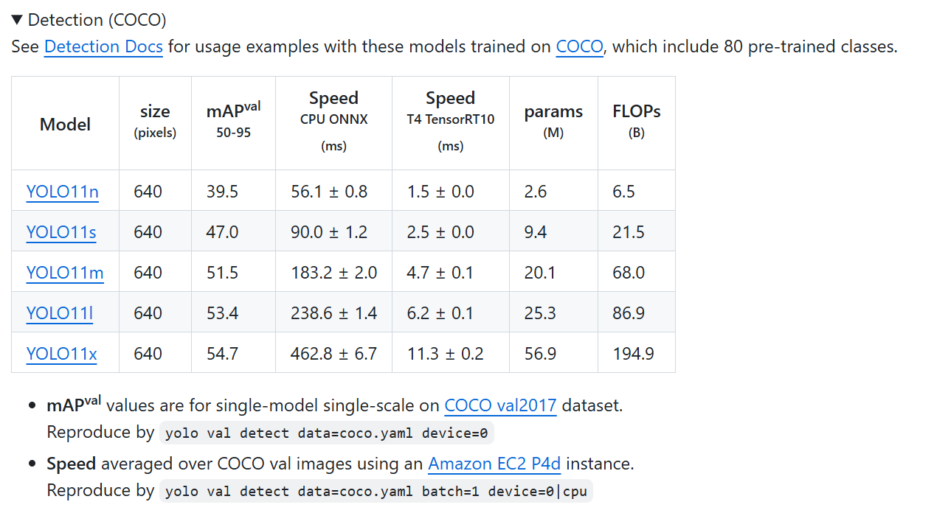
Testing result
We test five yolo11 object detection model given by ultralytics

Slide 6
What can be considered good performance?
For good performance
P (Precision, Accuracy for positive prediction): Higher is better.
R (Recall or Sensitivity): Higher is better.
mAP50(mean Average Precision based on IoU=0.5): Higher is generally better, indicating more accurate detections. Aiming for 0.5 (50%) and above is considered good in many applications, though it heavily depends on the difficulty of the task.
mAP50-95(the average of the average): This is stricter. Values above 0.3 (30%) can be good, especially on complex datasets, but strive for as high as you can.

Slide 7
Testing results
Testing results of fine-tuned `yolo11n`, `yolo11s`, `yolo11m`, `yolo11l`, `yolo11x`
All use `yolo detect train model=xxx.pt data=VisDrone.yaml batch=64 epochs=100 device=0,1,2,3 imgsz=640 ` to train
All use `yolo detect val model=/home/users/ntu/khu005/scratch/project/yolo11*/runs/detect/train/weights/best.pt data=VisDrone-test.yaml batch=64 epochs=100 device=0,1,2,3 imgsz=640` to test
Change the epochs of `yolo11x` to see the difference of training results and testing results
change training epochs to 200

Slide 8
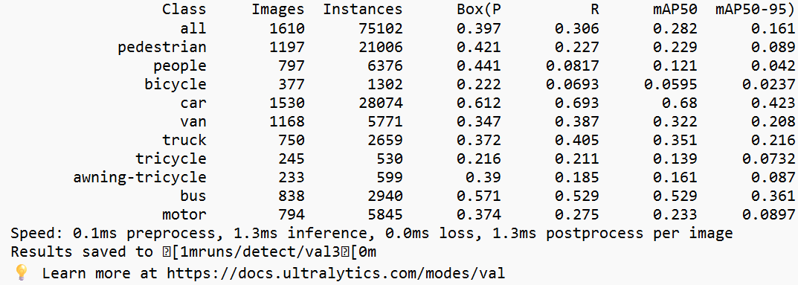
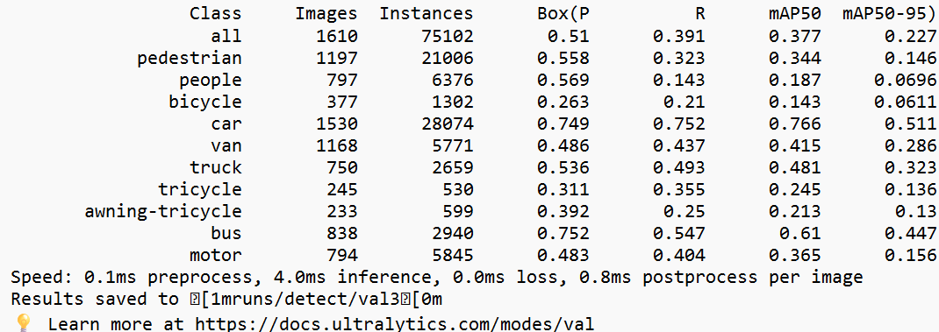
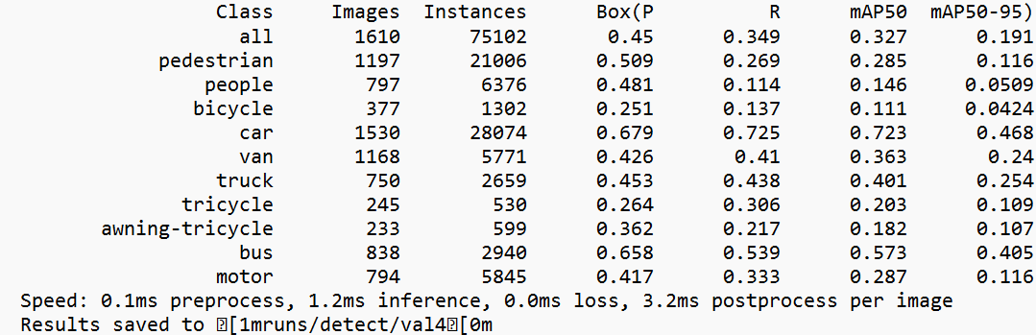
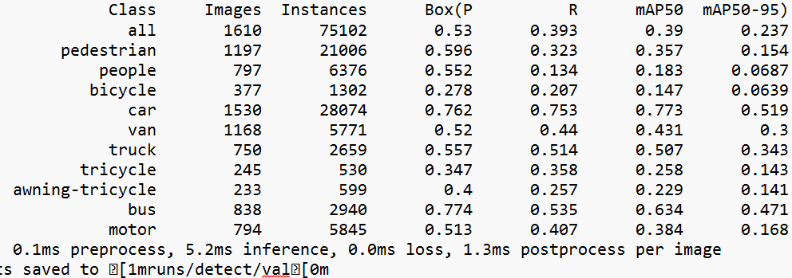
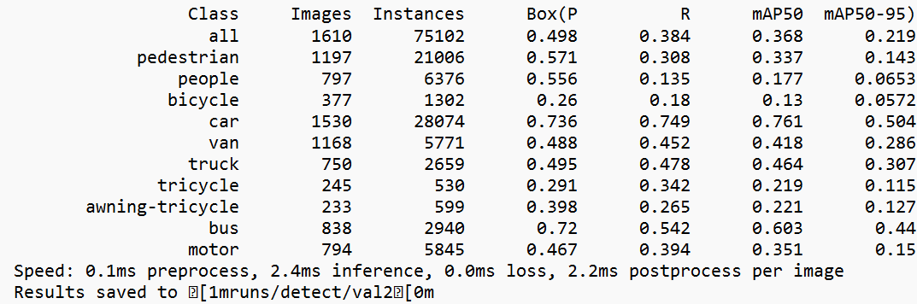
testing result of yolo11nano
testing result of yolo11large
testing result of yolo11xtra
testing result of yolo11small
testing result of yolo11middle
The testing results include both accuracy performance and inference time performance. The more complex the model is, the better its performance will be, and the longer the inference time will be.

Slide 9
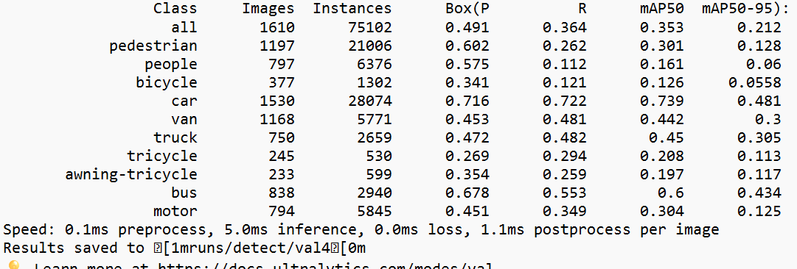
Comparison of yolo11x testing results between epochs=100 and epochs=200
testing result of yolo11xtra with epochs=100
testing result of yolo11xtra with epochs=200
Conclusion: The model's overall performance decreased slightly when training increased from 100 to 200 epochs. This suggests possible overfitting after 100 epochs.

Slide 10
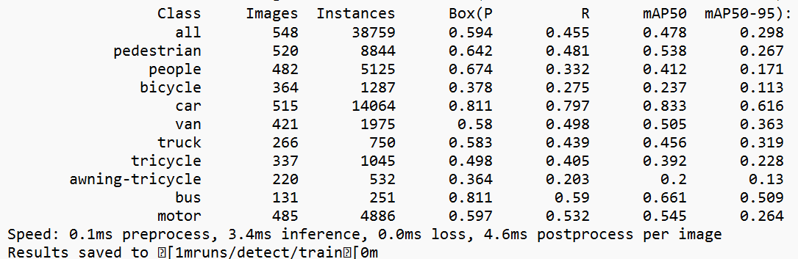
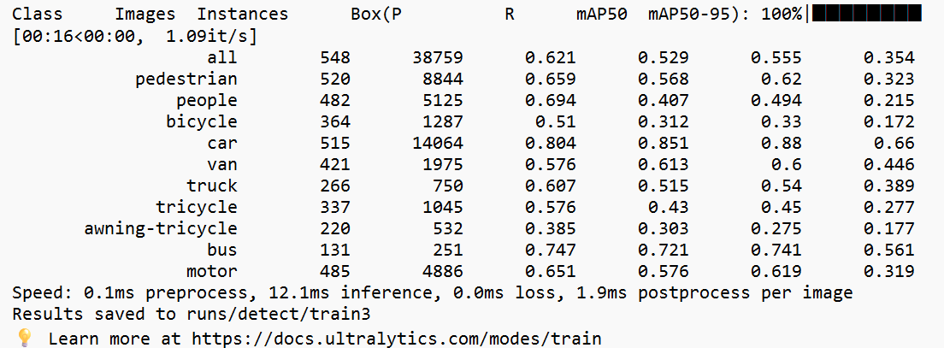
Comparison of yolo11x training results between epochs=100 and epochs=200
training result of yolo11xtra with epochs=100
training result of yolo11xtra with epochs=200
Conclusion:
While longer training improves performance on the training dataset, it can lead to overfitting, which reduces performance on unseen data.

Slide 11
Thank Y u! :)
Presented by UAV group

