Slide 1
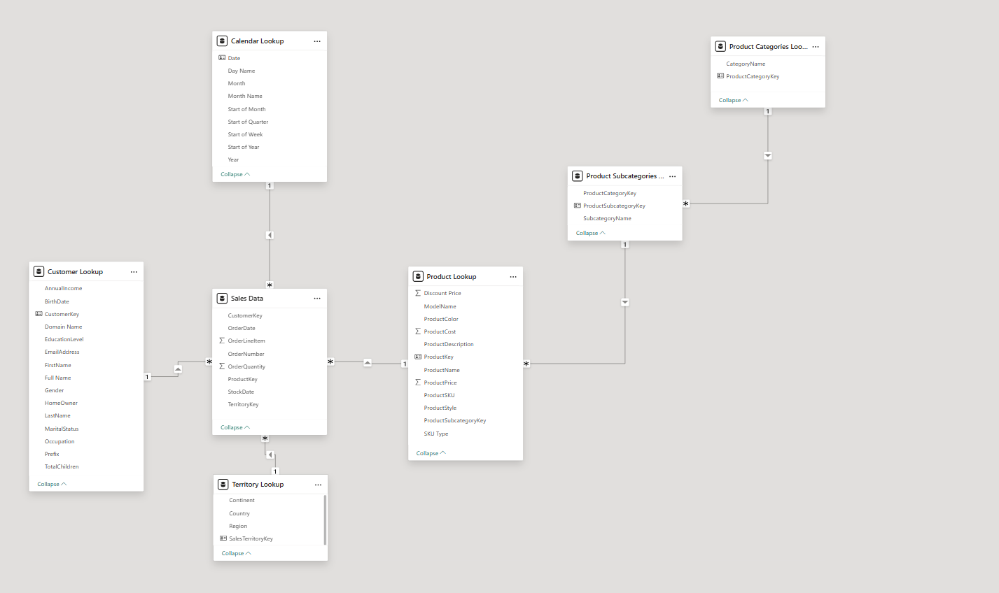
Star Schema
Snowflake Schema
Utilized both star and snowflake schemas in order to properly relate the model, given the objectives of the project.

Slide 2
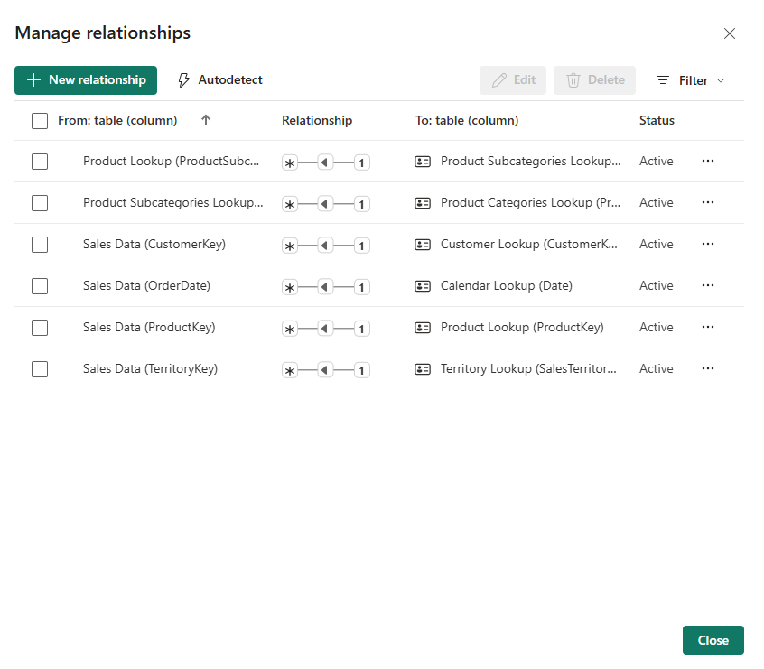


Slide 3
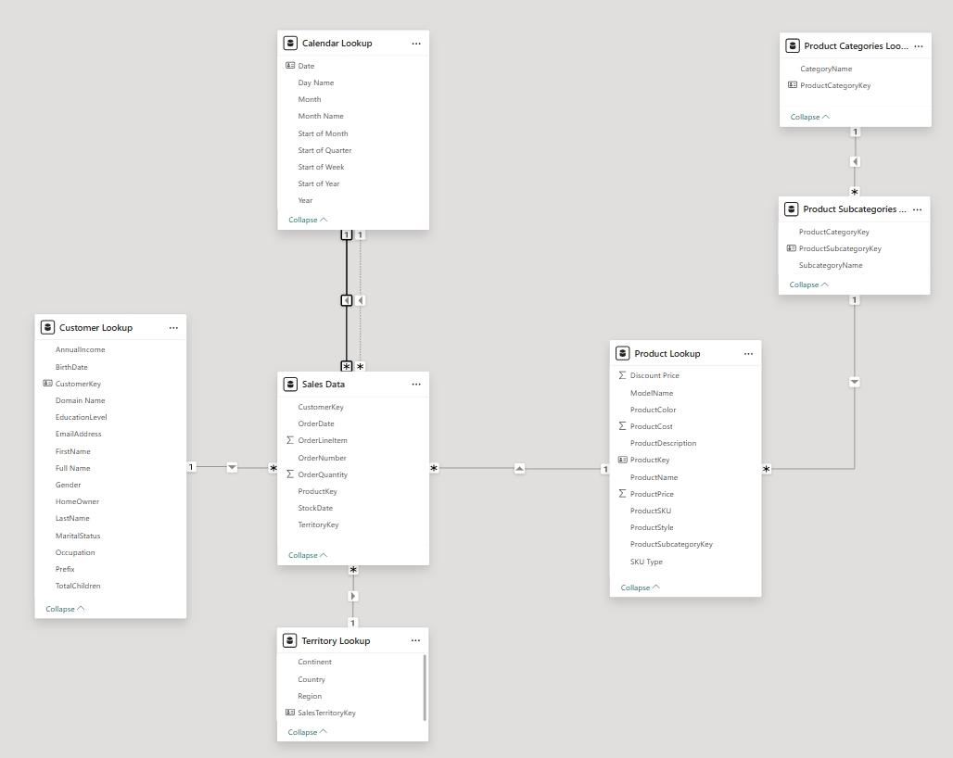

Slide 5
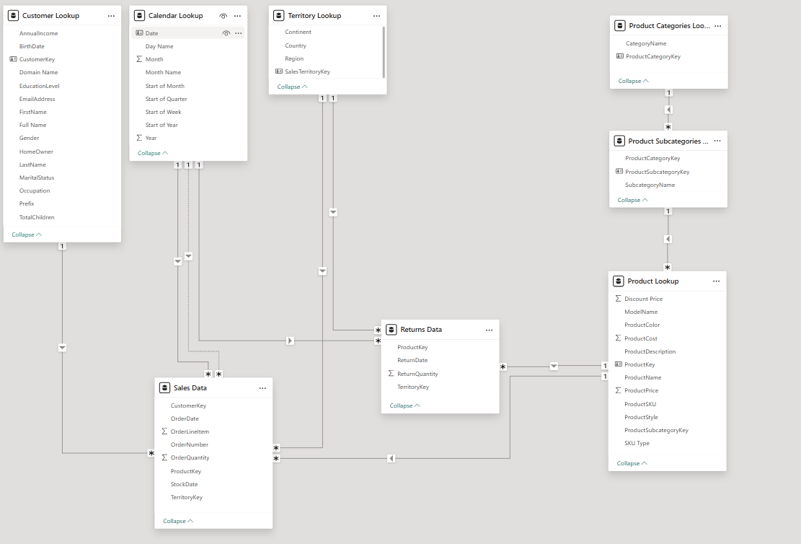

Slide 6
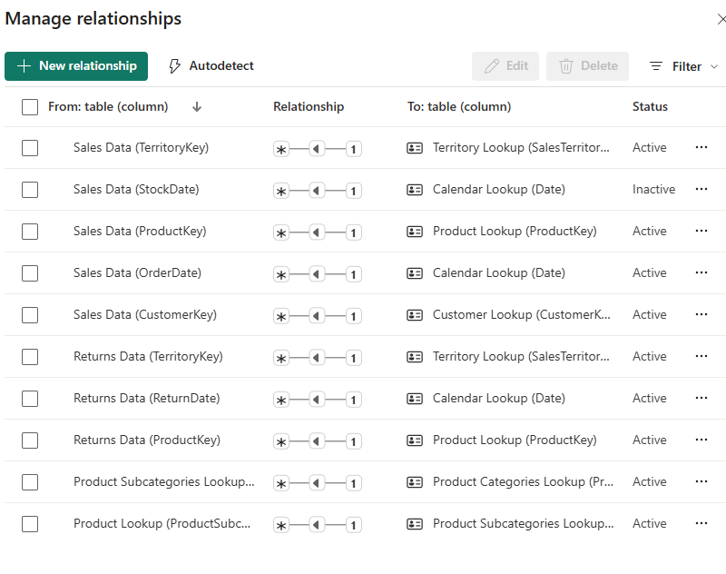

Slide 8
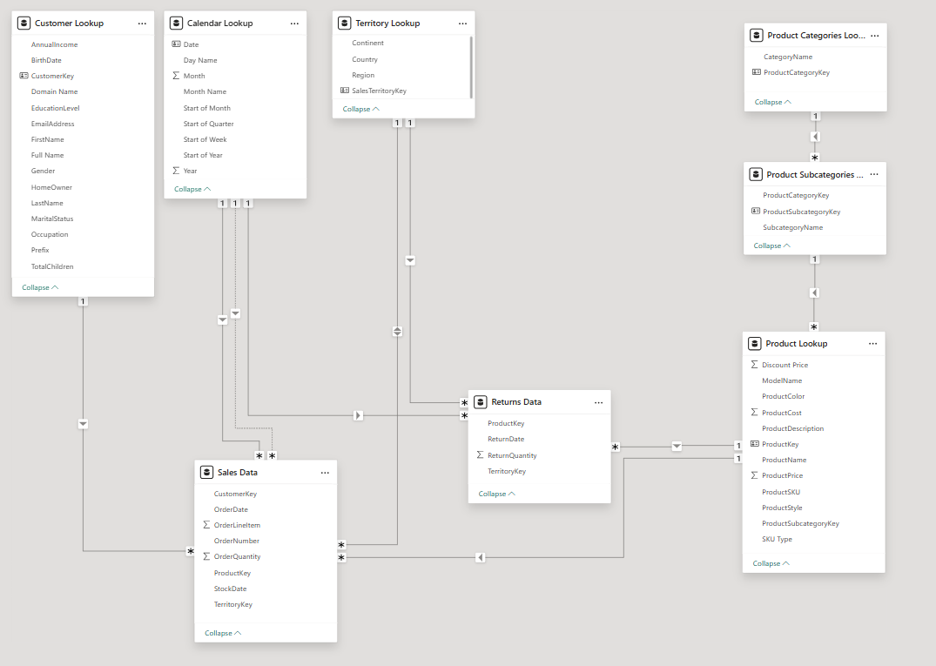

Slide 9
