Slide 1
Data Structures
Chapter 11: Multiway Search Trees
11-<number>

Slide 2
m-way Search Trees
Definition: An m-way search tree, either is empty or satisfies the following properties:
  The root has at most m subtrees and has the following structures:
  n, A₀, (K₁, A₁), (K₂, A₂), …, (K_{n}, A_{n})
  where each A_{i}, 0 ≤ i ≤ n ≤ m, is a pointer to a subtree, and each K_{i}, 1 ≤ i ≤ n ≤ m, is a key value.
  (2) K_{i} < K_{i +1}, 1 ≤ i ≤ n-1
  (3) Let K₀ =-∞ and K_{n+1} =∞. All key values in the subtree A_{i} are less than K_{i +1} and greater than K_{i} , 0 ≤ i ≤ n
  (4) The subtrees A_{i}, 0 ≤ i ≤ n , are also m-way search trees.
11-<number>

Slide 3
A Three-way Search Tree
a
T
20, 40
b
c
d
10, 15
25, 30
45, 50
< 20
e
>40
28
node | schematic format
a b c d e | 2(2筆資料), b, (20, c), (40, d) 2(2筆資料), , 0, (10, 0), (15, 0) 2, 0, (25, e), (30, 0) 2, 0, (45, 0), (50, 0) 1, 0, (28, 0)
> 20 && < 40
>25 && < 30
11-<number>

Slide 4
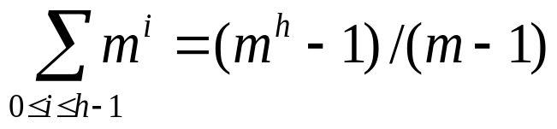
Searching an m-way Search Tree
Suppose to search an m-way search tree T for the key value x. By searching the keys of the root, we determine i such that K_{i} ≤ x < K_{i+1}.
  If x = K_{i}, the search is complete.
  If x ≠ K_{i}, x must be in a subtree A_{i} if x is in T.
  We proceed to search x in subtree A_{i} and continue the search until we find x or determine that x is not in T.
Maximum number of nodes in a tree of degree m and height h:
Maximum number of keys: m^{h} − 1.
11-<number>

Slide 5
B-trees (1)(期末考會考)
Definition: A B-tree of order m is an m-way search tree that either is empty or satisfies the following properties:
2 ≤ # children of root ≤ m
All nodes other than the root node and external nodes:
⎡m/2⎤ ≤ # children ≤ m(非常重要!!!)
(3) All external nodes are at the same level.
2-3 tree is a B-tree of order 3 and 2-3-4 tree is a B-tree of order 4.
All B-trees of order 2 are full binary trees.

Slide 6
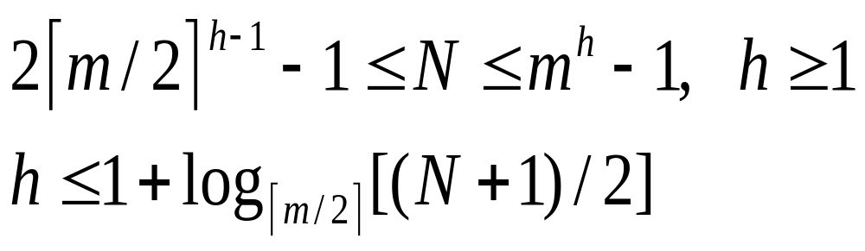
B-trees (2)
N: # of keys in a B-tree of order m and height h
  Reason: Root has at least 2 children, each other node has at least ⎡m/2⎤ children.
For example, a B-tree of order m=200 with # of keys N ≤ 2×10⁶−2 will have h ≤ 3.
11-<number>

Slide 7
2-3 tree: B-tree of order 3
A
40
B
C
2-3-4 tree: B-tree of order 4
10
20
80
50
10
70
80
5
7
8
30
40
60
75
85
90
92
11-<number>

Slide 8
Insertion into a B-tree of Order 5
320 540
430 480
380 395 406 412
451 472
493 506 511
(a) Initial portion of a B-tree
11-<number>

Slide 9
問 : 樹甚麼時候長高?
答 : 原本的B-tree滿了，要再加新資料，此時長高的地方在root!!
395 430 480
380 382
406 412
451 472
493 506 511
(b) After inserting 382 (Split the full node)
395 430 480 508
380 382
406 412
451 472
493 506
511 518
(c) After inserting 518 and 508
11-<number>

Slide 10
Insertion into a B-tree of Order 4 (2-3-4 Tree)
87 140
23 61 74
90 100 106
152 186 194
(a) An initial B-tree
97 102 140
23 61 74
90 100
106
152 186 194
(b) Inserting 102 with a left bias
11-<number>

Slide 11
87 100 140
23 61 74
90
102 106
152 186 194
(c) Inserting 102 with a right bias
11-<number>

Slide 12
Deletion from a B-tree of Order 5
(i) Rotation: Shift a key from its parent and its sibling.
80 120 150
A
90 113
126 135 142
B
Delete key 113
80 126 150
A
90 120
135 142
B
11-<number>

Slide 13
  (ii) Combination: Take a key from its parent and combine with its sibling.
80 126 150
68 73
90 120
135 142
B
Delete key 120
and
combine
80 150
68 73
90 126 135 142
B
11-<number>

Slide 14
(iii) Combine, then rotate for its parent
60 170
30 50
80 150
180 220 280
A
B
C
D
E
65 72
87 96
153 162
173 178
187 202
Delete 65,
combine
and rotate
60 180
30 50
150 170
220 280
A
B
C
D
E
72 80 87 96
153 162
173 178
187 202
11-<number>

Slide 15
(iv) Combine, then combine for its parent.
60 180 300
G
30 50
150 170
220 280
A
B
C
D
E
F
153 162
173 178
187 202
甚麼時候降低高度?
當root剩一個key且做deletion的時候!!!
Deleting 173
and a double
combination
60 300
G
30 50
150 180 220 280
C
D
E
F
A
B
153 162 170 178
187 202
11-<number>

Slide 16
Deletion in a B-tree
The combination process may be done up to the root.
If the root has more than one key,
  Done
If the root has only one key
  remove the root
  The height of the tree decreases by 1.
Insertion, deletion or searching in a B-tree
requires O(logN) time, where N denotes the number of elements in the B-tree.
11-<number>

Slide 17
B⁺-trees
Index node: internal node, storing keys (not elements) and pointers
Data node: external node, storing elements (with their keys)
Data nodes are linked together to form a doubly linked list. (data node 只能放兩個或三個)
A
20
40
index
data
B
C
D
10
30
70
80
2
4
6
12
16
18
20
25
32
36
40
50
60
71
72
80
82
84
11-<number>

Slide 18
Insertion into the B⁺-tree
A
A
20
40
20
40
B
C
D
B
C
D
10
30
70
80
10
16
30
70
80
2
4
6
12
16
18
20
25
32
36
40
50
60
71
72
80
82
84
2
4
6
12
14
16
18
20
25
32
36
40
50
60
71
72
80
82
84
(a) Initial B⁺-tree
G
(b) 14 inserted (split)
(3 + 1 => 2 + 2)
40
A
F
20
80
(c) 86 inserted
(split)
B
C
D
E
10
16
30
70
84
2
4
6
12
14
16
18
20
25
32
36
40
50
60
71
72
80
82
84
86
11-<number>

Slide 19
Deletion from a B⁺-tree
A
A
20
40
20
40
B
C
D
B
C
D
10
30
70
80
10
16
30
70
82
2
4
6
12
16
18
20
25
32
36
40
50
60
71
72
80
82
84
2
4
6
12
14
16
18
20
25
32
36
40
50
60
72
80
82
84
(a) Initial B⁺-tree
A
(b) 71 deleted (borrow)
20
40
B
C
D
10
16
30
70
(c) 80 deleted
(combine)
2
4
6
12
14
16
18
20
25
32
36
40
50
60
72
82
84
11-<number>

Slide 20
Deleting 32 (1)
G
40
A
F
20
80
B
C
D
E
10
16
30
70
84
2
4
6
12
14
16
18
20
25
32
36
40
50
60
71
72
80
82
84
86
(a) Initial B⁺-tree
G
40
A
F
20
80
B
C
D
E
10
16
70
84
(b) C is deficient
2
4
6
12
14
16
18
20
25
36
40
50
60
71
72
80
82
84
86
11-<number>

Slide 21
Deleting 32 (2)
G
40
A
F
20
80
B
C
D
E
10
16
70
84
2
4
6
12
14
16
18
20
25
36
40
50
60
71
72
80
82
84
86
(b) C is deficient
G
40
A
F
16
80
B
C
D
E
10
20
70
84
(c) After borrowing from B
2
4
6
12
14
16
18
20
25
36
40
50
60
71
72
80
82
84
86
11-<number>

Slide 22
Deleting 86 (1)
G
40
A
F
20
80
B
C
D
E
10
16
30
70
84
2
4
6
12
14
16
18
20
25
32
36
40
50
60
71
72
80
82
84
86
(a) Initial B⁺-tree
G
40
A
F
20
80
B
C
D
E
10
16
30
70
(b) E becomes deficient (combine)
2
4
6
12
14
16
18
20
25
36
40
50
60
71
72
80
82
84
11-<number>

Slide 23
Deleting 86 (2)
G
40
A
F
20
B
C
D
(c) F becomes deficient (combine)
10
16
30
70
80
2
4
6
12
14
16
18
20
25
32
36
40
50
60
71
72
80
82
84
A
20
40
B
C
D
10
16
30
70
80
(d) After combining A,G,F
2
4
6
12
14
16
18
20
25
32
36
40
50
60
71
72
80
82
84
11-<number>

