Slide 1
Good Morning and Good Evening Dr. Rodney
Semester 1 exam presentation

Slide 2
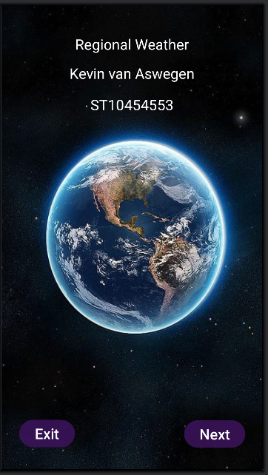
Opening screen:
This is the first screen, and the first thing you will see when opening my Regional Weathers app. On the top are some straight forward information about me, and the apps name. I chose white for the text due to the dark backround. I wanted to ensure anyone could identify and read the text at any given time.
At the bottom are 2 buttons, one reads exit, and does exactly that, it force closes the app. The other is the next button, once pressed it will direct you or any user to the following screen.

Slide 3
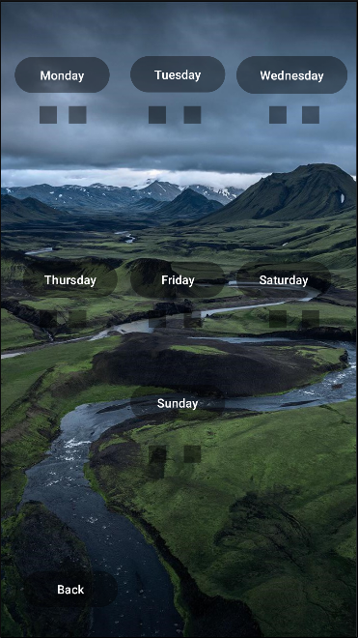
Utility page:
From here, we have each day of the week, Monday through to Sunday, and their respective temperatures. All of which the minimum and the maximum values are displayed.
At the bottom, left hand-side of the screen, is an additional button that reads ‘back’. This button if pressed simply returns the user and you back to the opening screen.
The last little thing is, each date displayed on screen are actually buttons. If you press any of the dates, Monday through to Sunday, it will carry you to a more detailed page specifically on the date you pressed.

Slide 4
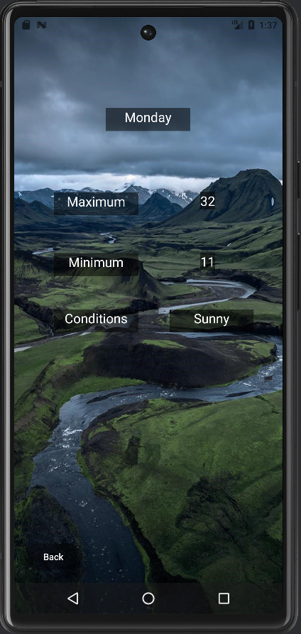
Detailed Page:
On this page, firstly is an additional ‘Back’ button allowing the user to return to the previous page if they would want to read further.
Otherwise on this screen will state the day of the week you would selected at the top, in this case Monday. It will state the maximum temperature of that day (32), the minimum temperature of that day (11), and the condition of that day. In this case it will be sunny.

Slide 5
Closing:
Thankyou Dr. Rodney for your time.
0.o

