Slide 1
Volumetric Error Compensation
Team Lead: Joseph A. Steurer
UI & Workflow: Charles Ortman
Measurement Alignment: Alex Bertels
Command Alignment: Kevin Zheng

Slide 2
Introduction
Machines are configured to compensate for error:
a given input may not reflect what is actually produced (cut not where it is expected)
error compensation is a manual process
BRNT seeking to offload burden of configuration from human resources, automate process with software

Slide 3
GUI Requirements
Create data entry fields to store user input for:
Tool Measurements
Tool Length
Tool Offset
Command Position
Machine Configuration (preferably image-driven)
Create standard GUI interaction buttons (Close, Run, Minimize, etc)
Create Progress Bar to track application progress

Slide 4
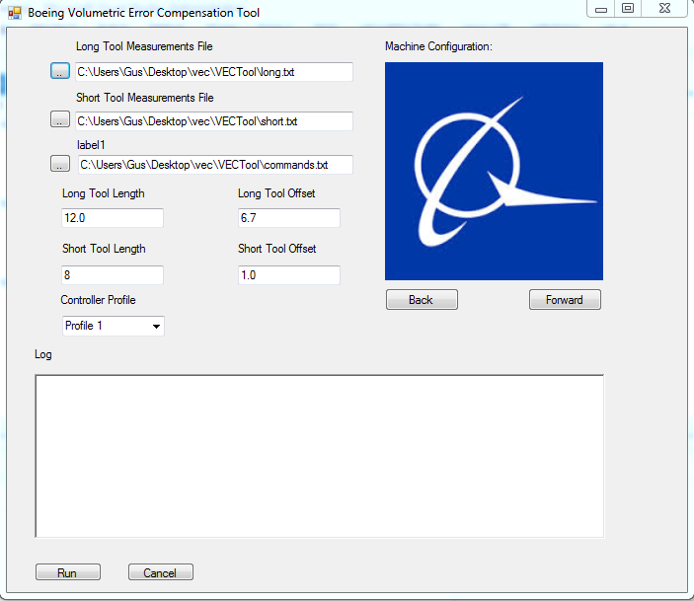
GUI Achieved Goals
All relevant data entry fields created
Data entry fields properly store to Input Data Structure
Machine Configuration fields are image-driven
Basic GUI interaction buttons created and function as intended
Debug dialogue box to receive both developer and user feedback

Slide 5
GUI Testing
Debug Dialogue Box
Input Type Verification
Input Range Verification
Blank Entry Handling
Premature Button Selection

Slide 6
Measurement Handling

Slide 7
Measurement Handling (cont)

Slide 8
Measurement Handling (cont.)

Slide 9
Measurement Handling (cont.)
Testing (Actual Data)
Single missing measurement
Many missing measurements
Initial values incorrect
Two different sets of data (Error)

Slide 10
Command Alignment

Slide 11

Changes
-Forward Kinematics
-Denavit-Hartenberg matrix

Slide 12
Testing
raw data from client: supply as input to application. observe what happens. identify problems. repeat.
implement requirement, observe output. if output different than expectation, modify implementation. repeat.

Slide 13
Project Demo

Slide 14
Iterations
Followed waterfall model, team member would prepare his step well enough to support sequential phases, then refined over development lifecycle
Client expectation changed: given relatively short time for implementation, focus shifted to first three phases. more important to have the first three phases working well than having all four phases implemented and not tested

Slide 15
Issues
MATLAB Difficulties
compilation to DLL not well documented; insufficient examples
expected that because it was possible for the MATLAB compiler to make a C++ library, we could integrate into c# application
wasn't what we needed for c#
request trial of NEBuilder from MATHWORKS
had to learn matlab .net api, how to integrate into .net application

Slide 16
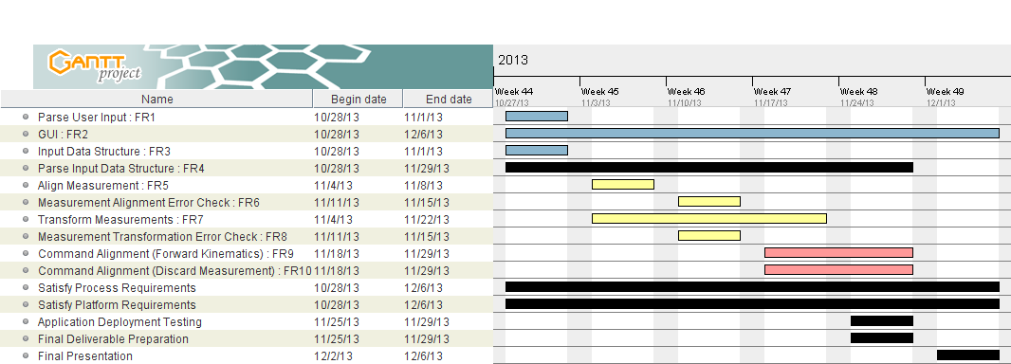
Project Timeline

Slide 17
Future Work
MATLAB, Compiler, NE Builder required for generation of MATLAB DLLs (proprietary software)
ILM and GA DLLs compiled, inputs and outputs thoroughly documented
depending on runtime of MATLAB compiled ILM and GA, consider new project re-implementing in a new compiled language to expedite runtime.
At least one developer should be able to reproduce the process manually and have access to a contact who can verify the output from each step
need additional raw input, compare results of each step of the application with manual calculations

Slide 18
Future Work (cont*)
explicit definition of machine configurations including examples of what a machine configuration should reflect for a given data set
beta testing: deploy to a few machines and have end user test the application, understanding that output may not be correct, and logging any issues encountered. end user should also compare the output they obtain with results calculated manually developers will fix issues and prepare for production deployment. this will enhance input validation and error handling
implementation of automatic report generation and compensation table formatting
careful documentation of what application inputs should be: e.g. a long tool offset is a positive double value

Slide 19
Conclusion
team members built new skills: C#, MATLAB Compilation, LaTeX, GIT
collaboration (as opposed to an individual effort) aided with requirements gathering, implementation, and identification/resolution of problems
generation of artifacts proved to be effective for capturing client's expectations and providing project documentation
need for ongoing work, project more complicated than anticipated.
learning curve for new technical skills, limited data set to test on; hindered project progress
Project demonstrates proof of concept; able to meet client's request for the software

Slide 20
Questions

