Slide 1
DISSERTATION PART II
Can a Mechanistic Digital Twin Be Both Reliable and Controllable?
A frozen-evidence synthesis of M1 and C1
M1
+
C1
=
DIGITAL TWIN MVP
Reliable
Controllable
bounded in-silico claim
M1 explains why C006 is the frozen twin. C1 tests whether that same C006 responds reproducibly to bounded causal control.
Advisor / group meeting | August 2026
Notes:
Question: Can a mechanistic digital twin be both reliable and controllable?
Evidence: M1 establishes frozen C006; C1 establishes a reproducible primary response in that same frozen model.
Does not prove: clinical efficacy, patient benefit, or control of all sleep dynamics.
Speaking guidance: Part II has two linked tests. First, justify and freeze one mechanistic twin. Second, test whether that exact frozen twin responds reproducibly to a bounded causal intervention. M1 answers the first; C1 answers the second. The conclusion is deliberately bounded.
[Sources] M1 HUMAN_REVIEW/FINAL_REPORT.md; C1 HUMAN_REVIEW/C1_HIERARCHICAL_PRIMARY_TARGET_FINAL_SUMMARY.md. Absolute roots are recorded in SOURCE_AUTHORITY_MAP.md.

Slide 2
M1 - WHY C006?
SYNTHESIS_FROM_EXISTING_M1_EVIDENCE
C006 emerged under the frozen M1 selection rule
FIT selection
Frozen HELDOUT check
Lowest NRMSE after FIT-only affine calibration
C006 was not reselected after HELDOUT access
46.6%
relative HELDOUT NRMSE improvement
All 16 candidates were evaluated; the four lowest plus matched C000 are shown.
95% paired bootstrap CI: [0.0798, 0.1015]
Reliable + Controllable Digital Twin MVP
02
Notes:
Question: Why C006 rather than another candidate?
Evidence: The frozen rule selected minimum FIT NRMSE after FIT-only calibration. C006 was lowest at 0.2546; C014 was next at 0.2759. After freeze, C006 HELDOUT NRMSE was 0.2478 versus 0.4638 for matched C000, a 46.6% relative improvement.
Does not prove: population superiority, clinical validity, or exhaustive coverage of possible mechanisms.
Speaking guidance: The left panel is the selection evidence; the right panel is a post-freeze credibility check, not a second selection step. The figure is a communication synthesis from existing machine-readable M1 evidence.
[Sources] D:/Year3_Mao_Projects/sleep_loop/BigBang_V4D1/COSTA_MVP_FRESH_R4_20260816_023933/RUNS/FIT_WORKER/SELECTION_FREEZE.json; CODE/FROZEN_V2/protocol_v2.json; RUNS/HELDOUT_WORKER/HELDOUT_G6_RESULT.json.

Slide 3
M1 - FREEZE + CREDIBILITY
The reliable-twin chain was frozen before controller research
FIT comparison
C006 frozen
HELDOUT gate
Independent reproduction
16 candidates
110 epochs
C006 NRMSE 0.2546
Selection hash locked
before HELDOUT access
110 epochs
46.6% vs C000
CI entirely > 0
G1-G7 PASS
No material disagreement
Provenance carried into C1
protocol
338366...E3C3
model
775A39...3869
selection
3D8C3D...8BBF
Conclusion
C006 was frozen before controller research.
Reliable + Controllable Digital Twin MVP
03
Notes:
Question: What makes the M1 evidence chain reliable enough for the control experiment?
Evidence: Selection, pre-heldout freeze, held-out gate, independent reproduction, and exact provenance hashes.
Does not prove: scalp-voltage validity, population generalization, or intervention response.
Speaking guidance: Reliability is procedural and evidential. C006 was selected on FIT, frozen before held-out access, passed the held-out margin with a positive bootstrap interval, and the full chain was independently reproduced. C1 inherits the exact same protocol, model, and selection identities.
[Sources] M1 STATE/CANDIDATE_FREEZE_CHECKPOINT.json; RUNS/HELDOUT_WORKER/HELDOUT_G6_RESULT.json; TOURNAMENT/FINAL_M1_JUDGMENT.json.

Slide 4
C1 - DEFINITION
A reproducible T2 response defines controllability
Prospective response test
Frozen C006
Frozen F01
Matched SHAM
3 fresh seeds
220 s + 910 s
Integrity vetoes
same M1 protocol
model + selection hashes
causal u_E pulses
0.045 inside [0, 0.05]
Target hierarchy
PRIMARY
SUPPORTING
SECONDARY - VISIBLE, NOT PRIMARY
T2
paired relative response
desired direction > 0
I_SO
N_SO_MIN | I_SP | N_SP_MIN
P_SO | T6 | P(C|SP)
independent corroboration
Adverse secondary effects remain in the claim boundary.
Reliable + Controllable Digital Twin MVP
04
Notes:
Question: What precise test defines controllability in this MVP?
Evidence: Frozen T2-primary direction, matched SHAM, fresh seeds, two durations, causal legal actuator, integrity vetoes, and visible secondary diagnostics.
Does not prove: simultaneous optimization of every endpoint or global state-space controllability.
Speaking guidance: C1 is a prospective response test. T2 is primary, I_SO is supporting, and spindle/coupling measures are mandatory diagnostics. The intervention is causal and bounded; success requires replicated T2 direction and complete integrity.
[Sources] C1 PROTOCOL/C1_PRIMARY_TARGET_V1_T2.json; STATE/FROZEN_CONTROLLER.json.

Slide 5
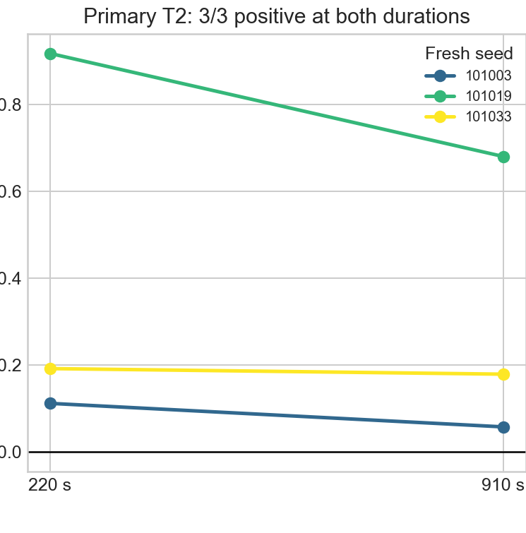
C1 - PRIMARY EVIDENCE
Primary T2 response replicates across seeds and duration
220 s
+0.1913%
median dT2
3/3 positive
910 s
+0.1784%
median dT2
3/3 positive
Authoritative C1 quicklook crop - paired dT2 (%)
Integrity PASS 6/6
Reliable + Controllable Digital Twin MVP
05
Notes:
Question: Does the primary response replicate and survive longer duration?
Evidence: T2 is positive in 3/3 seeds at 220 s and 3/3 at 910 s; medians are +0.1913% and +0.1784%; integrity passes all six runs.
Does not prove: a large clinical effect or a monotonic response for every possible seed and duration.
Speaking guidance: Every fresh seed is positive at both durations. Magnitudes vary, but the registered direction survives. Because seeds, durations, direction, and gate were fixed in advance, this is the core prospective controllability evidence.
[Sources] C1 RUNS/C1_PRIMARY_TARGET_AGGREGATE.json; six per-seed result.json files; FIGURES/C1_HIERARCHICAL_PRIMARY_TARGET_QUICKLOOK.png.

Slide 6
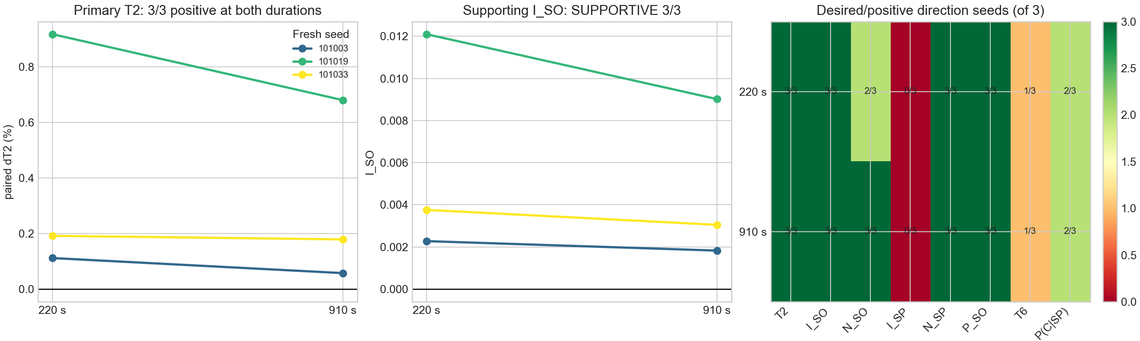
C1 - TRADE-OFFS
I_SO corroborates T2; secondary trade-offs remain
Authoritative C1 quicklook - supporting and secondary panels
I_SO
supportive 3/3 at both durations
I_SP
adverse 3/3 at both durations
T6
mixed; slightly negative medians
Primary controllability is established; controller-quality trade-offs remain.
Reliable + Controllable Digital Twin MVP
06
Notes:
Question: Is the primary T2 finding corroborated, and what adverse dynamics remain?
Evidence: I_SO is positive 3/3 at both durations. I_SP is adverse 0/3 positive at both durations; T6 is positive only 1/3 with slightly negative medians.
Does not prove: controller optimality or resolved spindle/coupling behavior.
Speaking guidance: The independent slow-oscillation diagnostic supports T2 in all seeds and both durations. The secondary heatmap prevents overclaiming: spindle-band strength is adverse in every run, and T6 is mixed. The correct sentence is primary controllability with secondary dynamical trade-offs.
[Sources] C1 RUNS/C1_PRIMARY_TARGET_AGGREGATE.json; RUNS/C1_PRIMARY_TARGET_METRICS.csv; authoritative quicklook.

Slide 7
SYNTHESIS
All required components of the bounded MVP passed
Reliable C006
M1 selection + held-out + reproduction
PASS
Frozen provenance
M1 identities retained in all six C1 runs
PASS
Frozen causal F01
No retuning during fresh confirmation
PASS
Bounded legal actuator
u_E = 0.045 inside [0, 0.05]
PASS
Fresh multi-seed T2
3/3 positive at 220 s
PASS
910 s duration robustness
3/3 positive at 910 s
PASS
I_SO corroboration
3/3 supportive at both durations
PASS
Final bounded claim
Reliable + Controllable Digital Twin MVP
Reliable + Controllable Digital Twin MVP
07
Notes:
Question: Which components of the bounded MVP passed?
Evidence: Reliable frozen C006, provenance, frozen causal F01, legal actuator, fresh multi-seed T2, 910 s robustness, and I_SO corroboration all pass.
Does not prove: clinical or global controllability claims.
Speaking guidance: M1 establishes model choice and credibility; C1 establishes a prospectively defined response in the same frozen model. Every listed component passed. This supports closure at the bounded in-silico MVP level while leaving controller-quality trade-offs open.
[Sources] M1 final decision and freeze artifacts; C1 final decision, protocol, aggregate, controller, and checkpoint.

Slide 8
DECISION
Advisor decision: close Part II at the bounded MVP level?
Evidence supporting closure
Limitations that remain
C006 selected by a frozen rule and held-out advantage
I_SP adverse in every fresh run
Protocol, model, and selection identities retained in C1
T6 mixed with slightly negative medians
T2 positive 3/3 across fresh seeds at 220 s and 910 s
One-subject Night-1, proxy-level M1 scope
Causal bounded F01 and integrity PASS 6/6
No clinical, population, global, or all-endpoint claim
I_SO independently supportive at both durations
Future work: spindle/coupling-aware controller quality
Close Part II at the bounded in-silico Reliable + Controllable
Digital Twin MVP level?
Reliable + Controllable Digital Twin MVP
08
Notes:
Question: What decision is requested from the advisor?
Evidence: The primary reliability-to-controllability chain is complete and hash-linked; remaining limitations are explicit and non-vetoing under the frozen gate.
Does not prove: that future controller optimization or translational validation is unnecessary.
Speaking guidance: The proposed closure is specific: Part II is complete at the bounded in-silico Reliable + Controllable Digital Twin MVP level. The limitations remain future work rather than being hidden or relabeled as success.
[Sources] CLAIMS_AND_LIMITATIONS.md; M1 and C1 final decisions and human reviews.

