Slide 1

PROJECT MOCKUP
Campus Support Agent
An AI-powered campus help system with
voice input, multilingual support, and
spoken answers.
Audio
Multilingual
AI Retrieval
Spoken Output
Gradio UI • CampusSupportAgent • GloVe / Word2Vec
Presentation deck

Slide 2
Project Overview
Key Features
Problem
🎤
Audio input
Students often spend time searching
multiple pages or asking staff for
simple campus information.
Students can ask questions using a microphone or uploaded audio.
Solution
🌍
Multilingual support
The app can detect language, translate for retrieval, and answer back in the
chosen language.
A smart assistant that understands
natural questions and returns the
best answer in text or voice.
🔊
Spoken answers
Core value
Responses can be converted to speech for a more natural user experience.
Faster access to campus information
More accessible for different languages and input styles
🤖
CampusSupportAgent
The agent keeps context, detects intent, and selects the best retrieval path.

Slide 3
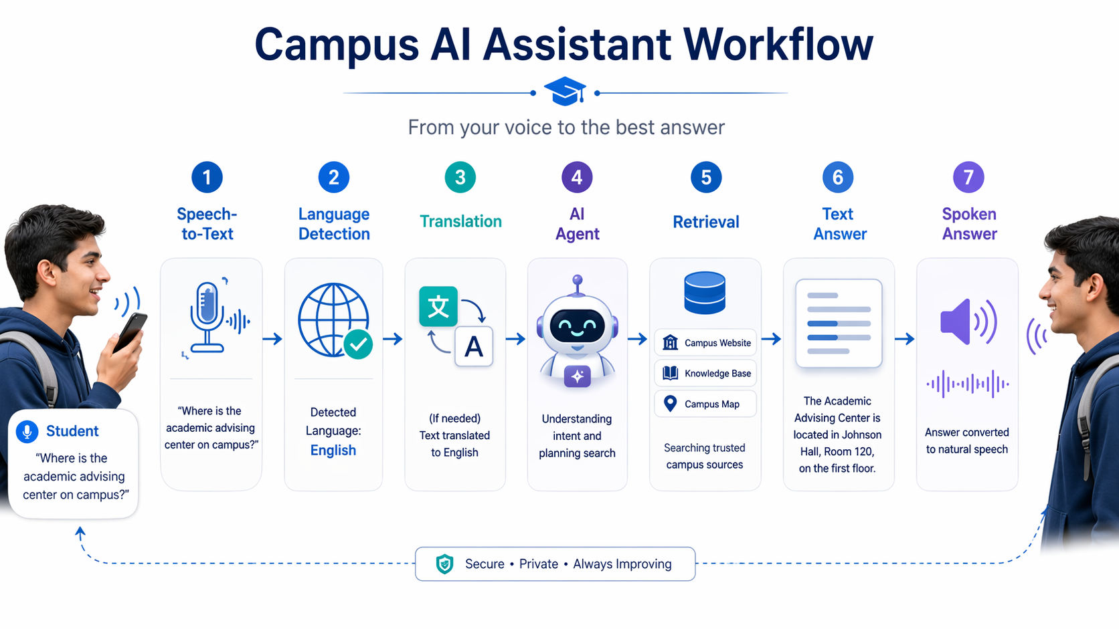
How the System Works
1. User asks by text or voice
2. App processes language and audio
3. Agent retrieves and returns answer
Text and voice follow the same retrieval pipeline before the final response is formatted.

Slide 4
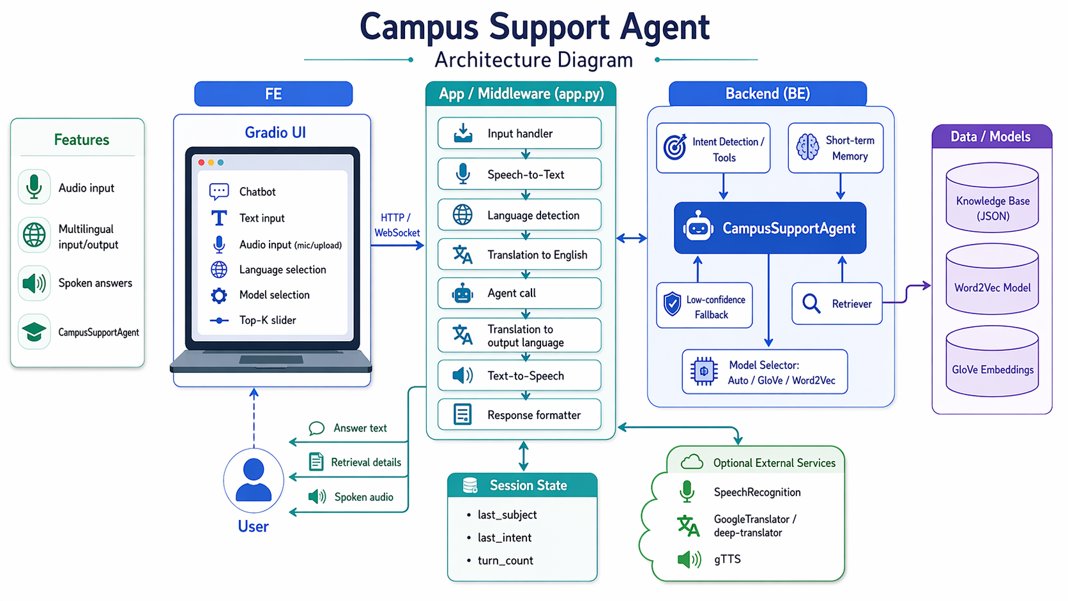
Architecture Diagram
Frontend
Gradio UI for chatbot, audio, language
selection, model choice, and Top-K control.
Middleware (app.py)
Handles input, speech-to-text, language
detection, translation, agent call,
text-to-speech, and response formatting.
Backend intelligence
CampusSupportAgent works with intent detection,
short-term memory, fallback logic, retriever,
and model selector.
Data + services
Knowledge base JSON, GloVe/Word2Vec
embeddings, plus optional SpeechRecognition,
translation, and gTTS.
Mockup-ready

