Slide 1
Forward Modelling for Gravity Anomalies
Ryan Younghwan Ok, Safian Omar Qureshi, Tian Yu

Slide 2
Overview
Gravitational potential (U) and gravity effect (g_{z}) are dependent on mass of anomaly and distance (‘depth’)
Perform forward modelling to visualize how U and g_{z} is affected with varying distance, mass distributions and viewed by changing grid spacings
Approximating U and g_{z} of nonuniform object via derivatives and testing against calculated results
A general goal: raise awareness on nonuniqueness within gravity surveys that rise from existence of two free parameters; depth and density

Slide 3

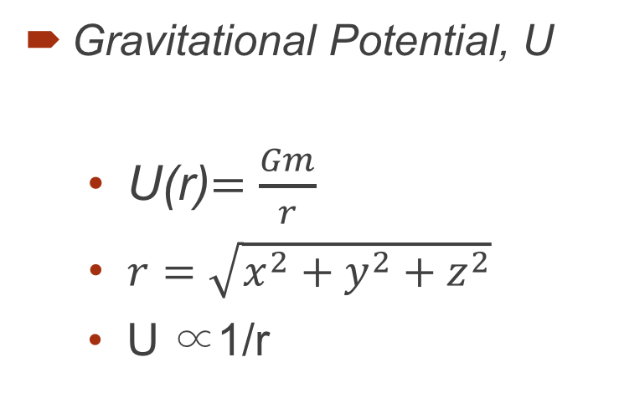
Background and Theory
Gravitational Potential, U
U(r)$=\frac{Gm}{r}$
$r=\sqrt{x^{2}+y^{2}+z^{2}}$
U ∝1/r
Gravity Effect, $g_{z}$
$g_{z}=−\frac{∂U}{∂z}=Gm\frac{z−z_{m}}{r^{3}}$
$g_{z}∝\frac{1}{r^{3}}$
Assumptions:
In equation used, derived volume integrals in Cartesian coordinates¹
Worked with scalar potential², obtaining g through g = -∇U
Mass and mass sets in q3/q4 were treated as point sources
Boundary condition
Homogenous halfspace layer (excluding anomaly points embedded)

Slide 4
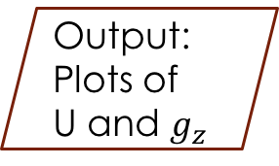
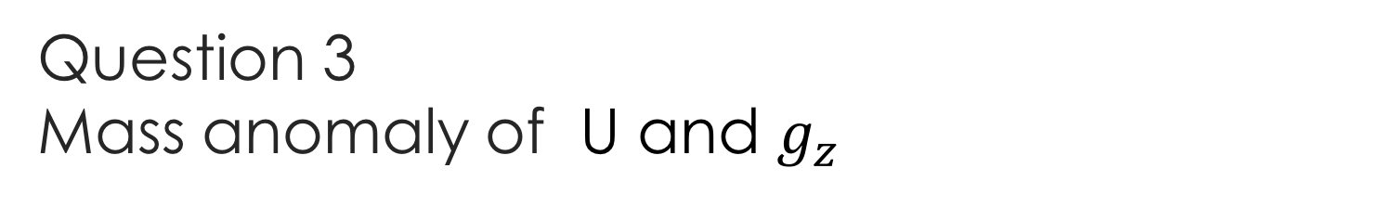
Question 3 Mass anomaly of U and $g_{z}$
Identify an anomaly of known mass and coordinate
Input: G, m, x, xm, spacing grid, z
dx = 5, 25
Meshgrid[X,Y]
Identify an anomaly of known mass and coordinate
Output:
Plots of
U and $g_{z}$
Z = 0, 10, 100

Slide 5
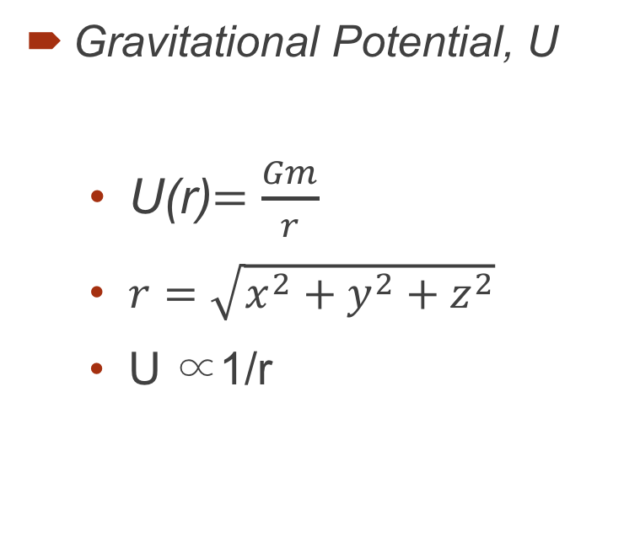
Question 4 Random mass and locations
Begin: 5 random masses and locations_Algorithm
End: 5 random masses and locations_Algorithm
Input: M, mu, sig
Output:
5 mass and locations
Find the 5th location
i=1
Sum of random mass and locations
Yes
i=i+1
Find the 5th mass
Random mass and locations
i$≤4$
False

Slide 6
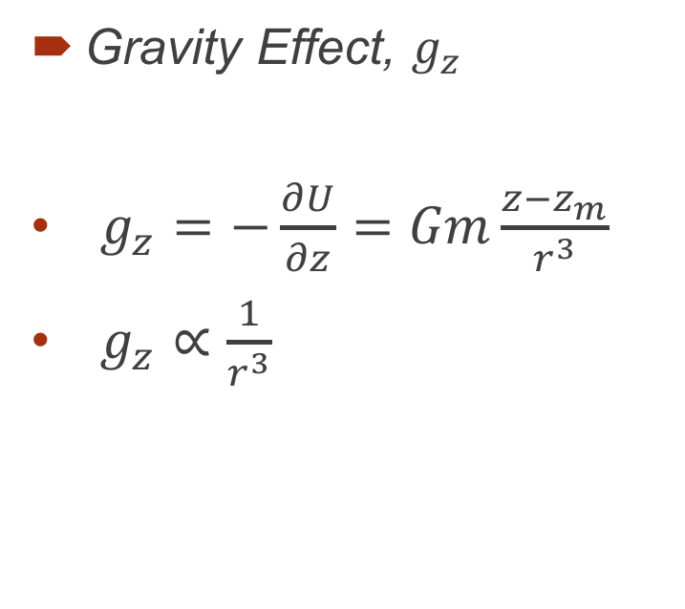
Question 5 Density cross-section of the anomaly
Begin: x=0_algorithm
load('anomaly_data.mat');
jth column
j=1
j=j+1
x$=0$
False
Yes
End: x=0_algorithm
Keep column fixed
Output: density cross-section

Slide 7
Question 5 Derivatives
Begin: first and second vertical derivative of g,
Input: g
First x direction, y direction and vertical derivatives of g
Second x direction and y direction derivatives of g
End: first and second vertical derivative of g,
Output: first and second vertical derivative of g,
second vertical derivative of g=-Sum of second x direction and y direction derivatives of g

Slide 8
Concluding Remarks
‘Resolution’ most clear of U and g_{z} at shallowest depths
Smaller grid spacings resolve mass points more effectively
Density cross sections of irregular shape help visualize geometry of object
Similar results to mass points earlier; shallow/small grid spacing = better
Partial derivatives are good approximations, yet resolution slightly lower
Exercise demonstrated the ultimate problem of nonuniqueness

Slide 9
References
^{1,2}Karchewski, B. (2017). GOPH 547 - Gravity and magnetics. Retrieved from https://d2l.ucalgary.ca/d2l/le/content/169330/viewContent/2346958/View
W.M. Telford, L.P. Geldart and R.E. Sheriff. (1990). Applied Geophysics, Second Edition. Cambridge University Press.
“Newton's law of universal gravitation” from Wikipedia: The Free Encyclopedia. Link: https://en.wikipedia.org/wiki/Newton%27s_law_of_universal_gravitation.
“Gravitational potential” from Wikipedia: The Free Encyclopedia. Link: https://en.wikipedia.org/wiki/Gravitational_potential.

