Slide 1
01
MCP Made Simple
Model Context Protocol
One shared way for AI apps to talk to tools, files, and services.

Slide 2

02
What MCP in one line
Short version
Why it matters
MCP is a standard that lets an AI app connect to tools and
data without custom wiring every time.
Without a standard, every app builds the same connections again and again.
“Me after hearing ‘just make one connector for every app’”

Slide 3
03
The problem
No access
Duplicate work
Hard to maintain
The model cannot read your files or check your data unless something connects it first.
Every app rebuilds the same connection again and again.
When one API changes, the custom connectors start breaking in different places.
This is the pain point MCP is trying to remove

Slide 4
04
MCP is like USB-C
Analogy
What changes
Result
USB-C works because the port is standard. MCP works the same way for AI tools.
The app does not need a custom cable for every service.
One connection pattern can be reused everywhere.
Use this analogy early. Freshers usually remember it fastest.

Slide 5
05
What MCP is
Open standard
Live context
Vendor-neutral
Anyone can read it, use it, and build on it.
The app gets the right data when the user asks, not from old guesses.
It works across apps and stacks instead of locking you to one company.

Slide 6
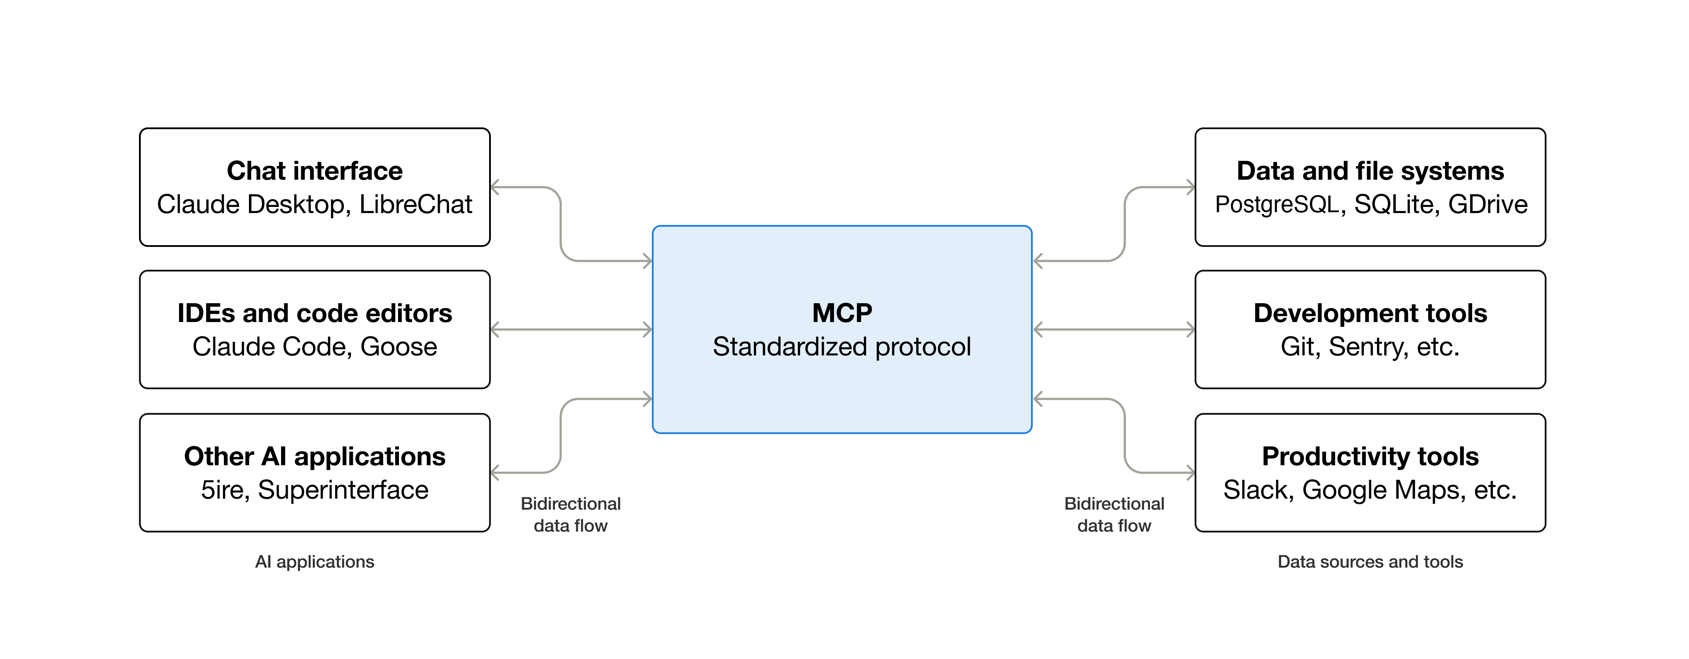

Slide 7
06
How it fits together
User
Host
Client
Server
Service
Asks the question
The AI app
The connector inside the app
Shows tools and data
The real system
“Five pieces, one request, zero custom chaos.”

Slide 8
07
Without MCP vs with MCP
The same apps become much easier to wire
Without MCP
With MCP
Every app needs a direct connection to every service. That grows into a spaghetti graph very quickly.
Each app connects once. Each service is described once.
“The left side is chaos. The right side is peace”

Slide 9
08
Step 1: Discover
The client asks what the server can do
Discovery
Response
Result
The client sends a tools/list request to ask what is available.
The server returns names, descriptions, and inputs for each tool.
The client now knows what it can offer to the LLM.

Slide 10
09
Step 2: Call the tool
Now the real request happens
LLM chooses a tool
Client sends it
Server responds
The model picks the best tool based on the user request.
The client sends a clean JSON-RPC call to the server.
The service returns the result and the client gives it back to the app.
“It is not magic. It is just a well behaved request/response loop.”

Slide 11
010
Security and limits
MCP solves the wiring problem, not every risk
Tool poisoning
Prompt injection
Permissions
A bad server can describe a tool in a misleading way.
Tool output can include hidden instructions if you are not careful.
A tool should only be allowed to do what it really needs.
“MCP is not a force field. It still needs good security.”

Slide 12
011
Real-world uses
IDE assistants
Knowledge tools
Agent workflows
Connect coding tools to files, terminals, and project data.
Connect AI to notes, documents, and searchable resources.
Let AI apps talk to services in a reusable way.

Slide 13

012
Takeaway
What students should remember
1. Problem
2. Fix
3. Result
AI needs access to tools and data.
MCP gives one standard connection pattern.
Less repeated work, cleaner integrations, easier scaling.

