Slide 1

MCP
Model Context Protocol
Giving LLMs a standard way to reach the outside world
Introductory AI Session · CSI-VIT Chennai

Slide 2

Quick Recap: What is MCP?
Model Context Protocol
An open standard that lets an LLM discover and use external tools, data, and services — in a consistent way, no matter who built them.
Today, we'll build up the picture piece by piece: why LLMs need this in the first place, who the players are, and how a request actually flows end-to-end.
By the end of this section you'll be able to:
Explain why an LLM alone can't answer real-time or personal questions
Name the three actors in MCP and what each one does
Trace one full request from user to tool and back
MCP · Model Context Protocol
2

Slide 3

What Is an LLM, Really?
The core job of an LLM
Process
1
Read and encode the incoming text
An example you already know
ChatGPT
Think
2
Reason over it using learned patterns
It's built on an LLM — but a chat app is far more than the raw model underneath it.
Produce
3
Generate the next piece of text
That's it — text in, text out. Nothing more is happening inside the model itself.
MCP · Model Context Protocol
3

Slide 4

So Here's the Catch
Ask an LLM something simple:
“What's the weather today?”
“I can't answer that — unless I was trained on today's weather, or I have access to a place that can fetch it for me.”
An LLM only knows what it was trained on. It has no eyes on today's weather, your calendar, or a live database — unless something gives it a way to reach out and check.
MCP · Model Context Protocol
4

Slide 5
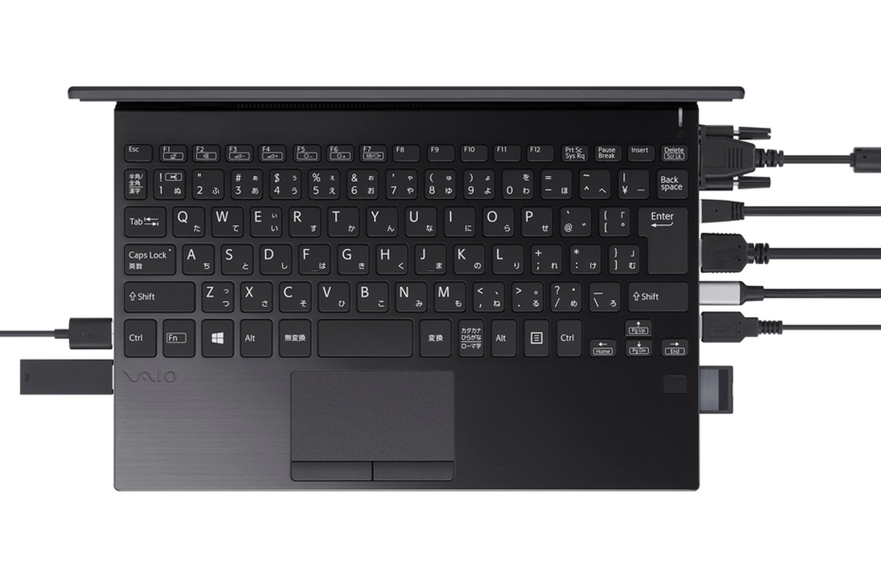
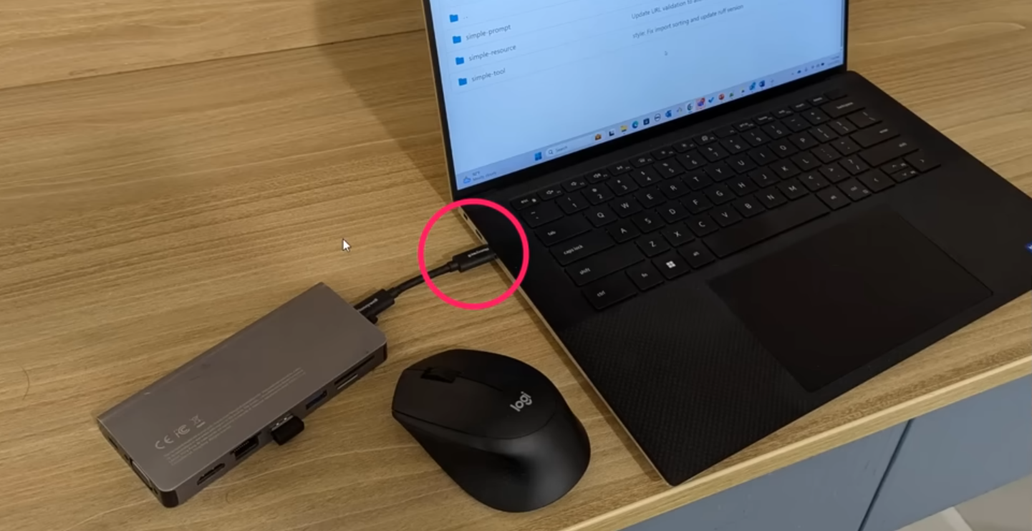
MCP = One USB-C Port
Why a standard protocol is just a smarter way to plug things in.
WITHOUT MCP
WITH MCP
Every tool = its own cable
One protocol, many tools
Custom integration per LLM-tool pair. Every new tool = more glue code.
Build the connection once. Any compliant tool plugs into the same port.
[ drop the tangled-cables GIF here ]
[ dr the USB-C hub illustration here ]
(old way: a laptop drowning in proprietary ports)
✗ N × M integrations ✗ brittle prompts ✗ breaks when tools change
✓ standard protocol ✓ plug-and-play ✓ tools swap freely
MCP — Model Context Protocol
13

Slide 6
From Glue Code to a Real Solution
The Problem
That's an N × M mess — brittle, duplicated, and it doesn't scale as tools and models multiply.
Glue Code
MCP Solution
Developers hand-wrote custom integration code for every single LLM + tool pairing.
One open, standard protocol. Build the connection once — any compliant LLM or tool can use it.
MCP · Model Context Protocol
5

Slide 7



Three Actors, One Protocol
Every MCP interaction comes down to these three roles:
MCP Client
MCP Server
The LLM
(lives inside the host app)
(wraps a tool or data source)
(the reasoning engine)
Speaks on behalf of the LLM. Connects to servers, requests their tools, and forwards results back.
Exposes a set of capabilities — e.g. a weather API, a file system, a database — in the MCP format.
Decides *when* a tool is needed and *what* to ask for, based on the tool descriptions it's given.
MCP · Model Context Protocol
6

Slide 8
Step One: Discovering What's Available
Before any question is asked, the client finds out what the server can do.
“list your tools” (initialize / list_tools request)
MCP Client
MCP Server
inside the host app
tool list + descriptions (JSON)
wraps a tool / data source
The server doesn't just say “yes I have a tool” — it sends back each tool's name, what it does, and what input it expects. This description is what the LLM will later read to decide if the tool is useful.
MCP · Model Context Protocol
7

Slide 9
Step Two: A Full Round Trip
Now the user actually asks something the LLM needs help with.
1
LLM receives the tool list
The tools + their descriptions (from Step One) are given to the LLM as context.
2
LLM decides to call a tool
Reasoning over the user's request, it picks a tool and drafts the arguments.
3
Client sends the request
The MCP client forwards that call to the right MCP server.
4
Server responds
The server runs the action and sends the result back through the client.
5
LLM responds to the user
With real data in hand, the LLM produces its final, grounded answer.
MCP · Model Context Protocol
8

Slide 10
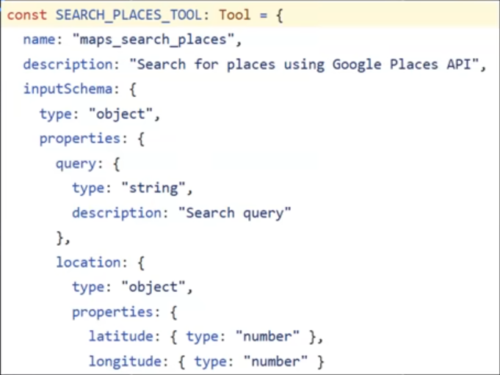
CLIENT GETS THE TOOLS
When an MCP client connects, it requests the list of available tools from the MCP server.
WITHOUT MCP
What you're looking at
1. The client requests the available tools.
When an MCP client connects, it sends a tools/list request asking the server which tools it provides.
2. The server returns each tool definition.
For every available tool, the server returns its name, description, and input schema. This tells the client exactly what the tool does and what parameters it accepts.
3. The client stores these definitions.
The client now understands every available tool and can automatically present them to the LLM.
MCP — Model Context Protocol
11

Slide 11
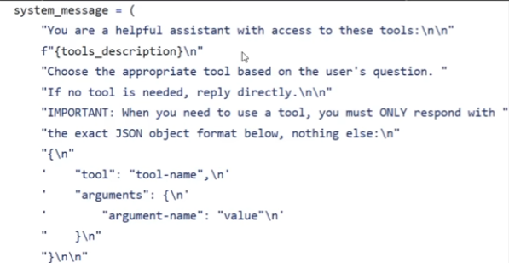
CLIENT INFORMS THE LLM ABOUT THE TOOLS
The client embeds the discovered tool definitions into the system prompt.
The hidden job of the system prompt
1. Builds the system prompt
The client creates a system prompt that tells the LLM how it should behave before processing the user's request.
2. Injects the discovered tools
The client inserts the tool definitions received from the MCP server, allowing the LLM to understand what tools are available and how to use them.
3. Defines the tool-calling rules
The prompt instructs the model when to use a tool, when to answer directly, and the exact JSON format required for every tool invocation.
MCP — Model Context Protocol
12

Slide 12


Security & Limitations
MCP solves the integration problem — it doesn't remove every risk.
Security Risks
Practical Limitations
Tool poisoning A malicious or compromised server can write misleading tool descriptions to trick the LLM into harmful actions.
Still just a language model The LLM can misread a tool's description or call it with the wrong arguments — hallucination doesn't disappear.
Prompt injection via tool output Data returned from a tool can contain hidden instructions the LLM may follow unintentionally.
Bounded by connected servers It can only do what a currently-connected server exposes — nothing more.
Over-broad permissions A tool connected for one task (e.g. read files) may quietly be able to do more — the “confused deputy” problem.
Added latency & complexity Every tool round trip costs time, and more moving parts means more failure points.
No universal auth standard yet Authentication/authorization patterns across servers are still inconsistent.
No guaranteed determinism The same request can lead to different tool choices on different runs.
Third-party supply-chain risk Every MCP server you connect is code you didn't write, running with real access.
Human oversight still needed Sensitive actions (payments, deletions, messages) should keep a human in the loop.
MCP · Model Context Protocol
9

Slide 13



Real-World Applications
MCP is already the plumbing behind a lot of tools you may have used.
AI Coding Assistants
Desktop AI Assistants
Project & Docs Tools
Claude Code and similar tools use MCP to read repos, run terminal commands, and open files directly.
Claude Desktop connects to local files, Google Drive, and calendars through MCP servers.
Servers for Notion, Slack, and Jira let an LLM read tickets, pages, and messages on request.
Databases & Analytics
Customer Support
Workflow Automation
An LLM can query a live database or BI tool through a server, instead of stale training data.
Support agents pull real order or account details from a CRM server before replying.
Chaining multiple MCP servers lets one assistant trigger actions across several apps at once.
MCP · Model Context Protocol
10

Slide 14
The Takeaway
MCP gives LLMs a standard, describable way to reach real tools and data —
turning “I can't do that” into a grounded, verifiable answer.
Questions?
Thank you
MCP · Model Context Protocol
14

