Slide 1
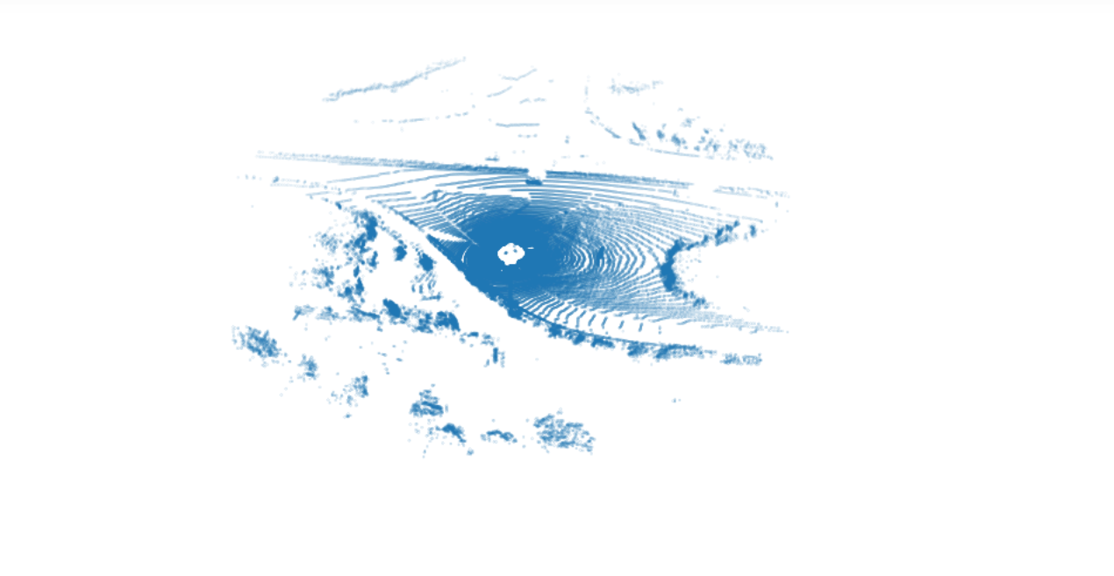
Visual Odometry
USING KITTI DATASET
BASIL REJI & KEVIN SANI

Slide 2
What can we do with this data?
We can perform
Stereo Odometry
Optical Flow
Visual Odometry
3D Object Detection
3D Tracking

Slide 3
What are the Applications?
OPTICAL
VISUAL
DETECTION
TRACKING
STEREO
Stereo Odometry
Optical Flow
Visual Odometry
3D object detection
3D Tracking

Slide 4
What data was used?
We made use of
Lidar Dataset (velodyne)
Calibration Files
Grayscale images data
Ground truth poses
From the Kitti vision
benchmark suite.

Slide 5
What is Disparity?
Disparity measures the displacement of a point between two images. The higher the disparity, the closer the object. This example computes disparity using the Semi-Global Block Matching (SGBM) method,which is similar to the disparity (Computer Vision Toolbox) function.
Try closing one eye, opening it quickly while closing the other to experience this. You'll observe that objects that are closest to you move more than those that are farther away. This condition is known as discrepancy.
Measure : Pixels
First we are going to define a disparity map to check for grayscale image.
We are inputing camera images from both sides as arguments.
https://ww2.mathworks.cn/help/visionhdl/ug/stereoscopic-disparity.html

Slide 6
What are we doing with Block Matching?
By comparing blocks of pixels, the Block Matching block calculates the amount of motion between two pictures or two video frames. By shifting the block of pixels over a search zone, the block matches the block of pixels between frames.
Stereo BM stands for block matching algorithm. Stereo SGBM stands for Semi Global Block Matching algorithm. We are using OpenCV2 library in python for its execution.
We modified SAD window (Sum of Absolute Differences window) size and block size to compare pixels

Slide 7
There is chance that there can be a gap of one side of the image where another side camera will not have matching information. This means that we should apply a mask when looking for features to match from one frame to the next so that we can use features which fall in the area of the picture for which we have depth information.
So for this kind of situation we are defining a depth map where projection mapping comes into picture.

Slide 8
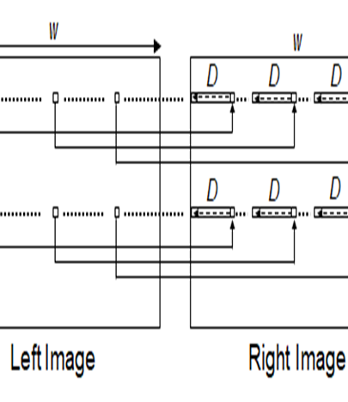
Semi-Global Block Matching (SGBM) Disparity algorithm?
DISPARITY: The difference in horizontal location of an object in the left and right image.
Categories of disparity estimation algorithms: local methods and global methods.
Local methods evaluate one pixel at a time.
Global methods consider information that is available in the whole image. Local methods are poor at detecting sudden depth variation and occlusions, and hence global methods are preferred.
Semi-global matching uses information from neighboring pixels in multiple directions to calculate the disparity of a pixel.
SGBM is more efficient
Instead of using the whole image, the disparity of a pixel can be calculated by considering a smaller block of pixels for ease of computation
As shown in figure, the algorithm searches for each pixel in the Left Image from among D pixels in the Right Image.
The first D columns of Left Image are unused because the corresponding pixels in Right Image are not available for comparison
https://ww2.mathworks.cn/help/visionhdl/ug/stereoscopic-disparity.html

Slide 9


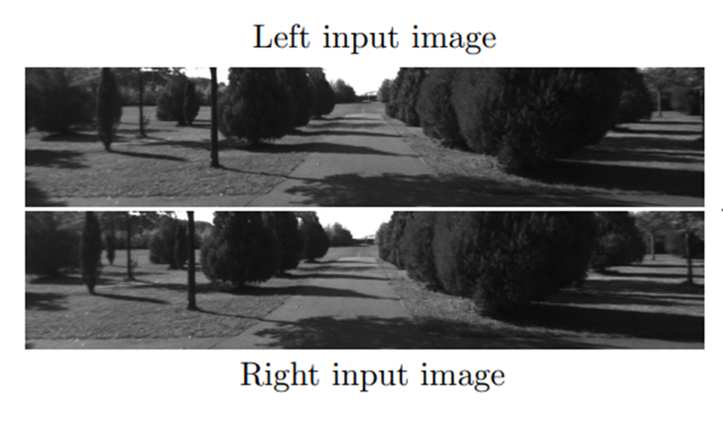
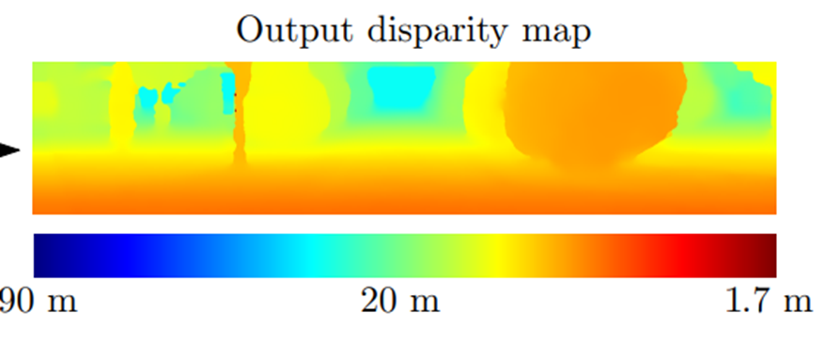
For a given image resolution,
Increasing the disparity level reduces the minimum distance to detect depth.
Increasing the disparity level also increases the computation load of the algorithm.
At a given disparity level, increasing the image resolution increases the minimum distance to detect depth.
Increasing the image resolution also increases the accuracy of depth estimation.
The number of disparity levels are proportional to the input image resolution for detection of objects at the same depth
If we know the disparity of an object, we can compute its depth z using the following relation: z = fB/ d.
Where f is the focal length of the camera and B is the distance between the camera centers
https://www.jmlr.org/papers/volume17/15-535/15-535.pdf

Slide 10
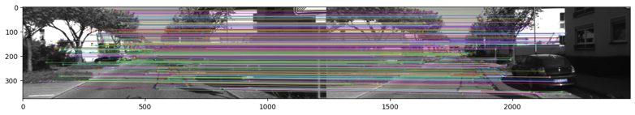
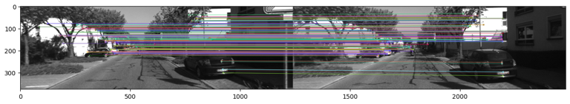
Feature Detection?
The feature detection is done using Perspective n-Point Algorithm (PnP).
PnP is a pose estimation process of a calibrated Camera with given n number of 3D points in the world and their corresponding 2D projections.
P2P and P3P are the commonly used algorithms for Lidar Data.
In python, we implement this with the SIFT (Scale Invariant Feature Transform) function in OpenCV
SIFT is a scale invariant transformation, ie: increasing or decreasing the scale of the image does not change the corner points
https://www.analyticsvidhya.com/blog/2019/10/detailed-guide-powerful-sift-technique-image-matching-python/

Slide 11
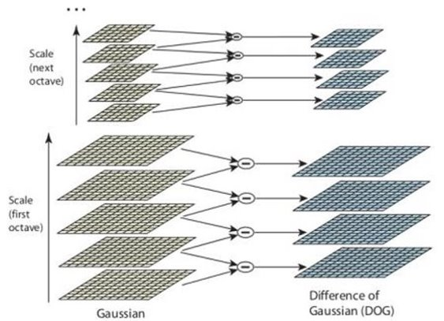
SIFT uses difference of Gaussian values of images to find the common features and end points
https://www.analyticsvidhya.com/blog/2019/10/detailed-guide-powerful-sift-technique-image-matching-python/

Slide 12
What is SIFT(Scale Invariant Feature Transform)?
Sift is used in the detection of interest points on an input image.
It allows identification of localized features in images which is essential in applications such as: Object Recognition, Image Matching, etc.
Find features in the image and match it with corresponding features in the second image using the pixel depth and reconstruct the 3D position of the object in the first camera frame.
Constructing a Scale Space To make sure that features are scale-independent
Keypoint Localisation: Identifying the suitable features or keypoints
Orientation Assignment: Ensure the keypoints are rotation invariant
Keypoint Descriptor: Assign a unique fingerprint to each keypoint
https://www.analyticsvidhya.com/blog/2019/10/detailed-guide-powerful-sift-technique-image-matching-python/

Slide 13
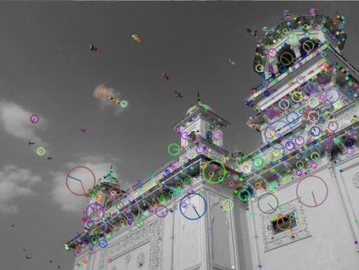
How does SIFT work?
sift.detect() function finds the keypoint in the images.
Each keypoint is a special structure which has many attributes like its (x,y) coordinates, size of the meaningful neighbourhood, angle which specifies its orientation,etc.
The keypoints and descriptors can be found by the function sift.detectAndCompute() it is then stored in a numpy array.
https://www.analyticsvidhya.com/blog/2019/10/detailed-guide-powerful-sift-technique-image-matching-python/

Slide 14
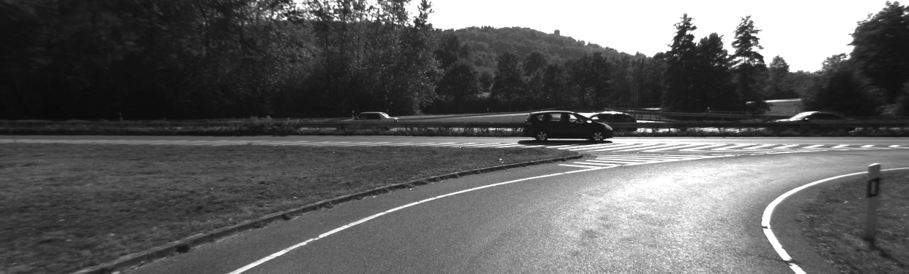
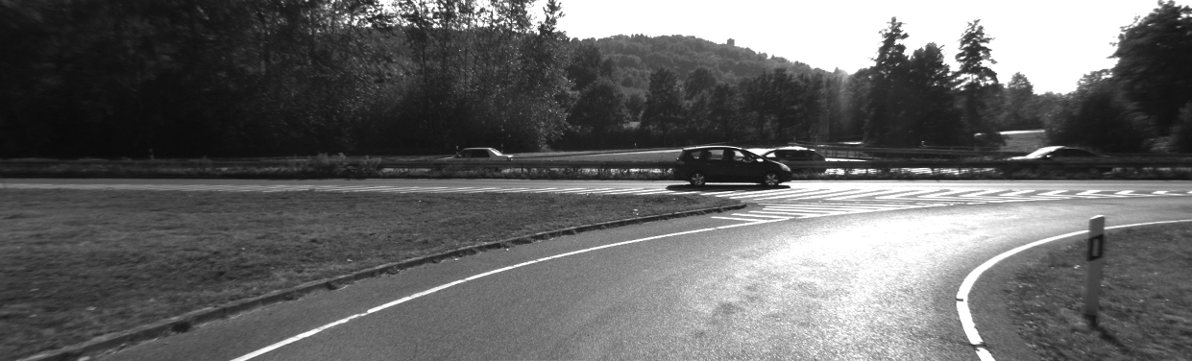
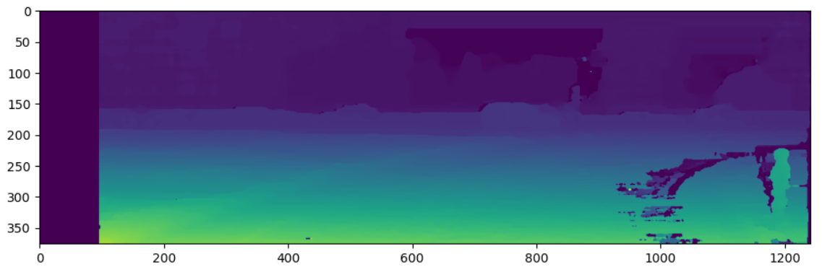
What is the progress?
Disparity matching between first two images using SGBM algorithm
Size – 1241 X 376
Left image
Right image
Disparity Image

Slide 15
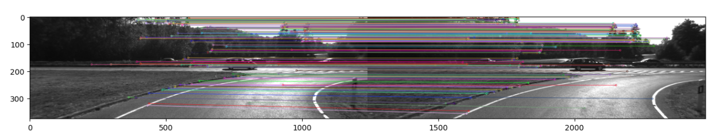
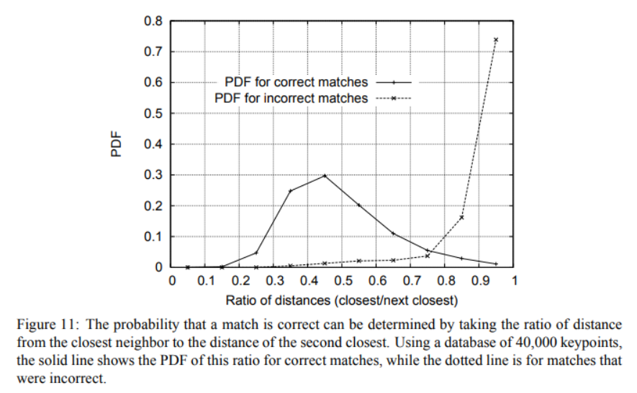
Feature Mapping using SIFT?
Left image i
Left image i + 1
David Lowe
For distinctive feature mapping we use ratio of
Euclidean distances between two key descriptors.
If the ratio is smaller, that means the descriptors a
vary a lot, then only they are different distinctive features
https://people.eecs.berkeley.edu/~malik/cs294/lowe-ijcv04.pdf

Slide 16
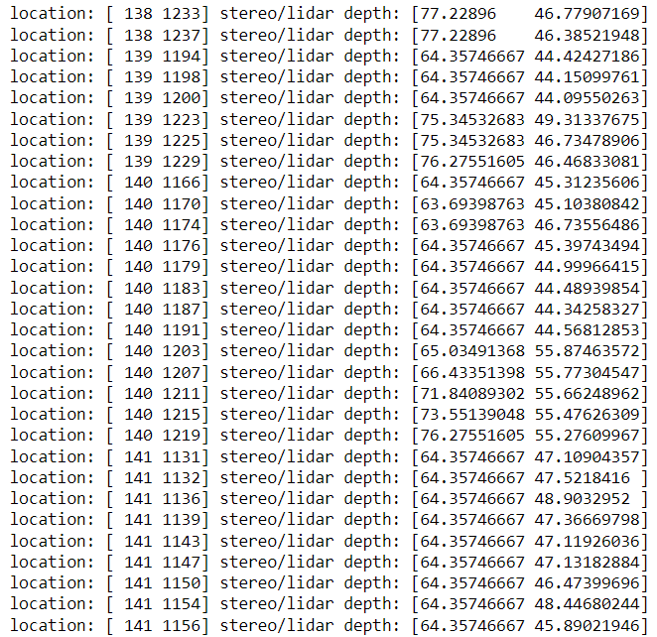
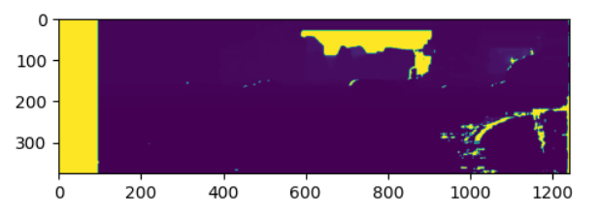
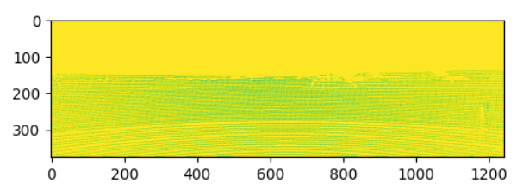
LIDAR depth comparison?
Stereo depth estimate
LIDAR depth estimate

Slide 17
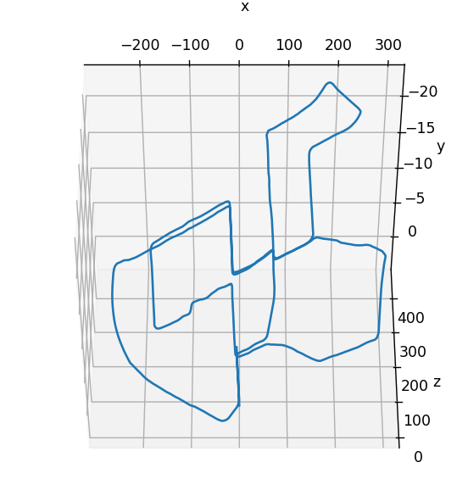
What were the challenges?
LIDAR projection transformation matrix information was not in calibration files
Projection transformations were rectified.
Algorithm parameter selection
Mismatches between features
Future work
How to run everything simultaneously
Error estimates
Pose estimation with respect to ground truth

Slide 18
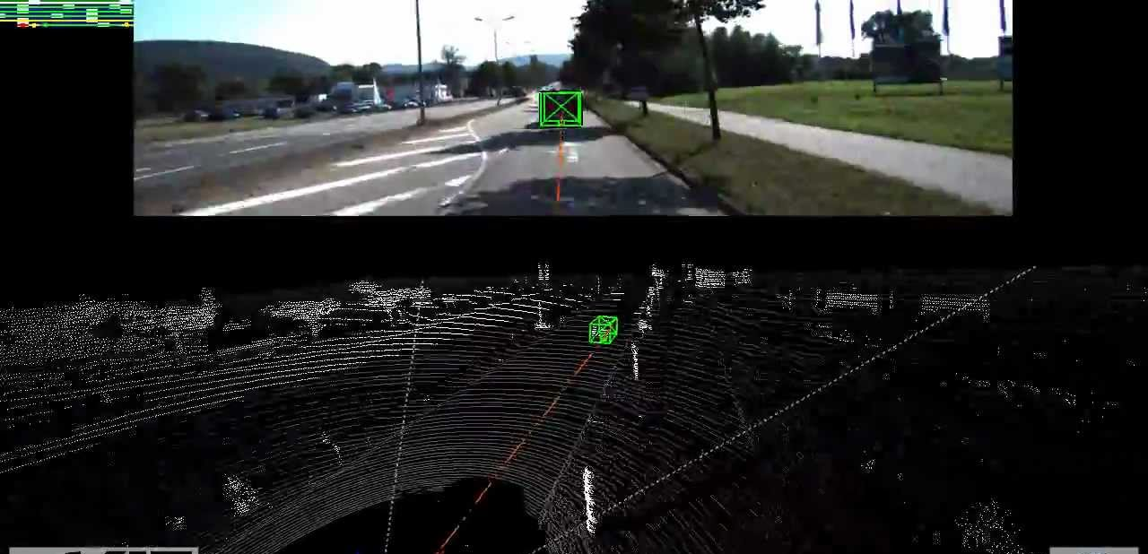
Thank You!

