Slide 1
題目
任意彩色圖像
影像處理方法 (任意組合)
灰階
負片
Gamma Correct
Min/Mean/Max/Median filter
邊緣偵測(Sobel、 Laplacian)
二值化
Salt and pepper

Slide 2
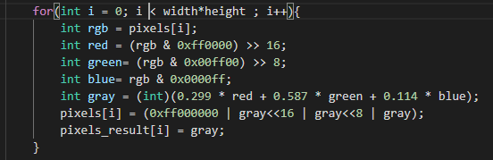
灰階

Slide 3
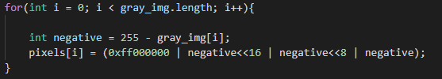
負片

Slide 4
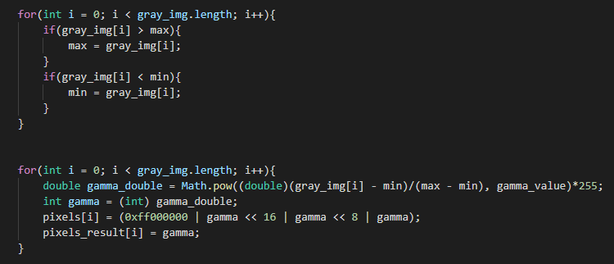
Gamma

Slide 5
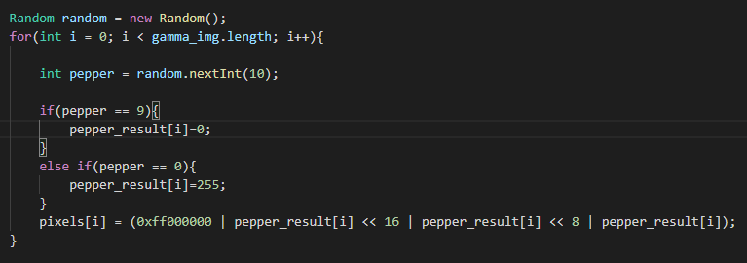
Salt and pepper

Slide 6
Salt and pepper

Slide 7
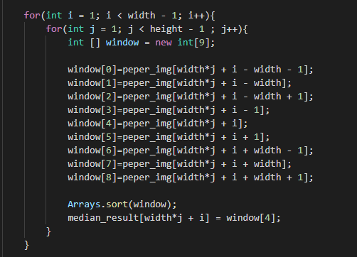
Median

Slide 8
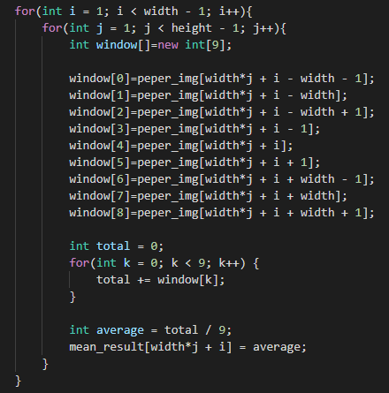
Mean

Slide 9
min

Slide 10
max

Slide 11
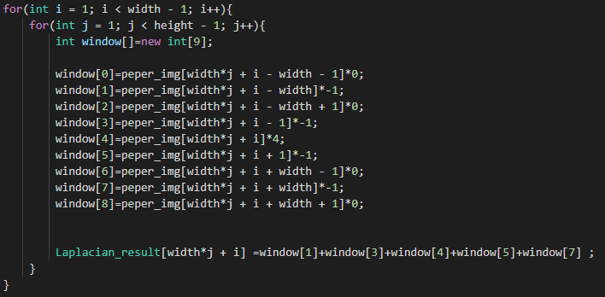
Laplacian
https://introcs.cs.princeton.edu/java/31datatype/LaplaceFilter.java.html

Slide 12
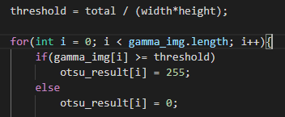
二值化

Slide 13
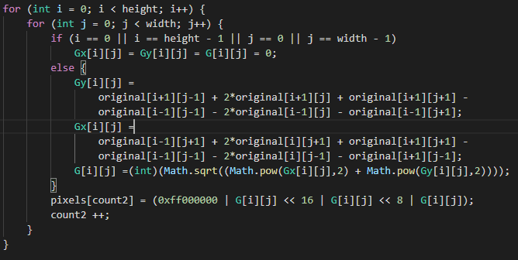
Sobel

Slide 14
import javax.imageio.ImageIO;
import java.awt.image.BufferedImage;
import java.io.File;
import java.io.IOException;
import java.util.Random;
import java.util.Arrays;
public class ImageProcess {
public static void main(String args[]){
File file = new File(“");
try {
//讀取資料檔
BufferedImage RGB_img = ImageIO.read(file);
//讀取高度
int height = RGB_img.getHeight();
//讀取寬度
int width = RGB_img.getWidth();
//灰階轉換
int [] gray_img = new int[width * height];
gray_img = Gray(RGB_img);
//負片轉換
Negative(gray_img, width, height);
//Gamma 轉換
int [] gamma_img1 = new int[width * height];
int [] gamma_img2 = new int[width * height];
int [] gamma_img3 = new int[width * height];
gamma_img1 = Gamma(gray_img, width, height, 0.5); //gamma函數超過1會越黑
gamma_img2 = Gamma(gray_img, width, height, 1);
gamma_img3 = Gamma(gray_img, width, height, 2);
//Salt and pepper胡椒鹽雜訊
int [] peper_img = new int[width * height];
peper_img = Pepper(gamma_img1, width, height);
//中位數
Median(peper_img, width, height);
//平均濾波器
Mean(peper_img, width, height);
//最小值濾波器
Min(peper_img, width, height);
//最大值濾波器
Max(peper_img, width, height);
//Laplacian拉普拉斯
Laplacian(gamma_img3, width, height);
//Sobel
Sobel(gamma_img2, width, height);
//二值化
OTSU(gamma_img3, width, height);
} catch (IOException e) {
// TODO Auto-generated catch block
e.printStackTrace();
}
}
//灰階轉換
public static int[] Gray(BufferedImage RGB_img){
int width = RGB_img.getWidth();
int height = RGB_img.getHeight();
int [] pixels = new int[width * height];
int [] pixels_result = new int[width * height];
// Get RGB pixels
RGB_img.getRGB(0, 0, width, height, pixels, 0, width);
/*
RGB Process
int red = (pixel >> 16) & 0xff; 右移16位之後原?的高8位就在低8位的位置上了，再與0xff就只剩下了原?的高8位數值
int green = (pixel >> 8) & 0xff; 右移8位之後原?的中間8位就在低8位的位置上了，再與0xff就只剩下了原?的中間8位數值
int blue = (pixel ) & 0xff; 與0xff就直接得到了低8位?值
*/
for(int i = 0; i < width*height ; i++){
int rgb = pixels[i];
int red = (rgb & 0xff0000) >> 16;
int green= (rgb & 0x00ff00) >> 8;
int blue= rgb & 0x0000ff;
//轉換灰階公式
int gray = (int)(0.299 * red + 0.587 * green + 0.114 * blue); // 由 RGB 來計算 Y 值
pixels[i] = (0xff000000 | gray<<16 | gray<<8 | gray);
pixels_result[i] = gray; //解決黃點問題
}
BufferedImage gray_image = new BufferedImage(width, height, BufferedImage.TYPE_INT_RGB); //image 轉 BfferedImage
gray_image.setRGB(0, 0, width, height, pixels, 0, width);
try {
File file_gray = new File("gray.bmp");
ImageIO.write(gray_image, "bmp", file_gray);
}catch (Exception e) {
// TODO Auto-generated catch block
e.printStackTrace();
}
return pixels_result;
}
//負片 （255-原像素值）
public static void Negative(int[] gray_img, int width, int height){
int [] pixels = new int[gray_img.length];
for(int i = 0; i < gray_img.length; i++){
int negative = 255 - gray_img[i];
pixels[i] = (0xff000000 | negative<<16 | negative<<8 | negative);
}
BufferedImage negative_image = new BufferedImage(width, height, BufferedImage.TYPE_INT_RGB); //image 轉 BfferedImage
negative_image.setRGB(0, 0, width, height, pixels, 0, width);
try {
File file_negative = new File("negative.bmp");
ImageIO.write(negative_image, "bmp", file_negative);
}catch (Exception e) {}
}
public static int[] Gamma(int [] gray_img, int width, int height, double gamma_value){
int max = -1;
int min = 256;
int [] pixels = new int[gray_img.length];
int [] pixels_result = new int[gray_img.length];
for(int i = 0; i < gray_img.length; i++){ //找max and min
if(gray_img[i] > max){
max = gray_img[i];
}
if(gray_img[i] < min){
min = gray_img[i];
}
}
/*
Gamma公式
[(p(i,j)-min/max-min)^gamma]*255
p(i,j)為像素點之值，min為圖片中像素之最小值，max為圖片中像素之最大值
*/
for(int i = 0; i < gray_img.length; i++){
double gamma_double = Math.pow((double)(gray_img[i] - min)/(max - min), gamma_value)*255;
int gamma = (int) gamma_double;
pixels[i] = (0xff000000 | gamma << 16 | gamma << 8 | gamma);
pixels_result[i] = gamma;
}
BufferedImage gama_image = new BufferedImage(width, height, BufferedImage.TYPE_INT_RGB); //image 轉 BfferedImage
gama_image.setRGB(0, 0, width, height, pixels, 0, width);
try {
File file_gama = new File("gamma_" + gamma_value + ".bmp");
ImageIO.write(gama_image, "bmp", file_gama);
}catch (Exception e) {
// TODO Auto-generated catch block
e.printStackTrace();
}
return pixels_result;
}
//胡椒鹽雜訊
public static int[] Pepper(int [] gamma_img, int width, int height){
int [] pixels = new int[gamma_img.length];
int [] pepper_result = new int[gamma_img.length];
for(int i = 0; i < gamma_img.length; i++){
pepper_result[i] = gamma_img[i];
}
Random random = new Random();
for(int i = 0; i < gamma_img.length; i++){
int pepper = random.nextInt(10);
if(pepper == 9){
pepper_result[i]=0;
}
else if(pepper == 0){
pepper_result[i]=255;
}
pixels[i] = (0xff000000 | pepper_result[i] << 16 | pepper_result[i] << 8 | pepper_result[i]); //轉換成十六進制
}
BufferedImage pepper_image = new BufferedImage(width, height, BufferedImage.TYPE_INT_RGB); //image 轉 BfferedImage
pepper_image.setRGB(0, 0, width, height, pixels, 0, width);
try {
File file_pepper = new File("peper.bmp");
ImageIO.write(pepper_image, "bmp", file_pepper);
}catch (Exception e) {
// TODO Auto-generated catch block
e.printStackTrace();
}
return pepper_result;
}
//中值濾波器（將九個值進行排序，利用中間的值取代最大的值（即九宮格右下的值））
public static void Median(int [] peper_img, int width, int height){
int [] pixels = new int[peper_img.length];
int [] median_result = new int[peper_img.length];
for(int i = 0; i < peper_img.length; i++){
median_result[i] = peper_img[i];
}
for(int i = 1; i < width - 1; i++){
for(int j = 1; j < height - 1 ; j++){
int [] window = new int[9];
window[0]=peper_img[width*j + i - width - 1]; //左上
window[1]=peper_img[width*j + i - width]; //上
window[2]=peper_img[width*j + i - width + 1]; //右上
window[3]=peper_img[width*j + i - 1]; //左
window[4]=peper_img[width*j + i]; //中
window[5]=peper_img[width*j + i + 1]; //右
window[6]=peper_img[width*j + i + width - 1]; //左下
window[7]=peper_img[width*j + i + width]; //下
window[8]=peper_img[width*j + i + width + 1]; //右下
Arrays.sort(window);
median_result[width*j + i] = window[4]; //取代
}
}
for(int i = 0; i < peper_img.length; i++){
pixels[i] = (0xff000000 | median_result[i] << 16 | median_result[i] << 8 | median_result[i]);
}
BufferedImage median_image = new BufferedImage(width, height, BufferedImage.TYPE_INT_RGB); //image 轉 BfferedImage
median_image.setRGB(0, 0, width, height, pixels, 0, width);
try {
File file_median = new File("median.bmp");
ImageIO.write(median_image, "bmp", file_median);
}catch (Exception e) {
// TODO Auto-generated catch block
e.printStackTrace();
}
}
//平均濾波器（將九宮格每一格數值相加取平均值，並將此數值取代全部值）
public static void Mean(int [] peper_img, int width, int height){
int mean_result[]=new int[peper_img.length]; //新
for(int i = 1; i < width - 1; i++){
for(int j = 1; j < height - 1; j++){
int window[]=new int[9];
window[0]=peper_img[width*j + i - width - 1]; //左上
window[1]=peper_img[width*j + i - width]; //上
window[2]=peper_img[width*j + i - width + 1]; //右上
window[3]=peper_img[width*j + i - 1]; //左
window[4]=peper_img[width*j + i]; //中
window[5]=peper_img[width*j + i + 1]; //右
window[6]=peper_img[width*j + i + width - 1]; //左下
window[7]=peper_img[width*j + i + width]; //下
window[8]=peper_img[width*j + i + width + 1]; //右下
int total = 0;
for(int k = 0; k < 9; k++) {
total += window[k];
}
int average = total / 9;
mean_result[width*j + i] = average; //取代
}
}
for(int i = 0; i < peper_img.length; i++){
mean_result[i] = (0xff000000 | mean_result[i] << 16 | mean_result[i] << 8 | mean_result[i]);
}
BufferedImage mean_image = new BufferedImage(width, height, BufferedImage.TYPE_INT_RGB); //image 轉 BfferedImage
mean_image.setRGB(0, 0, width, height, mean_result, 0, width);
try {
File file_mean = new File("mean.bmp");
ImageIO.write(mean_image, "bmp", file_mean);
}catch (Exception e) {
// TODO Auto-generated catch block
e.printStackTrace();
}
}
//最小值濾波器
public static void Min(int [] peper_img, int width, int height){
int min_result[]= new int[peper_img.length];
for(int i = 1; i < width - 1; i++){
for(int j = 1; j < height - 1; j++){
int window[]=new int[9];
window[0]=peper_img[width*j + i - width - 1]; //左上
window[1]=peper_img[width*j + i - width]; //上
window[2]=peper_img[width*j + i - width + 1]; //右上
window[3]=peper_img[width*j + i - 1]; //左
window[4]=peper_img[width*j + i]; //中
window[5]=peper_img[width*j + i + 1]; //右
window[6]=peper_img[width*j + i + width - 1]; //左下
window[7]=peper_img[width*j + i + width]; //下
window[8]=peper_img[width*j + i + width + 1]; //右下
Arrays.sort(window);
min_result[width*j + i] = window[0]; //取代
}
}
for(int i = 0; i < peper_img.length; i++){
min_result[i] = (0xff000000 | min_result[i] << 16 | min_result[i] << 8 | min_result[i]);
}
BufferedImage min_image = new BufferedImage(width, height, BufferedImage.TYPE_INT_RGB); //image 轉 BfferedImage
min_image.setRGB(0, 0, width, height, min_result, 0, width);
try {
File file_min = new File("min.bmp");
ImageIO.write(min_image, "bmp", file_min);
}catch (Exception e) {
// TODO Auto-generated catch block
e.printStackTrace();
}
}
//最大值濾波器
public static void Max(int [] peper_img, int width, int height){
int max_result[]= new int[peper_img.length];
for(int i = 1; i < width - 1; i++){
for(int j = 1; j < height - 1; j++){
int window[]=new int[9];
window[0]=peper_img[width*j + i - width - 1]; //左上
window[1]=peper_img[width*j + i - width]; //上
window[2]=peper_img[width*j + i - width + 1]; //右上
window[3]=peper_img[width*j + i - 1]; //左
window[4]=peper_img[width*j + i]; //中
window[5]=peper_img[width*j + i + 1]; //右
window[6]=peper_img[width*j + i + width - 1]; //左下
window[7]=peper_img[width*j + i + width]; //下
window[8]=peper_img[width*j + i + width + 1]; //右下
Arrays.sort(window);
max_result[width*j + i] = window[8]; //取代
}
}
for(int i = 0; i < peper_img.length; i++){
max_result[i] = (0xff000000 | max_result[i] << 16 | max_result[i] << 8 | max_result[i]);
}
BufferedImage max_image = new BufferedImage(width, height, BufferedImage.TYPE_INT_RGB); //image 轉 BfferedImage
max_image.setRGB(0, 0, width, height, max_result, 0, width);
try {
File file_max = new File("max.bmp");
ImageIO.write(max_image, "bmp", file_max);
}catch (Exception e) {
// TODO Auto-generated catch block
e.printStackTrace();
}
}
//Laplacian拉普拉斯
public static void Laplacian(int [] peper_img, int width, int height){
int Laplacian_result[]= new int[peper_img.length];
for(int i = 1; i < width - 1; i++){
for(int j = 1; j < height - 1; j++){
int window[]=new int[9];
window[0]=peper_img[width*j + i - width - 1]*0; //左上
window[1]=peper_img[width*j + i - width]*-1; //上
window[2]=peper_img[width*j + i - width + 1]*0; //右上
window[3]=peper_img[width*j + i - 1]*-1; //左
window[4]=peper_img[width*j + i]*4; //中
window[5]=peper_img[width*j + i + 1]*-1; //右
window[6]=peper_img[width*j + i + width - 1]*0; //左下
window[7]=peper_img[width*j + i + width]*-1; //下
window[8]=peper_img[width*j + i + width + 1]*0; //右下
Laplacian_result[width*j + i] =window[1]+window[3]+window[4]+window[5]+window[7] ; //取代
}
}
for(int i = 0; i < peper_img.length; i++){
Laplacian_result[i] = (0xff000000 | Laplacian_result[i] << 16 | Laplacian_result[i] << 8 | Laplacian_result[i]);
}
BufferedImage Laplacian_image = new BufferedImage(width, height, BufferedImage.TYPE_INT_RGB); //image 轉 BfferedImage
Laplacian_image.setRGB(0, 0, width, height, Laplacian_result, 0, width);
try {
File file_Laplacian = new File("Laplacian.bmp");
ImageIO.write(Laplacian_image, "bmp", file_Laplacian);
}catch (Exception e) {
// TODO Auto-generated catch block
e.printStackTrace();
}
}
//二值化（設門檻值(所有像素之平均值)，大於門檻值則設255，小於則設0）
public static void OTSU(int [] gamma_img, int width, int height){
int threshold = 0;
int total = 0;
int [] pixels = new int[width * height];
int [] otsu_result = new int[width * height];
for (int i = 0; i < gamma_img.length ;i++){
otsu_result[i] = gamma_img[i];
}
for(int i = 0; i < gamma_img.length ;i++){
total += gamma_img[i];
}
threshold = total / (width*height);
for(int i = 0; i < gamma_img.length; i++){
if(gamma_img[i] >= threshold)
otsu_result[i] = 255;
else
otsu_result[i] = 0;
pixels[i] = (0xff000000 | otsu_result[i] << 16 | otsu_result[i] << 8 | otsu_result[i]);
}
BufferedImage otsu_image = new BufferedImage(width, height, BufferedImage.TYPE_INT_RGB); //image 轉 BfferedImage
otsu_image.setRGB(0, 0, width, height, pixels, 0, width);
try {
File file_otsu = new File("otsu.bmp");
ImageIO.write(otsu_image, "bmp", file_otsu);
}catch (Exception e) {
// TODO Auto-generated catch block
e.printStackTrace();
}
}
//sobel轉換
public static void Sobel(int [] gamma_img, int width, int height){
int [] pixels = new int[gamma_img.length];
int [][] Gx = new int[height][width];
int [][] Gy = new int[height][width];
int [][] G = new int[height][width];
int [][] original = new int[height][width]; //gamma2
int count = 0;
for(int i = 0; i < height; i++){
for(int j = 0; j < width; j++){
original[i][j] = gamma_img[count];
count ++;
}
}
int count2= 0;
for (int i = 0; i < height; i++) {
for (int j = 0; j < width; j++) {
if (i == 0 || i == height - 1 || j == 0 || j == width - 1)
Gx[i][j] = Gy[i][j] = G[i][j] = 0; // image boundary cleared
else {
Gy[i][j] =
original[i+1][j-1] + 2*original[i+1][j] + original[i+1][j+1] -
original[i-1][j-1] - 2*original[i-1][j] - original[i-1][j+1];
Gx[i][j] =
original[i-1][j+1] + 2*original[i][j+1] + original[i+1][j+1] -
original[i-1][j-1] - 2*original[i][j-1] - original[i+1][j-1];
//公式（soble = sqrt[(x^2+y^2)]）
G[i][j] =(int)(Math.sqrt((Math.pow(Gx[i][j],2) + Math.pow(Gy[i][j],2))));
}
pixels[count2] = (0xff000000 | G[i][j] << 16 | G[i][j] << 8 | G[i][j]);
count2 ++;
}
}
BufferedImage sobel_image = new BufferedImage(width, height, BufferedImage.TYPE_INT_RGB); //image 轉 BfferedImage
sobel_image.setRGB(0, 0, width, height, pixels, 0, width);
try {
File file_sobel = new File("sobel.bmp");
ImageIO.write(sobel_image, "bmp", file_sobel);
}catch (Exception e) {
// TODO Auto-generated catch block
e.printStackTrace();
}
}
}

