Slide 1
Dimensional Modeling

Slide 2
Dimensional Modeling
Updates to the Dimension tables
Miscellaneous dimensions
Snowflake schema
Aggregate fact tables
Families of STARS

Slide 3
Updates to dimension tables
Changes to dimension tables may be
classified into 3 categories:
Type 1:Correction of errors
Type 2:Preservation of history
Type 3:Tentative soft Revisions

Slide 4
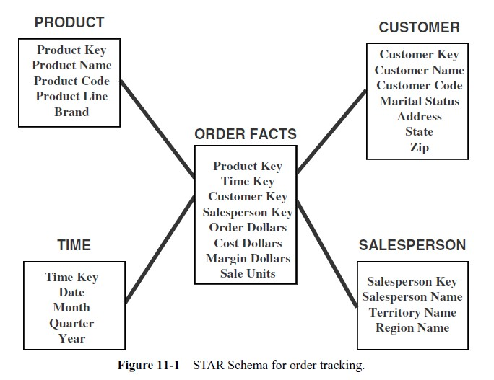

Slide 5
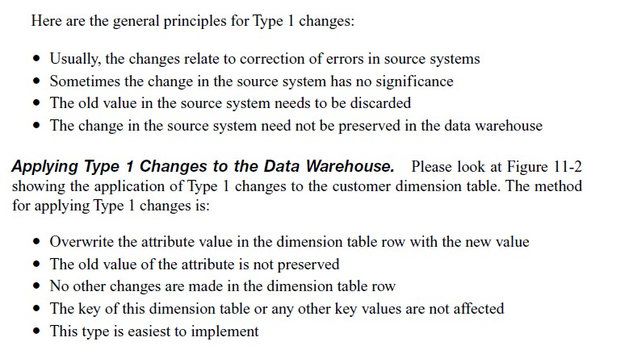
Type-I: correction of errors

Slide 6
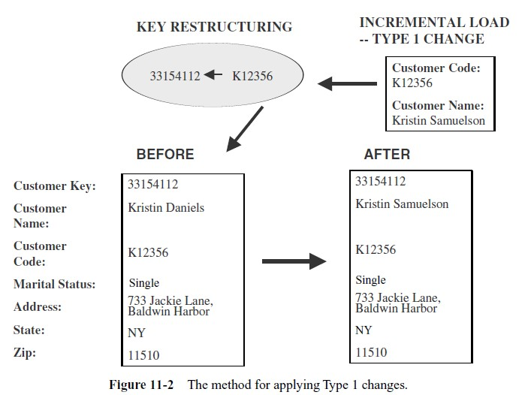
Type-I: correction of errors

Slide 7
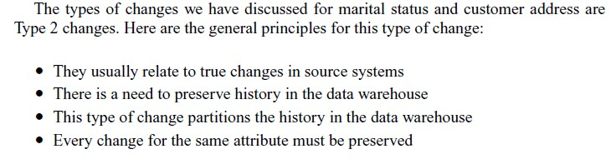
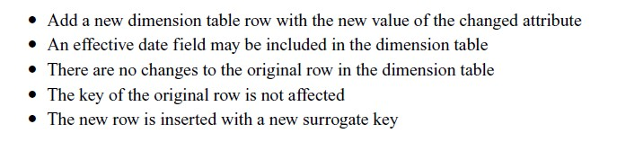
Type 2:Preservation of history

Slide 8
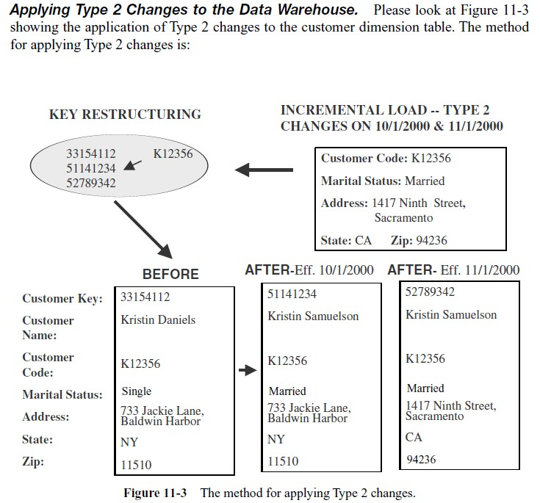

Slide 9
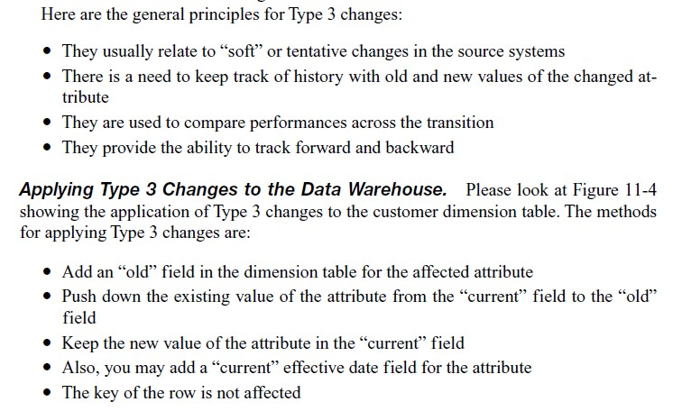
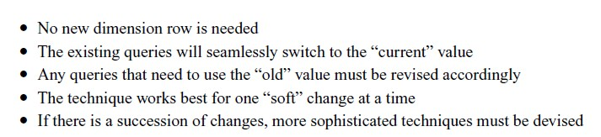
Type-3

Slide 10
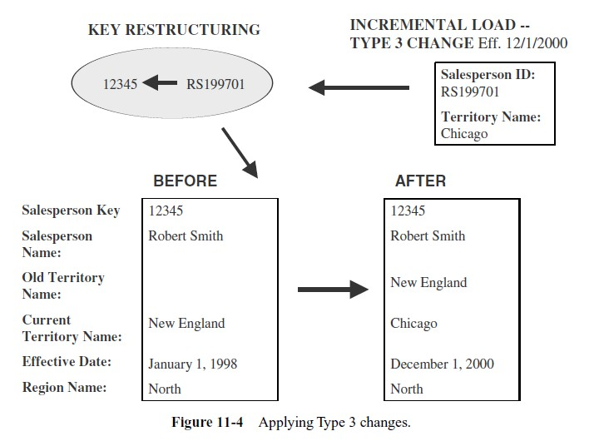

Slide 11
Miscellaneous Dimensions
Large Dimensions
Rapidly Changing Dimensions
Multiple Hierarchies
Junk Dimensions

Slide 12
Large Dimensions
A large dimension is very deep; has a large number of rows.
It may be very wide & may have a large number of attributes.
Large dimensions call for special considerations.

Slide 13
Multiple Hierarchies
Large dimensions often have multiple hierarchies. Eg: Product dimension of a large retailer
One set of attributes may form the hierarchy for the marketing department. Users from that department use these attributes to drill up & down. In the same way the finance department may need to use their own set of attributes from the same product dimension to drill up & drill down.

Slide 14
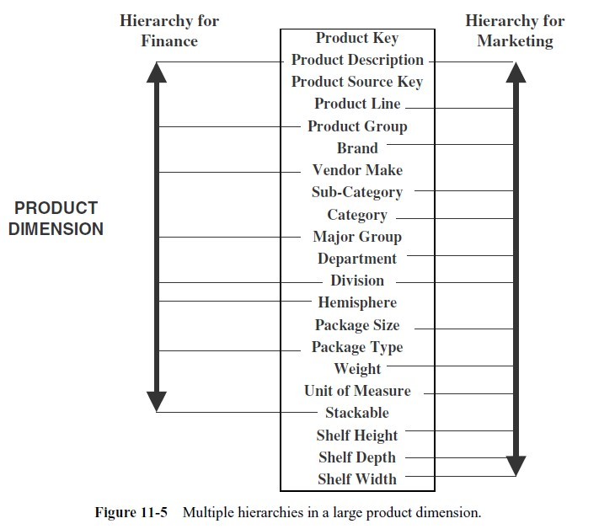

Slide 15
Rapidly Changing Dimensions
With Type 2 change, we can create additional dimension table row with the new value of the changed attribute. By doing so you are able to the preserve the history .same attribute changes a second time ,you can create one or more dimension table row with the latest value.

Slide 16
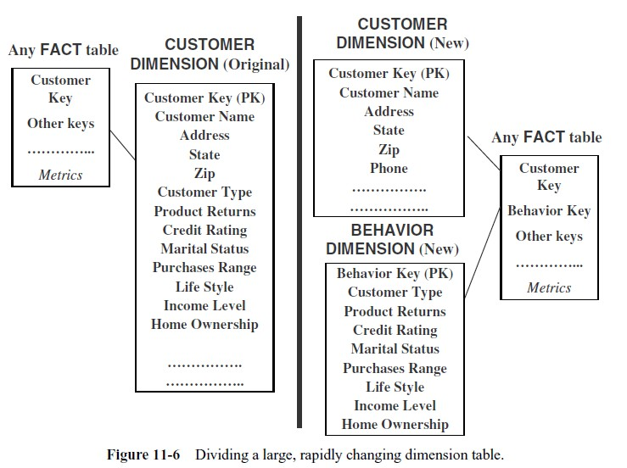

Slide 17
Junk Dimensions
Some of the flags & textual data may be too obscure to be real value. These may not be included as significant fields in the major dimensions. At the same time these flags & texts cannot be discarded either. Some of the choices are:
Exclude & discard all flags & texts.
Place the flags & texts unchanged in the fact table.
Make each flag & text a separate dimension table on its own.
Keep only those flags & texts that are meaningful.

Slide 18
SNOWFLAKE SCHEMA
Snowflaking is a method of normalizing the dimension tables in a STAR schema.
Options to Normalize:
Partially normalize only a few dimension tables, leaving the others intact.
Partially or fully normalize only a few dimension tables, leaving the rest intact.
Fully normalize every dimension table.

Slide 19
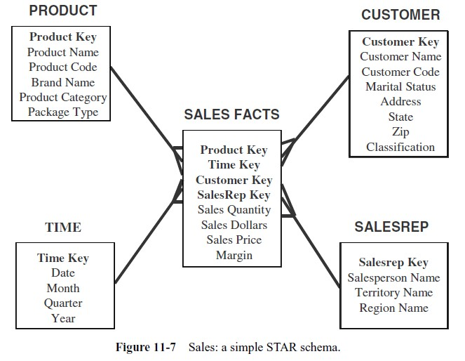
example

Slide 20
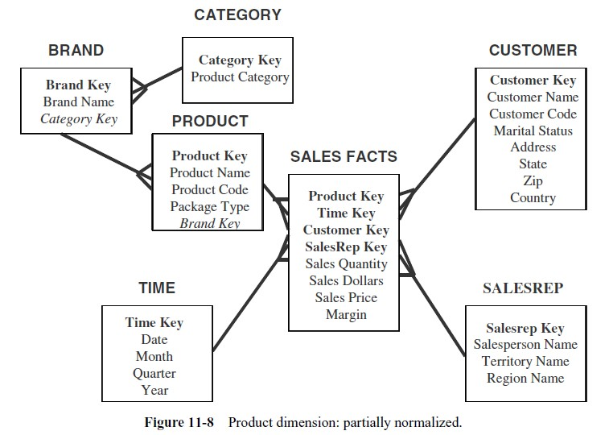
Partial normalization

Slide 21
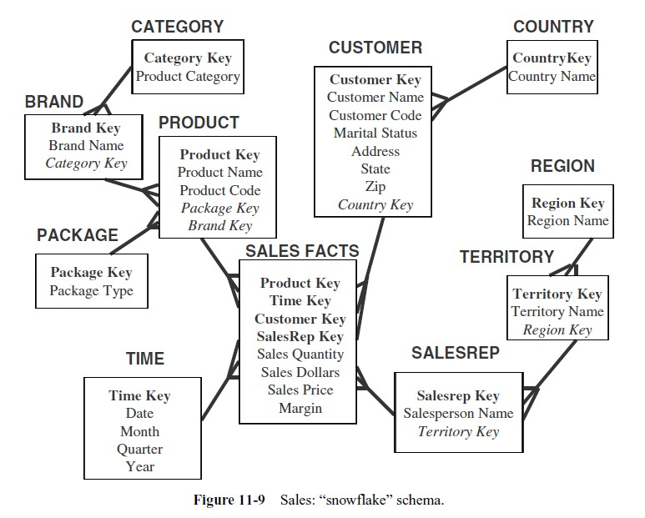
Snowflake schema

Slide 22
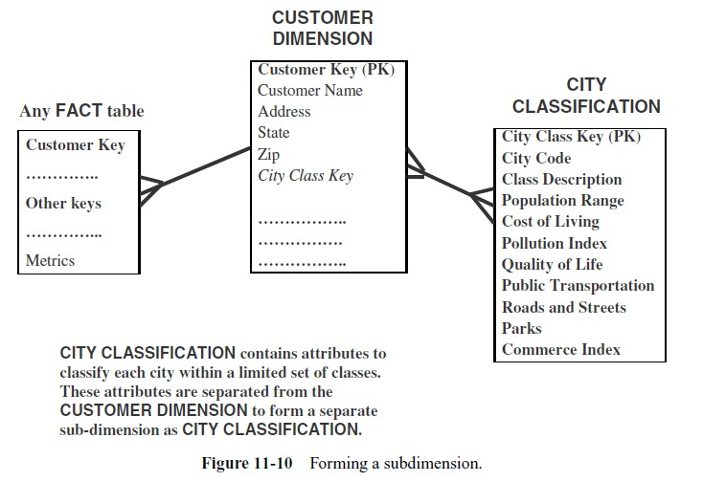
When to snowflake?

Slide 23
Advantages & Disadvantages
Advantages
Small savings in storage space.
Normalized structures are easier to update & maintain.
Disadvantages
Schema is less intuitive & end users are put off by the complexity.
Ability to browse through the contents difficult.
Degraded query performance because of additional joins.

Slide 24
Aggregate Fact Tables
Aggregate tables contain information that has a coarser granularity (fewer rows).
An aggregate table coexists with the base fact table, and contains pre
aggregated measures build from the fact table.
Why Aggregate Tables?
When a user performs various forms of analysis, he or she must be able to get results comprising of a variety of combinations of individual fact table rows.
If we do not keep details of individual stores, we can’t retrieve results for the product by individual stores. On the other hand, if we do not keep details by individual products, we can’t retrieve results for stores by individual product.

Slide 25
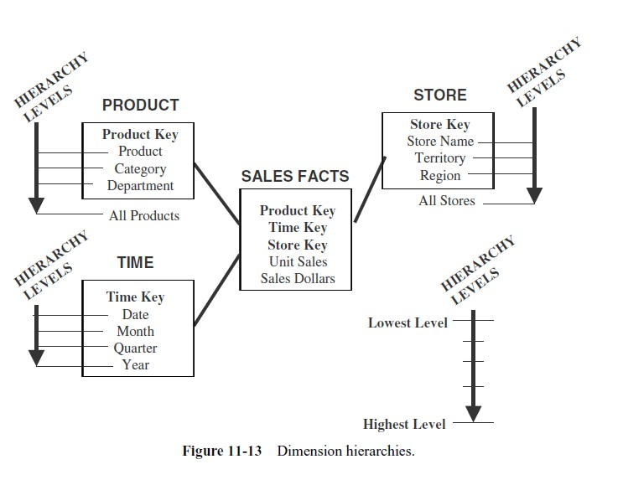

Slide 26
Aggregating Fact
Tables
One-Way Aggregates
Two Way Aggregates
Three-Way Aggregates

Slide 27
One way aggregates
When you rise to higher levels in the hierarchy of one dimension and keep
the level at the lowest in the other dimensions, you create one-way aggregate tables.
Two-Way Aggregates
When you rise to higher levels in the hierarchies of two dimensions and keep the level at the lowest in the other dimension, you create two-way aggregate tables.
Three-Way Aggregates
When you rise to higher levels in the hierarchies of all the three dimensions, you create three-way aggregate tables.

Slide 28
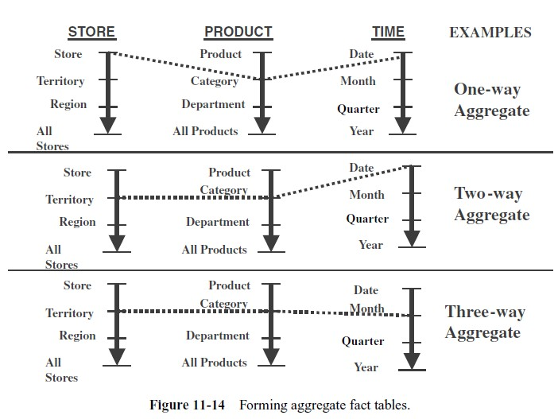

Slide 29
Families of STARS
Each STAR serves a specific purpose to track the measures stored in the fact table.
The fact tables of the STARS in a family share dimension tables.
Usually, Time dimension is shared by most of the fact tables in the group.

Slide 30
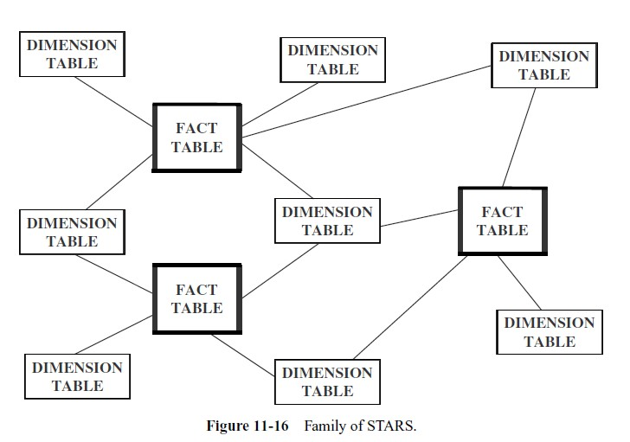
Families of stars

Slide 31
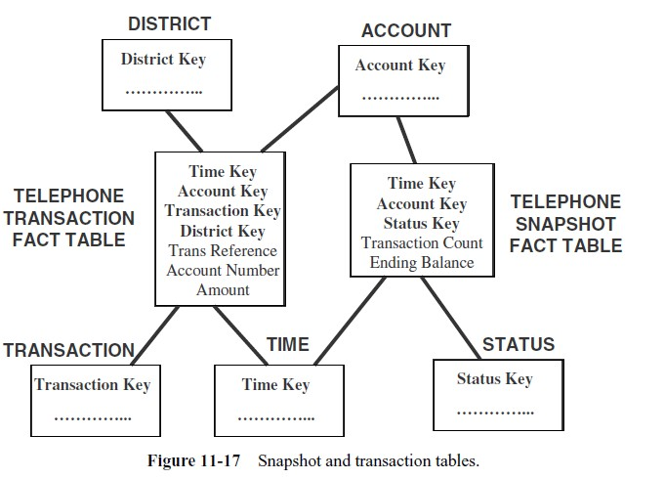
Snapshot and transaction tables

Slide 32
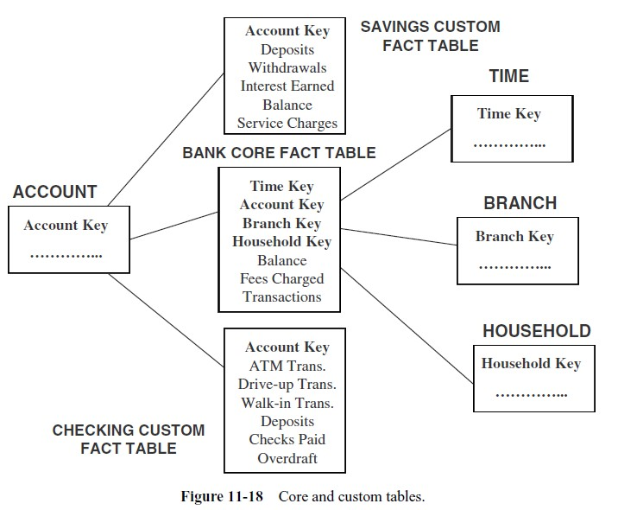
Core & custom tables

Slide 33
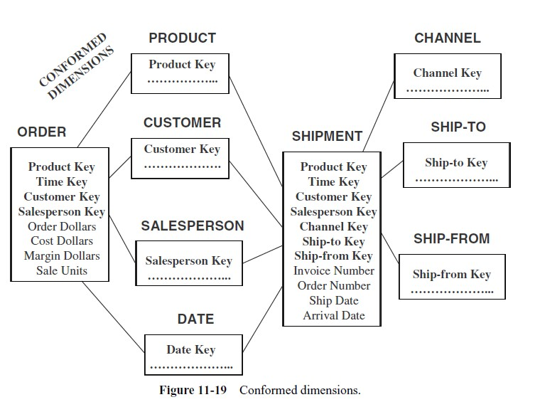
Conforming dimensions

