Slide 1
Comparing Evolutionary-Inspired Algorithms and Neural Networks on Breast Cancer Prediction CS566 Project – Kevin Lopez Sepulveda

Slide 2

Agenda
Introduction to problem
Project Goal
Random Forest
MLP Neural Network
Methods
Results
Conclusion

Slide 3
Why Predicting Breast Cancer Matters
Early detection is key for patient survival
Diagnostic data from biopsies offers opportunities for ML models
Dataset used: Wisconsin Breast Cancer (from scikit-learn)
30 numeric features extracted from digitized biopsy images
Using Random Forest and Multi Layer Perceptron Neural Network
Target: Classify as malignant or benign

Slide 4

How Random Forest Works
Builds many decision trees using bootstrapped data
Each tree “votes” → final prediction by majority
Mimics natural selection via variation and competition
Handles overfitting better than a single tree
Emphasize how RF resembles evolutionary algorithms: random variation, survival of the fittest trees, aggregation
Explain decision trees are like rule-based “if-else” logic machines

Slide 5
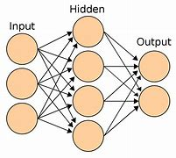
How MLP Neural Network Works
Layers of neurons: input → hidden → output
Each connection has weights, updated via backpropagation
Learns non-linear patterns
Sensitive to data scaling and hyperparameters
MLP learns by adjusting weights to reduce prediction error
Contrast its "deep" structure with RF’s “wide” set of trees

Slide 6

Methods
Dataset split: 80% train / 20% test
StandardScaler used to normalize features
Random Forest: 100 trees
MLP: 2 hidden layers (30, 15 neurons), ReLU activation
Normalization matters for neural networks because each neuron is weighted
RF doesn’t need feature scaling, another real-world advantage

Slide 7
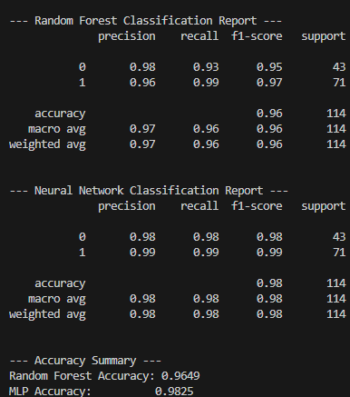
Results
Precision: How many predicted positive cases are positive
Recall: How many actual positive cases are identified
F1-Score: Balance of precision and recall
Accuracy: Overall correct predictions

Slide 8

Conclusion
Both models perform well on breast cancer prediction
Random Forest is faster, more interpretable, and slightly more accurate
MLP is flexible, but more sensitive and complex
For medical diagnosis, evolutionary-inspired RF may be the better choice
Which model is better for real-world, high-stakes decisions?

Slide 9
Thank you
Kevin Lopez Sepulveda
klopezs@bu.edu

