Slide 1


Bringing Great British baking to my doggie pals!

Slide 2


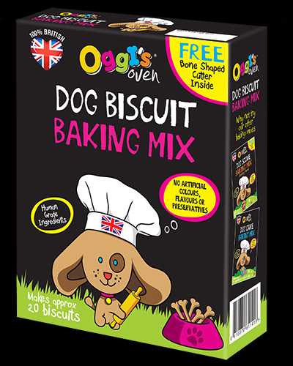
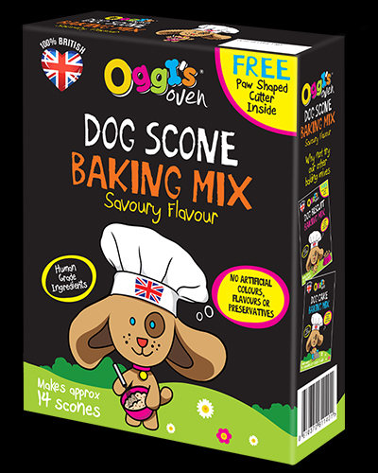
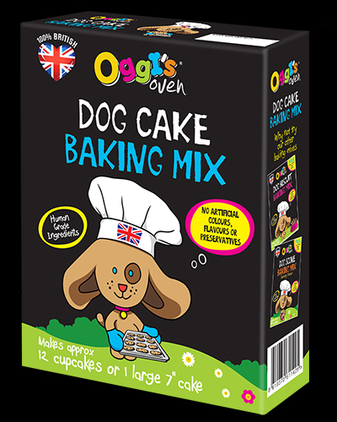
I've created three yummy baking mixes…
Biscuit… with free bone shape cutter
Scone… with free paw shape cutter
Cake… makes 12 small or 1 large cake

Slide 3

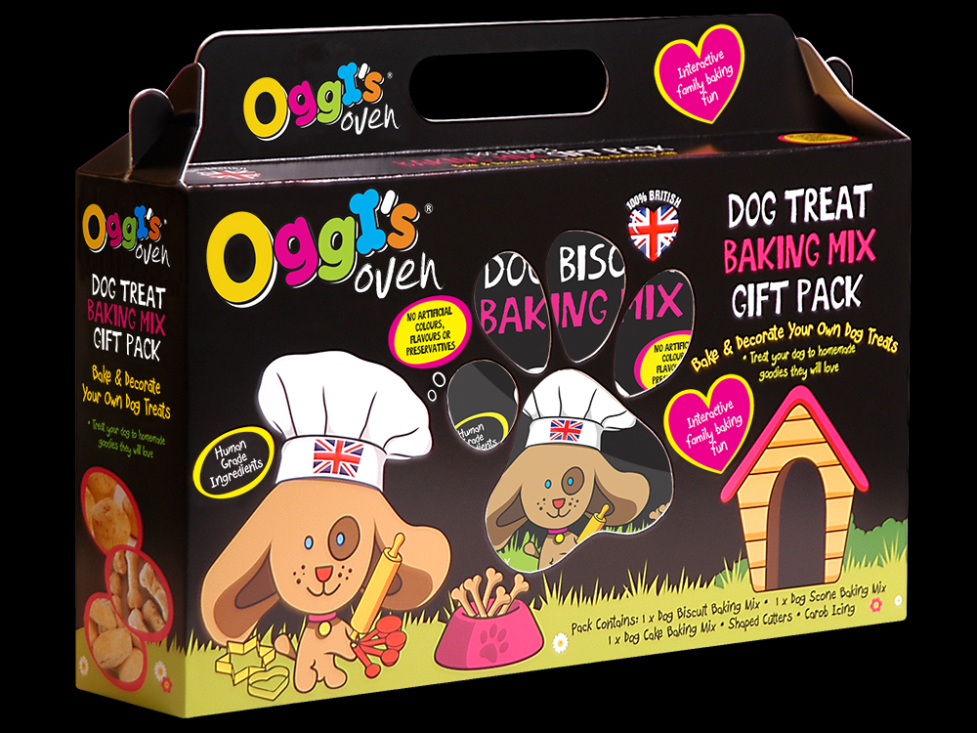
My general gift box contains everything you need to bake your own lovely decorated heart shaped or doggie shaped biscuits! Includes: biscuit mix, Scone mix, cake mix, Heart shaped cutter, puppy dog shaped cutter, and carob icing to decorate your home baked doggie treats!

Slide 4

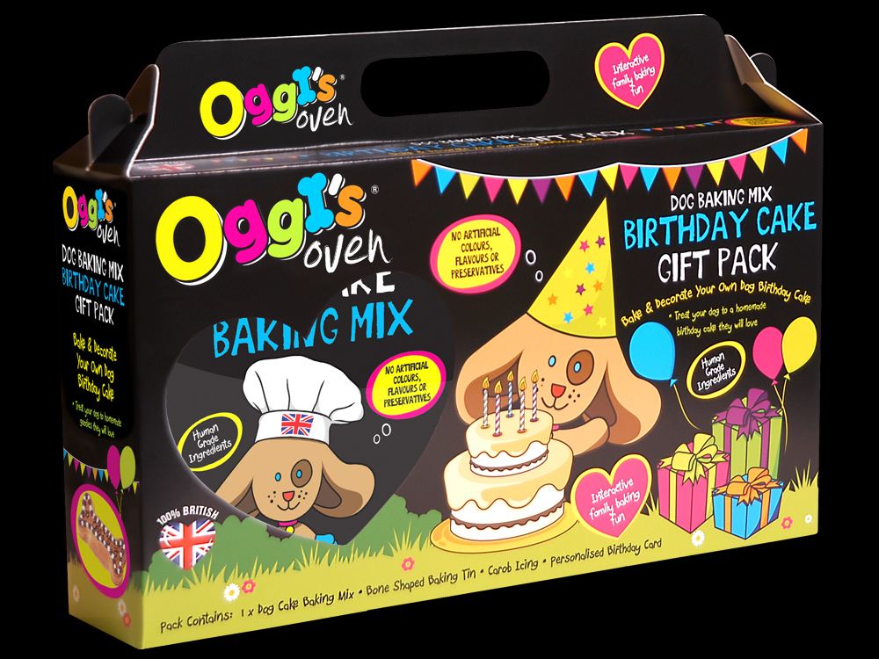
My Birthday gift box contains everything you need to bake your own doggie birthday cake! Includes: bone shaped cake mould, cake mix, carob icing to decorate your cake and a Birthday card to personalise for your pooch!

Slide 5
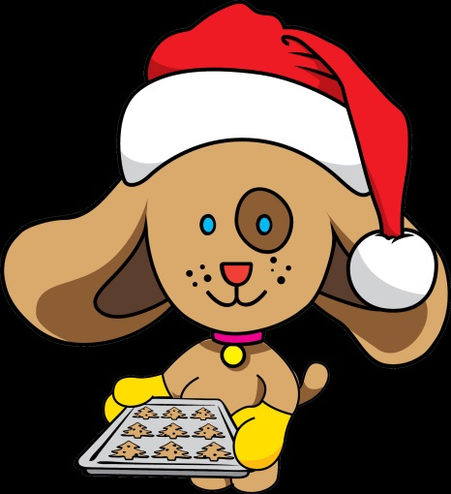
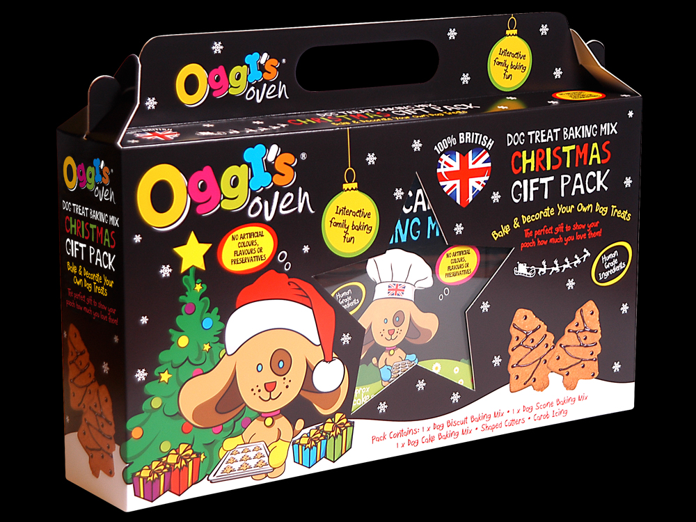
My Christmas gift box is full of festive fun with everything you need to make sure it really is a Merry Doggie Christmas!
Includes: biscuit mix, scone mix, cake mix, Reindeer and Christmas tree cutters, carob icing to decorate and a Christmas card to personalise for your pooch.

Slide 6


So why will your customers love me?
Mixes are quick and simple to use
Home baked goodies anytime
Know what goes into their snacks
100% British!
Human grade ingredients
NO artificial colours, flavours or preservatives
Interactive family baking fun!
Encourages children to care for their family pet
Affordable price range
Not to mention I’m really cute!

Slide 7


Why stock Oggi’s Oven?
Whole new concept to your pet aisle
Eye-catching branding
Offers year round and seasonal sales
Low RRP encourages repeat purchase
Offers high volume, high profit SKU’s
Extended range and brand opportunities
Promotes healthy pet eating habits
Supporting British industry!

