Slide 1
Machine Learning Model for Renal Recovery Prediction Following Initiation of Renal Replacement Therapy
Sul A Lee
Ana Cecilia Farfan Ruiz
Annie Liu
Hiroki Mizuno

Slide 2
What’s happening?
At present:
Evaluation of renal recovery is based on:
Patient factors (i.e. age, history of CKD and staging, degree, duration and frequency of AKIs)
Level of provider experience
Time is often the determining factor
Available prediction model is based on an outpatient population
The problem:
Leaves the patients, families and care teams feeling uncertain
Patients may choose differently if they knew it would be permanent given the circumstances
Prolonged ICU/hospitalization stay >> costs and ICU resources
Outpatient hemodialysis units are backlogged

Slide 3

Proposal
A machine learning guided prediction model for ICU patients initiated on dialysis to determine time to independence while inpatient
Notes:
Problem definition: Specifically, how the model improve patient outcomes?
Time to catheter removal (0 = no, 1 = yes)
Include how is it useful

Slide 4
Inclusion criteria
Exclusion criteria
Age ≥ 18 in MIMIC IV ICU dataset
Development of AKI requiring initiation of inpatient dialysis in the ICU
Patients with ICD code of CKD stage V or ESRD
Patients initiated on peritoneal dialysis during hospitalization
Died prior to discharge

Slide 5
Flow diagram
x
Adults (age ≥ 18) in ICU and initiated on HD/CVVH
SELECT DISTINCT icu.hadm_id, rrt.stay_id, rrt.dialysis_type FROM `physionet-data.mimiciv_derived.rrt` AS rrt
LEFT JOIN `physionet-data.mimiciv_derived.icustay_detail` AS icu
ON icu.stay_id = rrt.stay_id
WHERE rrt.dialysis_type <> 'Peritoneal' AND icu.admission_age >=18
(N = 6,713)
Underlying CKD V or ESRD
WHERE adm.icd_code NOT IN ('40301','40311', '40391', '40402', '40403', '40412', '40413', '40492', '40493', '5856', 'I120', 'I1311', 'I132', 'N186')
(N = 3,051)
In hospital death
(physionet-data.mimiciv_hosp.admissions, hospital_expire_flag = 1)
(N=1,722)
Included patients
(N = 1,940)
Notes:
Venous catheterization for renal dialysis ICD procedure code = 3895
Hemodialysis 3995
Peritoneal dialysis 5498

Slide 6
Outcome measurement
Primary outcome: dialysis independence by hospital discharge
Outcome measurement per ‘mimiciv_hosp’
>poe >> order_type >> hemodialysis
Time from last dialysis (>/= 72 hours from last HD session)
>Discharge time - last dialysis time
Notes:
Venous catheterization for renal dialysis ICD procedure code = 3895
Hemodialysis 3995
Peritoneal dialysis 5498
rrt_charttime data
iHD dialysate prescription data
Repeated values with chart time for procedure icd_code for iHD is available

Slide 7
Variables to measure
x
MIMICIV_hosp
Age, sex, self-reported race and ethnicity
BMI
Medical history (DM, HTN, malignancy, prev MI etc)
Pre-admission medication use
Vital signs at admission
Laboratory measurements: CBC, CMP, coagulation profile, peak inpatient creatinine, CRP, Albumin, lactate at admission
Baseline eGFR
Charlson Comorbidity Index, MELD
IV contrast
Antibiotic exposure (i.e. vancomycin, aminoglycosides)
First care unit prior to ICU transfer
MIMICIV_icu
APACHE IV score
Acute physiology score (APS III)
SOFA
Ventilator use
ICU LOS
Vital signs at admission
ICU medications
24hr Urine output before RRT initiation
Number and duration of pressors required
KDIGO stage
Charlson Comorbidity Index, MELD
IV contrast
Antibiotic exposure (i.e. vancomycin, aminoglycosides)
Notes:
Venous catheterization for renal dialysis ICD procedure code = 3895
Hemodialysis 3995
Peritoneal dialysis 5498

Slide 8
Biases
x
Patients with limited prior healthcare access or utilization (2/2 access, healthcare coverage)
Falsely classified as AKI on presentation and thus estimate earlier prediction off RRT
Patients who were too sick for RRT or died during hospitalization while on RRT
Often bias against older patients and/or patients with critical comorbidities
Notes:
Venous catheterization for renal dialysis ICD procedure code = 3895
Hemodialysis 3995
Peritoneal dialysis 5498

Slide 9
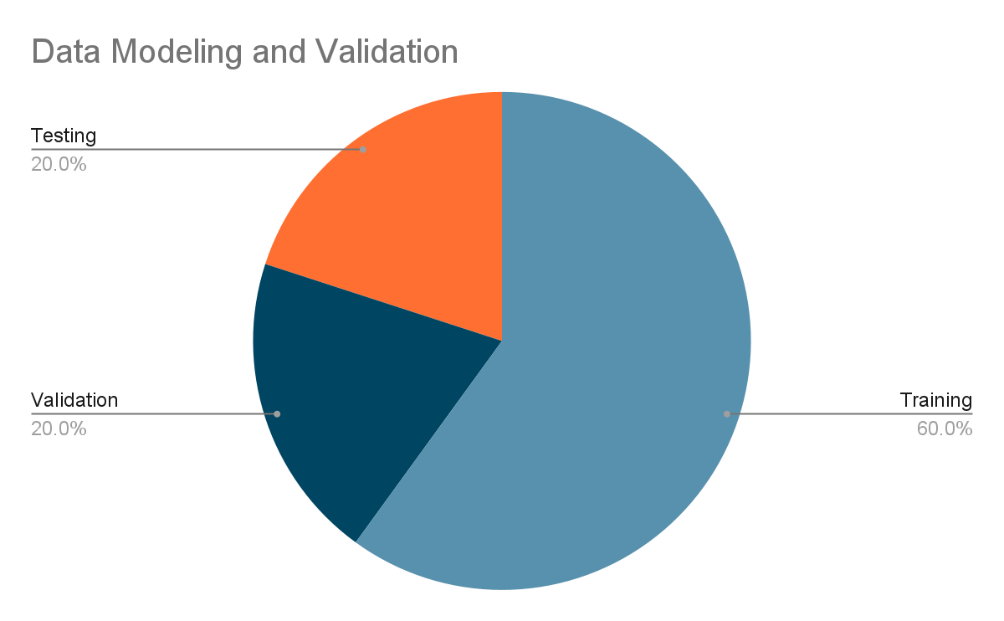
Evaluation of in silico model performance
Aim for AUC goal 0.85
Potential consequences of the algorithm when employed:
Generalizability
Underestimates chances of renal recovery as only includes inpatient data. Patients with pure AKI are more likely to recover sooner than AKI on CKD
Sample size ~1950 patients and variables may not be as strong (falsely overestimates and underestimates predictors)
Notes:
Venous catheterization for renal dialysis ICD procedure code = 3895
Hemodialysis 3995
Peritoneal dialysis 5498

