Slide 1

Distributed Database Design and Optimization
Zhenghao An
Course: MET CS 779 Advanced Database Management
Professor: Jack Polnar
Date: December 4, 2024

Slide 2
PROJECT BACKGROUND
Introduction:
Modern financial systems demand high-performance, scalable databases. Data distribution is key techniques to improve availability and performance.
Goals:
a. Design and implement a database simulating a distributed environment for stock trading
b. Optimize the database through fragment, replication, and performance tuning.

Slide 3
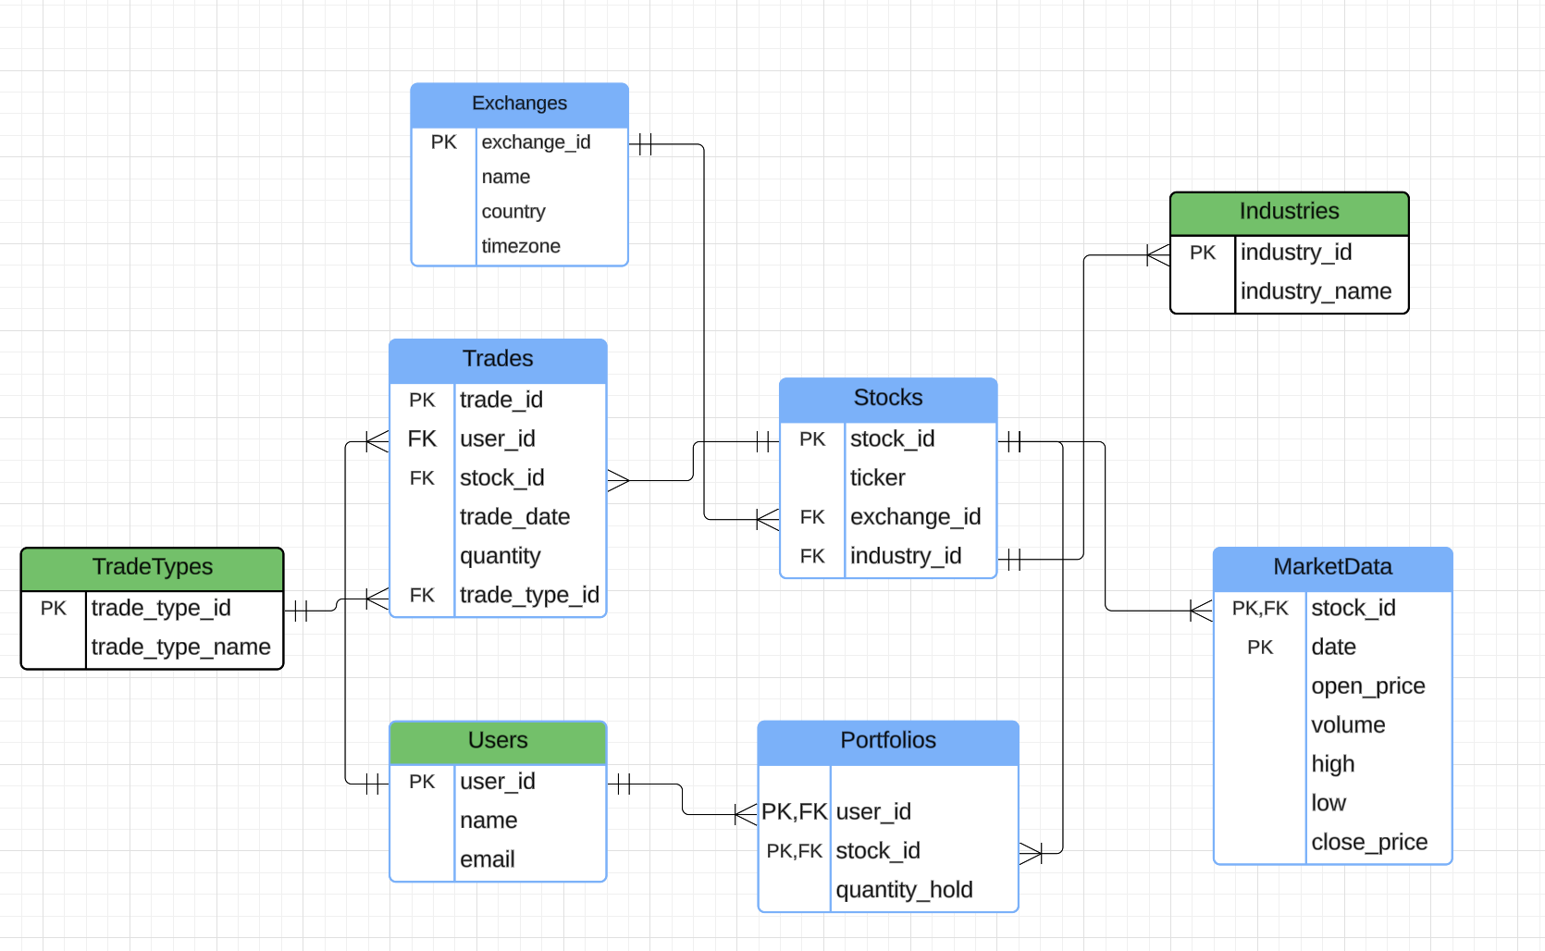
Schema For Dataset
Horizontal Fragment Tables →
Blue Color
Table of HeadQuarter Database →
Green Color

Slide 4
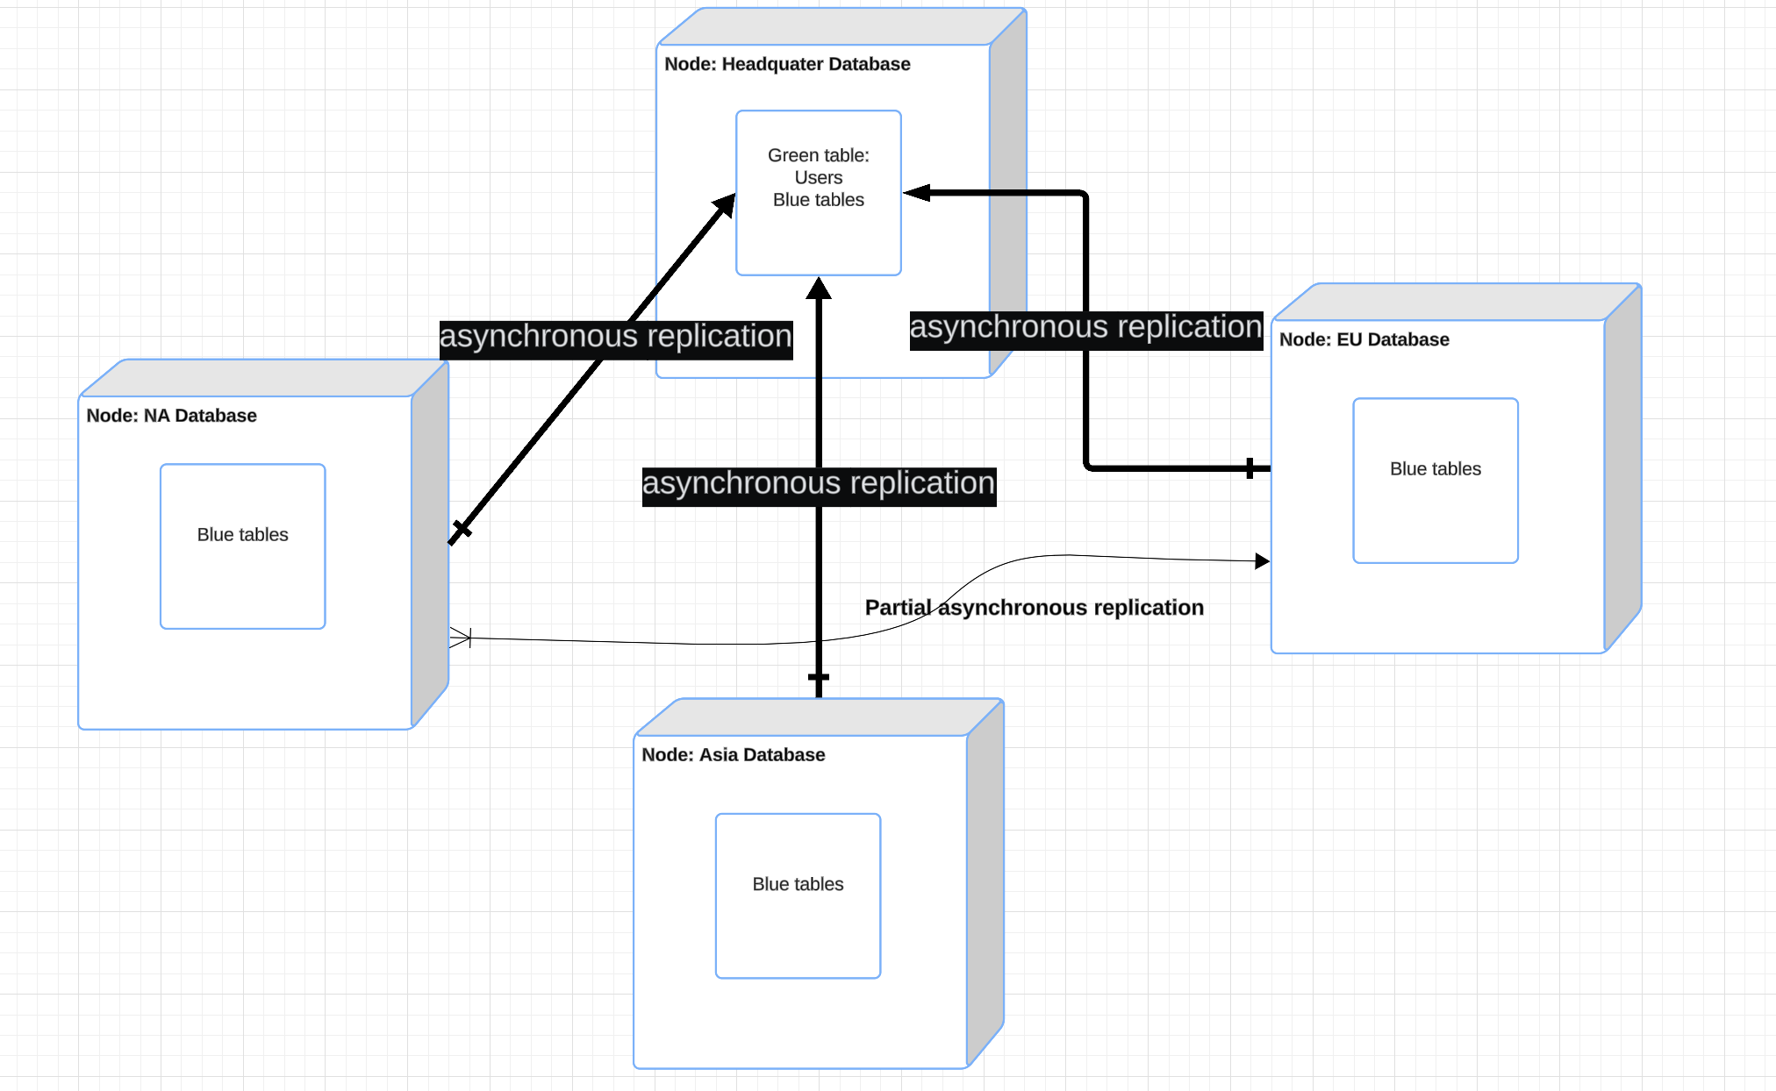
Architecture For Replication

Slide 5
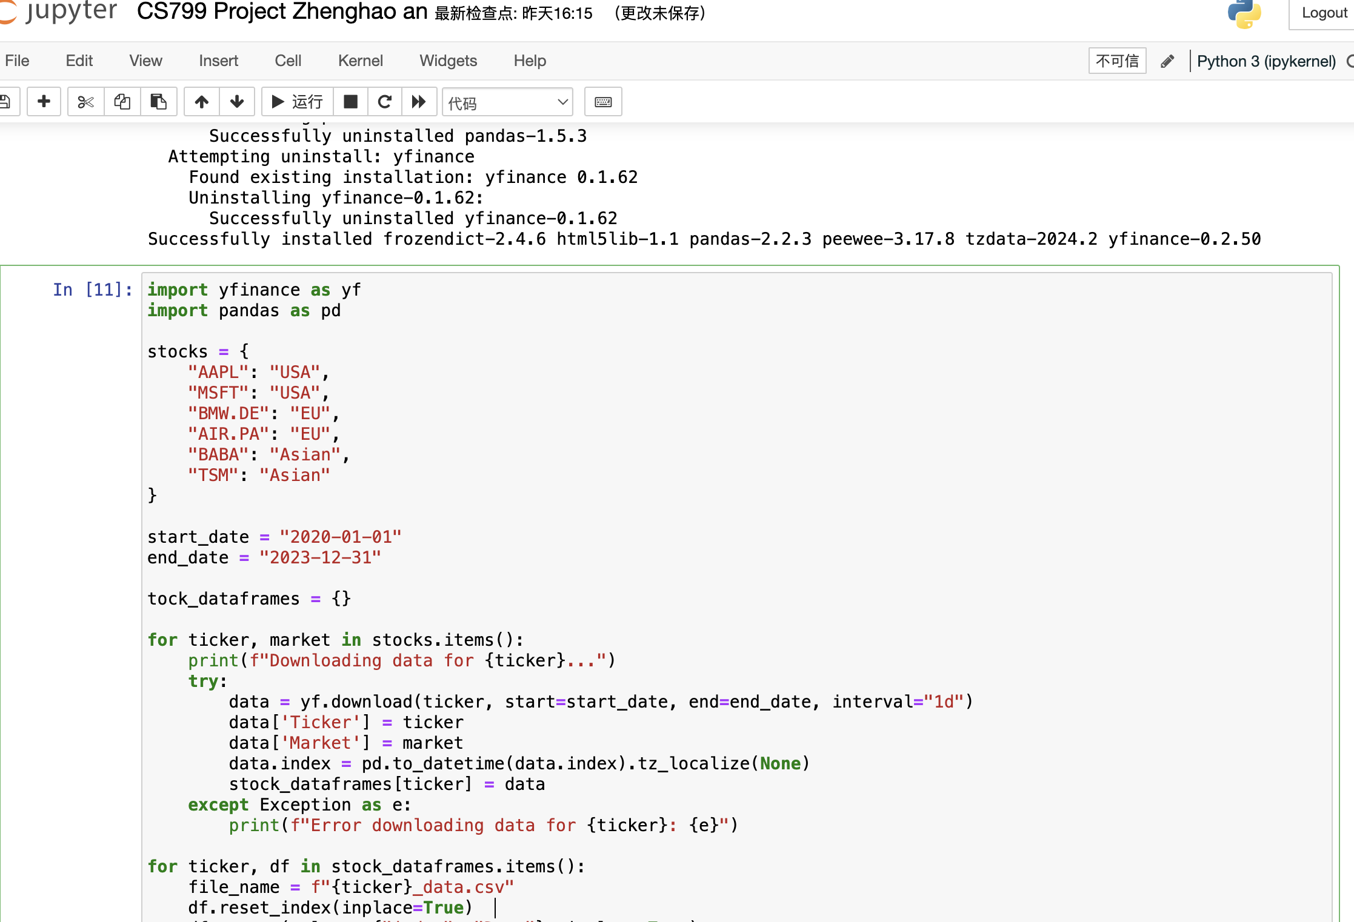
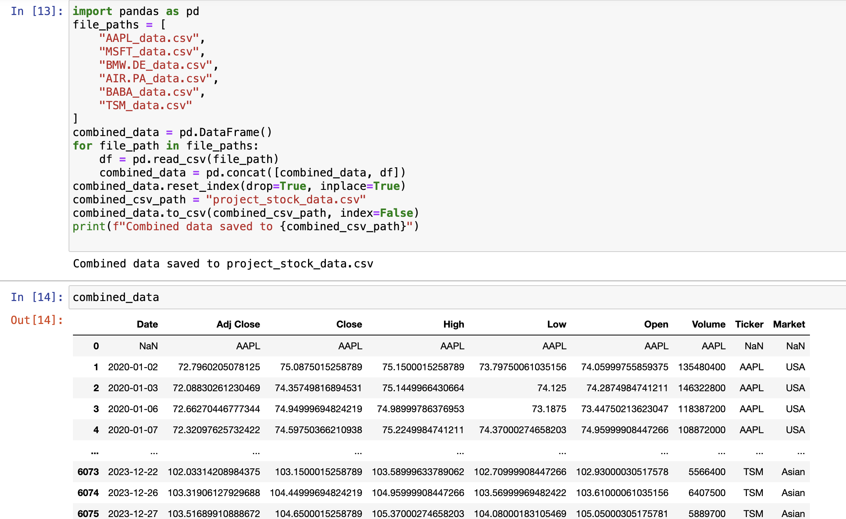
Data Preparation
Data Sources: Use Jupyter Python to get 6 stocks from Yahoo Finance with the range from Year 2020 to Year 2023.
Data Information: Include stock daily open, close,adj_close, high, low prices, trading volume, ticker and market distributions.

Slide 6
System Implementation
Core Features:
Data Partitioning:
Horizontal Partitioning: Based on market (market field).
Data Replication:
Source-Target Synchronization -- Use of event schedulers for data replication.
Since Multiple instances of MySQL and Citus in PostgreSQL have failed, I tried to simulate the partitioning, replication strategy in a single instance of MySQL and using Python to simulate a multiple instances with distributed database management.

Slide 7
Comparison: Event Scheduler vs. MySQL Asynchronous Replication
Feature | MySQL Asynchronous Replication | Event Scheduler
Architecture | Multi-instance (Source-Target structure) | Single instance
Synchronization Type | “Binlog”-based incremental synchronization | “updated_at”-based incremental synchronization
Incremental Sync | Based on Binlog change logs | Based on updated_at timestamps
Full Sync | Used during initial setup for the slave | Manually executed full synchronization
Asynchronous Behavior | Master-slave lag with eventual consistency | Time-delayed execution via scheduled events
Trigger Mechanism | Automatic Binlog push | Time-based event scheduler

Slide 8
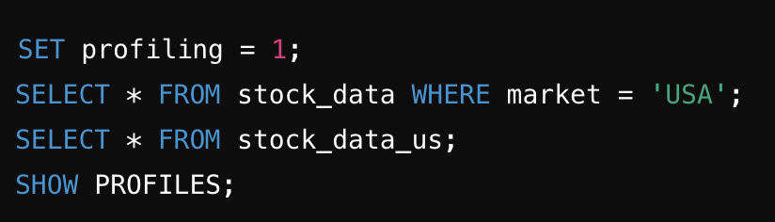
MySQL Code & Performance
Query performance analysis
Test the query performance of raw tables (stock_data) and horizontal shard tables (stock_data_us).
Analyze query time consumption by SHOW PROFILES to evaluate whether sharding results in performance optimization

Slide 9
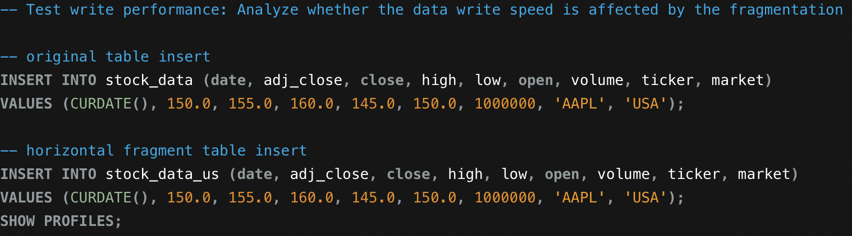
MySQL Code & Performance
Write performance test
Compare the performance of inserting data into raw tables (stock_data) and horizontal shard tables (stock_data_us).
Use SHOW PROFILES to analyze the time spent on two write operations to evaluate the impact of sharding on write performance.

Slide 10
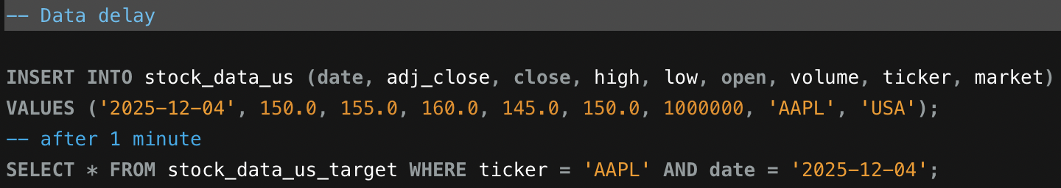
MySQL Code & Performance
Data delay test
Verify the data synchronization delay from the source table to the target table, testing whether the newly inserted data in the target table stock_data_us_target can be synchronized within the expected time range.

Slide 11
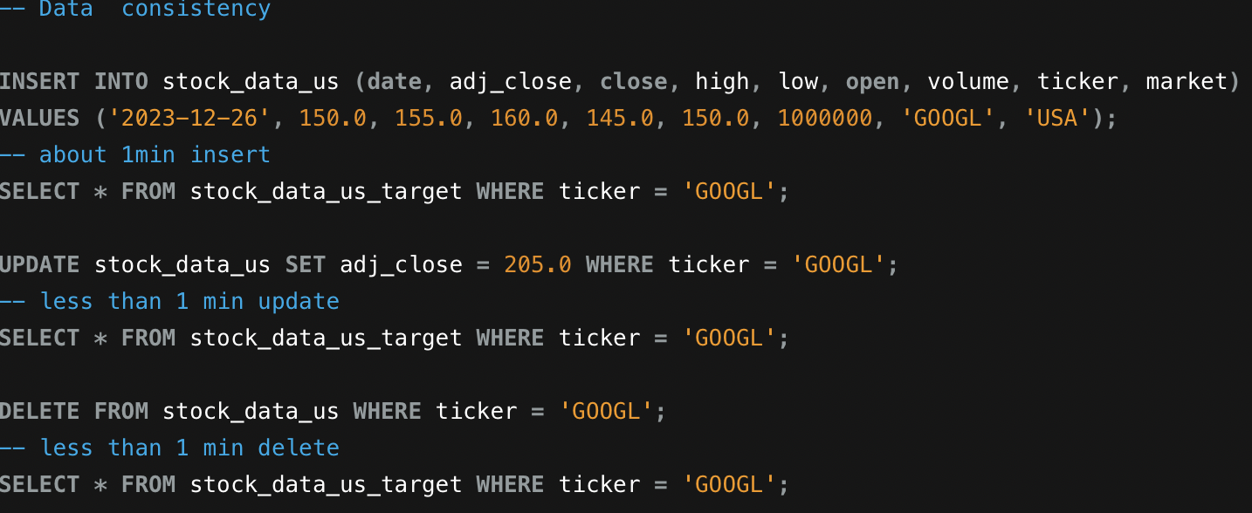
MySQL Code & Performance
Data conformance testing
Test data synchronization consistency between source and target tables, verifying the following operations:
a. Whether the insert operation is properly synchronized to the target table.
b. Whether the update operation reflects the latest value in the target table.
c. Whether the delete operation correctly removes the corresponding record from the target table.

Slide 12
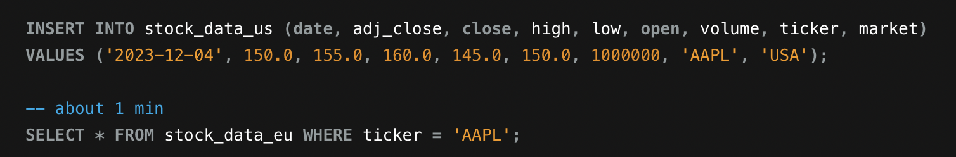
MySQL Code & Performance
Create a key stock synchronization event
Defines a timing event that synchronizes data for key stocks (AAPL and GOOGL) in source table stock_data_us to target table stock_data_eu.
Verify that the event sync_key_stocks_us_to_eu is executed correctly and ensure that the key stocks are successfully synchronized in the target table stock_data_eu

Slide 13
Results and Findings
The distributed architecture effectively improves query and write performance.
Horizontal partitioning improves efficiency.
Asynchronization replication enables consistency in a simulated environment.

Slide 14

Thank You!

