Slide 1

MET CS 555 Final Project Smoking and Health research
Zhenghao An

Slide 2

Research background:
Smoking in public health and its importance
Research problems:
Association between smoking and measures of cardiovascular health, metabolic health, and blood health.

Slide 3

Data Source: Kaggle's "Smoker Status Prediction using Bio-Signals" dataset.
Included variables: age, height, weight, waist circumference, vision, hearing, blood pressure, blood sugar, total cholesterol, triglycerides, HDL & LDL, Smoking(status), etc.

Slide 4

Statistical Methods
1. Logistic Regression
2. Backward selection
3. ANOVA table
4. ROC curve and AUC value

Slide 5
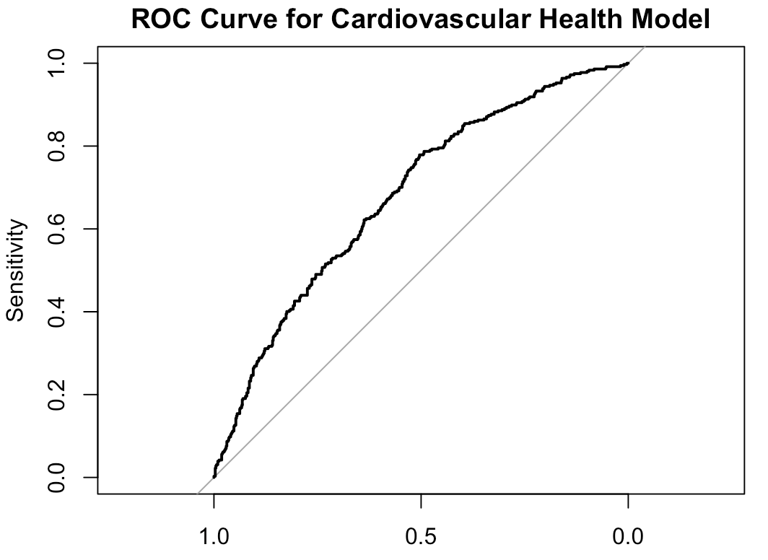
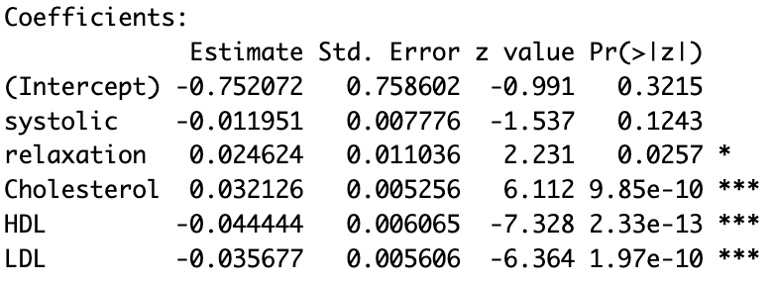
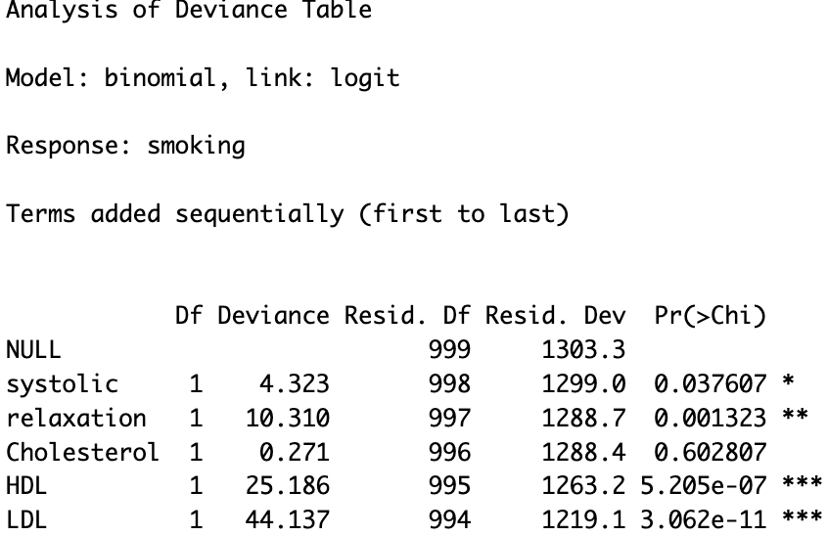
Smoking status vs. cardiovascular health indicators
Model Summary & ANOVA & ROC & AUC
AUC: 0.6798

Slide 6
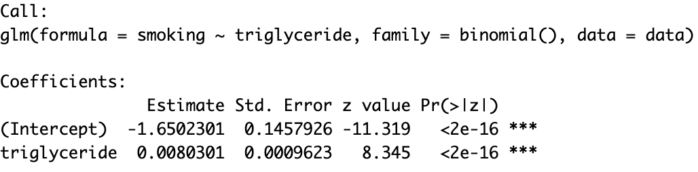
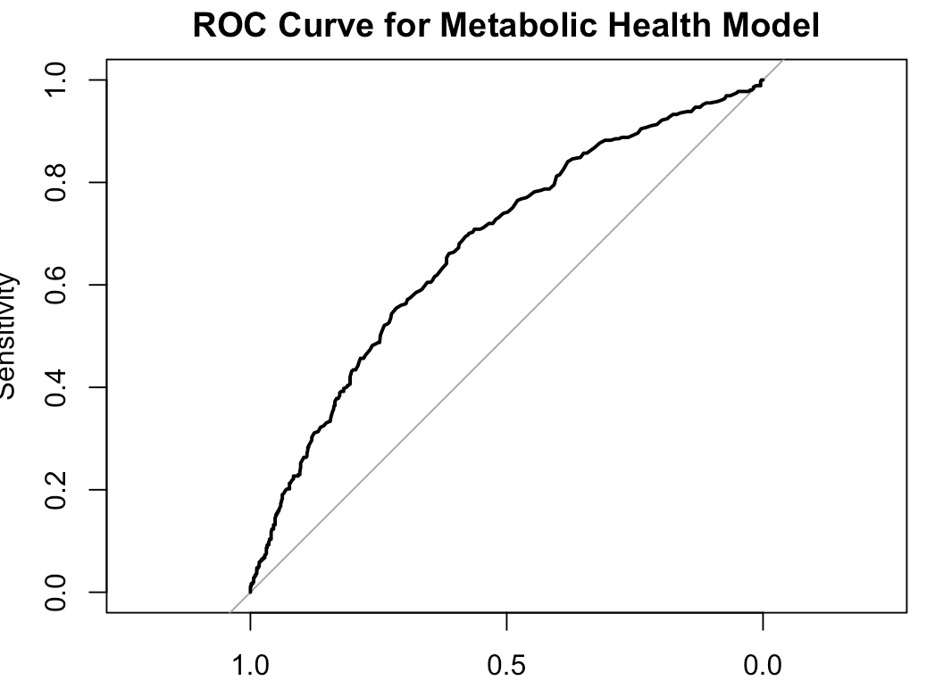
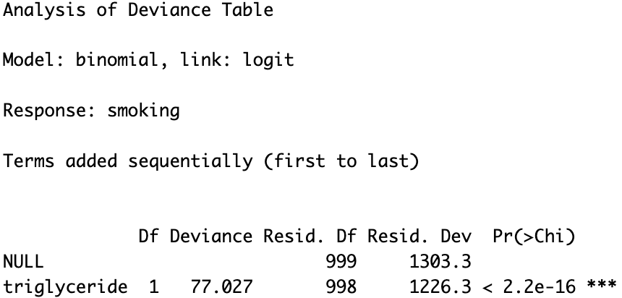
Smoking status vs. metabolic health indicators
Model Summary & ANOVA & ROC & AUC
AUC: 0.6740

Slide 7
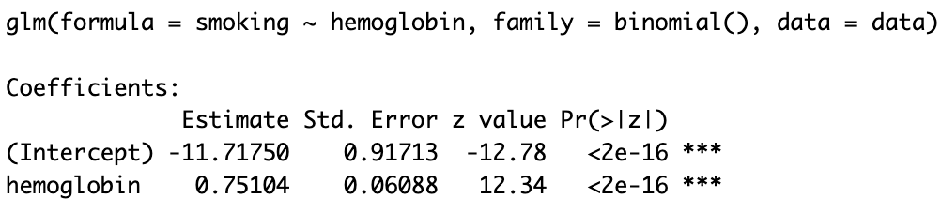
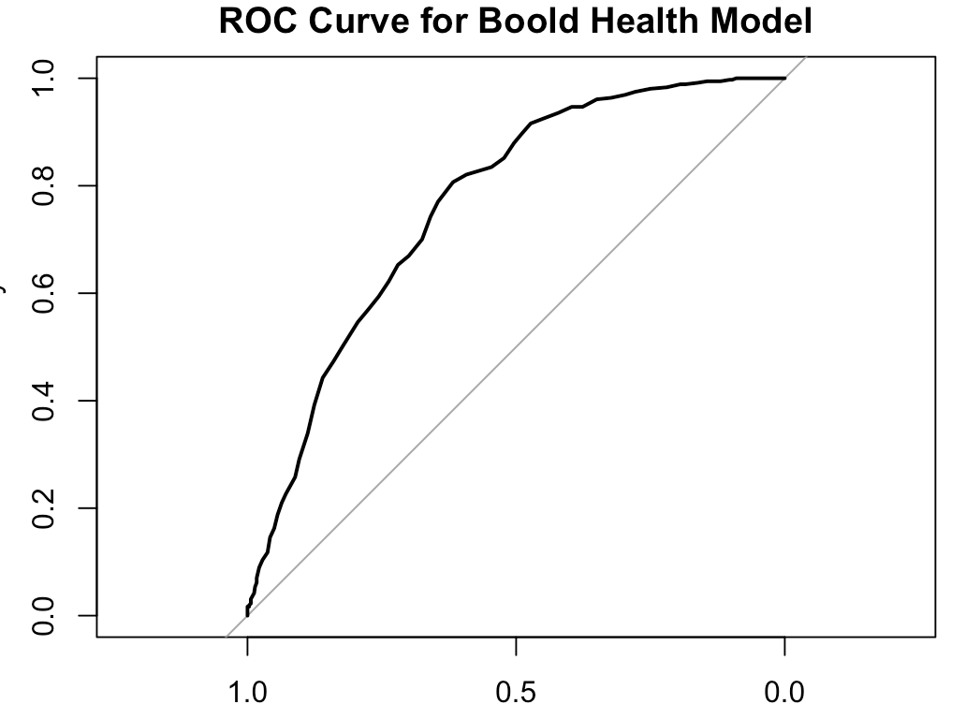
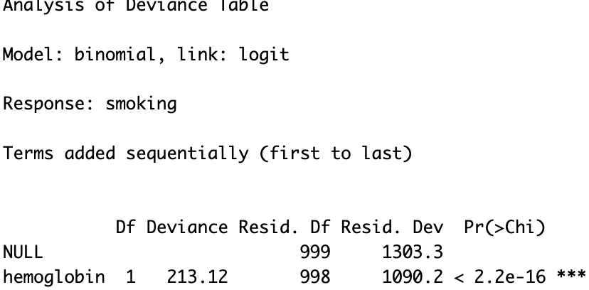
Smoking status vs. blood health indicators
Model Summary & ANOVA & ROC & AUC
AUC: 0.7651

Slide 8

Conclusion
Smoking is significantly associated with cardiovascular health indicators and has potential negative effects.
Blood health indicators showed a significant positive association between smoking and high hemoglobin levels.
Metabolic health indicators suggest that smoking may have adverse effects on metabolic health.

Slide 9
Discuss Limitations
Limitations of data sources and representativeness.
Possible interactions between variables and their impact on the results of the study.

Slide 10

Thank you！

