Slide 1

Stock Price Prediction: Random Forest vs GRU
A Comparative Study on Machine Learning and Deep Learning Models
Zhenghao An
CS688
Professor:Zlatko Vasilkoski

Slide 2

Objective:
To compare the performance of Random Forest (RF) and GRU in predicting stock prices.
Motivation:
Stock price prediction is crucial for financial decision-making.
ML and DL provide distinct approaches: RF handles static relationships, GRU captures temporal dependencies.

Slide 3
Why choose Random Forest & GRU?
Random Forest is a powerful and flexible algorithm that can handle both regression and classification problems.
Random Forest is capable of capturing non-linear relationships between features and the target variable, which is important in stock price prediction.
GRU is a deep learning model specifically designed to handle sequential and time-series data, such as stock prices. It captures long- and short-term dependencies in data, making it suitable for time-series forecasting.
GRU has fewer parameters than LSTM, as it uses fewer gates. GRU trains faster while maintaining comparable accuracy to LSTM. GRU can perform well on smaller datasets, whereas LSTM typically requires larger datasets for better performance.

Slide 4
The Steps of Project
Data Collection
Preprocessing
Model Training (RF and GRU)
Evaluation and Comparison

Slide 5
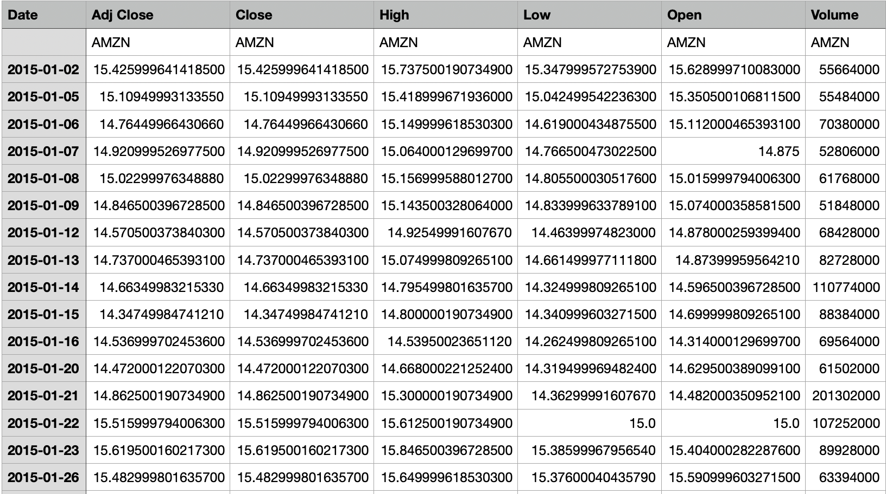
Data Description
Data Source: Yahoo Finance, Amazon (AMZN) stock data.
Date Range: 2015–2023.
Key Columns: Adj Close, Volume, Open, High, Low.
Target: Predicting Adj Close.
About 2000+ rows, Screenshot of Csv file

Slide 6
Data preprocessing
User upload data:
Upload a CSV file containing historical stock data through the interface.
Data cleaning:
Converts the Date column to date format and removes/skips invalid rows.
Key columns (such as Adj Close, Open, High, Low) are type-converted to ensure that there are no null values.
Feature engineering:
Random forest model:
Usage characteristics: Open, High, Low.
Target variable: Adj Close.
GRU model:
Add moving averages (MA10 and MA50).
Calculate the Volume Change.
The data is normalized to the interval [0, 1] to ensure stable training of the deep learning model.

Slide 7
Random Forest Model
Model Design:
Features: Open, High, Low.
Target: Predict Adj Close.
Number of Trees: 100 (adjustable via Streamlit).
Training and Test Split:
Train: 80%.
Test: 20%.

Slide 8
GRU Model
Model Architecture:
Input: Last 5 days of data (time window = 5).
Two GRU layers with 50 units each, followed by Dropout (40%) and Dense layers.
Output: Predict next day's Adj Close.
Hyperparameters:
Training Epochs: 50.
Batch Size: 32.

Slide 9
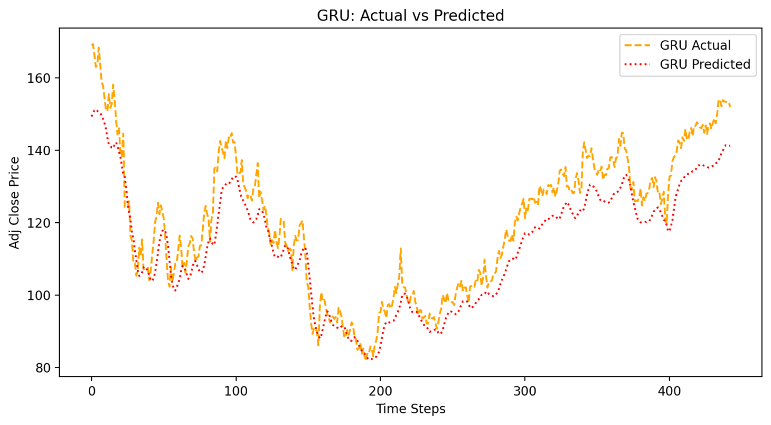
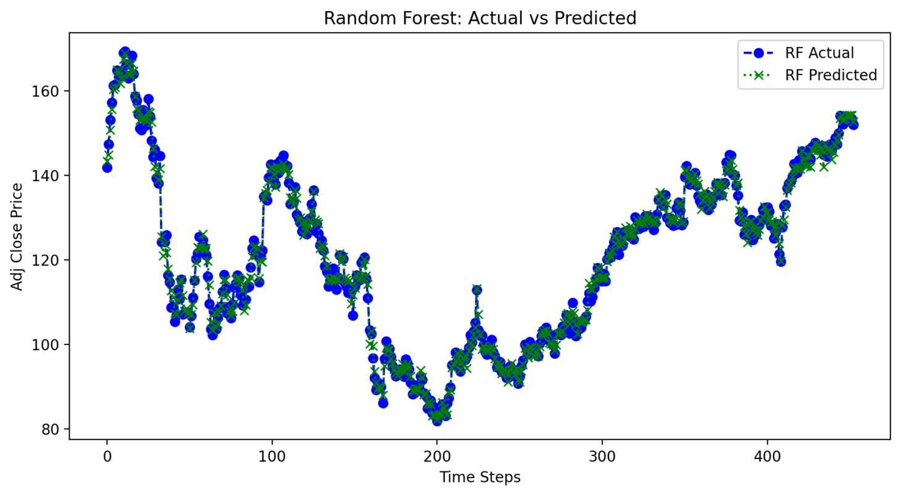
Actual vs. Predicted

Slide 10
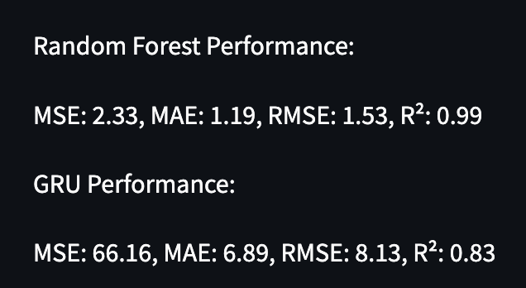
Model Comparison
Performance: RF performed exceptionally well, with high accuracy and minimal error. The R² score close to 1 indicates that the model captures almost all variance in the data.
GRU struggled compared to RF, with much higher error rates and a lower R² score, indicating suboptimal performance in capturing data variance.

Slide 11
Does the Result Meet Expectations?
Not Fully Aligned with Expectations:
GRU Performance: Being a deep learning model, GRU was expected to handle temporal dependencies better than RF. However, it performed poorly, suggesting that its potential was not fully realized in this experiment.
RF Performance: RF's success is consistent with its reputation as a robust, non-temporal model for data. It efficiently captured the short-term patterns in this dataset.

Slide 12
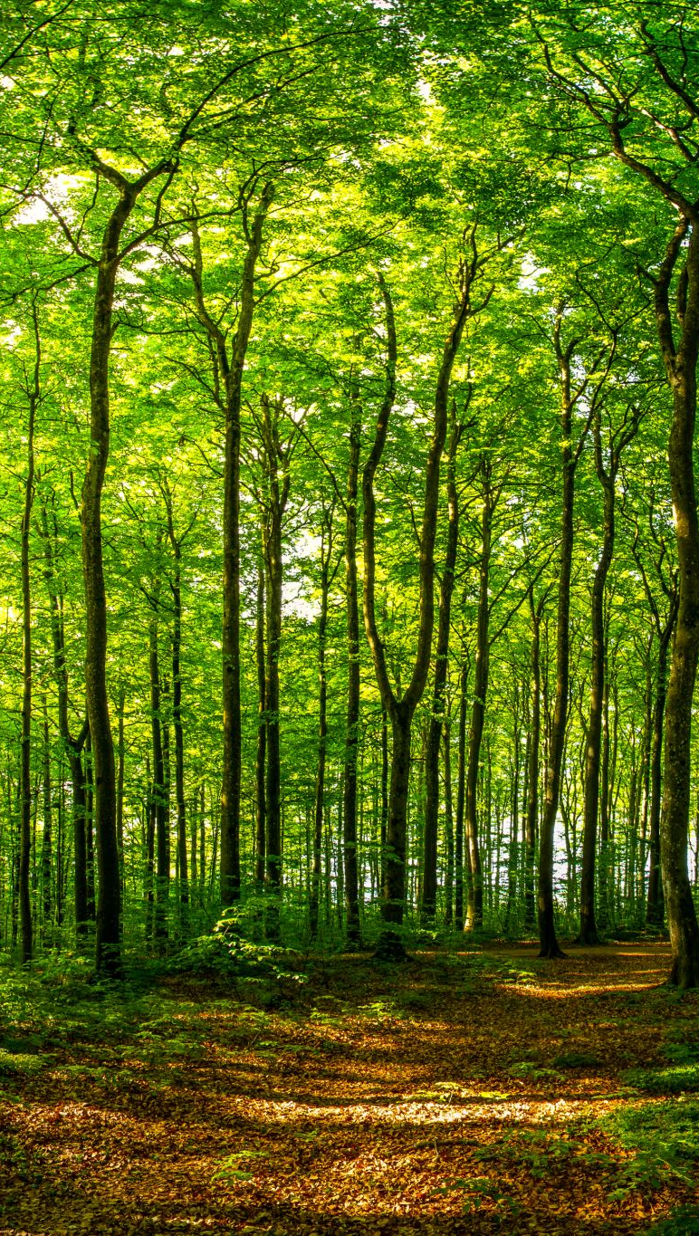
Result Finding & Limitation
The comparison revealed that Random Forest outperformed GRU for this dataset. The small dataset size and limited features likely hindered GRU's ability to fully utilize its temporal modeling capabilities. Future work should focus on increasing the dataset size, incorporating more complex features, and exploring advanced deep learning techniques to improve GRU's performance.

Slide 13
Thank You!

