Slide 1
Setting up the Annual Budget
Assumes continued use of QuickBooks Online Edition (QBOE).
Should be done each year around new fiscal year.

Slide 2
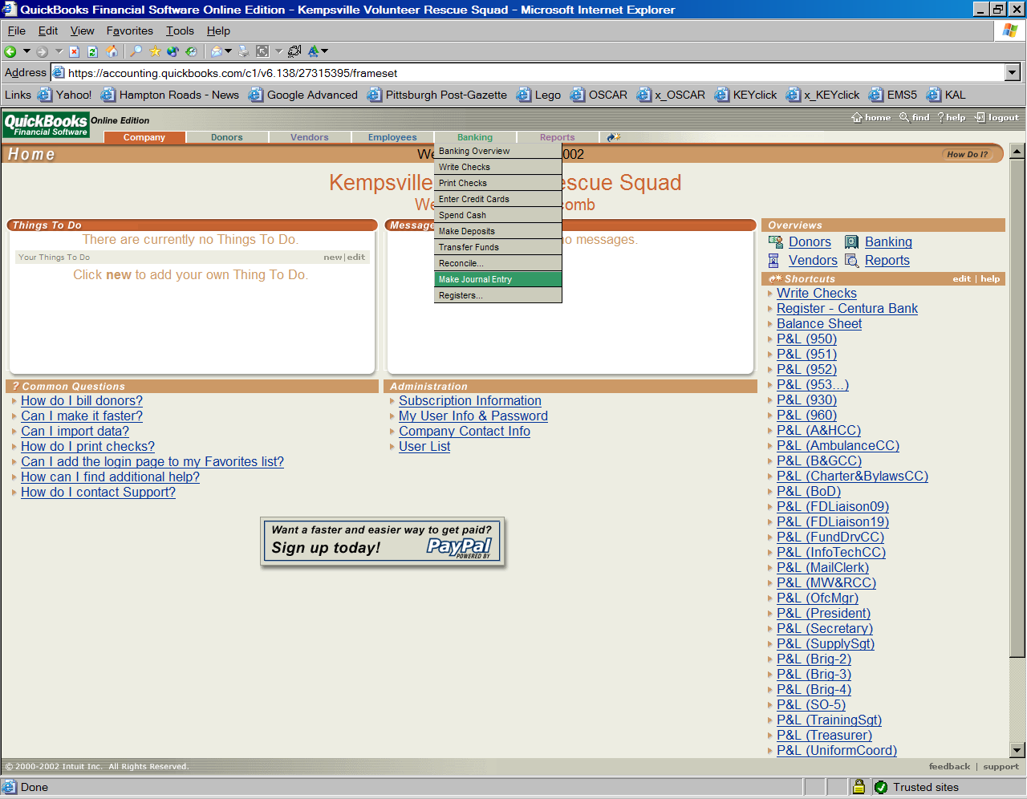
Make Journal Entry

Slide 3
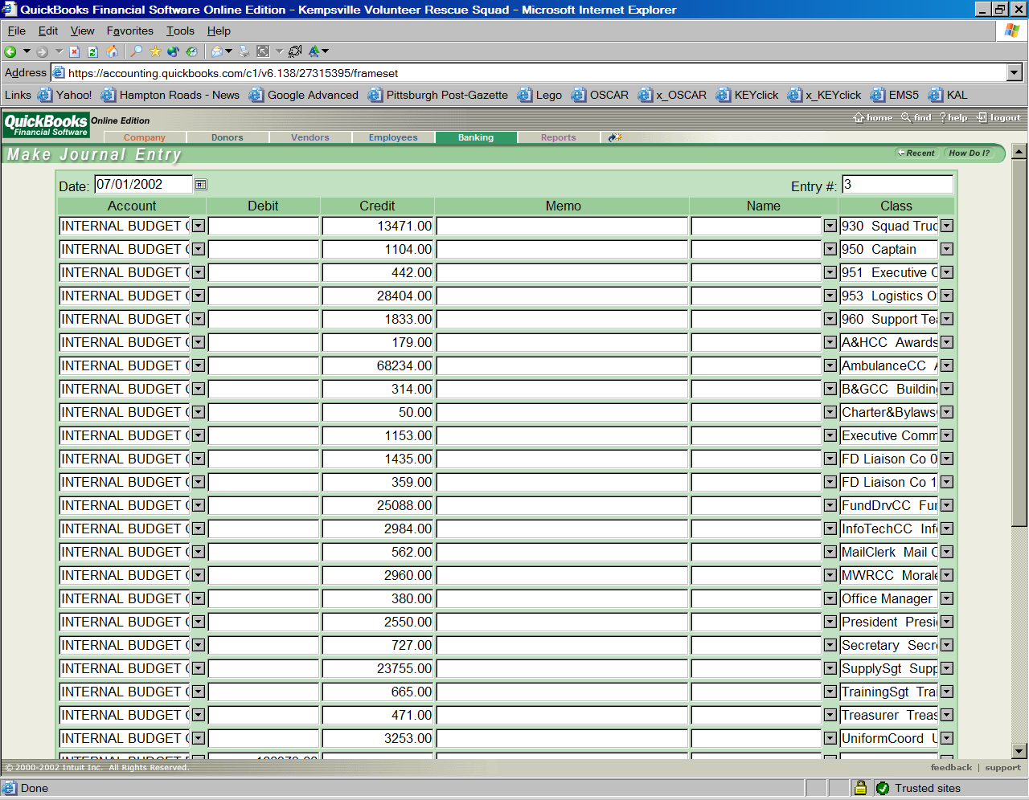
Set date to 7/1

Slide 4
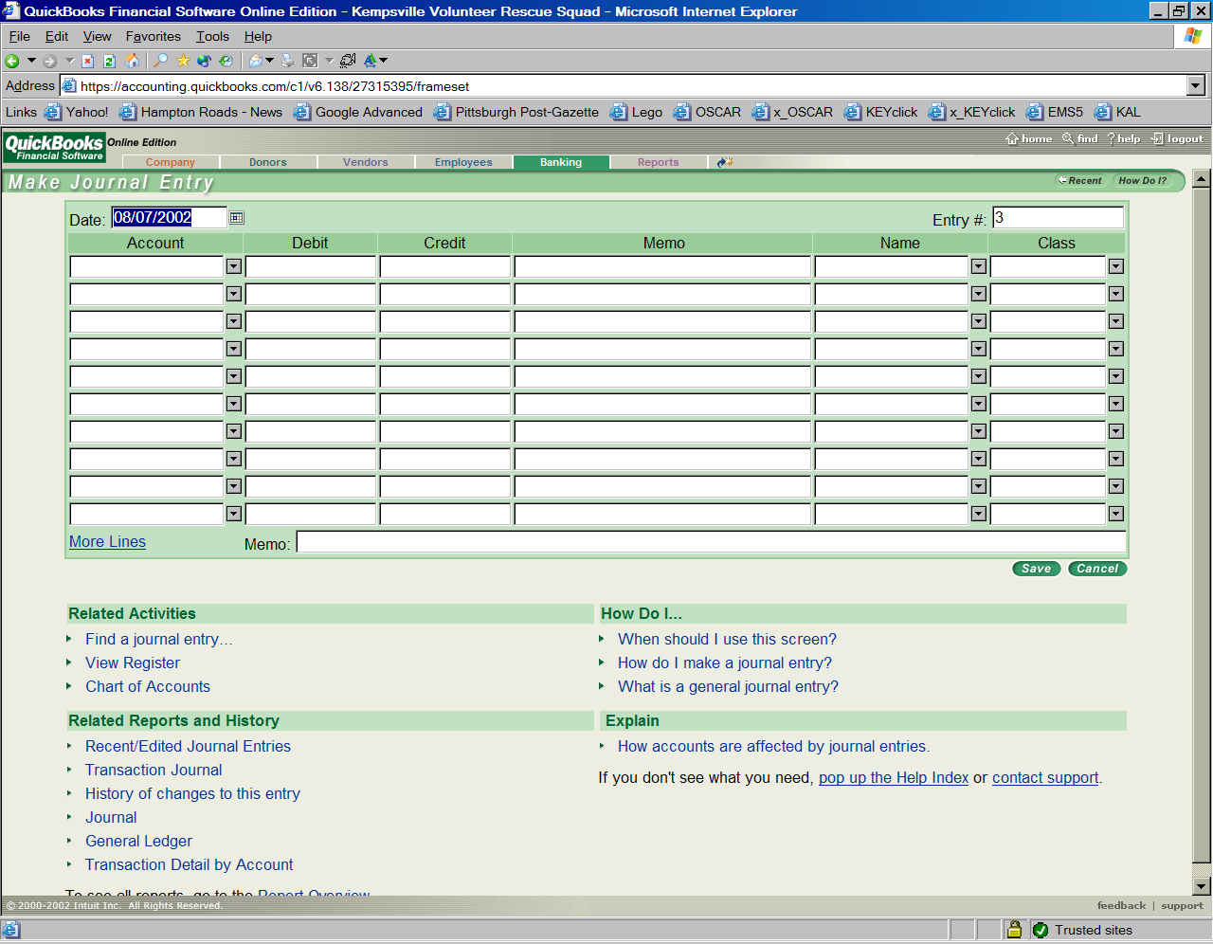
MORE LINES

Slide 5
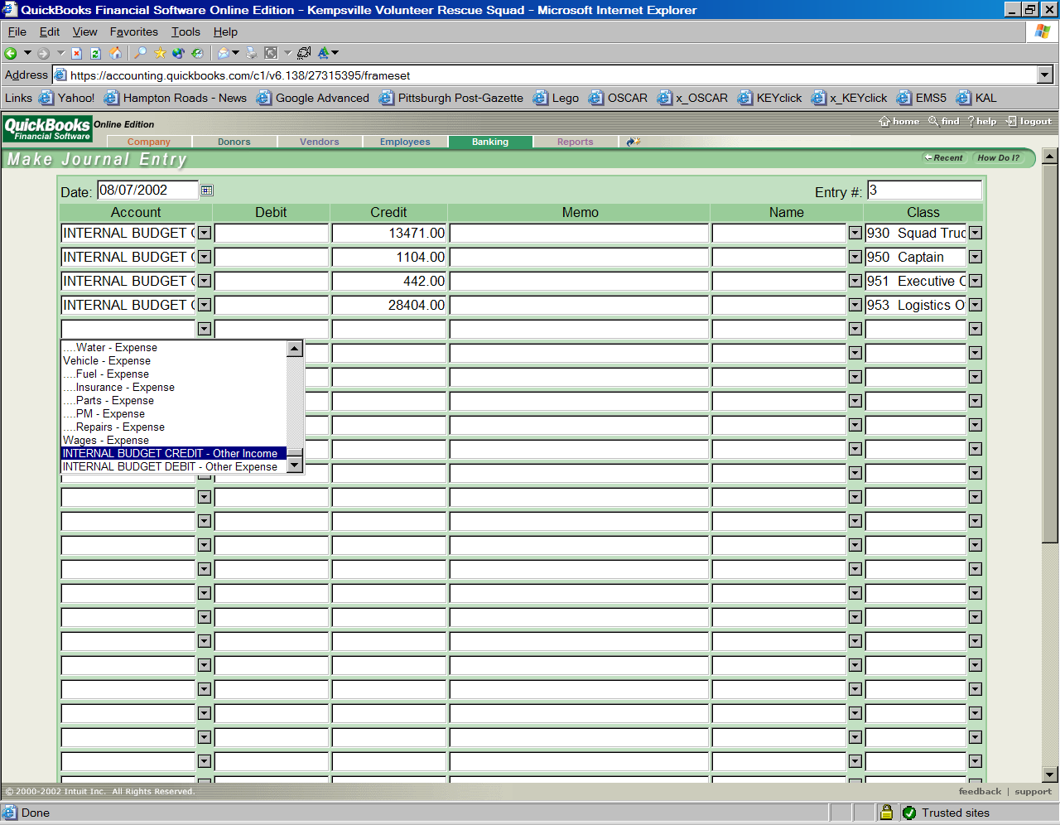
Choose INTERNAL BUDGET CREDIT

Slide 6
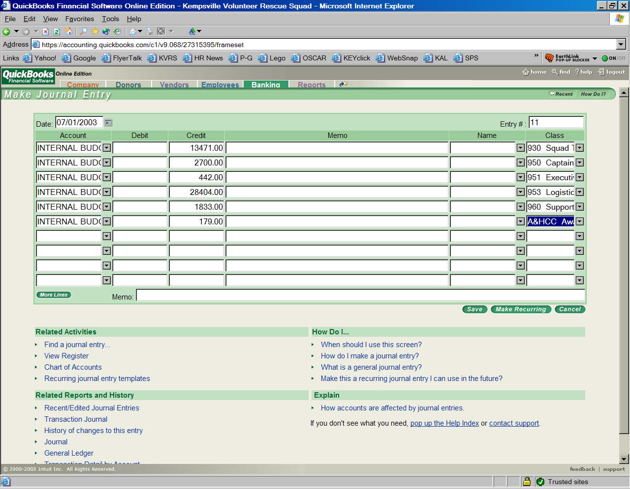
Enter fund credits
…
Use INTERNAL BUDGET CREDIT for each line.
Be sure to enter amounts in the Credit column.

Slide 7
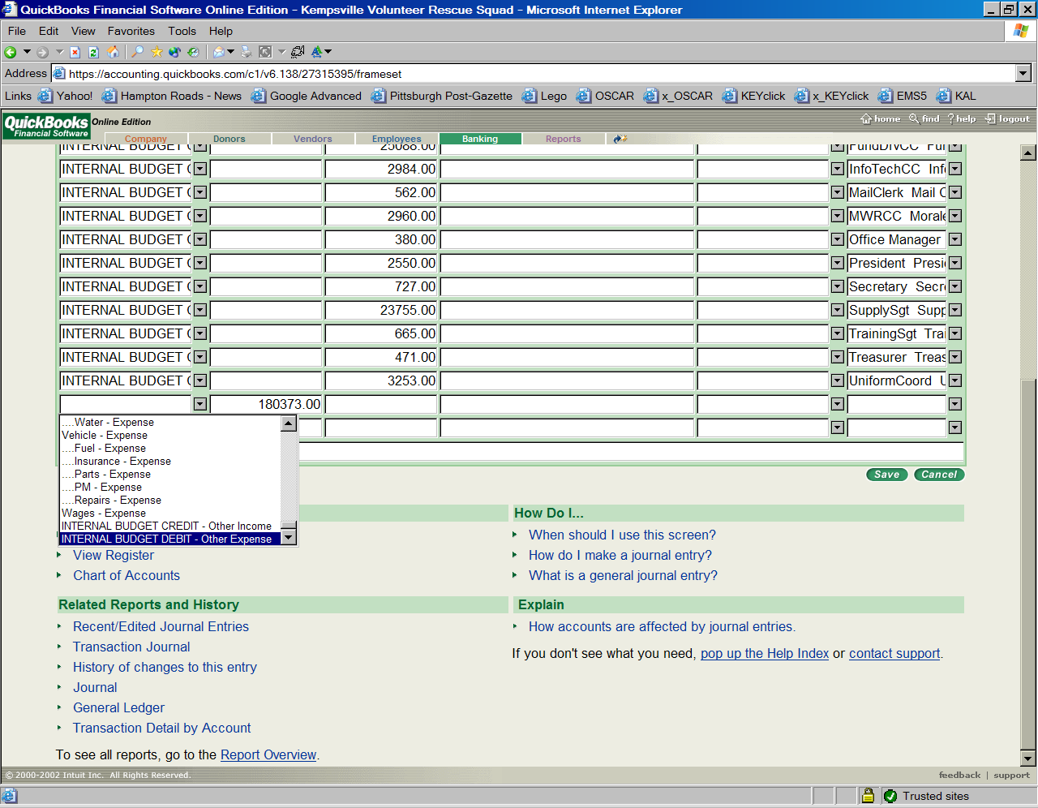
Final line on Annual Setup
Choose INTERNAL BUDGET DEBIT
Total appears automatically
But:
For mid-year budget adjustments, select INTERNAL BUDGET CREDIT for both the gaining and diminishing fund. Enter values in the Credit column for gaining funds, in the Debit column for diminishing funds.
Notes:
NOTE: For mid-year budget adjustments, select INTERNAL BUDGET CREDIT for both the gaining and diminishing fund. Enter values in the Credit column for gaining funds, in the Debit column for diminishing funds.

Slide 8
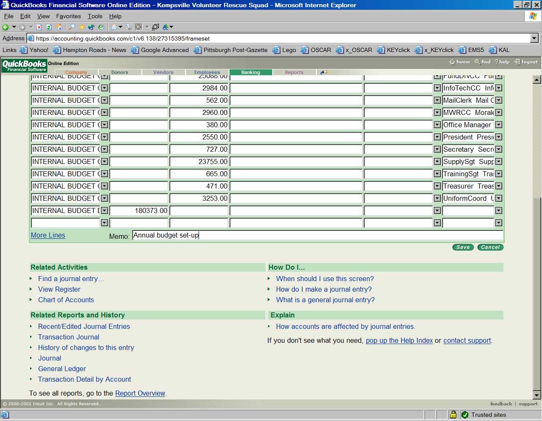
Enter memo and Save

Slide 9
Save

