Slide 1

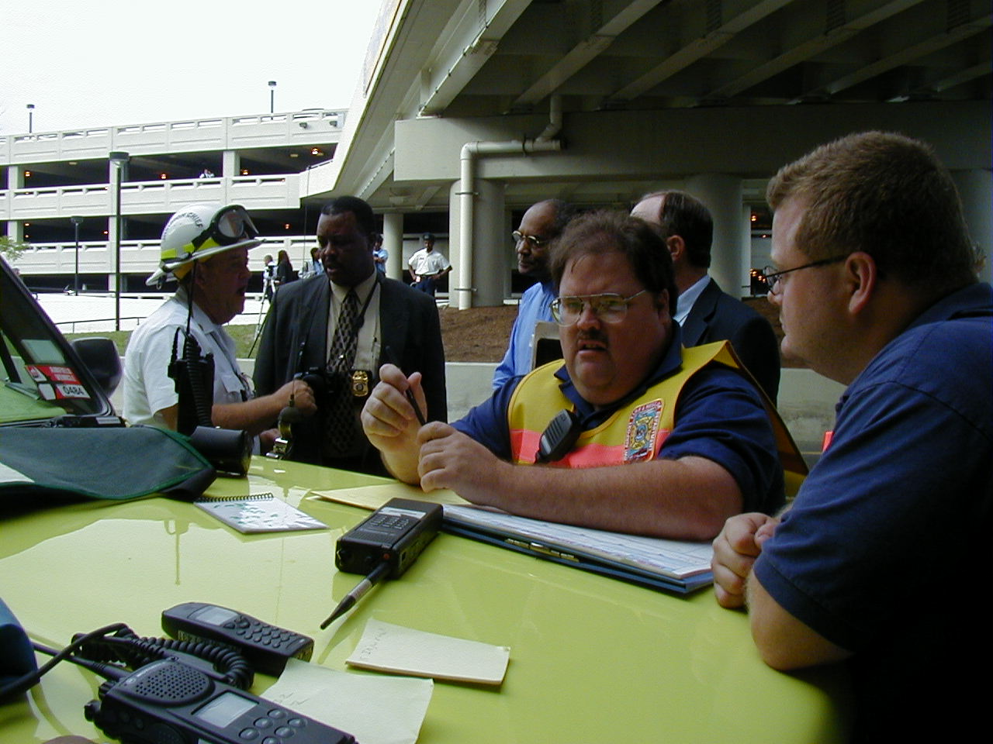
Information Management
During
Major Emergencies
Introducing
FRED
Notes:
Introduction of presentors
After action reports always cite communication of information during an incident -
We have experienced some of those difficulties
Will discuss new tool FRED to assist

Slide 2
FRED
Facility
Resource
Emergency
Database
Notes:
One might ask, “Why spend the time, effort and money to develop, post and participate in FRED.” Because it does what we are already doing, but it does it
Faster (instant Vs 30-90 min)
With better security that Faxes or phone calls (who knows who is on the other end)
One knows that MIEMSS is sending it and all information will be thoroughly verified before distributed
FRED keeps track of what has happened and can be saved for later evaluation or critique
FRED provides a new first option in a list 4 long of possible communication tools
FRED
EMS Voice Systen
Fax
Ma Bell
FRED will live at MIEMSS where, with the advent of EMAIS, he will two servers to host the participants. Both servers are backed up daily

Slide 3
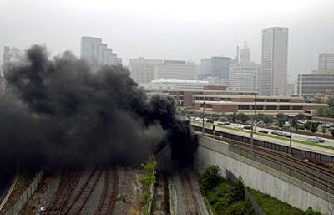
Information Conveyed
Advisement of an Incident
Notes:
Before we talk about FRED would like to cite a few examples of the type of information conveyed during previous incidents
Recent Rail disaster
Notified hospitals of incident and products involved
Fax from scene to EMRC then to hospitals - took>45 minutes to accomplish
Poison Center was not included in the transmission and received multiple calls from hospitals tying up their lines
Did not know products involved untill received from Hospitals and local media 3rd &4th hand

Slide 4
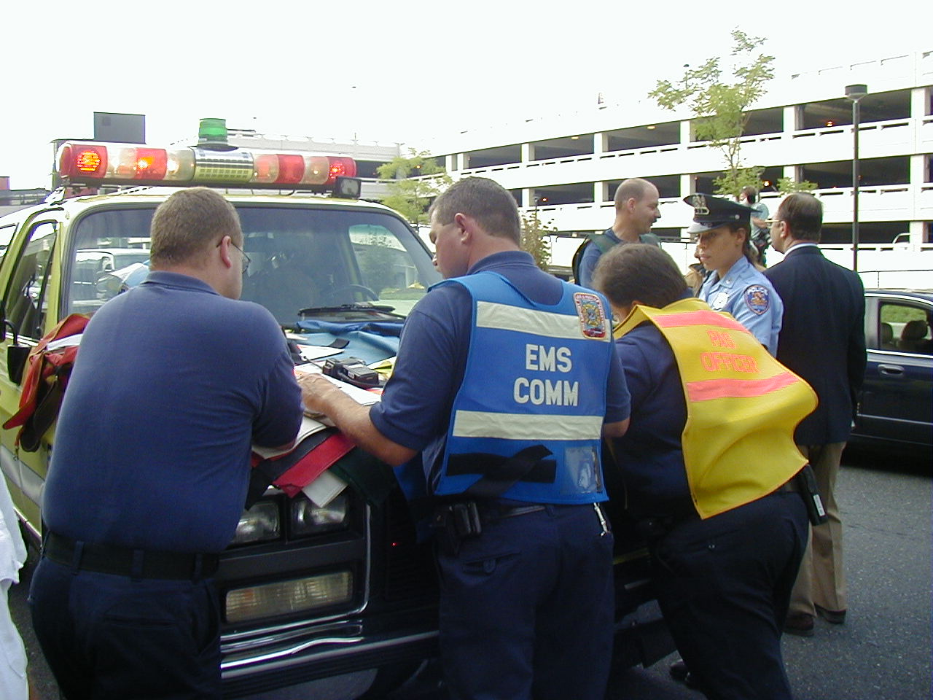
Information Conveyed
Spiral Call Down for Ed Availability
Notes:
On many incidents from minor bus accidents to incidents on the scale of the AMTRAK/Conrail crash EMRC does a call down of hospitals - spiraling Geographically from the scene until space is found for 150% of the estimated patient count.
Takes 30-90 minutes to complete

Slide 5
Information Conveyed
Unusual Occurrences
Notes:
Unusual events have been reported by one or more of the EMS System components in the past. EMRC has been used to pass along critical information
EX Homicide
Unusually violent reactions to Narcan being administered to OD patients
New street drug “Homicide” Heroin/scapolomine
Information gathered by Dr. Casani from Phila.
Dr Alcorta and John determined course of action and treatment guidelines
Info sent to FDs and Hospitals to curb use of Narcan to minimal effect

Slide 6

Information Conveyed
NDMS Drills
Notes:
On Sept 7 EMRC began a call-down at the request for NDMS to Exercise bed availability.
Was not completed until Sept 12

Slide 7
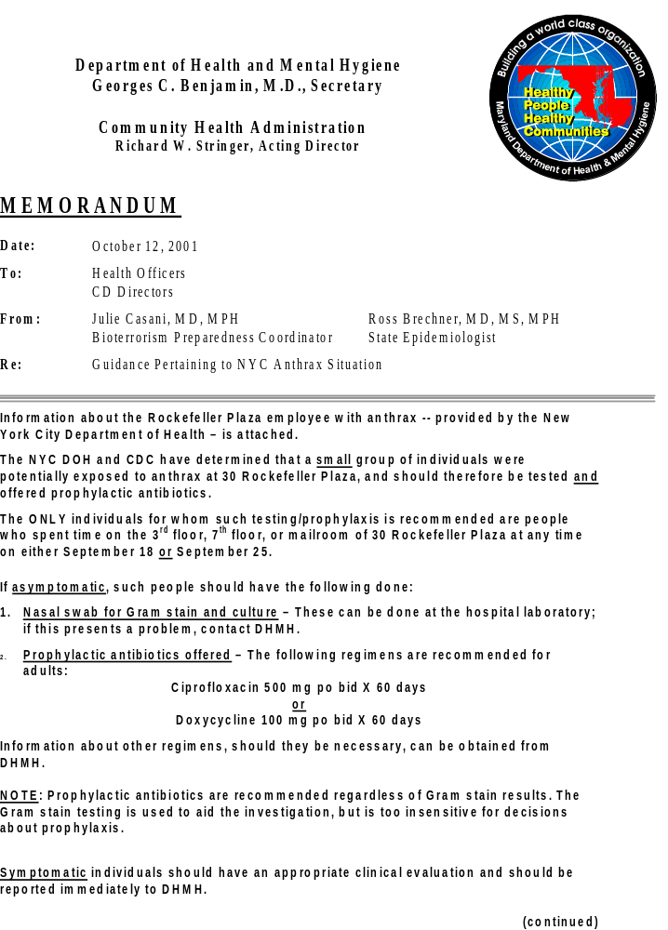
Information Conveyed
Anthrax Treatment Protocols
Notes:
Important treatment guidelines to maximize resources and assure public

Slide 8
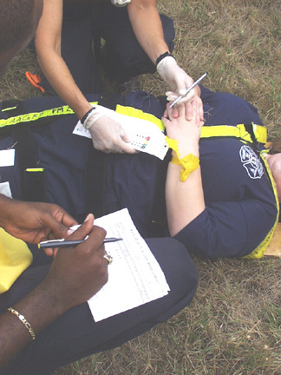
Information Conveyed
Patient Tracking
Notes:
Using new triage tags EMS officer at the scene of a multi-causality hand tallies patient transports as it relates to resources ( IE ED availability) and determines destination of patients
Minimal feed back as to receipt of patients
Weather plays havoc on the process
No central database of patients to provide information to families
Red Cross not linked in the process

Slide 9
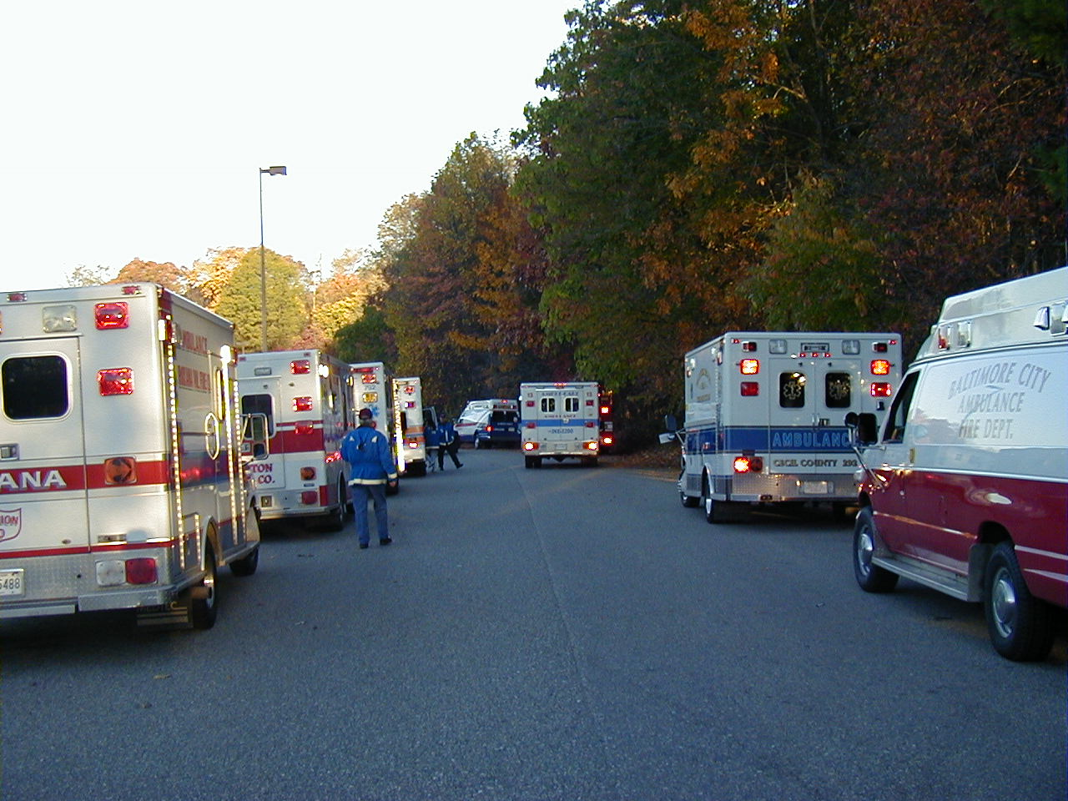
Information Conveyed
Resource Cataloging
Notes:
First completed on Sept 12 to0 get a handle on resources leaving the state

Slide 10
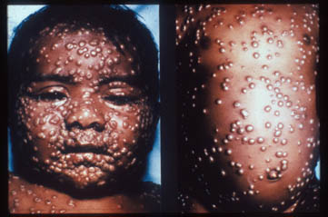
Information Conveyed
Syndromic Surveillance
Notes:
Now being done by DHMH
Administrators spent inordinate amount of time attempting to monitor activity looking for WMD related syndromes

Slide 11

Information Conveyed
Poison Center
Notes:
Minimal inclusion in the loop in the past
Need to reduce their call volume from system components
Have valuable information and access to many information sources

Slide 12
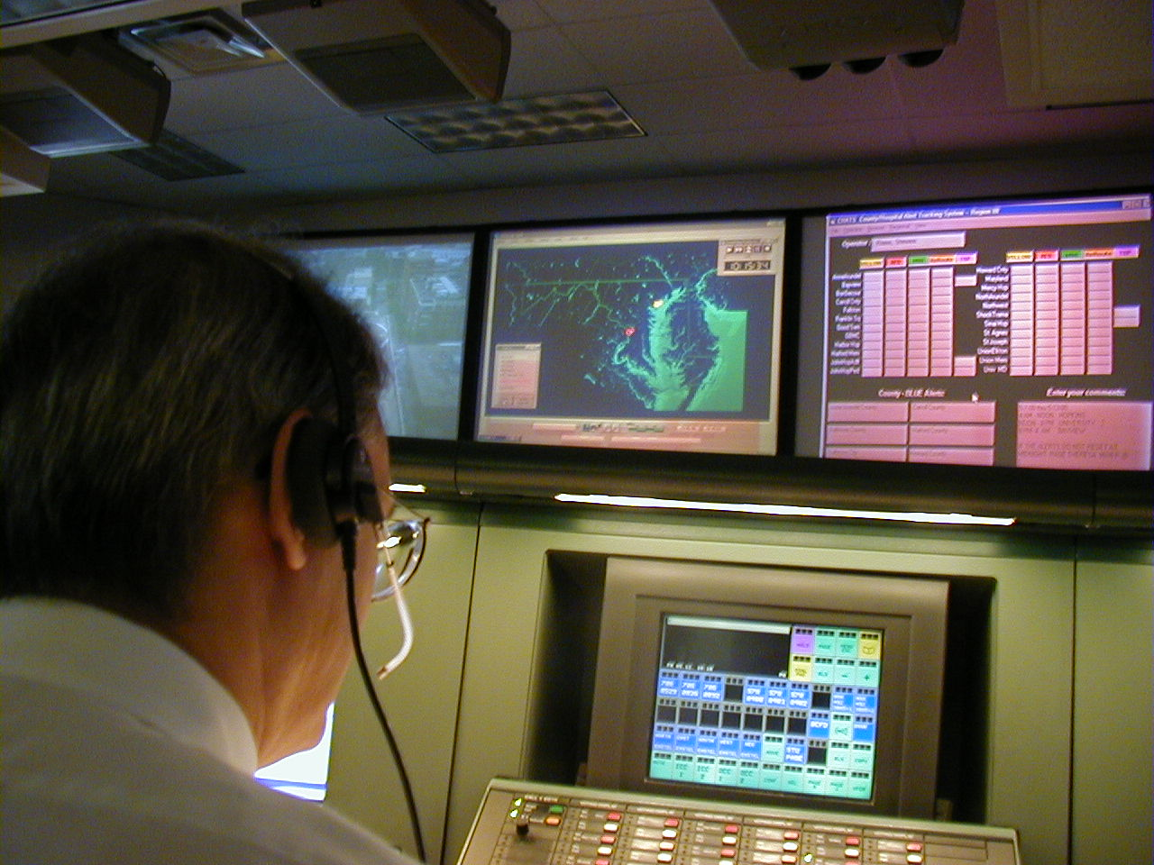
Current Methods of Conveyance
Telephone
Broadcast Fax
Notes:
Both take too long
minimal updates provided

Slide 13
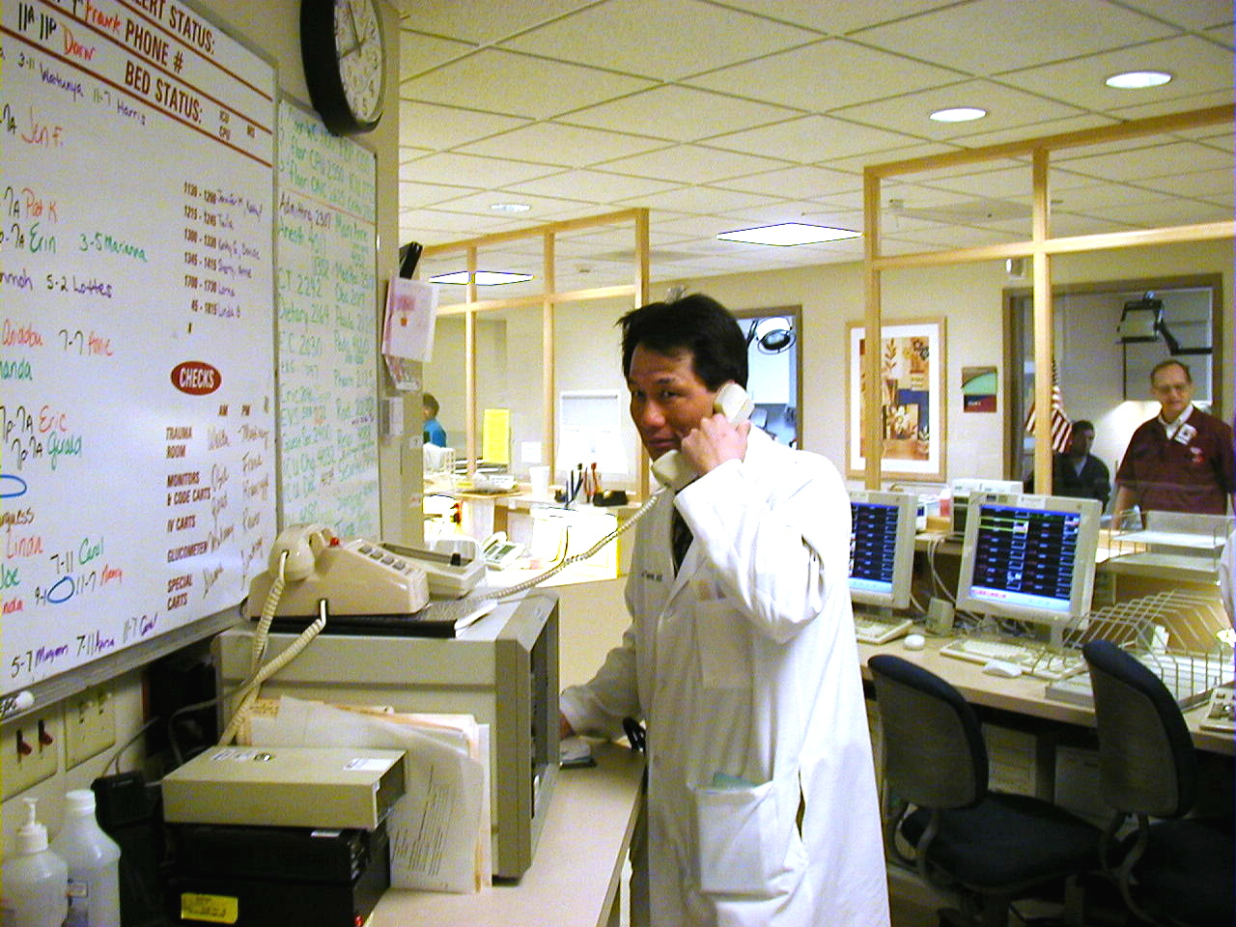
FRED
Facility Resource Emergency Database
  Simplifying Current Operations
Notes:
FRED is to be a tool to assist with current operations
Not meant to be additional burden
Simply combines several step of the communication process
and speeds the transmission of information
Replace what we are doing now

Slide 14
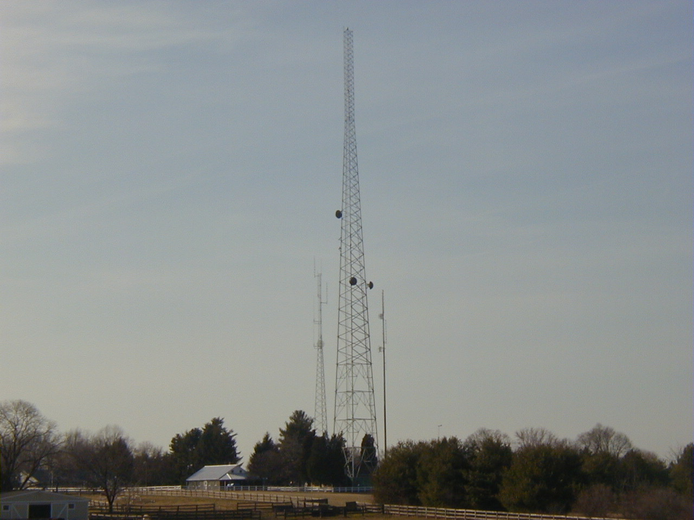
FRED
Web Vs Wire
Notes:
Discussed options to move the information
Hard wired closed network is optimal and is planned for the future. Infact may components are in place as we speak
Several months to years and mega bucks to implement such a system
WE CAN”T WAIT!
Will implement on secured web site through MIEMSS servers to get it up now!
Programming for version 1.0 is nearing completion
Would like to give a quick tour

Slide 15
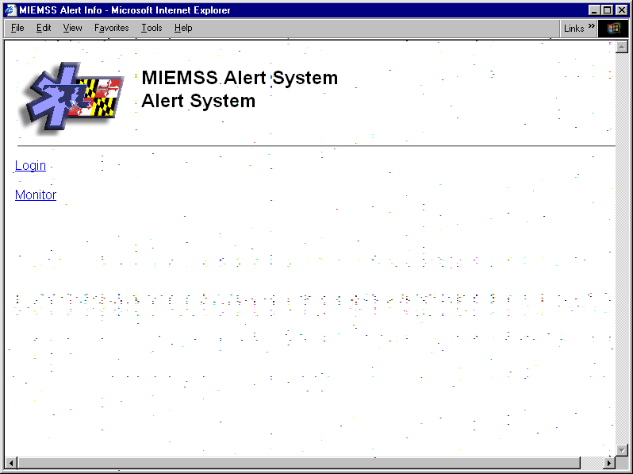
Initial Entry Screen

Slide 16
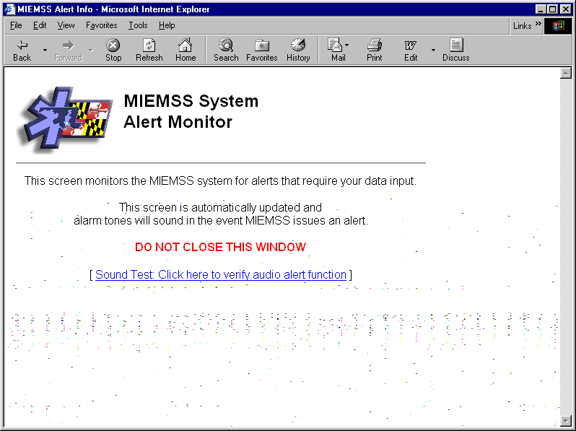
Monitoring Screen

Slide 17
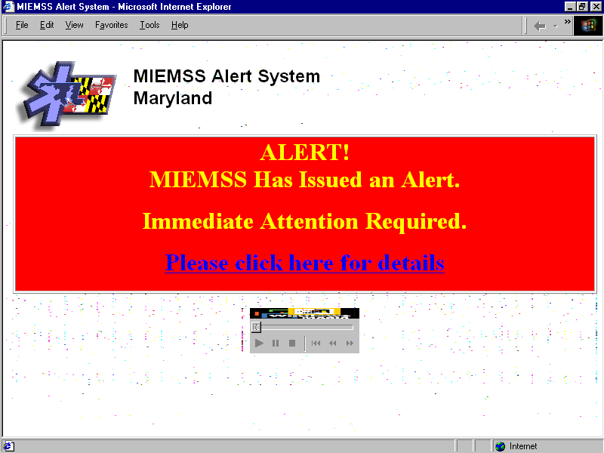

ALERT !
Notes:
When the participants in FRED receive the information they will hear an Irritating audible signal and a screen similar to this one will appear on their computer
They would then click the areas to which they are directed

Slide 18
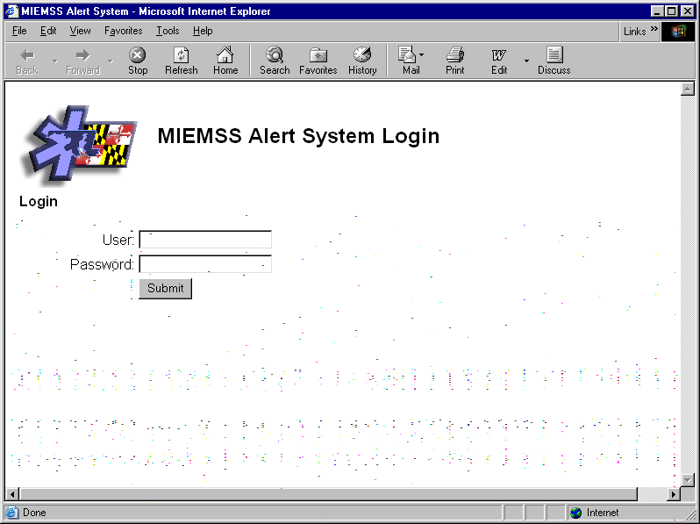
Log-in Screen

Slide 19
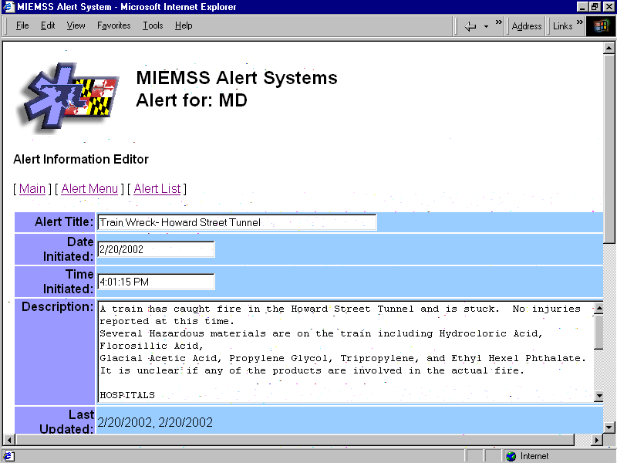
FRED
Components - Alert Entry
Notes:
In the case of any incident MIEMSS (EMRC/Syscom) would initiate an alert to all affected components of the EMS system. This could include Fire Depts, Hospitals, Emergency Management, Health Departments ETC

Slide 20
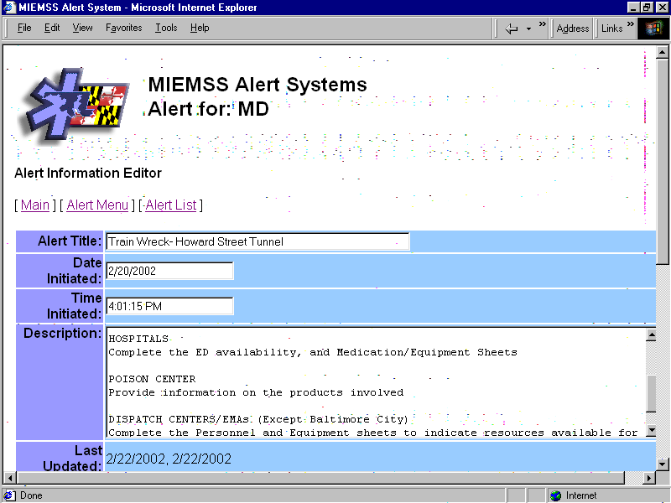
FRED
Components - Alert Entry
Notes:
Such an alert could include specific instructions and guidelines and request they submit specific information. Just as we do now but by voice of Fax

Slide 21
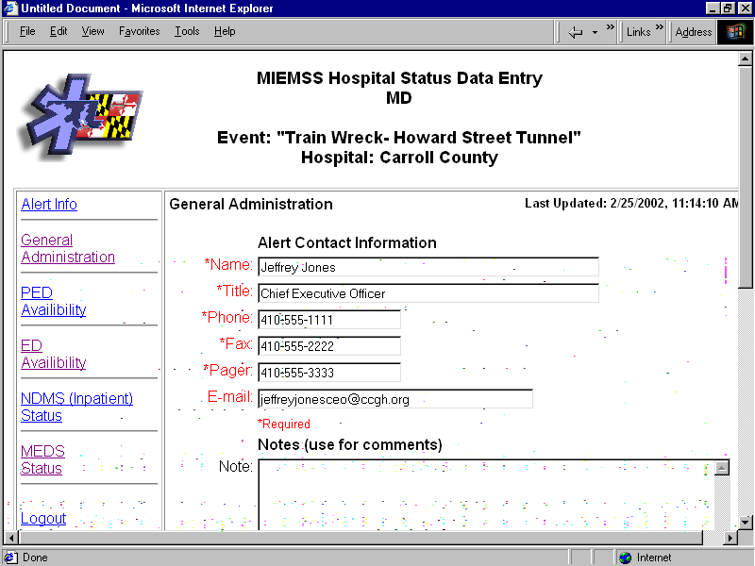
FRED
Components - Response Entry
Notes:
They will be asked to verify the Hospital contact person and then can proceed to submit the request information by clicking the screen

Slide 22
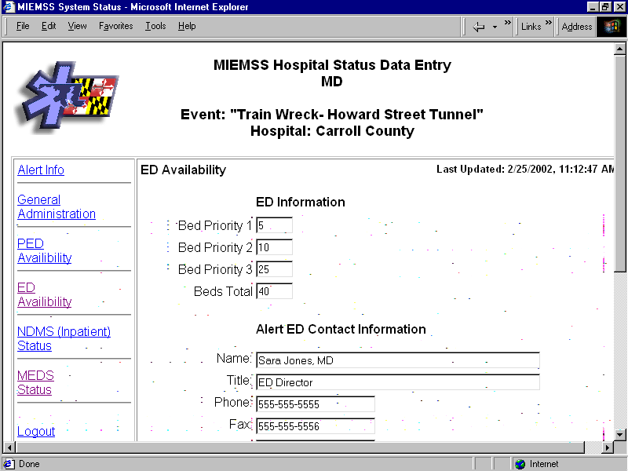
FRED
Components - Response Entry
Notes:
Here they can quickly enter the requested info
Each screen does have space to indicate the specific person responsible for the information requested.
This is the ED Availability entry Screen mentioned in the initial alert

Slide 23
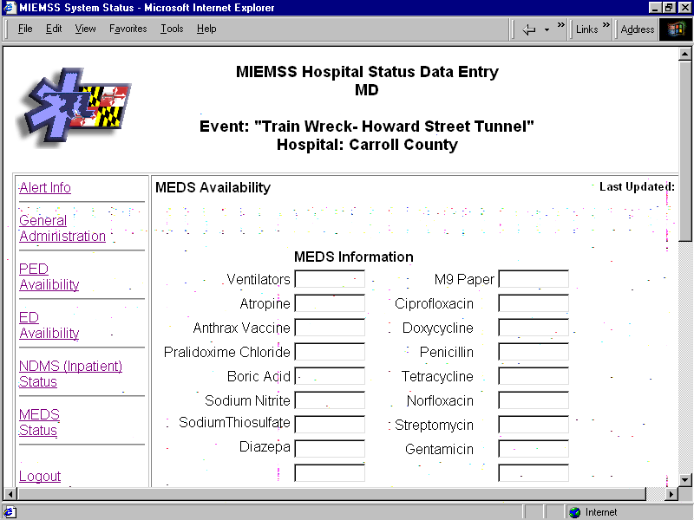
FRED
Components - Response Entry
Notes:
This is the Meds/ Equipment entry screen also requested in the alert

Slide 24
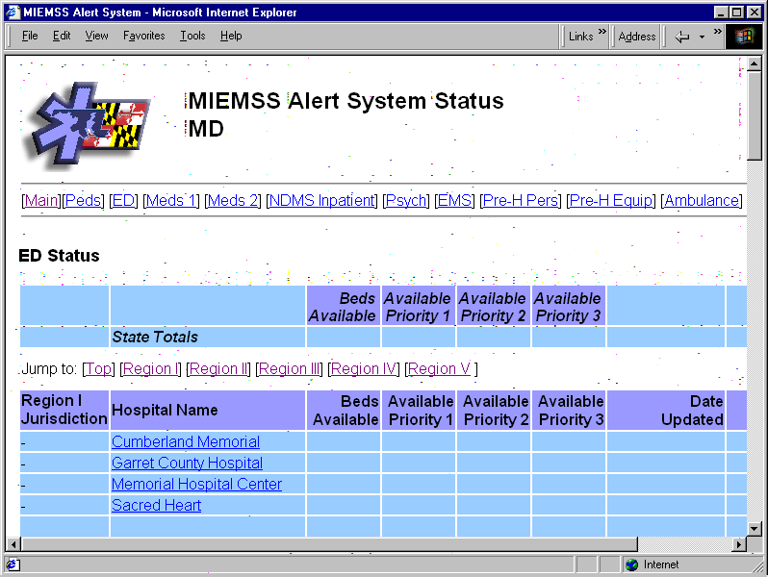
FRED
Spreadsheets - ED Availability
Notes:
This is the central spread sheet available to the incident manager

Slide 25
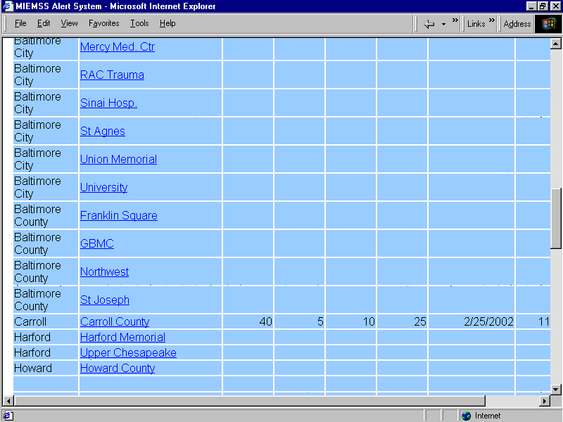
FRED
ED Availability - Instant Entry
Notes:
As you may see - the information entered is transferred instantenouusly
Total elapsed time from the initiation of the alert - 5-10 minutes!

Slide 26
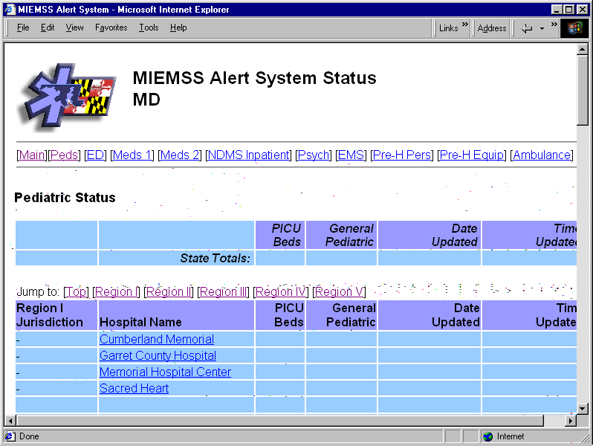
FRED
Spreadsheets - Pediatric beds
Notes:
There are also several other spreadsheets
This is one to monitor the availability of Pediatric beds as they are a precious resource that become tight from time to time

Slide 27
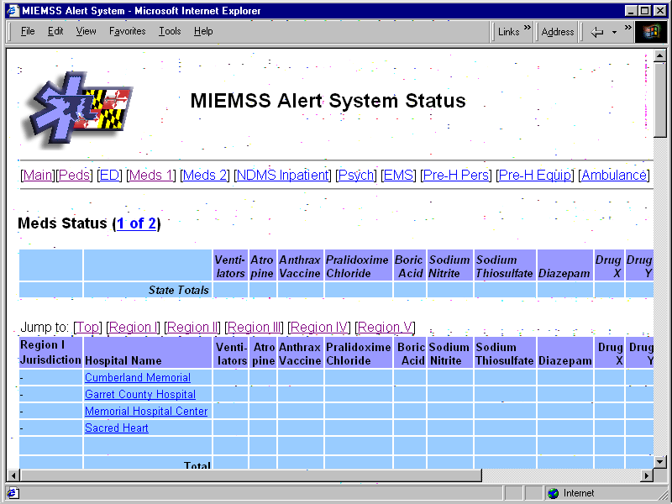
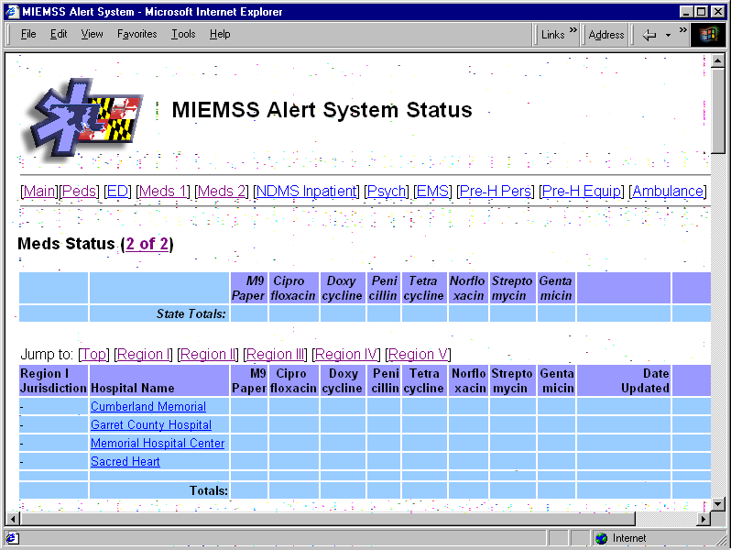
FRED
Medications and Equipment
Notes:
This is the medication /Equipment sheet. Several fields are definable for each specific incident

Slide 28
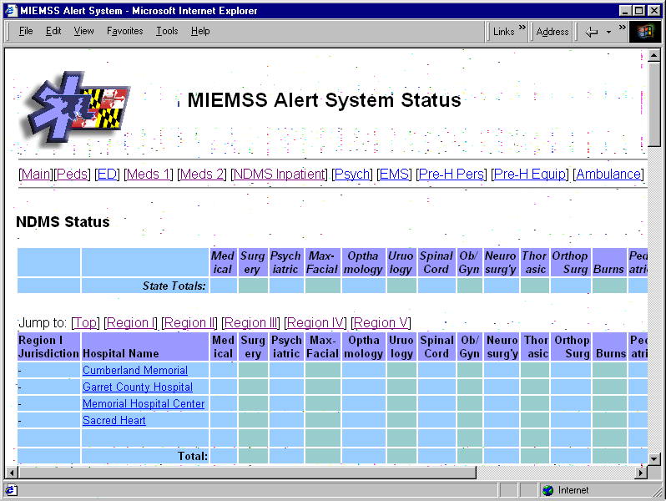
FRED
Spreadsheets - NDMS Beds
Notes:
This is the NDMS bed categorization -
When received the contact person will be listed so Hospital personnel know who to contact within their facility to gain the requested information

Slide 29
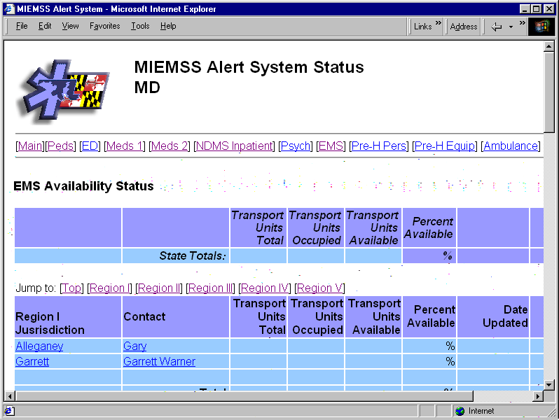
FRED
EMS Unit availability
Notes:
EMS Unit availability - needs to be linked to CAD (computer aided dispatch) systems to work best , but wanted to make it available for hand entry if deemed necessary

Slide 30
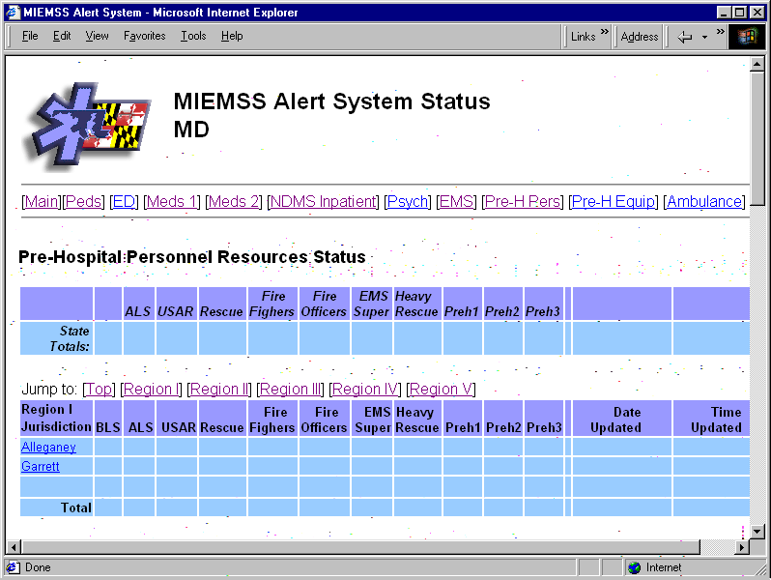
FRED
Prehospital Personnel
Notes:
This was used on Sept 12 Personner and….

Slide 31
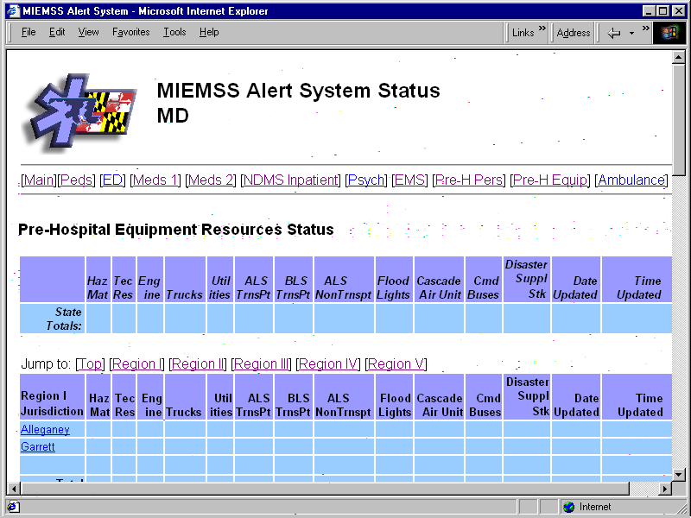
FRED
Prehospital Teams/Equipment
Notes:
Equipment
Want to make this compatible with the Fire Chiefs Council Resource list

Slide 32
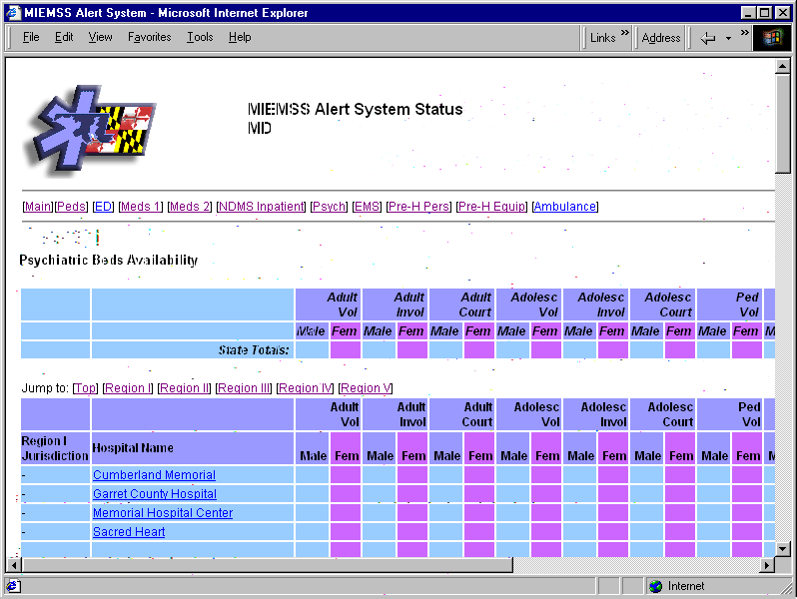
FRED
Spreadsheets - Psychiatric Beds
Notes:
This is the only portion that will not be incident dependent
Psych facilities will update every 4-8 hours
Hope to provide

Slide 33
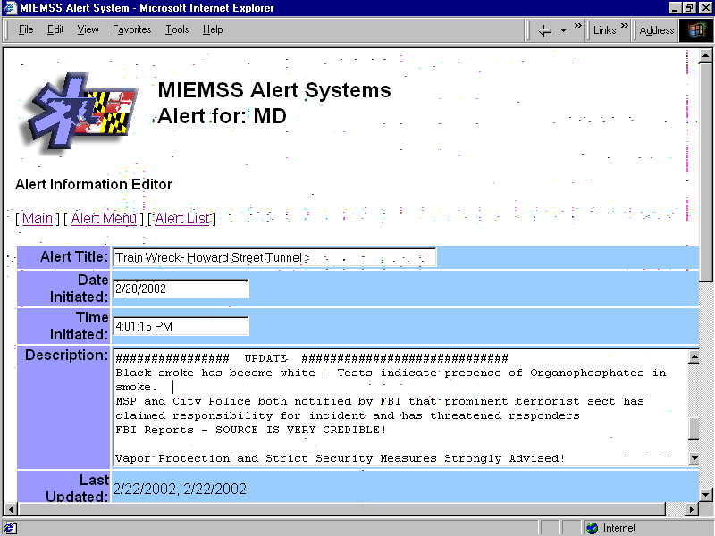
FRED
Components - Alert Log
Notes:
FRED also has a log feature that will allow participants to be updated through-out an event. And can scroll back to refresh themselves on the activities and advisements

Slide 34
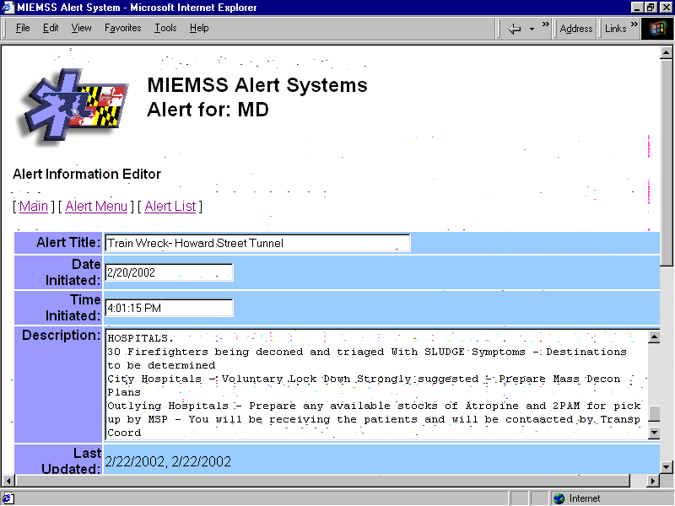
FRED
Components - Alert Log
Notes:
Additional instructions or information requests can also be provided

Slide 35
FRED
Access Rights
PEMA
Out of State
Partners
Poison Center
SYSCOM
DOH
Field EMS / Command Units
Local Health Depts
Local EMAs
Dispatch Centers
Psychiatric Facilities
Hospitals
Notes:
These are the planned partners that will be allowed access initially. These can be easily added or deleted as necessary. Everyone will be provided access through the use of a password and all transmissions will be encrypted.

Slide 36
Why FRED ?
Speed
Security
Reliable Information
Situational Update Log
Redundancy –
  multiple servers
Notes:
One might ask, “Why spend the time, effort and money to develop, post and participate in FRED.” Because it does what we are already doing, but it does it
Faster (instant Vs 30-90 min)
With better security that Faxes or phone calls (who knows who is on the other end)
One knows that MIEMSS is sending it and all information will be thoroughly verified before distributed
FRED keeps track of what has happened and can be saved for later evaluation or critique
FRED provides a new first option in a list 4 long of possible communication tools
FRED
EMS Voice Systen
Fax
Ma Bell
FRED will live at MIEMSS where, with the advent of EMAIS, he will two servers to host the participants. Both servers are backed up daily

Slide 37

System Requirements - MIEMSS
Web Server
Programming
Notes:
MIEMSS will handle most of the burden to post and maintain FRED
We will incur the cost of the initial programming and will provide the webserver in which FRED will reside. Users manuals will also be provider to approved participants

Slide 38













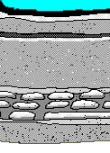
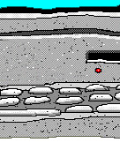

User Requirements
Desk Top Computer
  Internet Access
  Web Browser
  Sound Card
Notes:
Participants simply need a personal computer which has reliable internet access, a current web browser and a sound card. Mobile units such as command posts need to consider wireless access. Existing data channels could be used to transmit to a central access point versus direct wireless access. This will decrease the likelihood that transmissions would be intercepted.

Slide 39
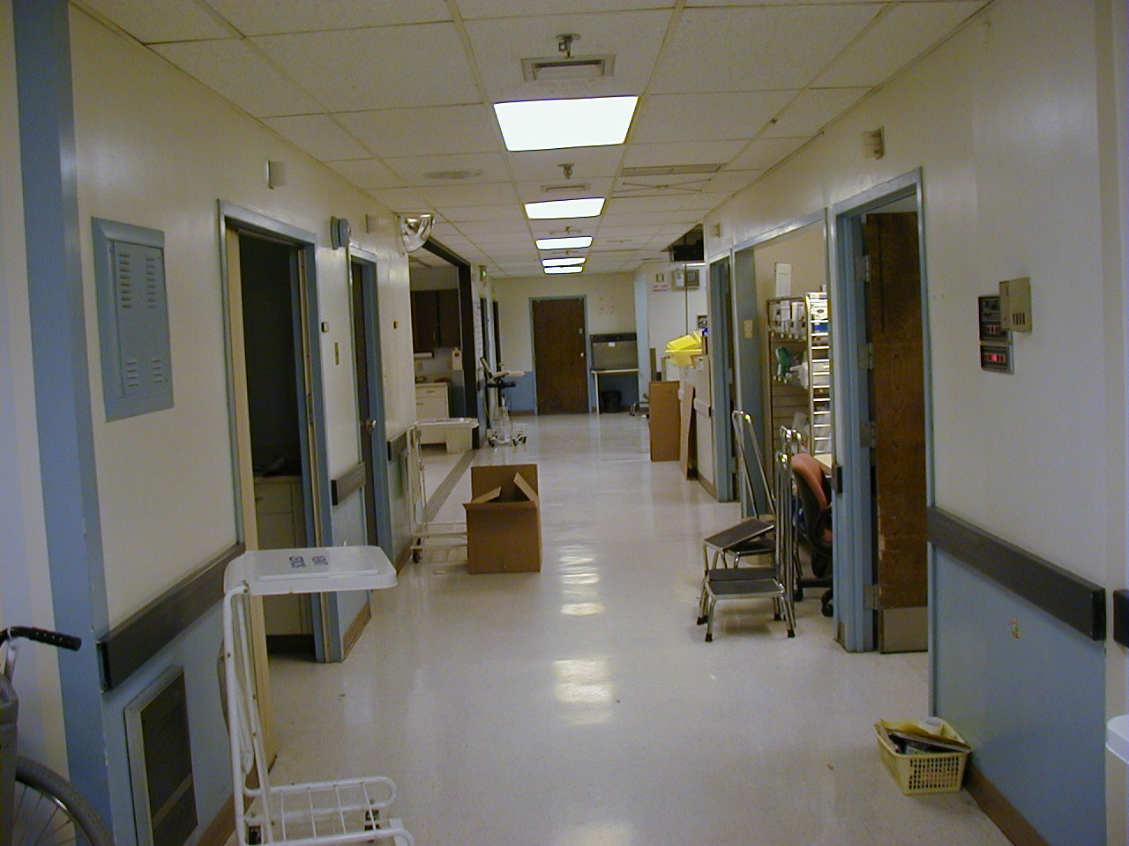
Where to Put FRED
Individual Facility Decision
Multiple Simultaneous Access Points
One must be Active 24/7
Notes:
Where the computers will be is up to the individual users. Some are considering the Emergency Department or Security Office.
Multiple sites are acceptable as long as they do not attempt to edit the same screen simultaneously.
We ask that participants monitor FRED 24/7. The monitoring program can be minimized to allow the PC to be used for other tasks

Slide 40
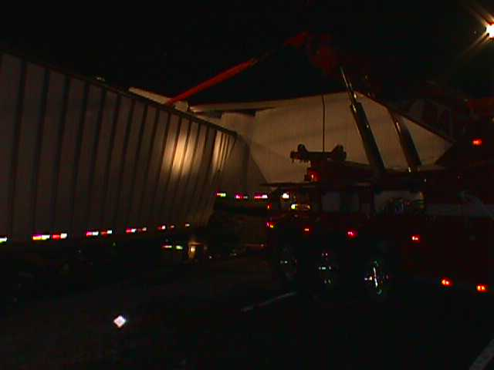
When Will FRED be Active?
Incident Driven
Exercises
Psychiatric Monitoring
Notes:
For the most part, FRED will only be active when there is an incident occurring.
Weekly tests of FRED will be performed to ensure the system is intact and participants are familiar with its use.
Some screens, such as the Psych Beds will be accessable all the time, but will be updated by the Psych facilities themselves. We may find other activities that may require constant activity in the future.

Slide 41
Future Plans for FRED
Regular Software Updates …..
Syndromic Monitoring ………...
Triage & Tracking ……………….
Database Linkage………………..
Infrastructure …………………….
Notes:
Once Up we do not plan to let FRED lounge around on our servers. We intend to continue to build on his assets with . . .
Regular Updates
We have had discussions with DHMH to allow FRED to assist wit the Syndromic monitoring
We hope to tie a Triage program under development to track bed availability as they are added and taken. This could also be used as a central repository to determine who went to which facility.
We hope to link several databases to decrease double entry of information to include Pysch Bed Registers, CADs, EMAIS, ED patient logs, Medical Records, ETC
Want to hard wire the system into a closed WAN for better security. This will be required for database linkage and will improve speed.
Costs are as stated
Notes on Infrastructure cost
806K will bring up 22 hospitals by the end of the Fiscal year
Infrastructure committee has the system planned but money has been cut from an already slow implementation
Cost may be reduced if Network Maryland fibers can be accessed for MPT so we can get access to their equipment.

Slide 42
Questions ?
Notes:
One might ask, “Why spend the time, effort and money to develop, post and participate in FRED.” Because it does what we are already doing, but it does it
Faster (instant Vs 30-90 min)
With better security that Faxes or phone calls (who knows who is on the other end)
One knows that MIEMSS is sending it and all information will be thoroughly verified before distributed
FRED keeps track of what has happened and can be saved for later evaluation or critique
FRED provides a new first option in a list 4 long of possible communication tools
FRED
EMS Voice Systen
Fax
Ma Bell
FRED will live at MIEMSS where, with the advent of EMAIS, he will two servers to host the participants. Both servers are backed up daily

