Slide 1
Welcome to CS 4330/5390, Mobile Application Development
Fall 2019
Dept. of Computer Science
University of Texas at El Paso

Slide 2
Course Staff
Instructor: Yoonsik Cheon
Email: ycheon@utep.edu
Office: CCSB 3.0606 (phone: 747-8028)
Office hours: MW 3:00 - 4:30 pm, by appointment, and when door is open

Slide 3
Course Website
URL: http://www.cs.utep.edu/cheon/cs4330/ (google “UTEP CS 4330”)
Resources available
News and important announcements
Course information (syllabus, contact info, etc.)
Lecture notes and reading materials
Assignments, projects, and exams
Scores and grades (do survey!)
Programming tips, tools, etc.

Slide 4
Quick Survey …
8 minutes

Slide 5
Why Mobile Computing?
Trends in computing industry
Mainframe/batch
Workstation/client-server
PC/Web/P2P
Mobile?
New Knowledge Areas (KA) in CS Curricula 2013
Joint work by ACM and IEEE-CS
Platform-based Development (PBD), e.g., mobile, Web, and game
Good addition to your resume?

Slide 6
Native vs. Cross-platform Mobile App Development*
Native app: meets the requirements of a particular operating system by using its SDK
Android apps in Java or Kotlan
iOS apps in ObjectiveC or Swift
Cross-platform app: compatible with multiple operating systems and thus can run on any smartphone or tablet
Hybrid HTML5 apps: HTML5, CSS and JavaScript (e.g., Apache Cordova a.k.a. PhoneGap)
Native cross-platform apps: Unified API on SDK (e.g., Xamarin in C# from Microsoft, React Native in JavaScript from Facebook)
Own UI: Platform-neutral UI components rendered by the framework itself (e.g., Flutter in Dart from Google)
Pros and cons?
*Based on: Andrew Klubnikin, Cross-platform vs. Native Mobile App Development: Choosing the Right Development Tools for Your App Project, May 2017 (online; google it).

Slide 7
Native vs. Cross-platform (Cont.)
Native mobile apps
High performance
Ultimate user experience
Greater app store visibility
Cross-platform mobile apps
Shorter development time
Cost effectiveness (development and maintenance)
Larger user base
Issues: Performance, user experience

Slide 8
Which Platform?
52% of developers earn less than $500 per month in mobile revenue (survey in 2016*)
18% in the high earning category ($25k or more per month)
88% of the high earners targeted three platforms:
Android
iOS
Web
*Developer Economics – State of the Developer Nation report Q1, 2016 by Vision Mobile
(http://vmob.me/DE1Q16).

Slide 9
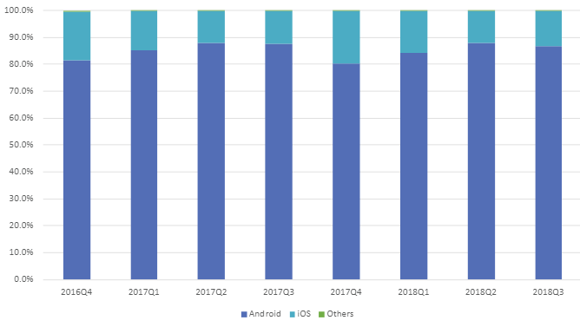
Why Android?
Android: Java-based, market dominance (86.8% share in 2018 Q3)
iOS: Objective-C (13.2%)
Global smartphone OS market share in 2018 Q3 (from www.idc.com)

Slide 10
In-Class: 8 Minutes, Pair
Read the syllabus and answer the following questions.
When are the office hours of the instructor?
What are the main objectives of the course?
What are the main topics to be covered?
Describe the homework policy? Are late submissions are allowed?
What’s the purpose of the semester project, and what are you supposed to do regarding it?
Is class attendance required?
Can everyone earn an A?
How can you earn bonus points (~ 5%) to improve your grade?

Slide 11
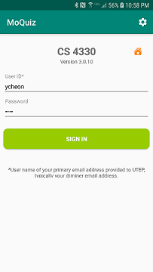
Practice Quiz: What You Just Learned
Install an Android app named MoQuiz
Search “MoQuiz” in Google Play Store
Or http://www.cs.utep.edu/cheon/moquiz/
Android 5.0 or higher
No Android device?
Install an emulator, e.g., BlueStacks
Google “Best Android emulators for PC”
Need to give a permission to install from “unknown sources”
Or use the MoQuiz Web
Available from the Lecture Notes page of the course website.

Slide 12
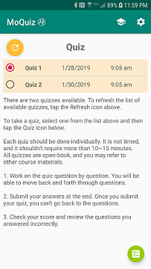
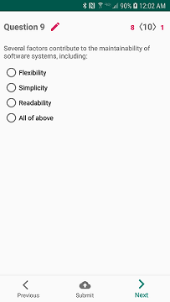
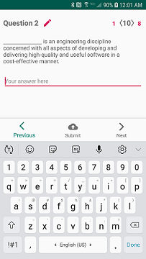
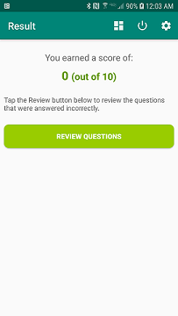
Quiz (10 Minutes)
Log in
User Id: UTEP user name (e.g., jsmith@miners)
Password: last 4 digits of student id (e.g., 80001234)*
Steps
Select a quiz
Answer
Submit
Review
Issues?
Try to answer one question incorrectly.
*Can change after login.

Slide 13
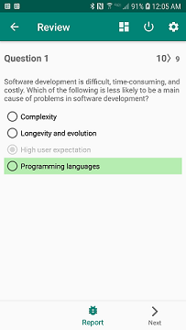
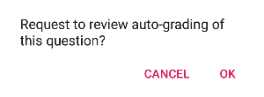
Quiz Grading
Done and collected automatically
Must be submitted on time
Q: Reporting a grading error?
Tap the “Report” button at the bottom.
Report
button

Slide 14
Course Web Account
Password-protected pages (e.g., lecture notes, assignment submission, and grade*)
Use your MoQuiz credentials or the following:
User Id: cs4330/cs5390
Password: room0208
*Lecture notes and grades are also available through the MoQuiz app.

Slide 15

Textbooks
J. F. DiMarzio, Beginning Android Programming with Android Studio, 4th edition, Wrox (John Wiley & Sons), 2017*.
Supplementary reading:
Dawn Griffiths and David Griffiths, Head First Android Development: A Brain-Friendly Guide, 2nd edition, O’Reily, 2017. Detailed instructions and explanations.
Paul Deitel, et al., Android 6 for Programmers: An App-Driven Approach, 3rd edition, Prentice Hall, 2015. Eight different example apps.
Bill Philips, et al., Android Programming: the Big Nerd Ranch Guide, 3rd edition, Big Nerd Ranch Guides, 2015. Professional apps.
Trish Cornez and Richard Cornez, Android Programming Concepts, Johns & Bartlett Learning, 2015. Read Chapters 5 (graphics and drawing) and 6 (threads and handlers).
Allan Vermeulen, et al., The Elements of Java Style, Cambridge University Press, 2000.
*Free e-book through UTEP Library

Slide 16
Course Structure
Active/cooperative learning, flipped classroom
Reading assignments and quizzes
In-class coding and group exercises
Class attendance required; circulate a sign-in sheet!
Hands-on, lab-type
In-class coding labs and homework assignments
Project-based
Semester project (individual, pair, or team)

Slide 17
Exams
Midterm: October 16 (Wednesday)
Final: December 13 (Friday) 10:00 am - 12:45 pm

Slide 18
Assignments
Reading assignment
For class preparation and active learning
Quizzes on reading
Programming assignments
Three homework assignments (more on this later)
On-line submission
No late submission will be accepted.
Semester project (more on this later)

Slide 19
Today’s Reading Assignment
Chapter 1 (Getting Started with Android Programming)
Do HW0: Android Studio (due on Wed, Sep. 4)
See the course website for the handout.
Configure an Android development environment.
Java SDK (version 8)
Android SDK
Android Studio (latest stable release, e.g., 3.4.2)
Android emulator (Android Virtual Device, AVD) or Android device
Create a “Hello world” app.
Run the app using an emulator or Android device.
Fill out the form (handout) available from the course website and bring a hard copy.

Slide 20
Semester Project
Objectives
Develop a realistic, usable app by applying concepts and techniques learned in the course,
Learn new significant features of mobile programming not discussed in the course, or
Perform mini research on mobile app development (CS 5390)
Approach
Project proposal (individual; to be approved by the instructor)
Prototype demo or progress report (individual, pair, or team)
Final presentation and report (individual, pair, or team)
Peer review and evaluation

Slide 21
Semester Project (Cont.)
Requirements
Related to course topics
Non-trivial and significant UI
Use of:
Data persistence (local or remote database),
Networking (e.g., Socket, HTTP, or Bluetooth), or
Significant framework or API (e.g., storage, maps, face recognition, and machine learning)

Slide 22
CS 5390: In-Class Presentation
Length: 15~20 minutes
Contents
Technical paper related to course topics, or
Mini lecture or tutorial on Android features, e.g.
Touch gestures
Sensors and camera
Tabbed interface
Navigation drawer
Kotlin language
Cross-platform development (Cordova, React Native or Flutter)
…

Slide 23
Grading
Approximate percentage:
Quizzes and in-classes: 15%
Homework: 40%
Projects: 20%
Exams: 25%
Percentage-score-to-letter-grade conversion
90% or above: A
80-90%: B
70-89% C
60-60%: D
below 60%: F
5% bonus points for class attendance and participation

Slide 24
Course Outline
Boot camp: reviews (1.5 weeks)
Frameworks and GUI programming
UML class diagram
Design patterns, JUnit, Javadoc
Android programming (12.5 weeks)
User interfaces (views, widgets, menus, touch gestures)
Activity, fragments, and intents
Multithreading and networking
Data persistency (shared preferences, file storages, and SQLite)
Content providers
Location-based services
Android services
Other topics: touch gestures, sensors, multimedia, etc.
Semester projects (2 weeks)
Project proposal, prototype demo, final presentation

Slide 25
Questions or Concerns?

Slide 26
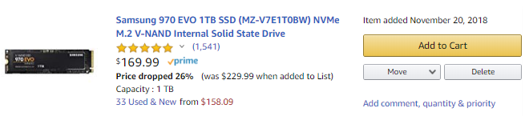
Pair (5 mins): Price Watcher
Find an app or website for watching or tracking the prices of items (e.g., Amazon’s wish list)
Identify its key features, e.g.,
Initial price (the price when the item was added to the list)
Current price and change (%)
Group and sort items
Alert or notification (e.g., when prices drop)
…

Slide 27
Homework Assignments
Evolutionary development of Price Watcher apps (HW 1-3)
Given URLs of items, watch or track price changes of the items.
Several increments
Modeling in UML
Basic (HW1): Single fixed item, simulated prices, simple UI
UI (HW2): Multiple items, multiple screens, dialogs, settings
Network (HW3): Web connection, persistence (database), notification
May be done individually or in pairs

Slide 28
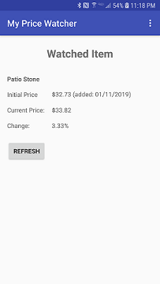
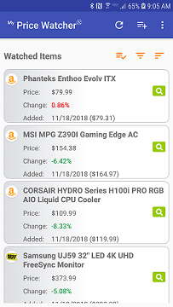
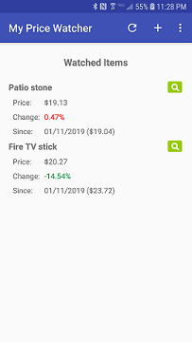
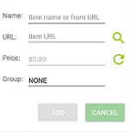
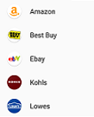
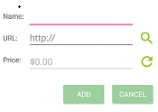
Incremental Development
Basic (HW1)
Network (HW3)
UI (HW2)
Item
PriceFinder
ItemManger
WebStore
AddDialog
EidtDialog
WebPriceFinder
ItemDatabaseHelper
ItemCursorAdapter

Slide 29
Exercise (Pair, 10 Minutes)
Form a pair
Draw a use case diagram for the Price Watcher app by identifying:
Actors
System boundary
Use cases
Price Watcher
Use cases?
User

