Slide 1
Mvibe
General tips on how to use it

Slide 2
Github
Mvibe (soon to be called stimBOLD) is currently stored on Github.
To make use of the development version, make sure you understand learn the following commands:
git push
git pull
Git checkout

Slide 3
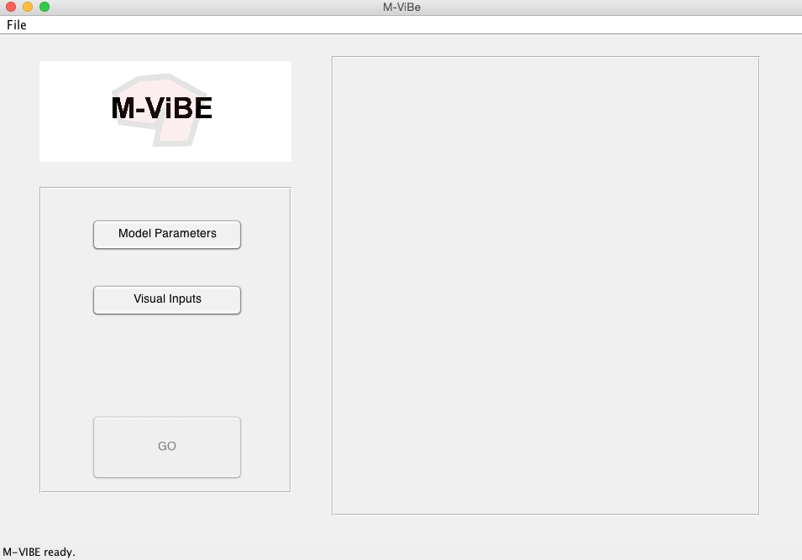
After you have downloaded the version..
To load up the gui, in matlab type:
>> mvibe
This will load up the following:

Slide 4
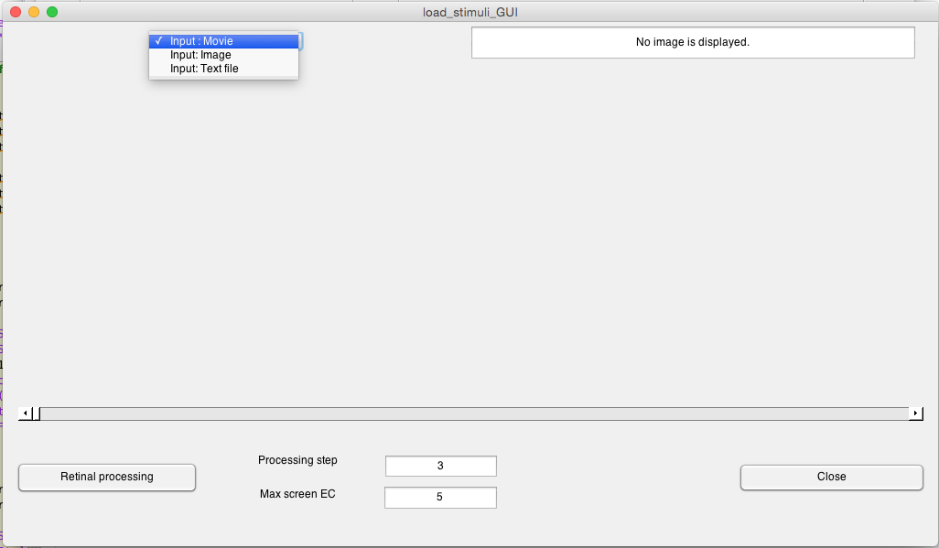
Loading a stimulus
To load up a stimulus, click on the visual inputs button.
This will bring the following window.
You can choose different formats to load up images
Max eccentricity of the display
Smoothing parameter
Once you have a stimulus loaded you can press this button to redo “retinal processing” that is, resmooth the data according to properties in the retina

Slide 5
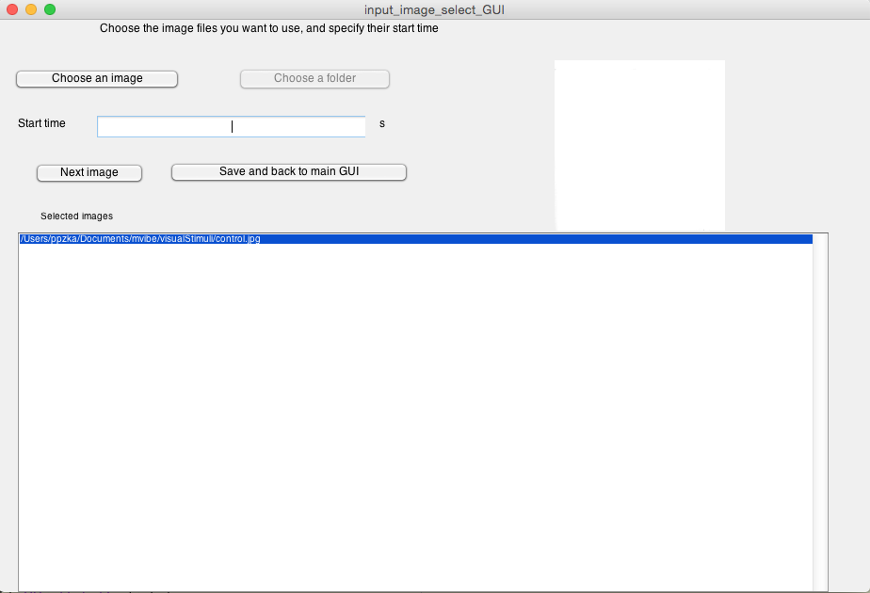
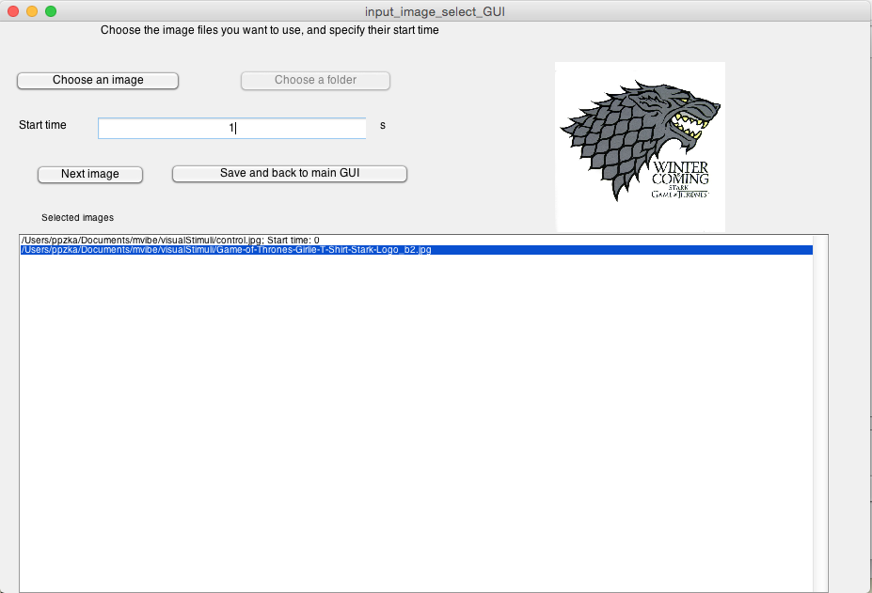
Loading images:
To load up images one by one, you can “choose an image”.
After you do enter the start time of this image in the text.
You can load multiple images with “choose a folder”.
Then click “save and back to main GUI”.
You will have to save a text file that saves the stimuli ordering.

Slide 6
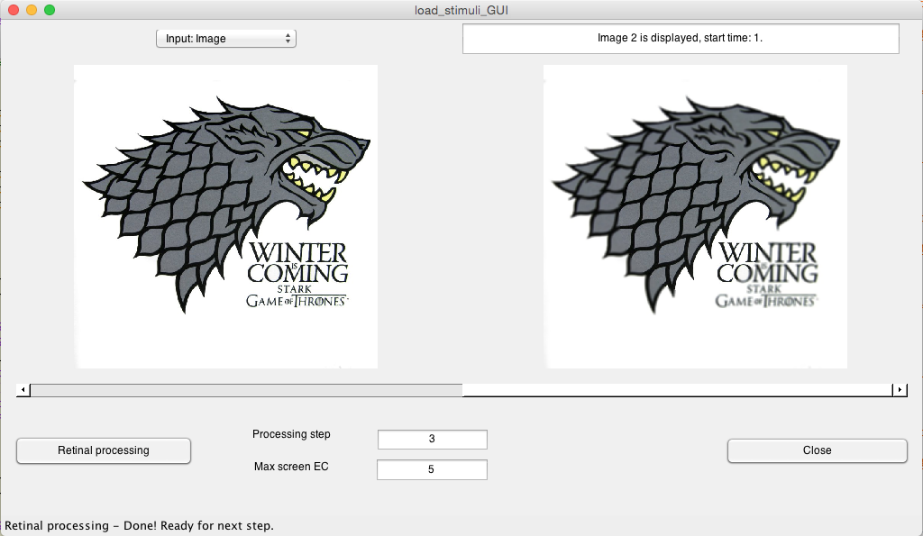
Inspecting the images:
When you have loaded the images, you can see the images and how they are blurred in the retinal processing.
Click “Close” when you are done.

Slide 7
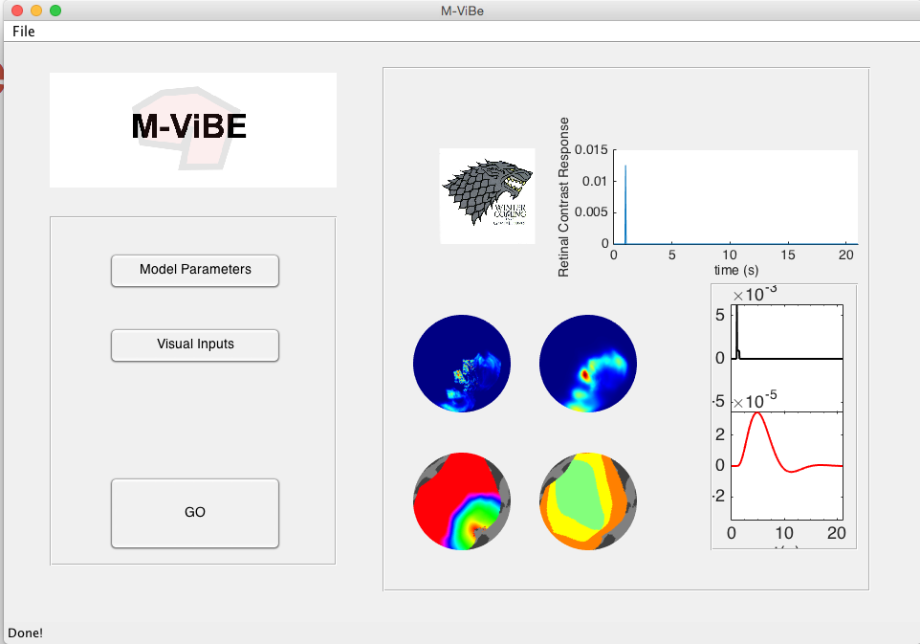
When all is done:
After you click go, you the code will begin running, this is the output as shown in the gui.
The first instance will display the mean time courses spatially and temporally.
Neural response
Neural response
BOLD Response
BOLD Response
Eccentricity Map
Visual area map

Slide 8
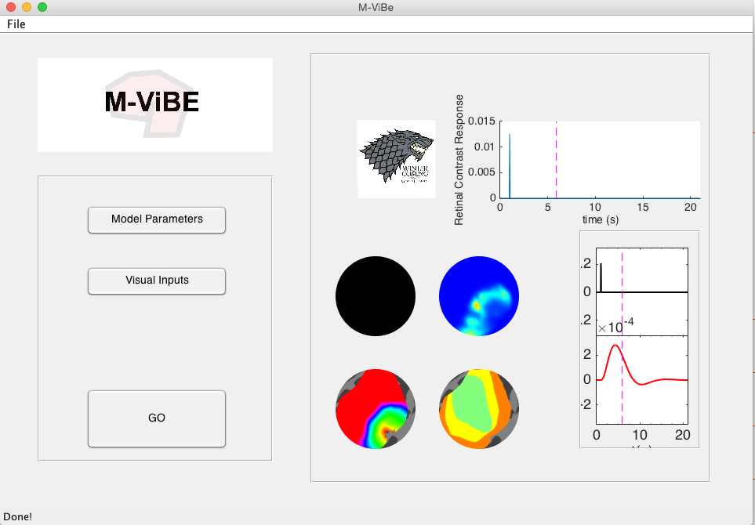
If you click on any of the parts it will refresh to that time point.
There is the capability to see how this looks like on the surface, it is currently in the old version (master branch). It will be a default feature in this version shortly.

