Slide 1
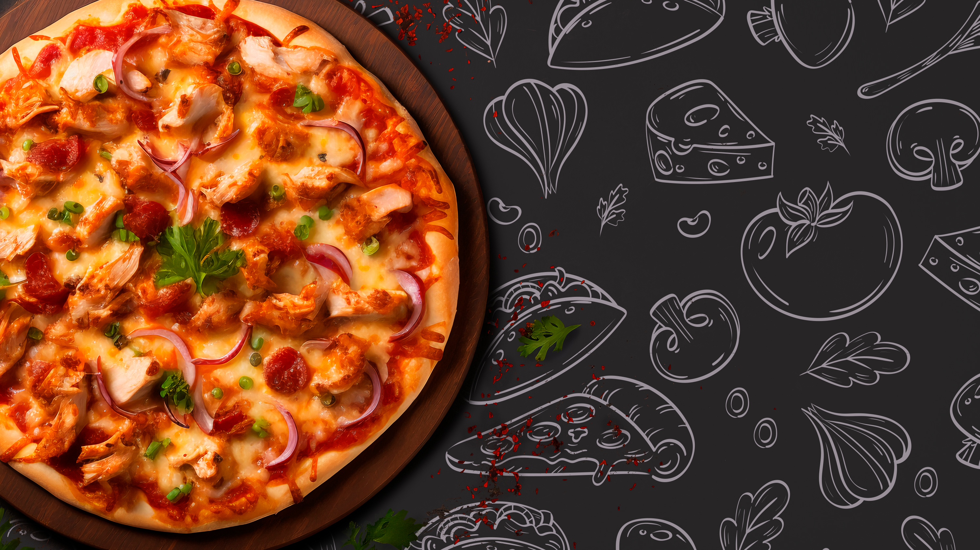
Plato’s Pizzeria

Slide 2
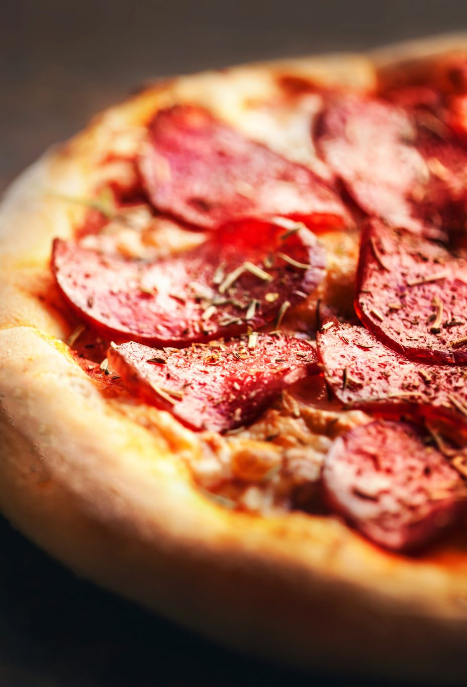
Objective
Analyze a year’s worth of transactional data for Plato's Pizza to uncover strategies for boosting sales and enhancing operational efficiency, leading to practical insights that can elevate overall business performance.

Slide 3
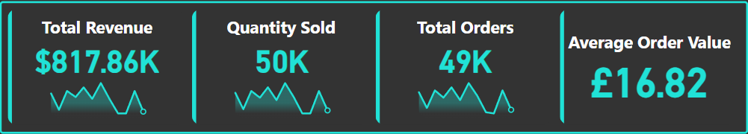
Data Overview
The transactional data contains information solely based on their pizza products.

Slide 4
What days and times do we tend to be busiest?

Slide 5

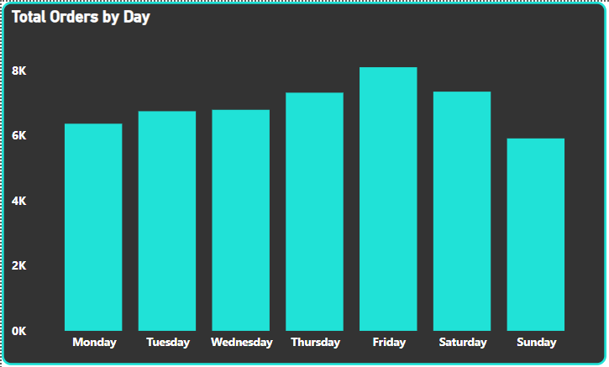


Peak Days
Total orders peaked on Friday with 8,106 orders.
Sunday is the least busy day with only 5,917 orders placed.
Total Orders progressively increase from the start of the week, Monday, and peak Friday-Saturday, and diminish at the end of the week on Sunday

Slide 6
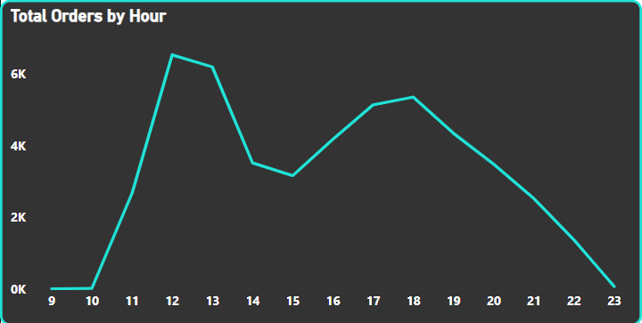
Peak Hours
Total orders peak between 12 PM (6,543) and 1 PM (6,203).
The least busy hours are between 9 AM and 10 AM with 21 orders placed.
The two peaks consist of Lunch time and dinner time.

Slide 7
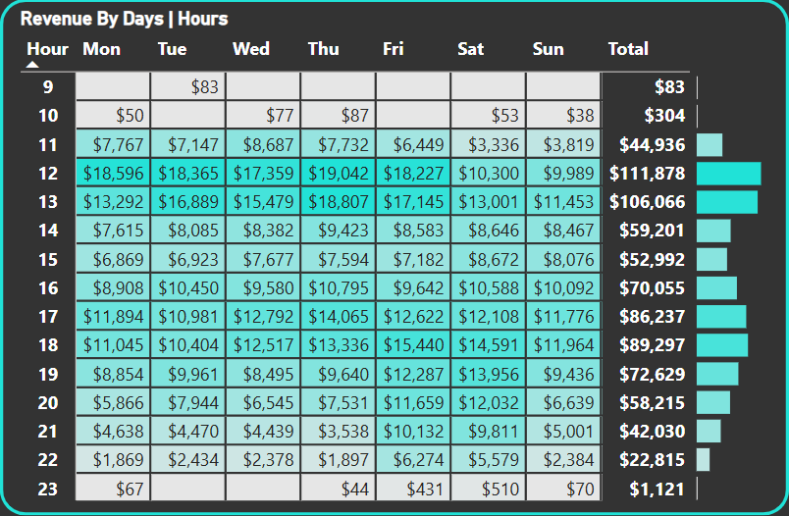


What does this mean in terms of revenue?
Peak Periods: In the peak hours of 12 PM and 1 PM when the restaurant is busiest a total Revenue of $217,944 was generated.
Off-Peak Periods: The least busiest hours; 09 AM, 10 AM, and 11 PM make a combined total revenue of $1,508 of $817,859.

Slide 8
How many pizzas are we making during peak periods?

Slide 9


Peak Periods | Number of Pizzas Sold
Lunch (12 PM to 3 PM) | 16,802
Dinner (6 PM to 9 PM) | 13,357
Afternoon (3 PM to 6 PM) | 12,666
Late Evening (9 PM to 11 PM) | 3,999
Morning (9 AM to 12 PM) | 2,750
Peak Periods: Pizza is most demanded during Lunch and Dinner. This may be because most people don't skip these meals, or because pizza is considered a convenient meal or a comfort food.
Afternoon Sales: 12,666 pizzas sold in the afternoon. This amount is nearly on par with dinner sales, with only 691 pizzas separating the two periods.
High demand may be because the Afternoon is between Lunch and Dinner, which could suggest a robust snack culture, people who take late lunches, or a tendency for early dinners.
Least Popular Periods: Late Evening demand drops significantly down to 3,999, while Morning demand has also dipped to 2,750. This decline could be because pizza isn't typically a popular option for late-night or early-morning meals.

Slide 10
What are our best and worst-selling pizzas?

Slide 11
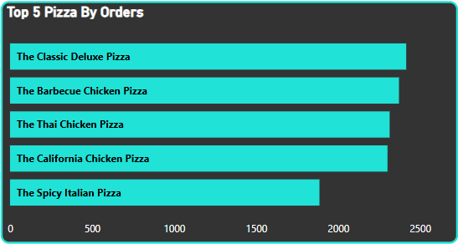
Top 5 Selling-Pizzas
Although the best-selling pizza is the 'Classic Deluxe Pizza’ with 2453 pizzas sold, the other top five pizzas have achieved comparable sales, each exceeding 2,300 units sold.

Slide 12
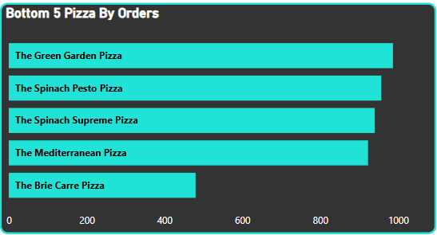
Worst 5 Selling-Pizzas
The 'Brie Carre Pizza' has consistently been the least popular option, with just 490 sold over the entire year. Additionally, the next four pizzas on the list have also struggled, failing to reach the thousand pizza sales mark.

Slide 13
What's our average order value?

Slide 14
The Average Order Value is $16.82. This appears to be on the lower side, especially when the cheapest item is priced at $9.75 and the most expensive is $35.95, resulting in a difference of $26.20.
Average Order Value | Min Order Value | Max Order Value
$16.82 | $9.25 | $35.95

Slide 15
How well are we utilizing our seating capacity? (we have 15 tables and 60 seats)

Slide 16

Utilizing Seating Capacity Based On Number Of Table
During the busiest period, only 13 of the 15 tables are being used, amounting to 86% use rate.
Order Date | Hours | Total Orders | Total Tables | Estimated Usage Percentage
2015-07-17 | 12 PM | 13 | 15 | 86%

Slide 17
Utilizing Seating Capacity Based On Average Party Size Per Order
With the assumption an average party size per order is 2.5 we can estimate how many seats were occupied:
Approximately only 54% of seats are occupied during peak season, with the assumption that the average group per order is 2.5 people.
Order Date | Hours | Total Orders | Total seats | Estimated Seats Used | Estimated Usage Percentage
2015-07-17 | 12 PM | 13 | 60 | 32.5 | 54%

Slide 18
Actionable Insights and Recommendations
Optimize Opening-Closing times: The least busy hours of 09 AM, 10 AM, and 11 PM make a combined total revenue of $1,508 out of $817,859. Therefore, it may be best practice to open at 11 AM and close at 11 PM to save costs and boost efficiency.
Staffing Optimization: During Peak days like Friday and Saturday ensure there are sufficient staff and resources available to meet the demand. You may want to consider increasing shifts, hiring temporary workers, or adjusting employee schedules to cover peak periods.
During Off-Peak Days like Sunday and Monday these days may be ideal for maintenance and training.
Marketing & Promotion: Running time-sensitive promotions during Peak times can help maximize sales by offering Lunch time or Dinner time discounts.
Consider targeted marketing for night owls and early birds to boost sales during late evenings and Mornings.
There's also the opportunity to drive sales through combo deals to help cross-sell during peak hours.
Menu Optimization: It is worth considering removing 'Brie Carre Pizza' from the menu altogether and focusing on raising the minimum benchmark of 1,000 pizzas sold.
Optimize seating capacity: With 15 tables available and a total of 60 seats, it is reasonable to conclude that each table accommodates 4 people Assess whether the layout can be adjusted to accommodate more guests or smaller parties without sacrificing comfort. Maximize table usage by having smaller-sized tables.

