Slide 1
The price forecast for New York Airbnb
Group member: Yu-Jui Chang, Jingyi Xu, Wei -Chen Lu, Rongtao Ding

Slide 2
Overview
● Introduction
● Multiple Linear Regression
● Regression Tree
● KNN
● Forecast

Slide 3


New travel options
Provide price forecasts to users

Slide 4

Data sorting

Slide 5
Multiple Linear Regression

Slide 6
Hypothesis
•H0: there is not linear relationship between response variable(price) and independent variables. (b1 =b2 =b3 =b4 =0)
•HA: At least one of the independent variable has linear association with response(price.)

Slide 7
Linear Model
The response variable of the linear regression in Airbnb in New York City is price, the independent variables are minimum_nights(<= 14days), number_of_reviews, reviews_per_month,neighbourhood_group,and room_type.
The neighbourhood_group,and the room_type are categorical variables.
In linear model, categorical variables are conducted as dummy variables in R.

Slide 8
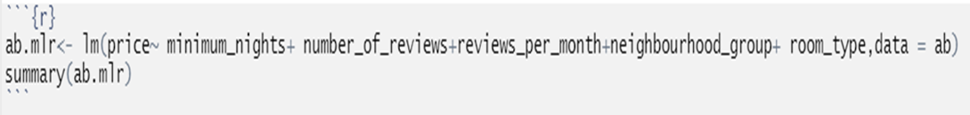
Multiple Regression
Here are the code used to run linear regression model for Airbnb in New York City:

Slide 9
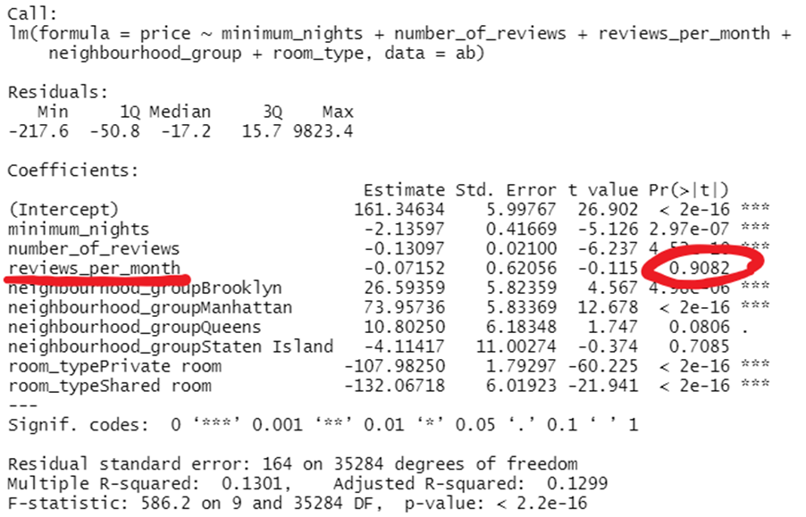
Result

Slide 10
Assessment of Regression Model
•The test was conducted as a significant level of 0.05 (alpha =0.05). The p value of the test is smaller than alpha =0.05 .
•The null hypothesis fails. There is enough evidence to support that there is at least one of the variables has linear association between the response(price) and the parameters at the significant level of 0.05.
•The test is reliable; however, the R-square is not ideal.
•The p value of reviews_per_month is 0.9082> 0.05, meaning that this parameter has no enough evidence to justify that there is linear relationship with the response variable(price). Therefore, the next step is running a new model without this parameter.

Slide 11
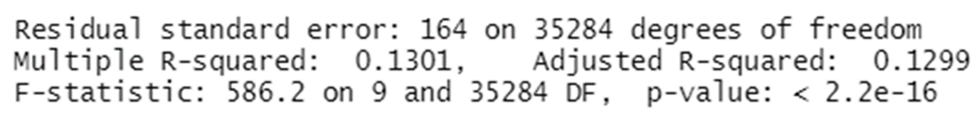
The R-squared is 13.01%, meaning that there is 13.01% of the data points follow to this model. In other words, this model is not precise for Airbnb data set.

Slide 12
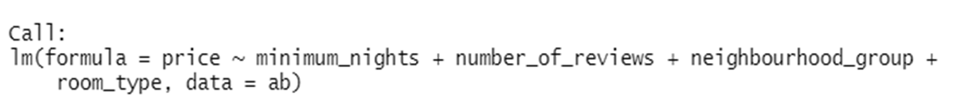
Linear Model 2
•The new linear model is setting price as response variable and minimum_nights, number_of_reviews, neighbourhood_group,and room_type are parameters. The neighbourhood_group,and room_type are categorical variables and minimum_nights, number_of_reviews are numerical variables.
•Here are the new model:

Slide 13
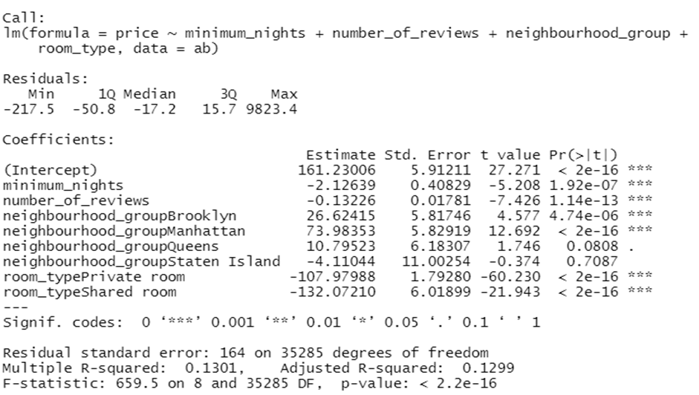
Result of New Model

Slide 14
Assessment of New Model
•The test was conducted as a significant level of 0.05 (alpha =0.05). The p value of the test is smaller than alpha =0.05 .
•The null hypothesis fails. There is enough evidence to support that there is at least one of the variables has linear association between the response(price) and the parameters at the significant level of 0.05.
•The test is reliable; however, the R-square is not ideal.

Slide 15
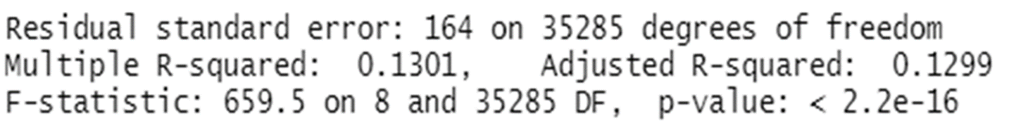
The R-squared is 13.01%, meaning that there is 13.01% of the data points follow to this model. In other words, this model is not precise for Airbnb data set. Also the RMSE of this model is 164. Our team will assess this RMSE for other model to decides which model is best fit for Airbnb data set.

Slide 16
Regression Tree

Slide 17
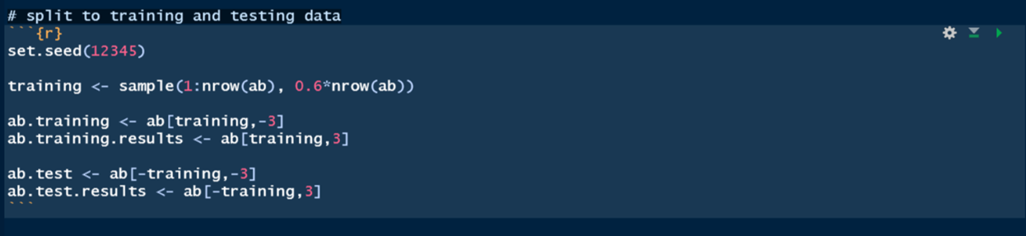
Split data to training and testing parts
•Using 60% data for training

Slide 18
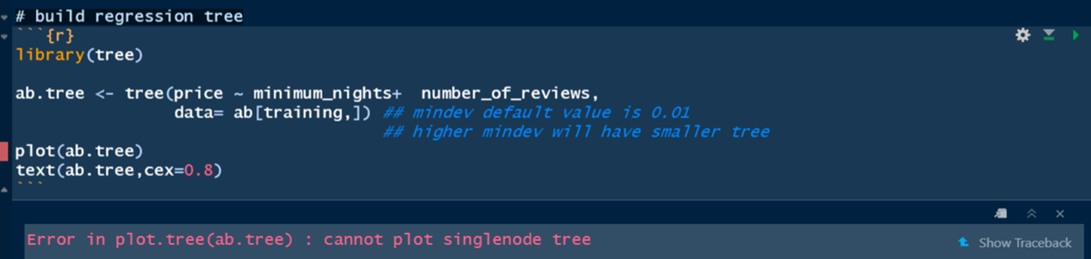
Build regression tree
•Mindev default value is 0.01
•Higher mindev will have smaller tree
•Mindev is too high to create the tree

Slide 19
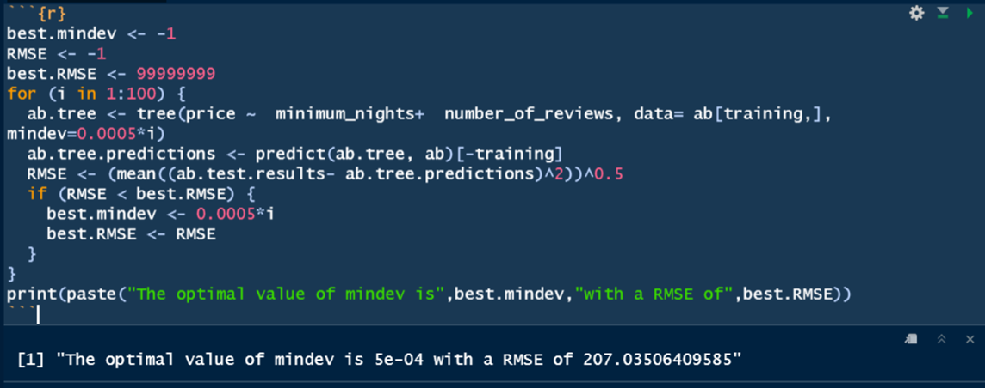
Find the best regression tree
•Mindev = 0.0005 RMSE = 207.035

Slide 20
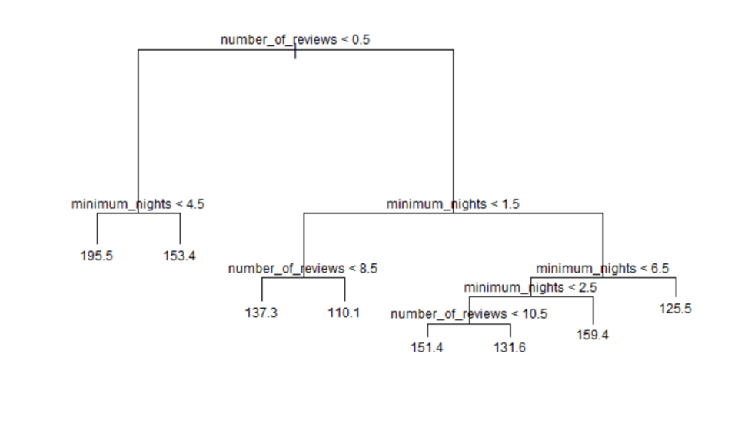
Build the best regression tree

Slide 21
k-Nearest Neighbors(kNN)

Slide 22
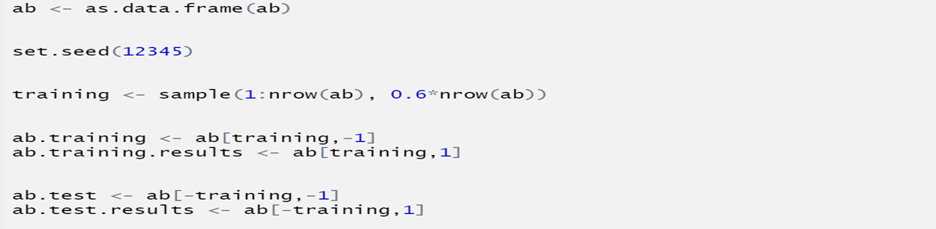
Split data to training and testing parts

Slide 23
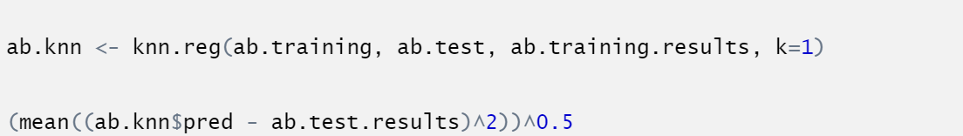
Build kNN model
RMSE = 212.5458

Slide 24
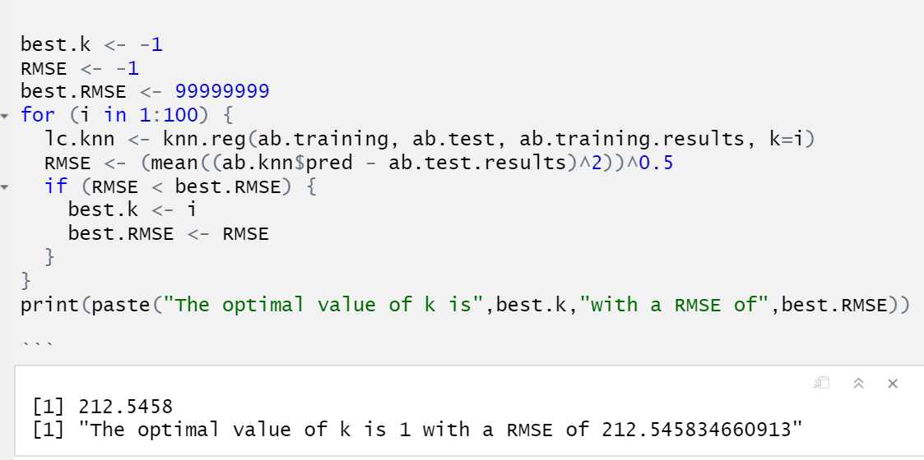
Find the best k value
K = 1, RMSE = 212.5458

Slide 25
Contrast RMSE：
Multiple Linear Regression: 164
Regression Tree：207.035
KNN：212.5458
164 < 207.035 < 212.5458
So we choose Linear Regression

Slide 26
Predict the room price
In order to help users understanding renting room in Airbnb in NYC, the study group set up a multiple linear regression model that allows customers understand whether the room price in Airbnb is reasonable for them. Taking a prediction for Airbnb in NYC as example:
Predict a private room located in Manhattan, its minimal booked night is 1, and the number of reviews is 43. That is : (minimum_nights = 1,number_of_reviews=43 ,neighbourhood_group= "Manhattan",room_type = "Private room")

Slide 27

Result
Here is the code uesd in prediction:
new.branche is the data frame that stored the values we are interested in, or we would like to predict for.
The prediction result is 119.4203, meaning that if a person who would like to have a Manhattan private room, which has 43 reviews, and its minimum night is only 1 day, the room price will be 119.4203.

Slide 28
References:
KAGGLE: https://www.kaggle.com/dgomonov/new-york-city-airbnb-open-data
http://90sheji.com/pngList/?pid=15395116

