Slide 1








Slide 2
Education
Master
Taiwan Tech
Electronics and Computer Engineering
GPA: 3.83 / 4.3
Bachelor
Taiwan Tech
Electronics and Computer Engineering
GPA: 3.88 / 4.3

Slide 3
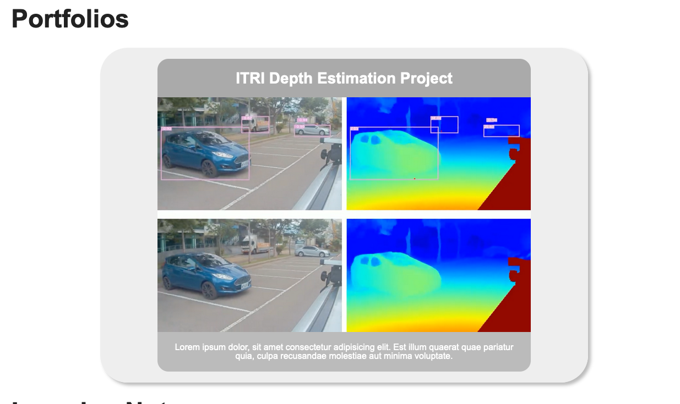

Slide 4
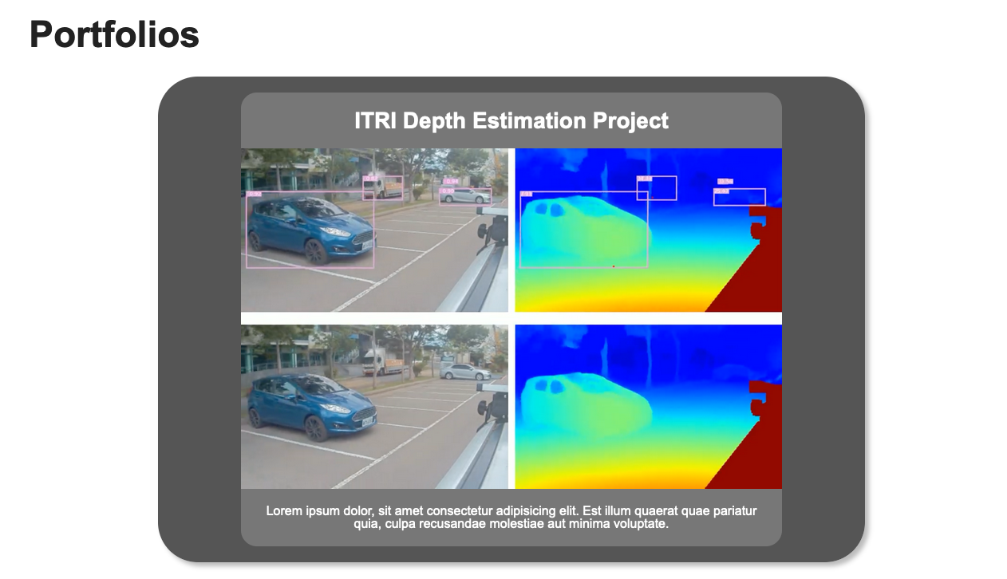

Slide 5
