Slide 1
DeepScaling: Microservices AutoScaling for Stable CPU Utilization in Large Scale Cloud Systems
Kevin Varghese Chittilapilly: kchittil@purdue.edu
Divya Sree Pulipati: vpulipat@purdue.edu

Slide 2
Introduction
Cloud service providers often provision excess resources to meet service level objectives (SLOs) and maintain service quality, even when the workload fluctuates. This excessive provisioning not only wastes resources but also consumes unnecessary power.
To address this issue, the paper introduces "DeepScaling," a solution with three innovative components:
1. Workload Forecasting
2. CPU Utilization Estimation
3. Adaptive Autoscaling
Notes:
Workload Forecasting: DeepScaling uses a Spatio-temporal Graph Neural Network to forecast the workload for each service. This helps in anticipating how the workload will change over time.
CPU Utilization Estimation: It employs a Deep Neural Network to estimate CPU utilization by mapping workload intensity to estimated CPU usage. This estimation takes various factors in the cloud environment into account, such as periodic tasks and traffic.
Adaptive Autoscaling Policy: DeepScaling generates an autoscaling policy for each service using an improved Deep Q Network (DQN). This policy dynamically adjusts the target CPU utilization to maintain a maximum stable value while ensuring SLOs are not violated.

Slide 3
Problem Statement
The paper provides their result solely on the cloud environment of the Ant Group. Our objective for this project would be to reproduce this paper’s results with a different cloud environment to see how well do the paper solution generalize in other cloud-based architectures.

Slide 4
Challenges
1. Workload Forecasting Challenge:
Accurately forecasting the workload of different services is difficult, especially in complex cloud-native microservice architectures. Existing approaches often rely on simpler regression techniques for workload prediction, which are inadequate for capturing the intricate interactions, including those between microservices.
To address this challenge, the proposed solution suggests using Spatio-temporal graph neural networks (STGNN) for workload forecasting. STGNN models the interactions within the service call-graph and considers the complex multi-variant relationships among various workload metrics.
Notes:
This approach allows for a more accurate workload forecast, providing extra time to proactively initiate resources when scaling up, ultimately improving the efficiency of the autoscaling process.
Like stock prediction
In scenarios involving spatio-temporal data, you have both spatial dependencies (relationships between entities at the same point in time) and temporal dependencies (evolution of entities over time). A standard GNN typically focuses on spatial dependencies and may not be well-suited to model the temporal aspect effectively.
STGNN – combines RNN with graph

Slide 5
Challenges
2. Workload Characterization:
It is challenging to accurately represent a service's workload in a way that reflects its CPU utilization properly. Attempting to predict CPU utilization solely based on historical CPU data results in significant forecasting errors, often exceeding 30% in trials.
To overcome the challenge of accurate workload characterization, the solution collects multi-dimensional workload metrics for each service.
These metrics encompass various aspects of the workload, including RPC requests, file I/O operations, database access, message requests, HTTP requests, and specific auxiliary features like instance count, service ID, and timestamp.
Collecting this comprehensive set of metrics aims to provide a more accurate representation of the service's workload.
Notes:
Existing approaches uses RPC (remote procedure calls) for this task however it is insufficient, since different requests invoke different aspects of the service to execute tasks. This inaccuracy is primarily due to the difficulty of handling the high variability in instantaneous CPU utilization when multiple services are multiplexed together.
RPC is a protocol that allows a program to cause a procedure (subroutine) to execute in another address space, typically on a remote server. In the context of autoscaling, RPCs can represent the requests made to a service. For example, in a web service, each HTTP request could be considered an RPC.
A Deep Probabilistic Network (DPN) is a type of machine learning model that combines deep learning techniques with probabilistic modeling. DPNs are designed to estimate not only the most likely outcome but also the level of uncertainty associated with their predictions. This is crucial in applications where having confidence intervals or uncertainty bounds is essential

Slide 6
Challenges
Expected Challenges specific to our implementation
Large Dataset. (2 TB for 13 days)
Due to lack of incomplete workload characteristics for all microservices, it is difficult to make accurate workload predictions which can adversely affect CPU estimations.
Less Compute Resources

Slide 7
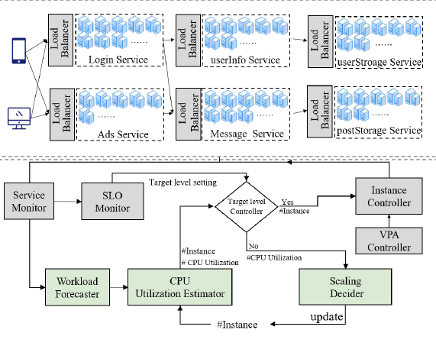
System architecture of DeepScaling
Notes:
1. The Load Balancer1 distributes requests so that each instance of a service, and thus each pod of a service, carries approximately the same workload and has the same CPU utilization.
2. The Service Monitor focuses on collecting metrics for all services in real time
3. Workload Forecaster: We analyze the call-graph and the main workload metrics for each microservice. Then, a spatial-temporal graph neural network (STGNN) is used to forecast the workload metrics for each microservice.
4. CPU Utilization Estimator: This module estimates CPU consumption based on 7 workload metrics along with 3 specific auxiliary features. Takes inputs from the workload forecaster and Scaling Decider to generate CPU utilization estimates
5. Scaling Decider: In this module, a reinforcement learning (RL) model is adopted to generate autoscaling policies. Collaborates with the CPU Utilization Estimator to determine the optimal number of service instances.
6. Target level Controller: The CPU target level (𝑇 ) is a core parameter value for DeepScaling. The initial value of 𝑇 is the maximum CPU utilization value seen historically for normal execution of the service in the past. DeepScaling provides a buffer value (𝜏 = 5%) to allow for possible model errors and other noise. It determines the desired CPU utilization level for a specific microservice within the DeepScaling system. It represents the optimal or target CPU utilization value that the system aims to maintain to meet performance goals while efficiently utilizing resources.
7. SLO Monitor (service level objectives: The SLO monitor determines whether a core microservice violates its SLO by monitoring the microservice response time (RT), GC (garbage collection) time, I/O RT, and other metrics. When the SLO monitor detects an abnormal value of a metric for the core microservice, it notifies the target level controller to lower the target level for that service, in addition to changing the controller state.
8. The Instance Controller adjusts the service resources of each microservice by increasing or decreasing the number of standard pods.
9. Vertical Pod Autoscaler (VPA) Controller: managing the configuration of Kubernetes pods; VPA Controller allows for customization of pod resource requirements

Slide 8
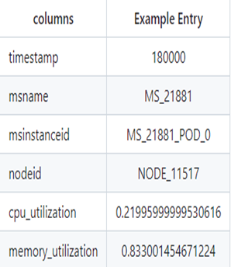
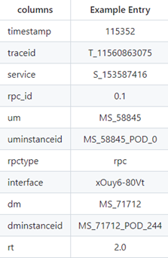
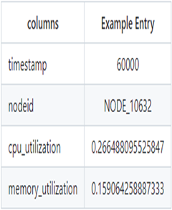
Baseline Solution/Deployment/Experimental Setup
We are using Alibaba Google Trace 2022 microservices as our dataset since it matches the closest with the dataset considered in the paper
The data has been collected over 13 days and total size is about 2TB
Size of data for an hour is around 52GB.
For our project, we have focused on data for an hour due to it’s large size
There are 4 directories created while downloading
Node MSResource MSRTMCR MSCallGraph
Notes:
Our current plan is to use Google Colab with Python libraries such as TensorFlow and Hugging face to build STGNN, Deep Probabilistic Model to reproduce the results of the paper.
We will be splitting cluster data from Alibaba cluster data into training and test and use that to evaluate the accuracy of our framework.
Node: BM Node runtime information. It records CPU and memory utilization of 40000+ BM nodes in a production cluster.
MSResource: MS runtime information. It records CPU and memory utilization of 470000+ containers for 28000+ MSs in the same production cluster.
MSRTMCR: Microservice call rate (MCR) and response time (RT) information. It records MCR and RT of the calls via different communication paradigms among 28000+ MSs with 470000+ containers in the same production cluster.
MSCallGraph: MS Call Graphs information. It contains about more than twenty million call graphs among 17000+ MSs with in more than ten clusters
upstream microservice (UM) and one downstream microservice (DM).

Slide 9
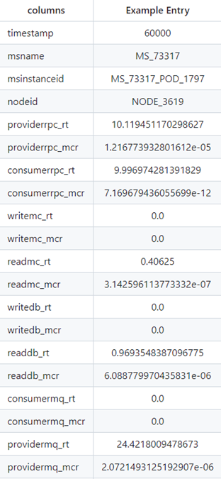


Baseline Solution/Deployment/Experimental Setup
To reduce the size of the dataset, we have focused on microservices belonging to only one Node (NODE_27596)
We chose this node as it had the max number of microservices working in it.
We then join our MSRMTCR files with MSResource files and obtain a dataset with the columns shown in the image.
After dropping the duplicates, we are left with around 800 non NA rows.

Slide 10
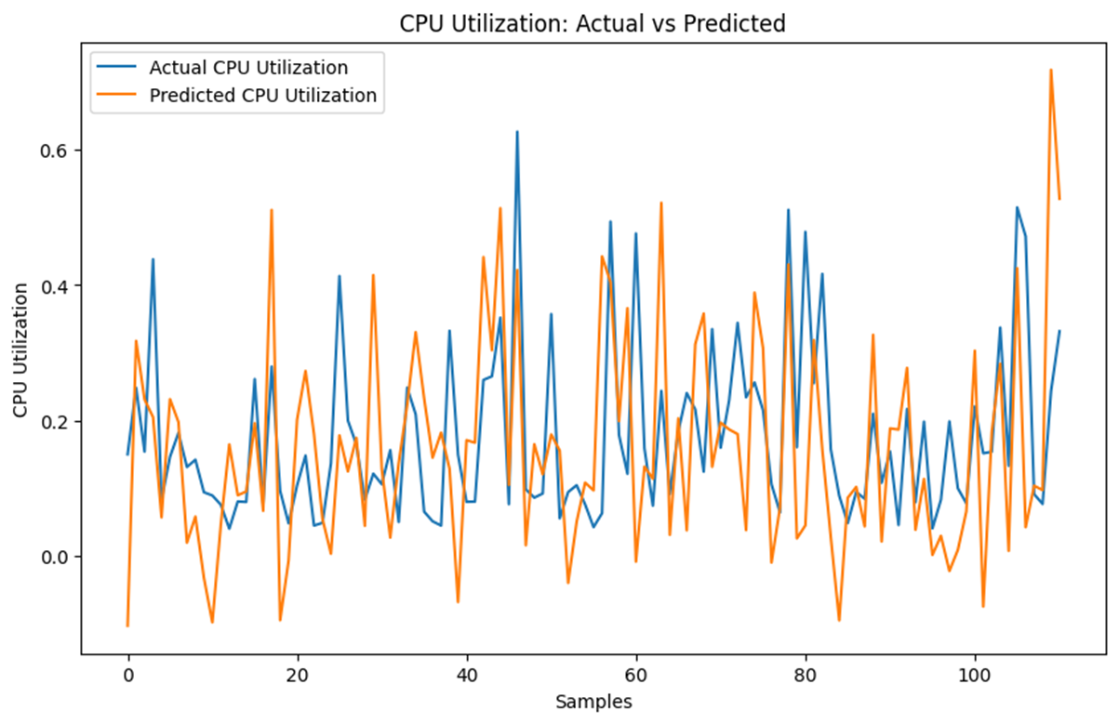
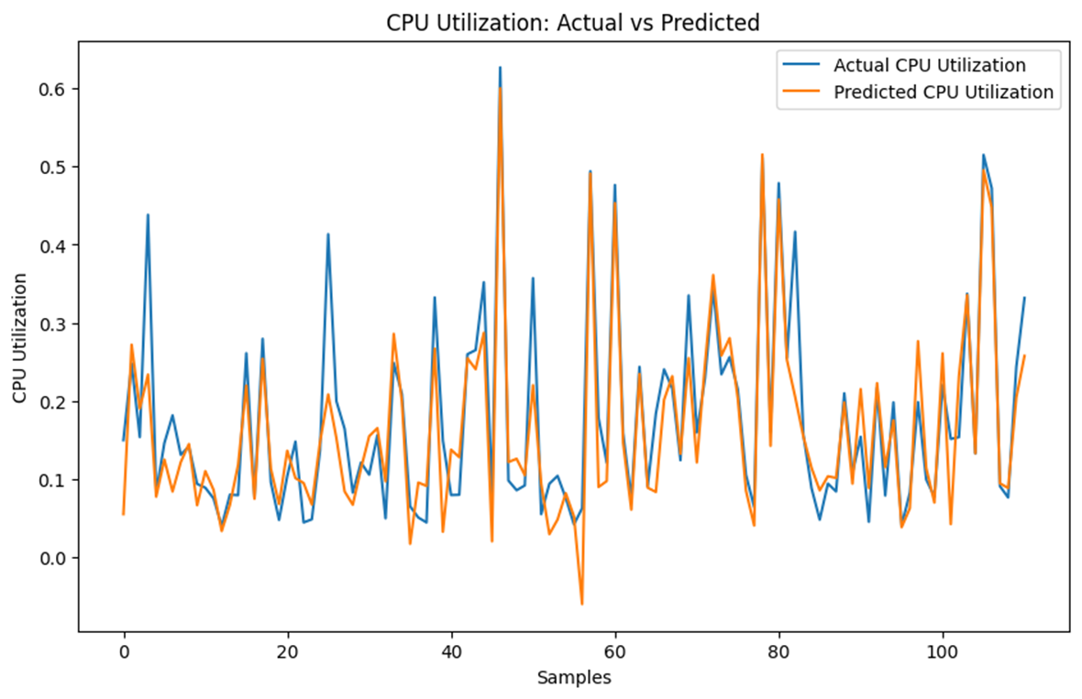
Experimental Results and Evaluation
As suggested by the paper, we have used Deep Probabilistic Neural Network for CPU Utilization Estimation.
Since we are using timeseries data, we used train test for splitting data and Standard Scaler for scaling the data. This way we can still capture essence of sequential data.
We have trained the model with 10 epochs and the spit on data was 80-20%
Notes:
As suggested by the paper, we have used Deep Probabilistic Neural Network for CPU Utilization Estimation.
Since we are using timeseries data, we used train test for splitting data and Standard Scaler for scaling the data. This way we can still capture essence of sequential data.
We have trained the model with 10 epochs and the spit on data was 80-20%

Slide 11
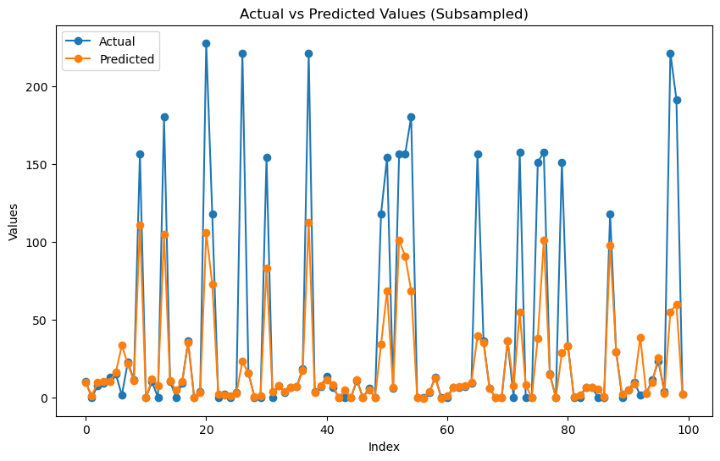
Experimental Results and Evaluation
We could not implement STGNN completely because of Adjacency Matrix. Since we focused on one Node, intra communication between microservices was very less. In addition, we only considered 1 hour timeline. Due to these reasons, the Adjacency Matrix was a Zero Matrix.
So, we decided to use a Normal Neural network to test the workload predictions.
Notes:
Apart from these, we found that we lacked the compute resources to execute the STGNN as mentioned in the paper.
We used LSTM with 64 layers
We found the results for providerrpc_rt, num_epochs = 100

Slide 12
Conclusion
We have implemented LSTM Based Neural Network for Workload Metrics and DQNN Model for CPU Utilization
The biggest challenge we faced was the size of the dataset.
Overall, we saw that both DQNN and STGNN architectures described in the paper work well for this use-cases.
For Future Scope, we would like to download more data and extend our model to other nodes.

Slide 13
Thank You
Any Questions?

